Slide 1
A star
Mehraveh Ahmadi
Mahdieh AsnaAshari

Slide 2
Dijkstra & best first search
In Dijkstra’s algorithm we visit very node while we reach to the shortest distance to that node.
So we repeat this action until we reach to destination.

Slide 3
Dijkstra & best first search
The Greedy Best-First-Search algorithm is like Dijkstra except that it has some estimate (called a heuristic) of how far from the goal any vertex is. Instead of selecting the vertex closest to the starting point, it selects the vertex closest to the goal. Greedy Best-First-Search is not guaranteed to find a shortest path.

Slide 4
A*
A* is the most popular choice for pathfinding, because it’s fairly flexible and can be used in a wide range of contexts.
A* is like Dijkstra’s algorithm in that it can be used to find a shortest path.
A* is like Greedy Best-First-Search in that it can use a heuristic to guide itself.

Slide 5
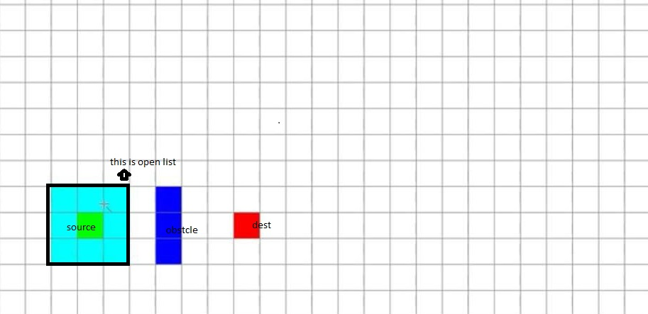
How does A* algorithm works?
We have 2 lists open list and close list .
Open list : is a list that shows the nodes that are available to go.

Slide 6
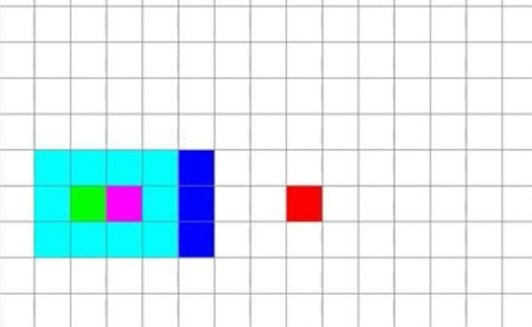
How does A* algorithm works?
Close list: list that we put visited nodes in it.
Here we put our source in close list.

Slide 7
How does A* algorithm works?
So we describe how we find the best way.
We have 2 functions h() and g().
g() : returns the distance of our source from every nodes in open list.
h() : heuristic : returns the distance of our dest from every nodes in open list.

Slide 8
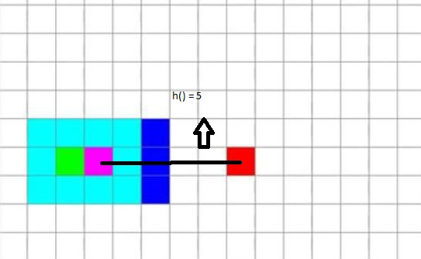
How does A* algorithm works?

Slide 9
How does A* algorithm works?
So we have a queue that we put h()+g() in it .
We should sort our queue .it means that we put smallest h()+g() at the beginning of our queue.
So we act like bfs algorithm for finding the best path.

Slide 10
Reference
http://web.mit.edu/
http://theory.stanford.edu/
Youtube:
https://youtu.be/eTx6HQ9Veas
https://www.youtube.com/watch?v=-L-WgKMFuhE
https://www.youtube.com/watch?v=pKnV6ViDpAI
Wikipedia:
https://en.wikipedia.org/wiki/A*_search_algorithm

