Slide 1

Enabling On-Body Transmissions with Commodity Devices
Mehrdad Hessar, Vikram Iyer,
Shyam Gollakota

Slide 2
Can we send signals confined to the body
with mobile devices?

Slide 3
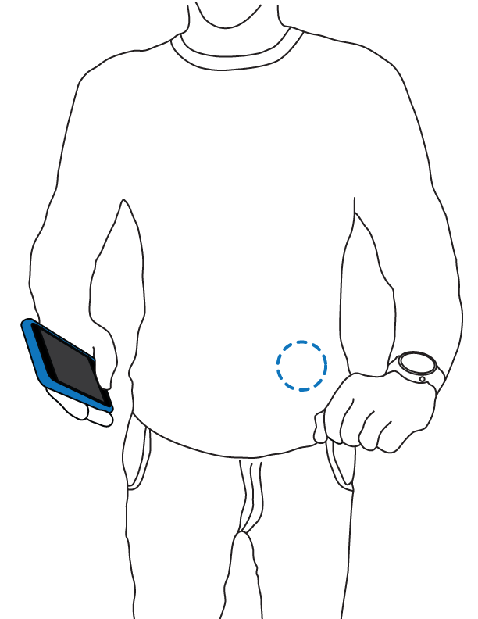
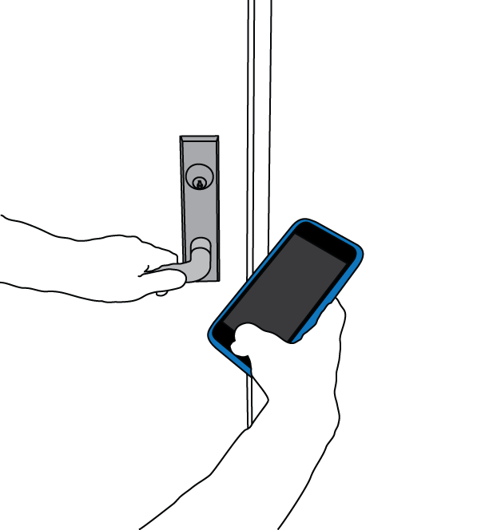
Enable secure on body communication
Unlock doors with a phone
Share secret keys

Slide 4



How do we achieve this on a phone?
Look beyond radios for wireless communication

Slide 5
System Requirements
Signals don’t propagate through the air
Can’t use radios like Bluetooth or Wi-Fi
Direct contact with the body
Explore using input modalities
Produce electromagnetic signals
Should emit low frequency signals

Slide 6
Our Contributions
First transmission throughout the body using commodity devices
Fingerprint sensors and touchpads
Evaluate effects of posture, motion, and body type
Data transmissions at up to 50 bps

Slide 7
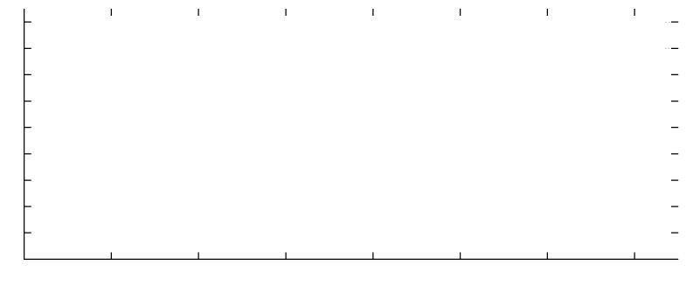
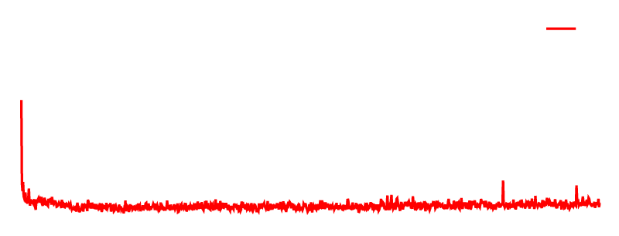
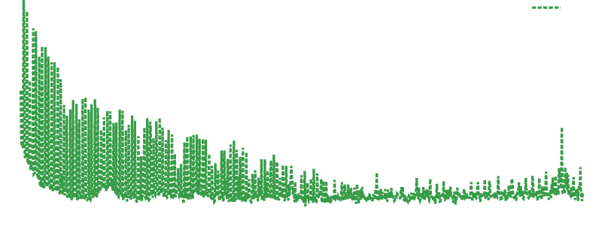
What signals do these devices generate?
Fingerprint Sensor Spectrum
-10
-30
-50
-70
-90
0 cm
20 cm
dBm
0 20 40 60 80 100 120 140
Frequency (MHz)

Slide 8
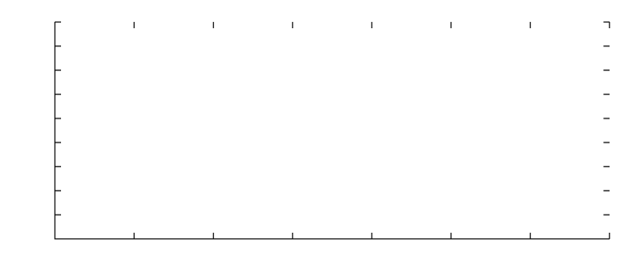
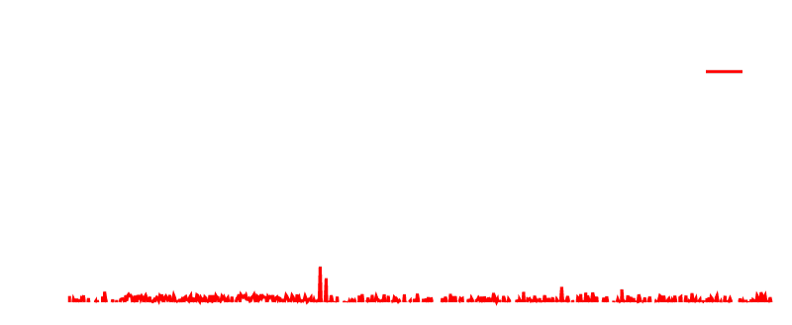
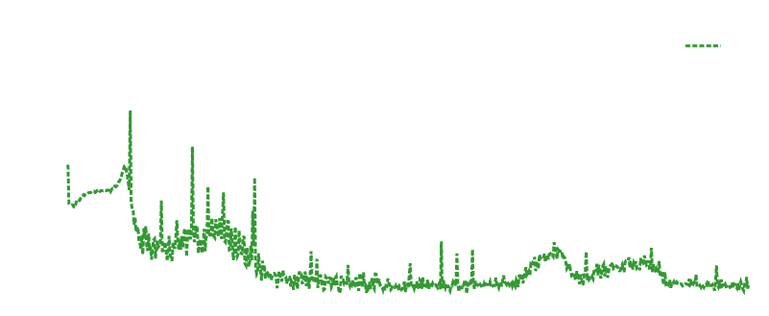
What signals do these devices generate?
-20
-40
-60
-80
-100
Touchpad Spectrum
0 cm
20 cm
dBm
0 50 100 150 200 250 300 350
Frequency (MHz)
Touchpads and fingerprint sensors produce secure signals

Slide 9
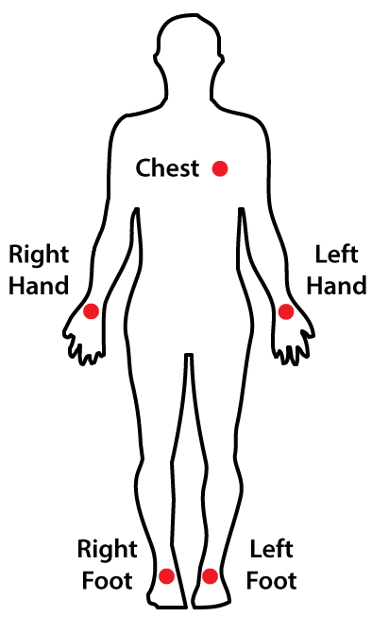
How well do signals propagate on body?
Transmitting phone placed in hand

Slide 10






How well do signals propagate on body?
SNR at Different Locations on the Body
R Hand
R Leg
R Hand
L Leg
L Hand
R Leg
L Hand
L Leg
R Hand
Chest
L Hand
Chest
Hands
22
18
14
10
SNR dB
iPhone 6s
Fingerprint
iPhone 5s
Fingerprint
Adafruit
Trackpad
Lenovo
Trackpad
Mobile devices send signals throughout the body

Slide 11
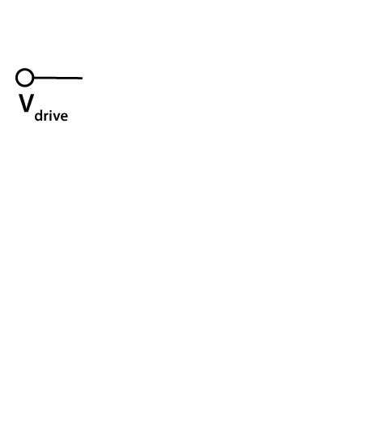
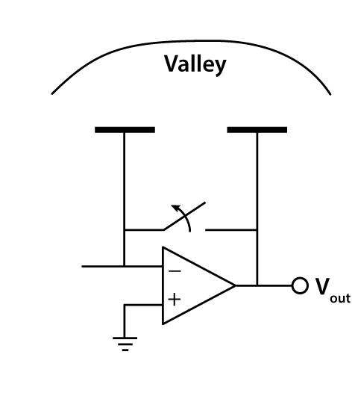
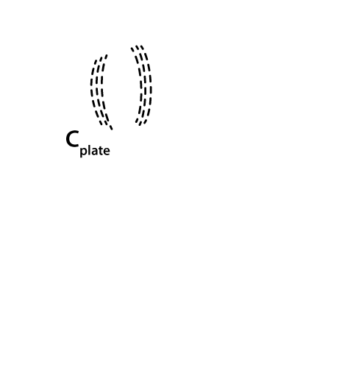
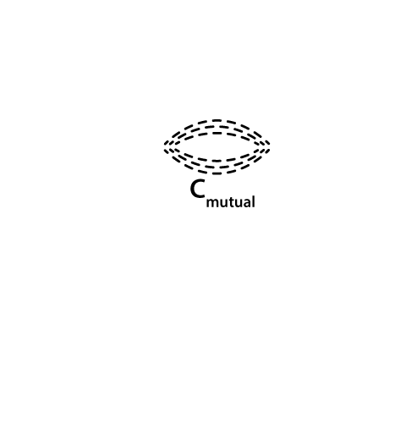

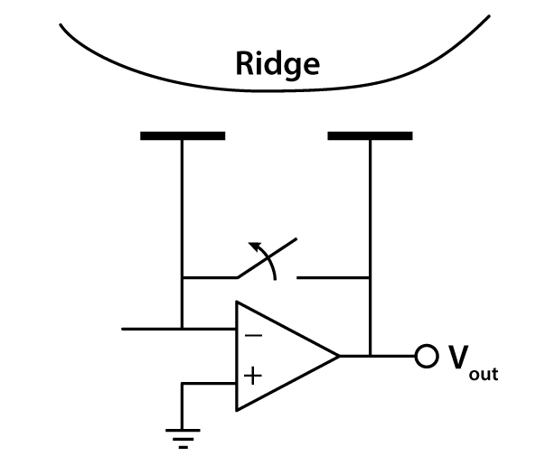


Understanding fingerprint sensors

Slide 12

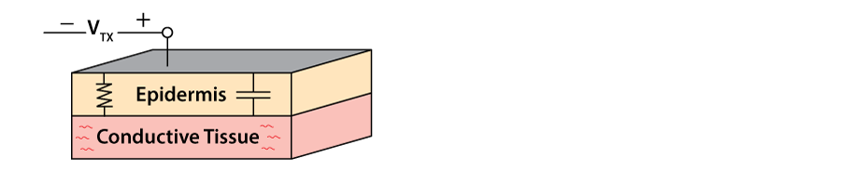
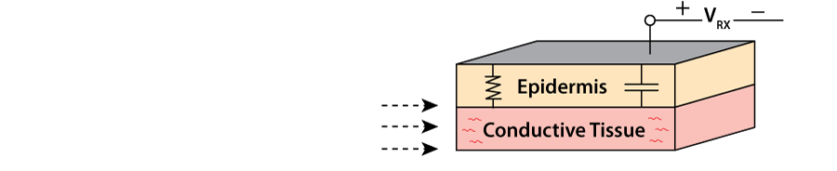

Capacitive coupling through body
Modeling the human body
Fingerprint
Sensor
Receiver
V_{RX}
V_{TX}

Slide 13
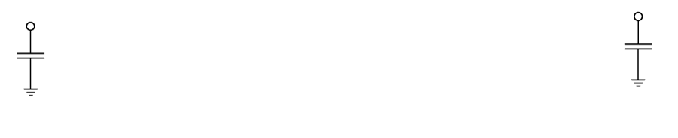
Capacitive coupling through body
What about lack of common ground?
Modeling the human body
Fingerprint
Sensor
Receiver
V_{RX}
V_{TX}
Earth
GND
Earth
GND
Weak coupling to ground
Inaccurate voltage at receiver
But fingerprint sensors generate strong signals
Can still receive reliably

Slide 14
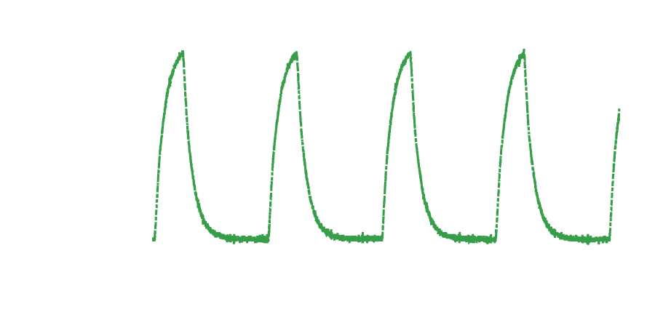
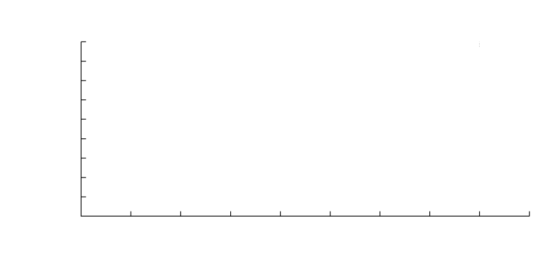
Transmitting signals through the body
3.5
2.5
1.5
0.5
0.5
Fingerprint Sensor Signal
Amplitude (V)
-0.5 0 0.5 1 1.5 2 2.5 3 3.5 4
Time (μs)
Fingerprint sensors produce high amplitude signals

Slide 15

Designing a transmitter
Modulate data by turning on and off the signal
Fingerprint Sensor- Verifi P5100
→ Start and stop fingerprint scan
Touchpad- Adafruit Capacitive Touchpad
→ Power cycle the touchpad
1 0 1 0 1 0 1 0
1 2 3 4 5 6 7 8
Time (s)

Slide 16
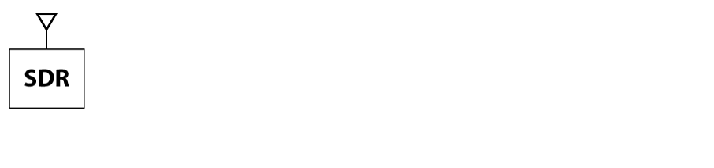
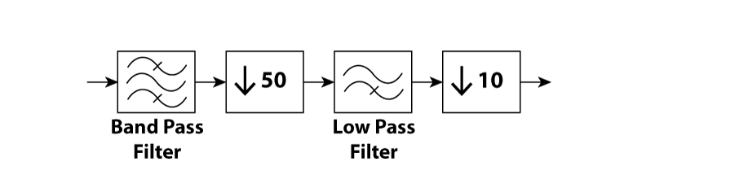
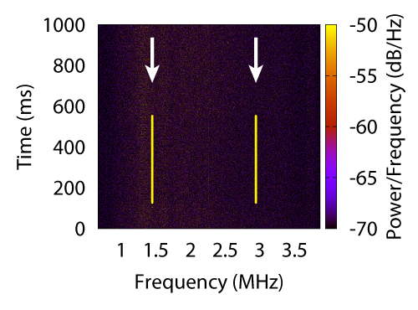
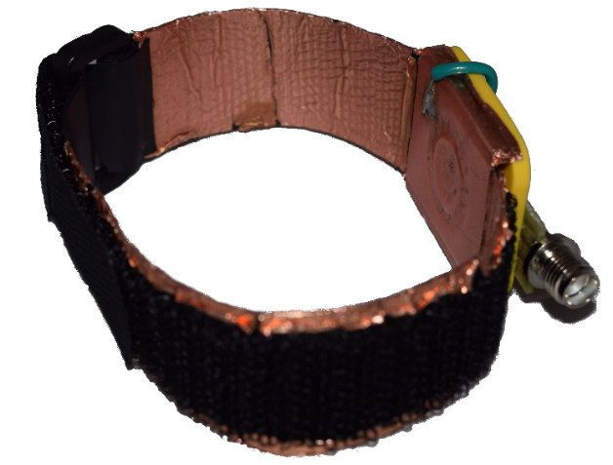
Receiving and decoding data
iPhone 6s Fingerprint Spectrogram
RX

Slide 17
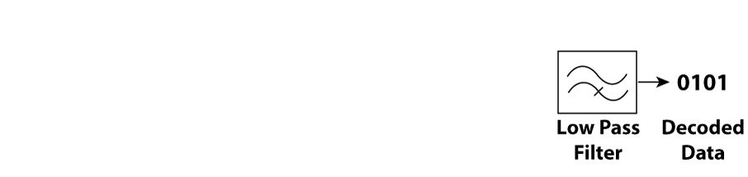
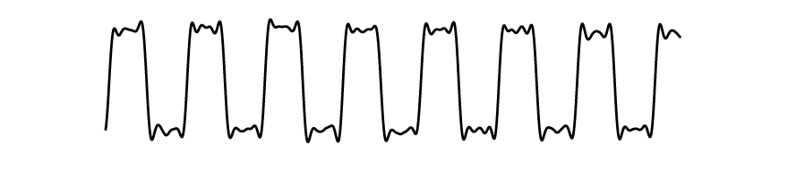
Receiving and decoding data
iPhone 6s Fingerprint Spectrogram
RX
Decoded Data
Amplitude
0.8
0.4
0
1 2 3 4 5 6 7 8
Time (s)

Slide 18
Evaluation
How does SNR vary in different scenarios?
Body type
Posture
Motion
What data rates can we achieve?

Slide 19



Effect of Height and Weight
Total Participants: 10
Weight Range: 118 – 195lbs
Height Range 5’4” – 6’3”
R Hand,
L Hand
L Hand,
L Leg
R Hand,
L Leg
iPhone 6s SNR dB
20
15
10
2 3 4 5 6 7 8 9 10
Participants

Slide 20

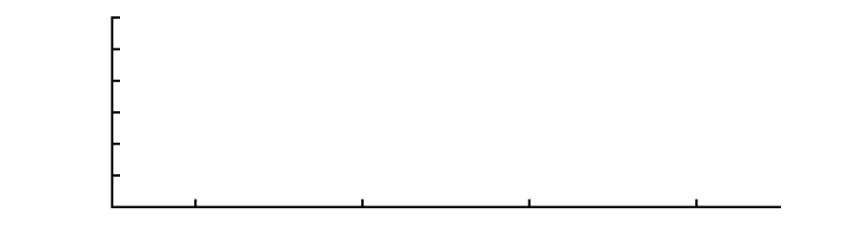


Effect of Different Postures
iPhone 6s SNR Measurements
22
18
14
10
Standing
Sitting
Sleeping
SNR dB
Left Arm, Chest
Right Arm, Chest
Left Arm, Left Leg
Right Arm, Left Leg
Difference of 1-2 dB across postures

Slide 21




Effect of Motion
20
15
10
SNR dB
Still Hands
Moving Hands
Walking
SNR >10 dB across different motion scenarios

Slide 22


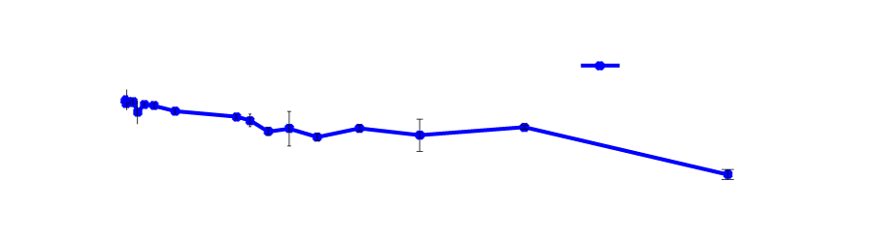
Bit Rate Evaluation
Bit Rate vs. SNR for Fingerprint Sensor and Touchpad
Fingerprint Sensor
20
15
10
Touchpad
SNR dB
0 5 10 15 20 25 30 35 40 45 50 55
Bit Rate (bps)
Bit rates are sufficient for our target applications

Slide 23
Conclusion
Commodity devices can communicate throughout the body
Evaluate effects of posture, motion, and body type, data rate
Enable new applications on body communication

Slide 24
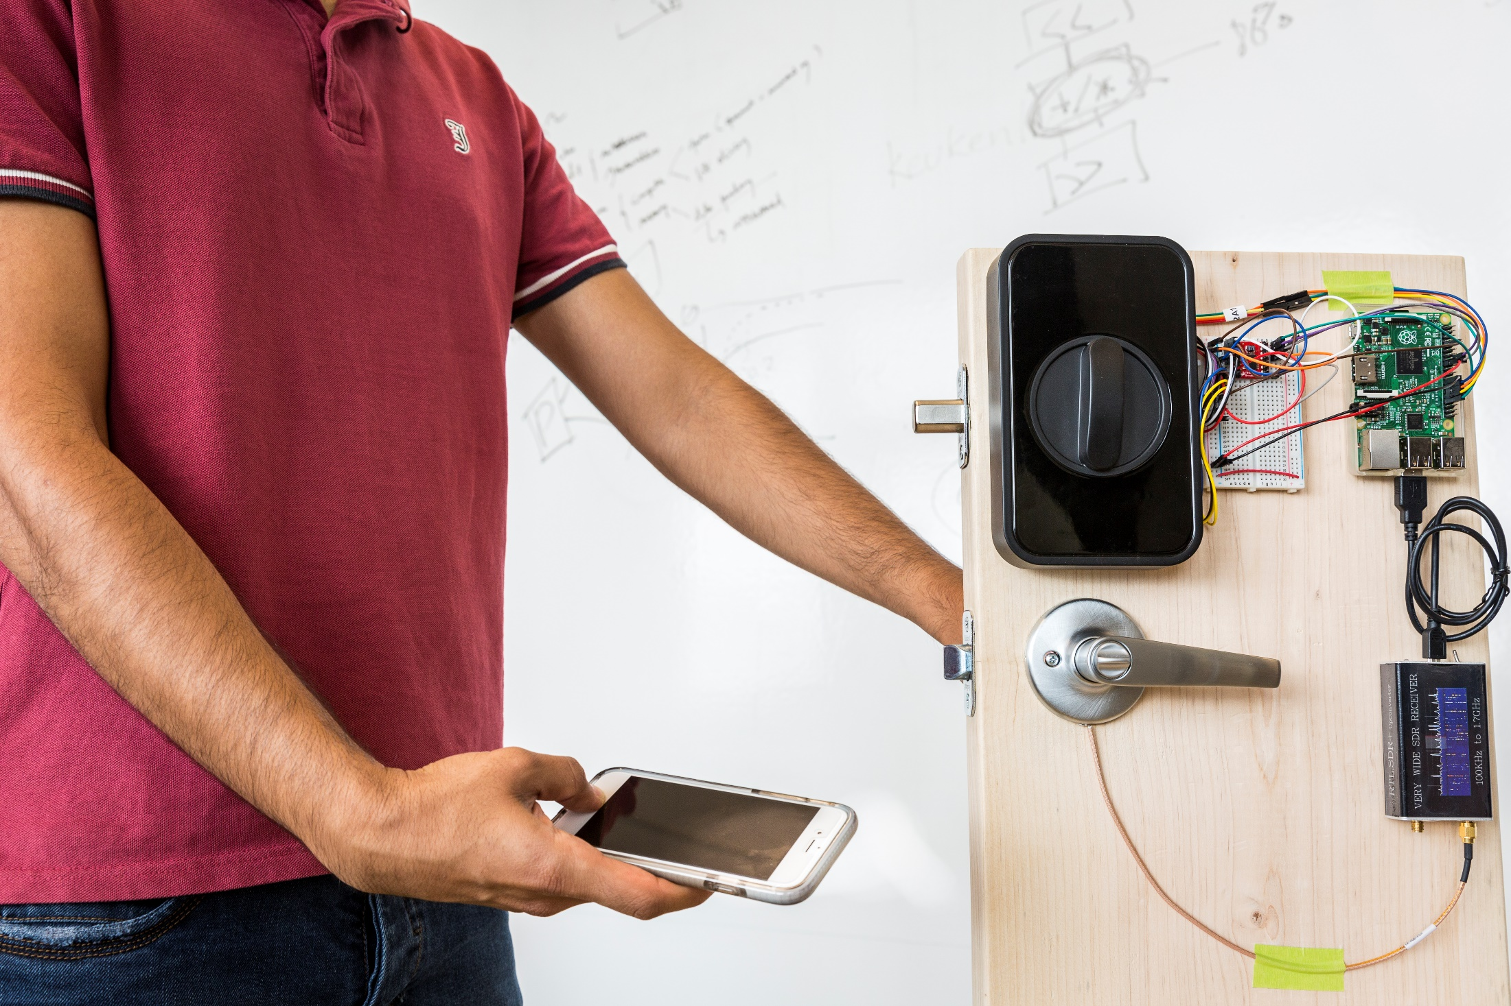
onbody.cs.washington.edu

