Slide 1
CN7050 – Intelligent Systems
Analyzing Financial Sentiment through fine-tuned Transformers
and Reasoning based Large Language Models
GROUP 6
Gabriel Filipini
Hemin Mathews Pullan
Isabel Beristain
Mehrdad Lashgari
University of East London

Slide 2
Introduction
Importance of financial sentiment analysis
Financial markets are strongly influenced by information from news articles, corporate reports, and economic announcements.
Investors and analysts frequently rely on these sentiment signals to interpret market trends and support decision-making.
The rapid growth in news volume makes manual analysis increasingly difficult, requiring automated processing.
Role of NLP in analysing financial news
NLP techniques are now widely used to automatically analyze textual data and extract meaningful insights.
Deep learning and transformer-based architectures, like BERT, have significantly improved the performance of these systems.
These models capture contextual relationships between words through bidirectional training to achieve strong results.
Objective: Compare BERT, FinBERT and GPT-OSS reasoning
This study investigates three approaches: a fine-tuned BERT-base as a baseline and the domain-specific FinBERT.
A third approach uses a reasoning-based Large Language Model (GPT-OSS) to generate sentiment predictions.
The comparison aims to evaluate how different architectures contribute to sentiment analysis in financial contexts.
Investigate the impact of domain-specific models
General-purpose models often struggle with the specialized terminology and linguistic patterns found in financial texts.
The research evaluates whether domain-specific pre-training in models like FinBERT improves classification accuracy.
The study determines if specialised training outperforms generalist models when dealing with complex financial documents.

Slide 3
Dataset
• Financial PhraseBank (Kaggle: ankurzing): a collection of financial news headlines
• Labels: each headline is labelled as Positive, Neutral, Negative
• Number of samples: 4,846 rows before cleaning.
• Sentiment distribution: 59.3% Neutral, 28.2% Positive, 12.5% Negative. Clear imbalance, this is an important fact for interpreting later model performance, particularly on the minority negative class.
• Example financial headline
Positive | The OMX Helsinki 25 index was up 0.92 pct at 2,518.67 and the Helsinki CAP portfolio index was 0.91 pct higher at 4,711.19.
neutral | A maximum of 666,104 new shares can further be subscribed for by exercising B options under the 2004 stock option plan.
negative | Peer Peugeot fell 0.81 pct as its sales rose only 6.3 pct from the same period last year.

Slide 4
Evaluation Metrics & Data integrity
The following evaluation metrics were used throughout the project:
• Accuracy.
The proportion of correctly classified headlines. Because the dataset is imbalanced (neutral = 59.3%, positive = 28.2%, negative = 12.5%), accuracy alone can be misleading - a model that predicts 'neutral' for every sample would still achieve 59.3% accuracy.
• Macro-F1 Score.
The unweighted average of the F1 scores across all three classes. This treats each class equally regardless of size, making it the primary metric for comparing performance on imbalanced data. It serves as the primary benchmark for model comparison in this study.
• Confusion Matrix.
A visual matrix showing the count of true vs. predicted labels for all combinations of classes, making misclassification patterns easy to interpret.
• Data Integrity.
Data from all three models (BERT, FinBERT, and GPT-OSS) was merged into a unified CSV to ensure a consistent framework for final qualitative analysis.

Slide 5
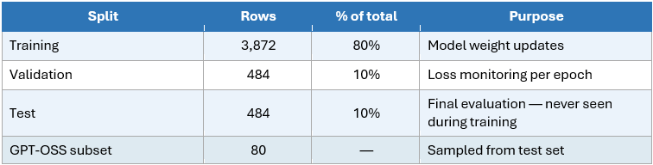
Data Preparation
Column Headers | Manually assigned 'sentiment' and 'text' headers to raw CSV
Duplicate Removal | Dataset cleaned from 4,846 to 4,840 unique samples.
Null Value Analysis | Both variables were found to be fully populated with no missing entries.
Label Normalization | All sentiment labels were converted to lowercase to ensure consistent string matching during evaluation.
Mojibake character handling | Replaced non-ASCII characters with [UNK] token to preserve sentence structure
Tokenization | BERT-base-uncased tokenizer (max length: 128 tokens) with padding/truncation
Train / Validation / Test split | To ensure total consistency and prevent data leakage, a 'Golden Data Block' protocol was implemented using stratified sampling and fixed seeds to guarantee identical test samples across all models.

Slide 6
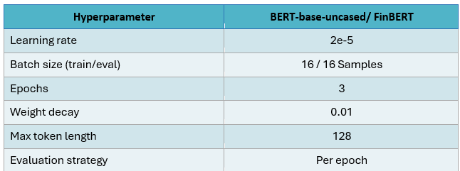
Architecture & training: Model A - BERT-base & Model B - FinBERT
 | Model A - BERT - base-uncased | Model B - FinBERT
Model Type | Encoder-only Transformer (110M parameters) | Same
Pre-training Corpus | General English (Wikipedia, Books) | Financial (SEC filings, news, reports)
Architecture modifications | Custom 3-class linear layer for sentiment analysis | Same
Training Strategy | Full fine-tuning (all layers updated) on financial text. | Same
Persistence | Best checkpoint saved via load_best_model_at_end based on lowest validation loss. | Same

Slide 7
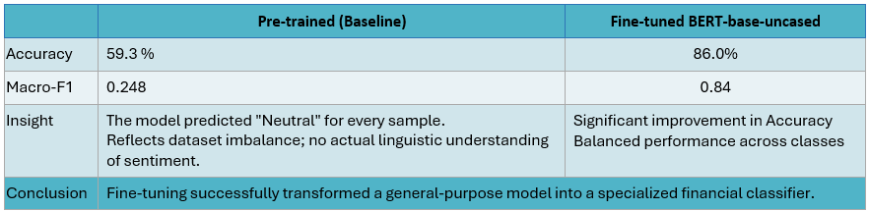
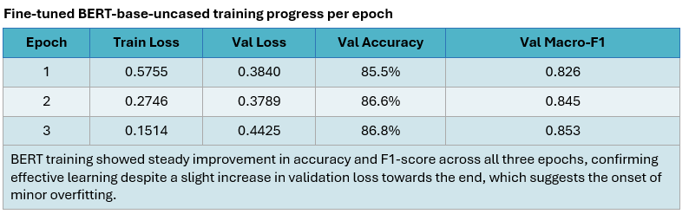
BERT Results

Slide 8
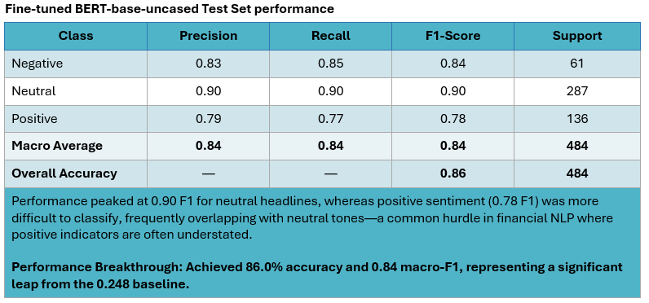
BERT Results (continuation)

Slide 9
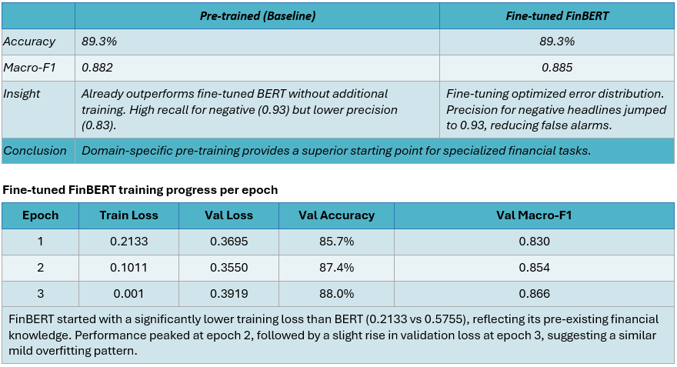
FinBERT Results

Slide 10
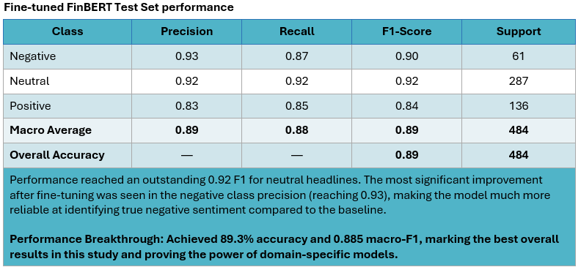
FinBERT Results (Continuation)

Slide 11
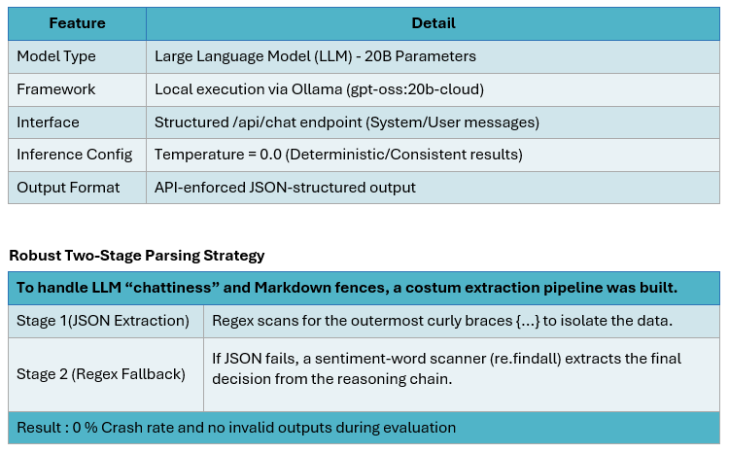
Model C – GPT-OSS 20B. Architecture & Setup

Slide 12
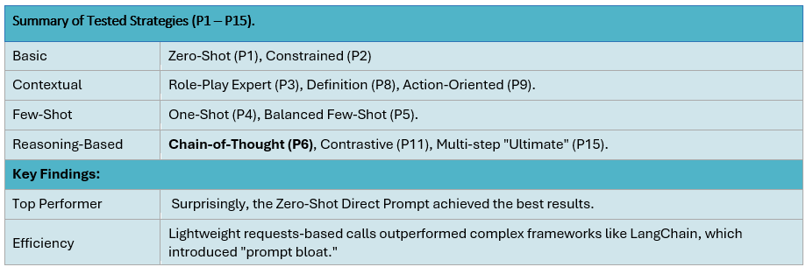
Prompt Engineering: 15-Prompt Ablation Study
Ablation Study
A systematic method to isolate which prompt characteristics (examples, personas, reasoning) actually drive accuracy by changing one variable at a time while keeping the model and dataset fixed.

Slide 13
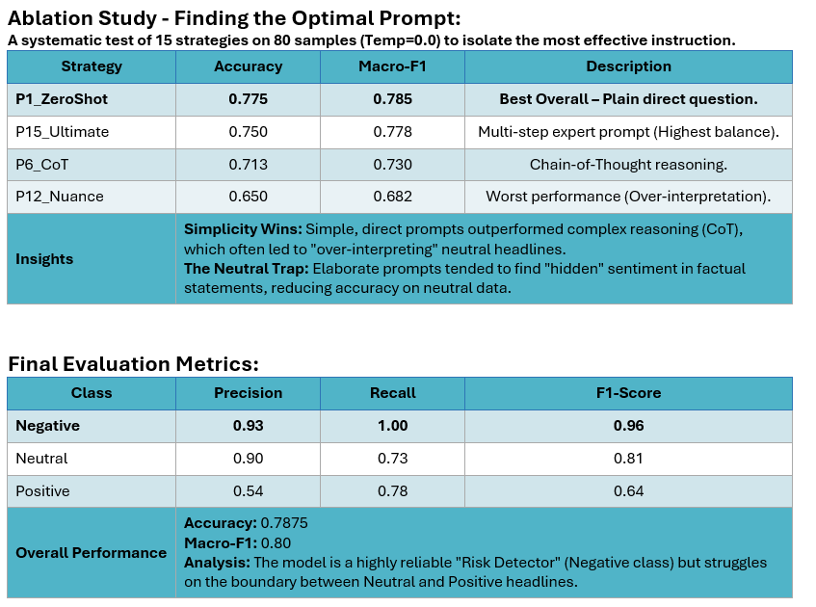
Model C – Performance & Optimisation

Slide 14
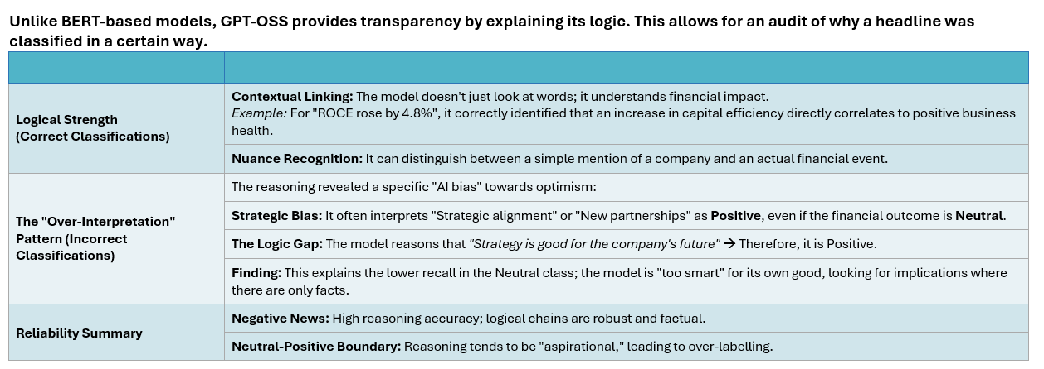
Model C – Qualitative Analysis – Reasoning Quality

Slide 15
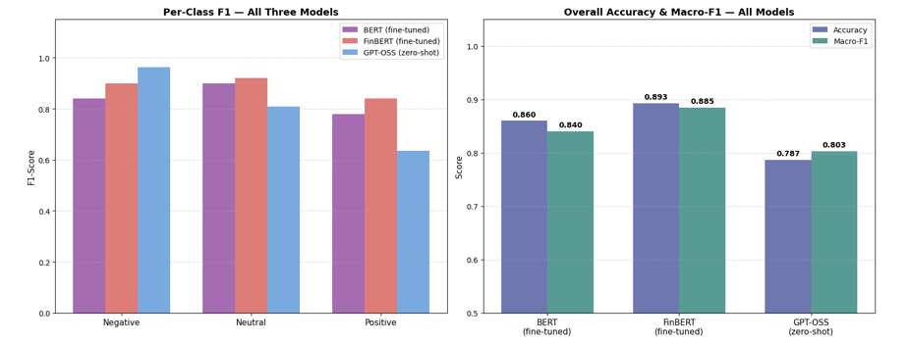
Comparative Analysis
Bar chart right comparing overall accuracy and macro-F1 for BERT, FinBERT, and GPT-OSS. FinBERT leads on both metrics; GPT-OSS macro-F1 is nearly equal to BERT despite no training. Bar chart left, showing per-class F1 for negative, neutral, and positive across all three models. GPT-OSS has the highest negative F1 by a large margin; all three models struggle most with the positive class.

Slide 16
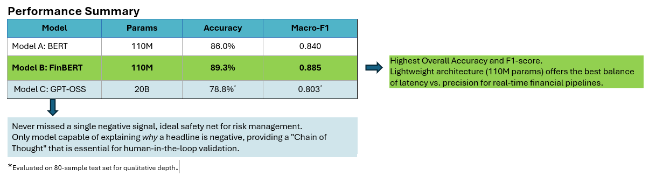
Comparative Analysis
Domain Pre-training > Task Fine-tuning: FinBERT’s prior to fine-tunning performance (89.3%) already beat a fully fine-tuned BERT. Specialized vocabulary (e.g., EBIT, write-down) is better handled via pre-training than small-scale fine-tuning.
The Positive Class Problem: All models struggled with the "Positive" label. (F1 Positive always the lowest). Positive signals in finance are often indirect or forward-looking (e.g., hiring plans), which are harder to distinguish from "Neutral" facts.
Prompt Engineering vs. Bloat: Simple strategies (P1_ZeroShot) outperformed complex reasoning (Chain-of-Thought). Adding too much nuance caused the model to "talk itself" into the wrong answer.

Slide 17
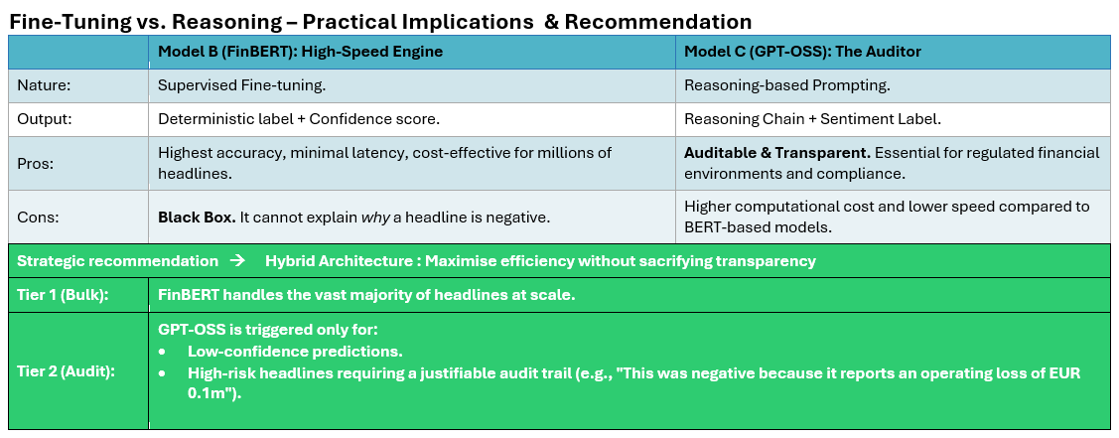
Fine-Tuning vs Reasoning

Slide 18
Reflection & Ethical Considerations
Critical Considerations for Real-World Deployment
1. Automation Risk (Ethical Problem)
Deploying any of these models for automated trading without human oversight is risky. All models make systematic errors on the positive/neutral boundary. A false negative signal could trigger erroneous stock sales, potentially causing significant market harm.
2. Dataset Bias (Generalization)
The model is trained primarily on Finnish financial news (e.g., Nokia, Sponda). This data may not generalize to other markets or languages. While GPT-OSS has broader pre-training and is less affected, it lacks specific knowledge of Finnish corporate reporting conventions.
3. Hallucination in Reasoning (Safety)
GPT-OSS sometimes produced confident reasoning for incorrect predictions. A model that sounds certain while being wrong is more dangerous than one that is visibly uncertain. Human review of reasoning is essential before making financial decisions.
4. Overfitting (Technical Limitation)
Both BERT and FinBERT showed mild validation loss increases at epoch 3. This indicates a risk of memorizing patterns rather than generalizing. The current dataset (4,840 samples) is relatively small for transformer fine-tuning. Larger datasets and Early Stopping are recommended.

Slide 19
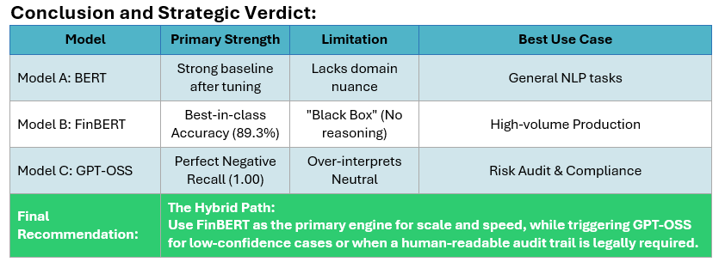
Conclusion

Slide 20
Questions
Thank you!
Questions?

