Slide 1

TALASH
Talent Acquisition & Learning
Automation for Smart Hiring
CS 417 – Large Language Models | Spring 2026
BSDSA-2023 · SEECS, NUST
Mehreen Raheel · Eeshal Tahir · Huma Ejaz
Instructor: Prof. Dr. Muhammad Moazam Fraz
MILESTONE 1

Slide 2




The Problem with Traditional Hiring
Keyword-Only Matching
Manual & Subjective Evaluation
Traditional ATS systems miss nuanced candidate strengths, relying on surface-level keyword scans.
Human reviewers introduce bias and inconsistency, especially under high application volumes.
Research Profile Ignored
Experience Gaps Undetected
Journal rankings, conference tiers, authorship roles, and publication impact are rarely assessed.
Employment timeline inconsistencies and duration gaps go unnoticed in manual screening.

Slide 3

What is TALASH?
TALASH
Core Capabilities
Automated CV Screening
Talent Acquisition &
Learning Automation
for Smart Hiring
Candidate–Job Matching
Academic Profile Analysis
Publication & Research Scoring
An AI-powered LLM-assisted recruitment
support system for university hiring.
Focused on NUST HR portal CV format.
Experience Timeline Validation
Skill Alignment Assessment

Slide 4
System Architecture
1
Input Layer
CV PDFs via direct upload or folder-based batch monitoring
2
Preprocessing Layer
pdfplumber reads PDFs, passes text to parser module
3
Analysis Layer
Section-aware regex extracts education, experience, publications, skills
4
Storage Layer
Structured JSON files → future relational database schema
5
Presentation Layer
Streamlit web app: results, missing flags, raw text, JSON output

Slide 5



Core Modules
pdf_reader.py
parser.py
streamlit_app.py
Opens PDFs via pdfplumber. Extracts text with layout awareness across all pages. Handles None-page edge cases.
Section-aware pipeline: splits CV into named sections, extracts personal info, education, experience, publications, skills via targeted regex.
Web interface with two input modes: PDF upload and folder selection. Renders all parsed fields, flags, raw text and JSON.

Slide 6
Data Flow Pipeline
1
2
3
4
5
6
Input CV PDF
Extract Text
Split Sections
Extract Entities
Structured JSON
Display in UI
Upload / Folder
pdfplumber
Header Keywords
Regex Patterns
Candidate Profile
Streamlit
Milestone 1 Pipeline
• CVs ingested as PDF via direct upload or monitored folder
• pdfplumber preserves spatial layout for space-aligned tables used in NUST HR portal CVs
• Section detection via keyword scan → named text blocks (header, education, experience, publications, skills)
• Structured JSON output stored in data/sample_outputs/ for future database ingestion

Slide 7
Database & Storage Design
{
"personal_information": {
"name": "Muhammad Salman",
"position_applied": "Asst Prof - ECE",
"dob": "..."
},
"education": [ ... ],
"experience": [ ... ],
"publications": [
{ "type": "Journal", "impact_factor": "2.80" }
],
"skills": ["Deep Learning", ...],
"missing_information": ["email", "phone"]
}
JSON Output Schema
personal_information
Name, email, phone, DOB, position
education
Degree, grade/CGPA, year, institution
experience
Title, org, start/end year, duration
publications
Title, venue, type, year, impact factor
skills
Detected technical & domain skills
missing_information
Flags for absent/undetected fields
Milestone 2: Map to relational DB with candidate, education, experience & publication tables

Slide 8
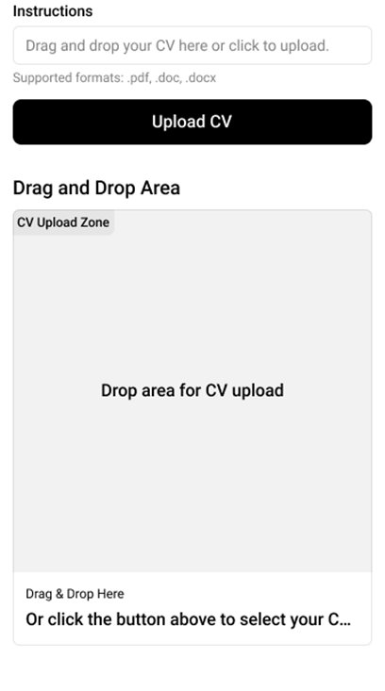
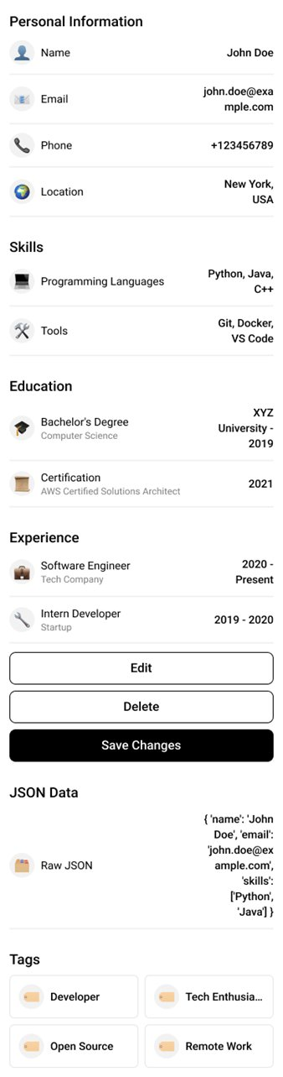
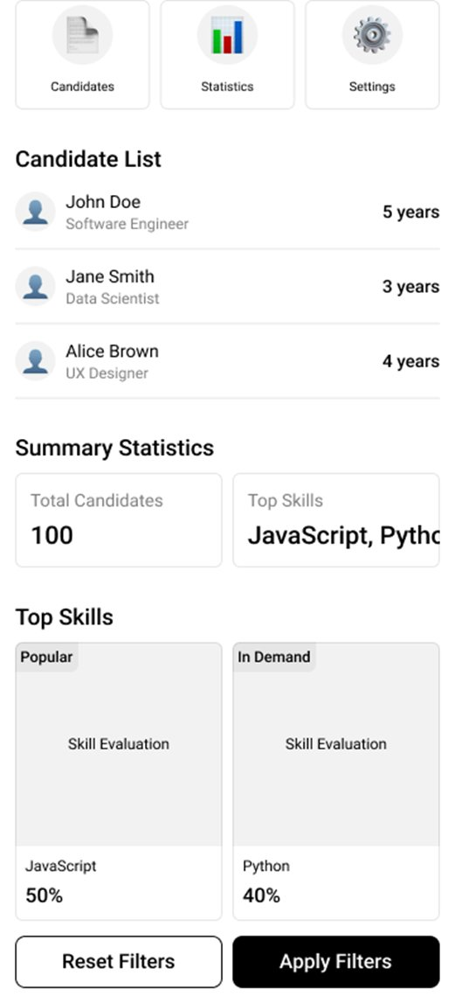
UI/UX Wireframes
1 · Upload Screen
2 · Results Screen
3 · Dashboard (M2/M3)
› Drag-and-drop zone
› Personal info panel
› Candidate comparison table
› Click-to-browse option
› Education & experience
› Skill alignment charts
› Supported format indicator
› Publications listing
› Publication quality breakdown
› Upload status feedback
› Missing info flags + JSON
› Educational timeline viz

Slide 9
Sample Parsed Output — Muhammad Salman
Field
Extracted Value
Name
Muhammad Salman
Position
Assistant Professor – ECE, SEECS
PhD
Electrical Eng. (Comm. Systems) · CGPA 3.33 · IIU Islamabad · 2024
MS
Electrical Eng. · CGPA 3.03 · COMSATS Islamabad · 2014
BSc
Electronics Engineering · 69.84% · COMSATS Abbottabad · 2011
Experience
5 roles: Support Eng → Prog Coord → Lecturer → Asst. Prof → Assoc. Prof (2012–Present)
Publications
5 entries: 4 Journal (IF 2.10–2.80), 1 Conference
Skills
Deep Learning, Optimization, Research
Missing Flags
Email, Phone, DOB (not printed on portal-generated CVs)

Slide 10








Technologies & Stack
Python 3.14
Streamlit ≥1.33
pdfplumber ≥0.11
pandas ≥2.2
Primary language
Web UI framework
Layout-aware PDF extraction
Tabular data & status display
python-dateutil
re / json / pathlib
Git / GitHub
LLMs (planned M2)
Date parsing utilities
Regex, JSON, file paths (stdlib)
Version control & collaboration
NLP pipeline & analysis

Slide 11


Milestone 1 — Completion Status
System architecture & technical design
Folder-based CV ingestion pipeline
UI/UX wireframes (3 screens)
Preliminary extraction from real CVs (2 samples)
Preprocessing module — PDF reader
Missing information detection
Preprocessing module — CV parser
LLM / NLP analysis pipeline
→ Milestone 2
Early Streamlit prototype (upload/read flow)
Advanced analysis modules (scoring, ranking)
→ Milestones 2–3

Slide 12

Limitations & Next Steps
Current Limitations
Upcoming — Milestones 2 & 3
1. Parser tuned for NUST HR portal format — free-form CVs may need extra rules
LLM-powered educational profile scoring
Research analysis: journal rankings, conference tiers, authorship roles
2. Publication title extraction picks up co-author fragments due to multi-column layout
Professional experience timeline validation
3. Email/phone not printed on portal-generated PDFs — missing flags correctly raised
Co-author network analysis & supervision/patent detection
Candidate ranking, comparison dashboard & personalized email drafts
4. Skill detection via keyword list — unlisted skills are not detected
Relational database with SQL-based querying

Slide 13

Thank You
TALASH — Smart HR Recruitment System
Milestone 1 · CS 417 LLMs · Spring 2026
Mehreen Raheel · Eeshal Tahir · Huma Ejaz
Instructor: Prof. Dr. Muhammad Moazam Fraz
BSDSA-2023 | SEECS, NUST
github.com/mehreennwhyn0t/Talash
Questions?

