Slide 1
Project Title: Search Engine for Desserts (Sweets)
TEAM 5
Students:
Mehroos Ali (mxa200089@utdallas.edu)
Pranjal Upadhyay (pxu210002@utdallas.edu)
Abhijeetsinh Vaghela (abv210000@utdallas.edu)
Utsav Adhikari (uxa200002@utdallas.edu)
Karumuru Siddhartha (kvs200001@utdallas.edu)

Slide 2
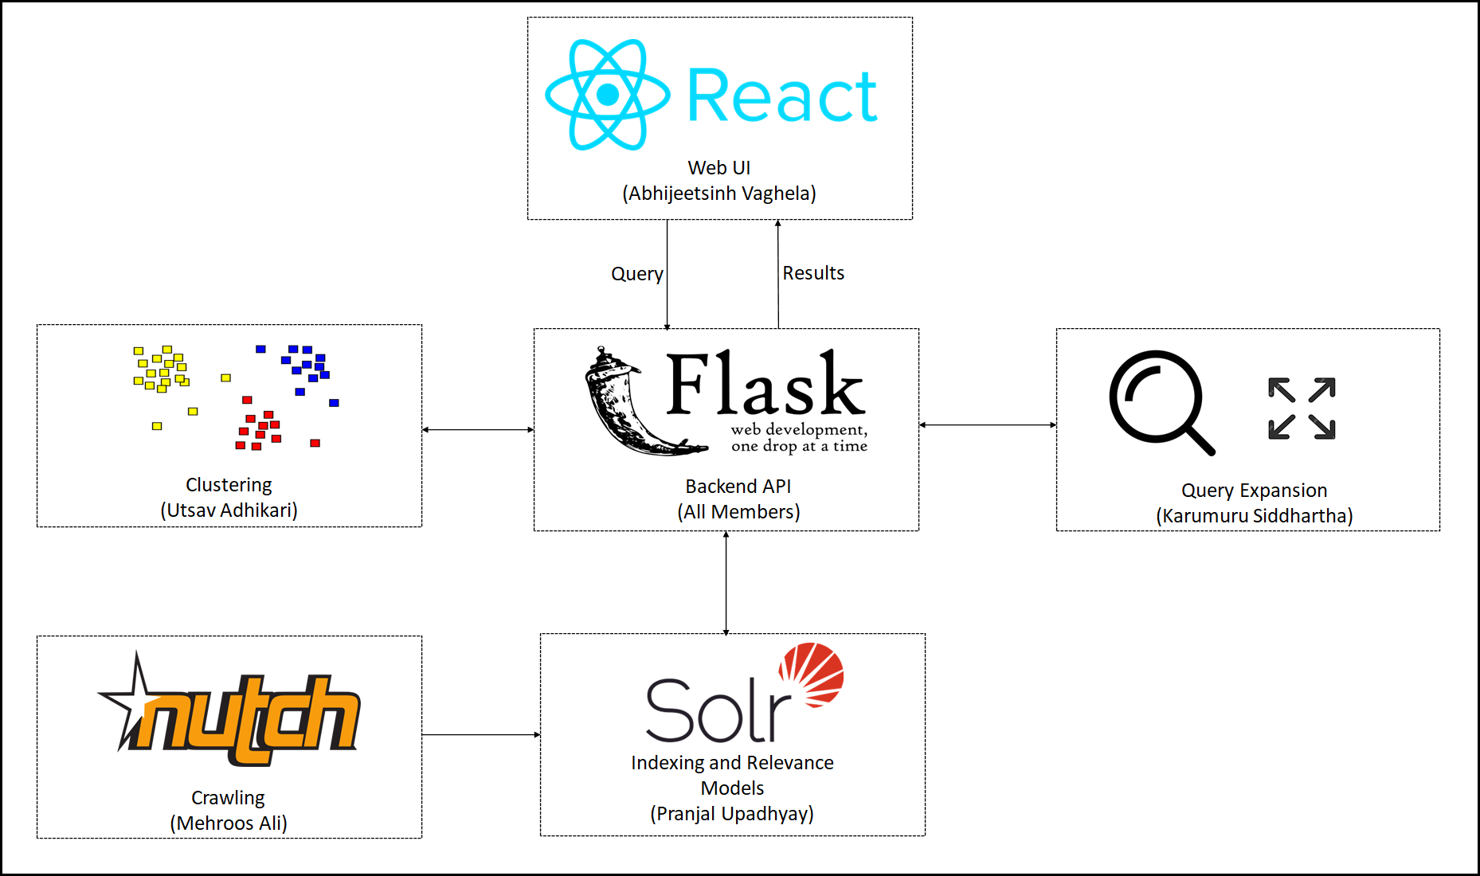
Overview

Slide 3

Crawling (Mehroos Ali)
Apache Nutch Crawler.
334 Seed URLs.
105,885 crawled web pages.
12 iterations of crawling.
Duplication handled by Nutch Dedup MR job.

Slide 4

Indexing and Relevance Models (Pranjal Upadhyay)
Apache Solr is used for indexing.
Vector Space model implemented while indexing in Solr.
Webgraph created using nutch.
Page Rank algorithm generated using nutch Link Rank program.
HITS algorithm implemented using python library (networkx).
60 queries were used for experimenting with relevance models.

Slide 5

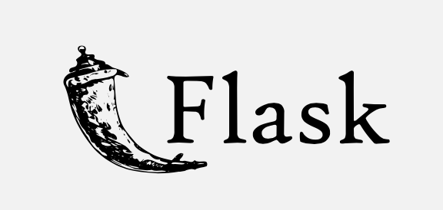
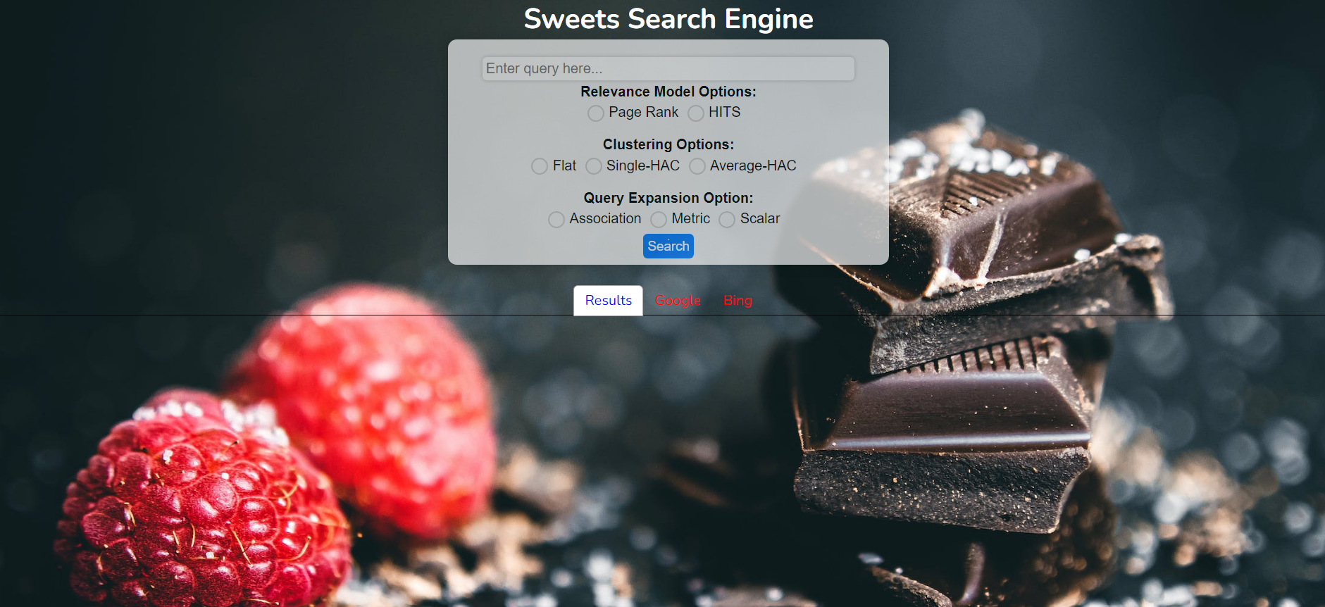
User Interface (Abhijeetsinh Vaghela)

Slide 6
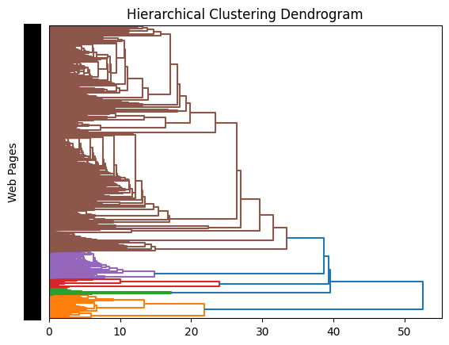
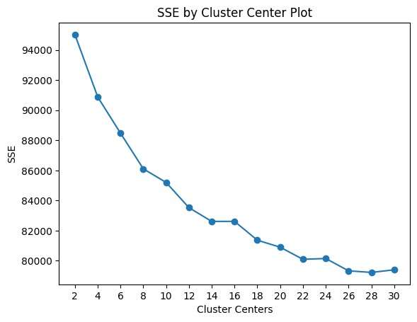
Clustering (Utsav Adhikari)
Flat Clustering
k = 14 was determined using elbow method.
MiniBatchKMeans from sklearn.cluster was used to cluster all web pages to 14 clusters.
Hierarchical Clustering
'single' and 'average' methods used.
k = 12 was determined by making a cut in the dendrogram obtained.(Gap between two successive combination is the largest)
Results (Documents, cluster_number) and (cluster_number, cluster_center) were saved computing average.

Slide 7
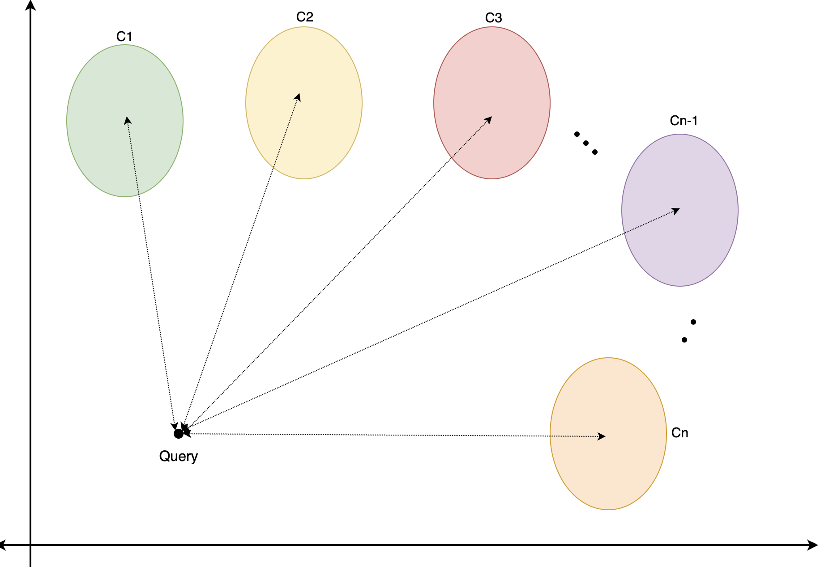
Improvement of results using Clustering
Convert query to Vector using tfidfVectorizer object trained in entire dataset
Compute distance between query and centroid of each cluster
Result arranged according to distance to the cluster and URLs in that cluster
Notes:
Cluster evaluated using Normal Mutual Information(NMI)

Slide 8
Query Expansion (Karumuru Siddhartha)
Implemented Rocchio Algorithm for relevance feedback
Implemented Association , Metric and Scalar Methods for pseudo relevance feedback
These local strategies are used to for local document set, vocabulary set, stem set and compute correlation weights for given query.
Added 3 words to the end of query as expanded query.
Tested with over 60 queries on all the three methods.

Slide 9

DEMO

Slide 10

Queries
chocolate cake
apple pie
candies
what are the best desserts for thanksgiving?
what are some quick desserts recipes?

Slide 11


