Slide 1
Microsoft Agent Framework Workshop

Slide 2

What is Microsoft Agent Framework?
https://github.com/microsoft/agent-framework

Slide 3



Sematic Kernel
AutoGen
Open-source SDK from Microsoft for building Al-powered applications
﻿﻿It helps developers embed reasoning and natural-language capabilities into apps "AI as a function call"
Open-source framework from
Microsoft Research for building multi-agent systems ie. multiple LLM agents talking to each other and collaborating to solve problems.

Slide 4

Microsoft Agent Framework
Open-source SDK and runtime from Microsoft for building, orchestrating and deploying Al agents and multi-agent workflows
﻿﻿Supports both .NET (C#) and Python
﻿﻿Unifies Semantic Kernel and AutoGen into a single framework

Slide 5
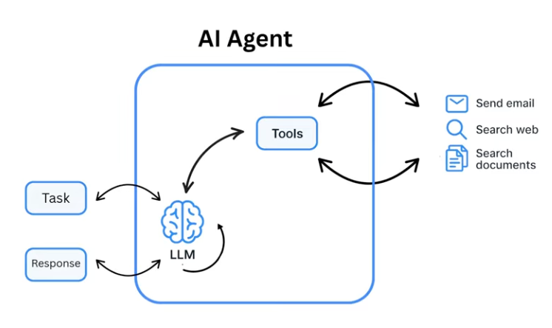
Act
Reasoning
ReAct: Reason + Act

Slide 6
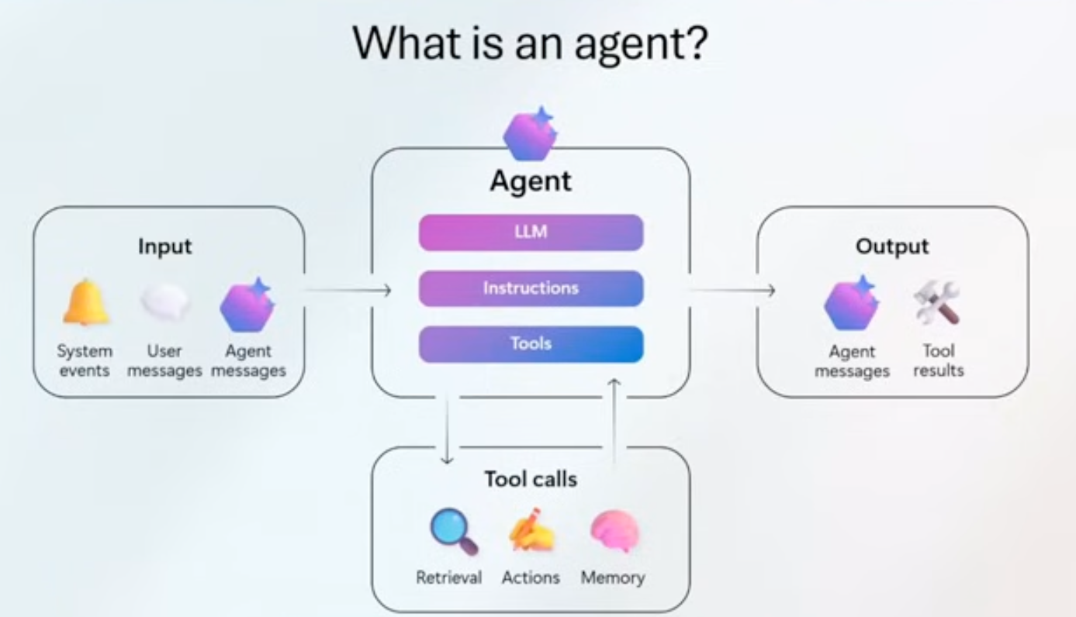

Slide 7


Slide 8
Why Build Agents in Code?
Full Control & Customization
Code-first agents can use any model, tool, or data source - not limited to pre-defined connectors or templates
Local Experimentation
Run agents on your laptop with your preferred IDEs (VS Code, GitHub) with no cloud dependency; debug, test, and integrate into CI/CD pipelines before scaling
Portability
Move from local to any cloud without rewrites, avoiding vendor lock-in

Slide 9
Topics
Producing Structured Output with Agents
Using an agent as a function tool
Create a Simple Sequential Workflow

Slide 10
Producing Structured Output with Agents

Slide 11
What is structured output with an agent?
Structured output with an agent means that an AI agent is designed to return its results in a predefined, machine-readable format, instead of free-form text
In simple terms:
👉 The agent doesn’t just talk - it responds with data that other systems can reliably consume.

Slide 12
Why is structured output important?
Structured output is important because it makes AI reliable, automatable, and safe to integrate into real systems.
We can enable dynamic analysis of business rules.
For example, a fintech operating with Bitcoin and equities needs to send user-friendly notifications about:
  new investments
  price appreciation and depreciation,
  market movements and growth trends.

Slide 13
Why is structured output important?
We can design a set of microservices, exposing APIs that receive data and instructions, supported by classes that can interact with one another.
Each class encapsulates its own AI-driven business logic and is able to orchestrate with other components, producing high-quality and consistent results.

Slide 14
Another Use Case
Another use case is leveraging structured inputs, such as friendly, guided questions, and connecting the agent directly to database inputs.
Additionally, we can:
  define regex-based rules for data filtering
  orchestrate API workflows
  perform data transformation and enrichment
In this context, structured output allows us to make our APIs significantly more dynamic, enabling them to produce precise, actionable, and business-oriented information.
What would traditionally require two development sprints to implement a complex architecture can be delivered in significantly less time using structured output, with greater predictability, lower complexity, and faster time to value.

Slide 15
Producing Structured Output with Agents
DEMO

Slide 16
Demonstration
PATCH /employees:
Reads Chat Config, executes an Azure OpenAI agent that generates an AIResponse, which is used as a filter (filter.AIAnswer) to query the Employee Repository, and return the list of employees.
POST /agent-run:
Reads Chat Config, executes an Azure OpenAI agent that produces a PersonInfo JSON, deserializes it, and returns the PersonInfo object

Slide 17
Using an agent as a function tool

Slide 18
Workflows
designed to handle complex and long-running processes that might involve multiple agents, human interactions, and integrations with external systems
often require more than one AI agent

Slide 19
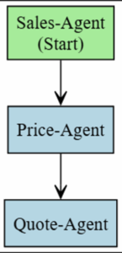
Simple Sequential Workflow
dotnet add package Microsoft.Agents.AI.Workflows --prerelease
Notes:
https://github.com/microsoft/agent-framework/blob/main/dotnet/samples/GettingStarted/Workflows/_Foundational/01_ExecutorsAndEdges/Program.cs

Slide 20
Demo
Simple Sequential Workflow
Notes:
using Microsoft.Agents.AI.Workflows;
namespace WorkflowExecutorsAndEdgesSample;
/// <summary>
/// This sample introduces the concepts of executors and edges in a workflow.
///
/// Workflows are built from executors (processing units) connected by edges (data flow paths).
/// In this example, we create a simple text processing pipeline that:
/// 1. Takes input text and converts it to uppercase using an UppercaseExecutor
/// 2. Takes the uppercase text and reverses it using a ReverseTextExecutor
///
/// The executors are connected sequentially, so data flows from one to the next in order.
/// For input "Hello, World!", the workflow produces "!DLROW ,OLLEH".
/// </summary>
public static class Program
{
private static async Task Main()
{
// Create the executors
Func<string, string> uppercaseFunc = s => s.ToUpperInvariant();
var uppercase = uppercaseFunc.BindAsExecutor("UppercaseExecutor");
ReverseTextExecutor reverse = new();
// Build the workflow by connecting executors sequentially
WorkflowBuilder builder = new(uppercase);
builder.AddEdge(uppercase, reverse).WithOutputFrom(reverse);
var workflow = builder.Build();
// Execute the workflow with input data
await using Run run = await InProcessExecution.RunAsync(workflow, "Hello, World!");
foreach (WorkflowEvent evt in run.NewEvents)
{
if (evt is ExecutorCompletedEvent executorComplete)
{
Console.WriteLine($"{executorComplete.ExecutorId}: {executorComplete.Data}");
}
}
}
}
/// <summary>
/// Second executor: reverses the input text and completes the workflow.
/// </summary>
internal sealed class ReverseTextExecutor() : Executor<string, string>("ReverseTextExecutor")
{
/// <summary>
/// Processes the input message by reversing the text.
/// </summary>
/// <param name="message">The input text to reverse</param>
/// <param name="context">Workflow context for accessing workflow services and adding events</param>
/// <param name="cancellationToken">The <see cref="CancellationToken"/> to monitor for cancellation requests.
/// The default is <see cref="CancellationToken.None"/>.</param>
/// <returns>The input text reversed</returns>
public override ValueTask<string> HandleAsync(string message, IWorkflowContext context, CancellationToken cancellationToken = default)
{
// Because we do not suppress it, the returned result will be yielded as an output from this executor.
return ValueTask.FromResult(string.Concat(message.Reverse()));
}
}

Slide 21
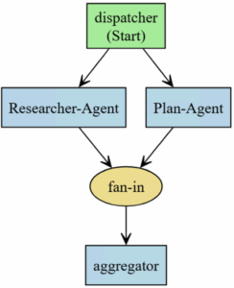
Simple Concurrent Workflow
Implement fan-out and fan-in patterns that enable parallel processing, allowing multiple executors or agents to work simultaneously and then aggregate their results.
dotnet add package Microsoft.Agents.AI.Workflows --prerelease
Notes:
https://github.com/microsoft/agent-framework/blob/main/dotnet/samples/GettingStarted/Workflows/_Foundational/01_ExecutorsAndEdges/Program.cs

Slide 22
Agent as a function tool
An agent as a function tool means treating an AI agent like a callable function inside your system — with defined inputs, a clear contract, and structured outputs, instead of free-form conversation.
In other words:
👉 the agent behaves like software, not a chatbot

Slide 23
Core idea
Traditional agent:
  Conversational
  Unstructured text output
  Hard to integrate
Agent as a function tool:
  Invoked programmatically
  Receives structured input
  Returns structured output
  Can be composed, validated, and reused

Slide 24
Process
Prerequisites: Set up the environment (Azure, .NET, packages)
Create C# function: Write a method with discrete business logic
Convert to tool: Use AIFunctionFactory.Create
Create agent: Inject tools when creating the AIAgent
Invoke / test: Send a prompt to the agent and evaluate the response
Agent as tool (advanced): Expose an agent as a tool for other agents

Slide 25
Using an agent as a function tool
DEMO

Slide 26
Business Plan Presentation

Slide 27
Sequential Workflows

Slide 28
Sequential Workflows
Microsoft’s Sequential Workflow is an AI orchestration model in which multiple steps are executed in a fixed order, in a deterministic and controlled manner, using agents, tools, and structured outputs.
It is part of the Microsoft Agent Framework and is designed for predictable, business-critical processes, rather than open-ended conversations.
In simple terms
  “Execute Step A → then Step B → then Step C,
  passing the output of one step as the input to the next.”

Slide 29
Sequential Workflows
Each step can:
  invoke an AI agent
  call a function tool
  validate structured output
decide whether to continue, stop, or fail the workflow
Key characteristics of a Sequential Workflow
  ✔ Linear, ordered execution
  ✔ Each step depends on the previous step’s output
  ✔ Structured inputs and outputs
  ✔ Easy to audit, test, and monitor
  ✔ Ideal for regulated and enterprise workflows

Slide 30
Sequential Workflows
DEMO

