Slide 1
Microsoft Agent Framework Workshop
Notes:
MZE

Slide 2

What is Microsoft Agent Framework?
Microsoft Agent Framework is an open-source development kit for building AI agents and multi-agent workflows for .NET and Python. It brings together and extends ideas from Semantic Kernel and AutoGen projects, combining their strengths while adding new capabilities. Built by the same teams, it is the unified foundation for building AI agents going forward.
https://github.com/microsoft/agent-framework
Notes:
MZE

Slide 3



Sematic Kernel
AutoGen
Open-source SDK from Microsoft for building Al-powered applications
﻿﻿It helps developers embed reasoning and natural-language capabilities into apps "AI as a function call"
Open-source framework from
Microsoft Research for building multi-agent systems ie. multiple LLM agents talking to each other and collaborating to solve problems.
Notes:
MZE

Slide 4

Microsoft Agent Framework
Open-source SDK and runtime from Microsoft for building, orchestrating and deploying Al agents and multi-agent workflows
﻿﻿Supports both .NET (C#) and Python
﻿﻿Unifies Semantic Kernel and AutoGen into a single framework
Notes:
MZE

Slide 5
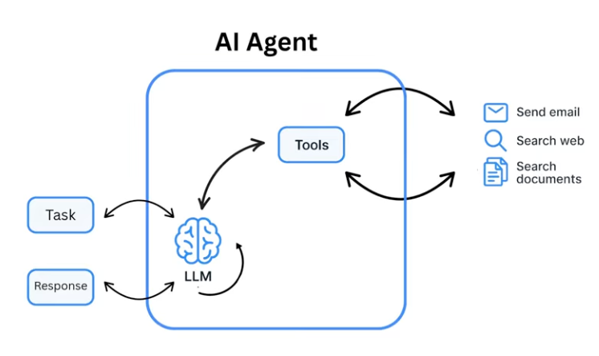
Act
Reasoning
ReAct: Reason + Act
Notes:
MZE

Slide 6

Notes:
MZE

Slide 7



Why Build Agents in Code?
Full Control & Customization
Code-first agents can use any model, tool, or data source - not limited to pre-defined connectors or templates
Local Experimentation
Run agents on your laptop with your preferred IDEs (VS Code, GitHub) with no cloud dependency; debug, test, and integrate into CI/CD pipelines before scaling
Portability
Move from local to any cloud without rewrites, avoiding vendor lock-in
Notes:
MZE

Slide 8
Topics and Workshops
Producing Structured Output with Agents (AI Agent SQL)
Create a Simple Sequential Workflow
Concurrent Workflow
Payment Transaction Validator
Notes:
MS

Slide 9
Producing Structured Output with Agents
Notes:
MS

Slide 10
What is structured output with an agent?
Structured output with an agent means that an AI agent is designed to return its results in a predefined, machine-readable format, instead of free-form text
In simple terms:
👉 the agent doesn’t just talk — it responds with data that other systems can reliably consume.
Notes:
MS

Slide 11
Why is structured output important?
Structured output is important because it makes AI reliable, automatable, and safe to integrate into real systems.
We can enable dynamic analysis of business rules.
For example, a fintech operating with Bitcoin and equities needs to send user-friendly notifications about:
  new investments
  price appreciation and depreciation,
  market movements and growth trends.
Notes:
MS

Slide 12
Why is structured output important?
We can design a set of microservices, exposing APIs that receive data and instructions, supported by classes that can interact with one another.
Each class encapsulates its own AI-driven business logic and is able to orchestrate with other components, producing high-quality and consistent results.

Slide 13
Another Use Case
Another use case is leveraging structured inputs, such as friendly, guided questions, and connecting the agent directly to database inputs.
Additionally, we can:
  define regex-based rules for data filtering
  orchestrate API workflows
  perform data transformation and enrichment
In this context, structured output allows us to make our APIs significantly more dynamic, enabling them to produce precise, actionable, and business-oriented information.
What would traditionally require two development sprints to implement a complex architecture can be delivered in significantly less time using structured output, with greater predictability, lower complexity, and faster time to value.

Slide 14
Demonstration
PATCH /employees:
Reads Chat Config, executes an Azure OpenAI agent that generates an AIResponse, which is used as a filter (filter.AIAnswer) to query the Employee Repository, and return the list of employees.
POST /agent-run:
Reads Chat Config, executes an Azure OpenAI agent that produces a PersonInfo JSON, deserializes it, and returns the PersonInfo object
Notes:
MS

Slide 15
Producing Structured Output with Agents
DEMO
Notes:
MS

Slide 16
Simple sequential workflow
Notes:
MS

Slide 17
Simple Sequential Workflow
Is designed to handle complex and long-running processes that might involve multiple agents, human interactions, and integrations with external systems

Slide 18
Simple Sequential Workflow
Simple Sequential Workflow (.NET + AI) is a linear execution flow in which each step runs in order, one after the other, with no parallelism or complex branching, using .NET as the foundation and AI to make decisions or generate responses.
In simple terms
Step 1 → Step 2 → Step 3 → End
Each step:
receives the output from the previous one
performs an action
passes the result forward
Notes:
MS

Slide 19
Simple Sequential Workflow
Simple mental example
Receive a text from the user
Send the text to an Lib/ Method/ LLM model
Interpret the response
Return the result to the API
Nothing happens out of order.
Notes:
MS

Slide 20
Simple Sequential Workflow
How to build a simple structure?
We will build a simple C# console application that demonstrates a sequential workflow using Agent Framework Workflows. It converts input text to uppercase and then reverses it, executing the steps in sequence.
Notes:
MS

Slide 21
Demo
Simple Sequential Workflow
Notes:
MS
using Microsoft.Agents.AI.Workflows;
namespace WorkflowExecutorsAndEdgesSample;
/// <summary>
/// This sample introduces the concepts of executors and edges in a workflow.
///
/// Workflows are built from executors (processing units) connected by edges (data flow paths).
/// In this example, we create a simple text processing pipeline that:
/// 1. Takes input text and converts it to uppercase using an UppercaseExecutor
/// 2. Takes the uppercase text and reverses it using a ReverseTextExecutor
///
/// The executors are connected sequentially, so data flows from one to the next in order.
/// For input "Hello, World!", the workflow produces "!DLROW ,OLLEH".
/// </summary>
public static class Program
{
private static async Task Main()
{
// Create the executors
Func<string, string> uppercaseFunc = s => s.ToUpperInvariant();
var uppercase = uppercaseFunc.BindAsExecutor("UppercaseExecutor");
ReverseTextExecutor reverse = new();
// Build the workflow by connecting executors sequentially
WorkflowBuilder builder = new(uppercase);
builder.AddEdge(uppercase, reverse).WithOutputFrom(reverse);
var workflow = builder.Build();
// Execute the workflow with input data
await using Run run = await InProcessExecution.RunAsync(workflow, "Hello, World!");
foreach (WorkflowEvent evt in run.NewEvents)
{
if (evt is ExecutorCompletedEvent executorComplete)
{
Console.WriteLine($"{executorComplete.ExecutorId}: {executorComplete.Data}");
}
}
}
}
/// <summary>
/// Second executor: reverses the input text and completes the workflow.
/// </summary>
internal sealed class ReverseTextExecutor() : Executor<string, string>("ReverseTextExecutor")
{
/// <summary>
/// Processes the input message by reversing the text.
/// </summary>
/// <param name="message">The input text to reverse</param>
/// <param name="context">Workflow context for accessing workflow services and adding events</param>
/// <param name="cancellationToken">The <see cref="CancellationToken"/> to monitor for cancellation requests.
/// The default is <see cref="CancellationToken.None"/>.</param>
/// <returns>The input text reversed</returns>
public override ValueTask<string> HandleAsync(string message, IWorkflowContext context, CancellationToken cancellationToken = default)
{
// Because we do not suppress it, the returned result will be yielded as an output from this executor.
return ValueTask.FromResult(string.Concat(message.Reverse()));
}
}

Slide 22
Concurrent Workflow
Notes:
MS
using Microsoft.Agents.AI.Workflows;
namespace WorkflowExecutorsAndEdgesSample;
/// <summary>
/// This sample introduces the concepts of executors and edges in a workflow.
///
/// Workflows are built from executors (processing units) connected by edges (data flow paths).
/// In this example, we create a simple text processing pipeline that:
/// 1. Takes input text and converts it to uppercase using an UppercaseExecutor
/// 2. Takes the uppercase text and reverses it using a ReverseTextExecutor
///
/// The executors are connected sequentially, so data flows from one to the next in order.
/// For input "Hello, World!", the workflow produces "!DLROW ,OLLEH".
/// </summary>
public static class Program
{
private static async Task Main()
{
// Create the executors
Func<string, string> uppercaseFunc = s => s.ToUpperInvariant();
var uppercase = uppercaseFunc.BindAsExecutor("UppercaseExecutor");
ReverseTextExecutor reverse = new();
// Build the workflow by connecting executors sequentially
WorkflowBuilder builder = new(uppercase);
builder.AddEdge(uppercase, reverse).WithOutputFrom(reverse);
var workflow = builder.Build();
// Execute the workflow with input data
await using Run run = await InProcessExecution.RunAsync(workflow, "Hello, World!");
foreach (WorkflowEvent evt in run.NewEvents)
{
if (evt is ExecutorCompletedEvent executorComplete)
{
Console.WriteLine($"{executorComplete.ExecutorId}: {executorComplete.Data}");
}
}
}
}
/// <summary>
/// Second executor: reverses the input text and completes the workflow.
/// </summary>
internal sealed class ReverseTextExecutor() : Executor<string, string>("ReverseTextExecutor")
{
/// <summary>
/// Processes the input message by reversing the text.
/// </summary>
/// <param name="message">The input text to reverse</param>
/// <param name="context">Workflow context for accessing workflow services and adding events</param>
/// <param name="cancellationToken">The <see cref="CancellationToken"/> to monitor for cancellation requests.
/// The default is <see cref="CancellationToken.None"/>.</param>
/// <returns>The input text reversed</returns>
public override ValueTask<string> HandleAsync(string message, IWorkflowContext context, CancellationToken cancellationToken = default)
{
// Because we do not suppress it, the returned result will be yielded as an output from this executor.
return ValueTask.FromResult(string.Concat(message.Reverse()));
}
}

Slide 23
Simple Concurrent Workflow
A concurrent workflow is a model in which multiple tasks or steps are executed at the same time, either in parallel or partially in parallel, instead of one after another (sequentially).
Basic concept
Concurrent: A, B, and C can occur simultaneously or with overlapping execution time
Notes:
MS
https://github.com/microsoft/agent-framework/blob/main/dotnet/samples/GettingStarted/Workflows/_Foundational/01_ExecutorsAndEdges/Program.cs

Slide 24
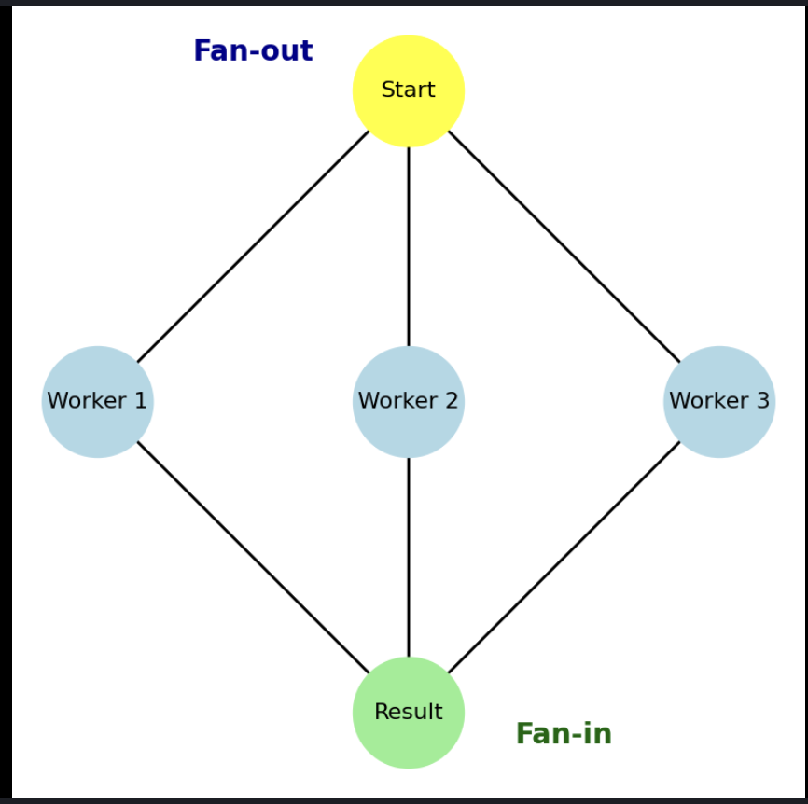
Simple Concurrent Workflow
This engine implements fan-out and fan-in.
Are patterns that enable parallel processing, allowing multiple executors or agents to work simultaneously and then aggregate their results.
Notes:
MS
https://github.com/microsoft/agent-framework/blob/main/dotnet/samples/GettingStarted/Workflows/_Foundational/01_ExecutorsAndEdges/Program.cs

Slide 25
Simple Concurrent Workflow
Fan-out
Fan-out is when a main task triggers multiple tasks in parallel.
Goal: split the work for simultaneous execution.
This can significantly improve performance when tasks are independent.
Notes:
MS
https://github.com/microsoft/agent-framework/blob/main/dotnet/samples/GettingStarted/Workflows/_Foundational/01_ExecutorsAndEdges/Program.cs

Slide 26
Simple Concurrent Workflow
Fan-in
Fan-in is when multiple parallel results are gathered into a single final task.
Goal: consolidate results after the concurrent tasks finish.
Notes:
MS
https://github.com/microsoft/agent-framework/blob/main/dotnet/samples/GettingStarted/Workflows/_Foundational/01_ExecutorsAndEdges/Program.cs

Slide 27
Why is Concurrent Workflow important?
Better performance and efficiency
Processing large volumes of data (Big Data)
Distributed model training
Real-time inference
Orchestration of multiple models or steps

Slide 28
Use cases
Creating the workflow which sends the 2 different questions or task to two different agents simultaneously.
Creating a transaction validator with concurrent workflow where you can register agents and invoke 3 agents to validate a transaction based on a transaction history, using statistics to allow or block the transactions, involving geospatial, behavior analysis, and transaction pattern.

Slide 29
Demo
Simple Concurrent Workflow
Notes:
MS
using Microsoft.Agents.AI.Workflows;
namespace WorkflowExecutorsAndEdgesSample;
/// <summary>
/// This sample introduces the concepts of executors and edges in a workflow.
///
/// Workflows are built from executors (processing units) connected by edges (data flow paths).
/// In this example, we create a simple text processing pipeline that:
/// 1. Takes input text and converts it to uppercase using an UppercaseExecutor
/// 2. Takes the uppercase text and reverses it using a ReverseTextExecutor
///
/// The executors are connected sequentially, so data flows from one to the next in order.
/// For input "Hello, World!", the workflow produces "!DLROW ,OLLEH".
/// </summary>
public static class Program
{
private static async Task Main()
{
// Create the executors
Func<string, string> uppercaseFunc = s => s.ToUpperInvariant();
var uppercase = uppercaseFunc.BindAsExecutor("UppercaseExecutor");
ReverseTextExecutor reverse = new();
// Build the workflow by connecting executors sequentially
WorkflowBuilder builder = new(uppercase);
builder.AddEdge(uppercase, reverse).WithOutputFrom(reverse);
var workflow = builder.Build();
// Execute the workflow with input data
await using Run run = await InProcessExecution.RunAsync(workflow, "Hello, World!");
foreach (WorkflowEvent evt in run.NewEvents)
{
if (evt is ExecutorCompletedEvent executorComplete)
{
Console.WriteLine($"{executorComplete.ExecutorId}: {executorComplete.Data}");
}
}
}
}
/// <summary>
/// Second executor: reverses the input text and completes the workflow.
/// </summary>
internal sealed class ReverseTextExecutor() : Executor<string, string>("ReverseTextExecutor")
{
/// <summary>
/// Processes the input message by reversing the text.
/// </summary>
/// <param name="message">The input text to reverse</param>
/// <param name="context">Workflow context for accessing workflow services and adding events</param>
/// <param name="cancellationToken">The <see cref="CancellationToken"/> to monitor for cancellation requests.
/// The default is <see cref="CancellationToken.None"/>.</param>
/// <returns>The input text reversed</returns>
public override ValueTask<string> HandleAsync(string message, IWorkflowContext context, CancellationToken cancellationToken = default)
{
// Because we do not suppress it, the returned result will be yielded as an output from this executor.
return ValueTask.FromResult(string.Concat(message.Reverse()));
}
}

Slide 30
Demo
Transaction Validator
Notes:
MS
using Microsoft.Agents.AI.Workflows;
namespace WorkflowExecutorsAndEdgesSample;
/// <summary>
/// This sample introduces the concepts of executors and edges in a workflow.
///
/// Workflows are built from executors (processing units) connected by edges (data flow paths).
/// In this example, we create a simple text processing pipeline that:
/// 1. Takes input text and converts it to uppercase using an UppercaseExecutor
/// 2. Takes the uppercase text and reverses it using a ReverseTextExecutor
///
/// The executors are connected sequentially, so data flows from one to the next in order.
/// For input "Hello, World!", the workflow produces "!DLROW ,OLLEH".
/// </summary>
public static class Program
{
private static async Task Main()
{
// Create the executors
Func<string, string> uppercaseFunc = s => s.ToUpperInvariant();
var uppercase = uppercaseFunc.BindAsExecutor("UppercaseExecutor");
ReverseTextExecutor reverse = new();
// Build the workflow by connecting executors sequentially
WorkflowBuilder builder = new(uppercase);
builder.AddEdge(uppercase, reverse).WithOutputFrom(reverse);
var workflow = builder.Build();
// Execute the workflow with input data
await using Run run = await InProcessExecution.RunAsync(workflow, "Hello, World!");
foreach (WorkflowEvent evt in run.NewEvents)
{
if (evt is ExecutorCompletedEvent executorComplete)
{
Console.WriteLine($"{executorComplete.ExecutorId}: {executorComplete.Data}");
}
}
}
}
/// <summary>
/// Second executor: reverses the input text and completes the workflow.
/// </summary>
internal sealed class ReverseTextExecutor() : Executor<string, string>("ReverseTextExecutor")
{
/// <summary>
/// Processes the input message by reversing the text.
/// </summary>
/// <param name="message">The input text to reverse</param>
/// <param name="context">Workflow context for accessing workflow services and adding events</param>
/// <param name="cancellationToken">The <see cref="CancellationToken"/> to monitor for cancellation requests.
/// The default is <see cref="CancellationToken.None"/>.</param>
/// <returns>The input text reversed</returns>
public override ValueTask<string> HandleAsync(string message, IWorkflowContext context, CancellationToken cancellationToken = default)
{
// Because we do not suppress it, the returned result will be yielded as an output from this executor.
return ValueTask.FromResult(string.Concat(message.Reverse()));
}
}

Slide 31
Tutorials
https://surl.li/niihte
Notes:
MS

