Slide 1
Glyph Packing Visualization
Arunabh Ghosh

Slide 2
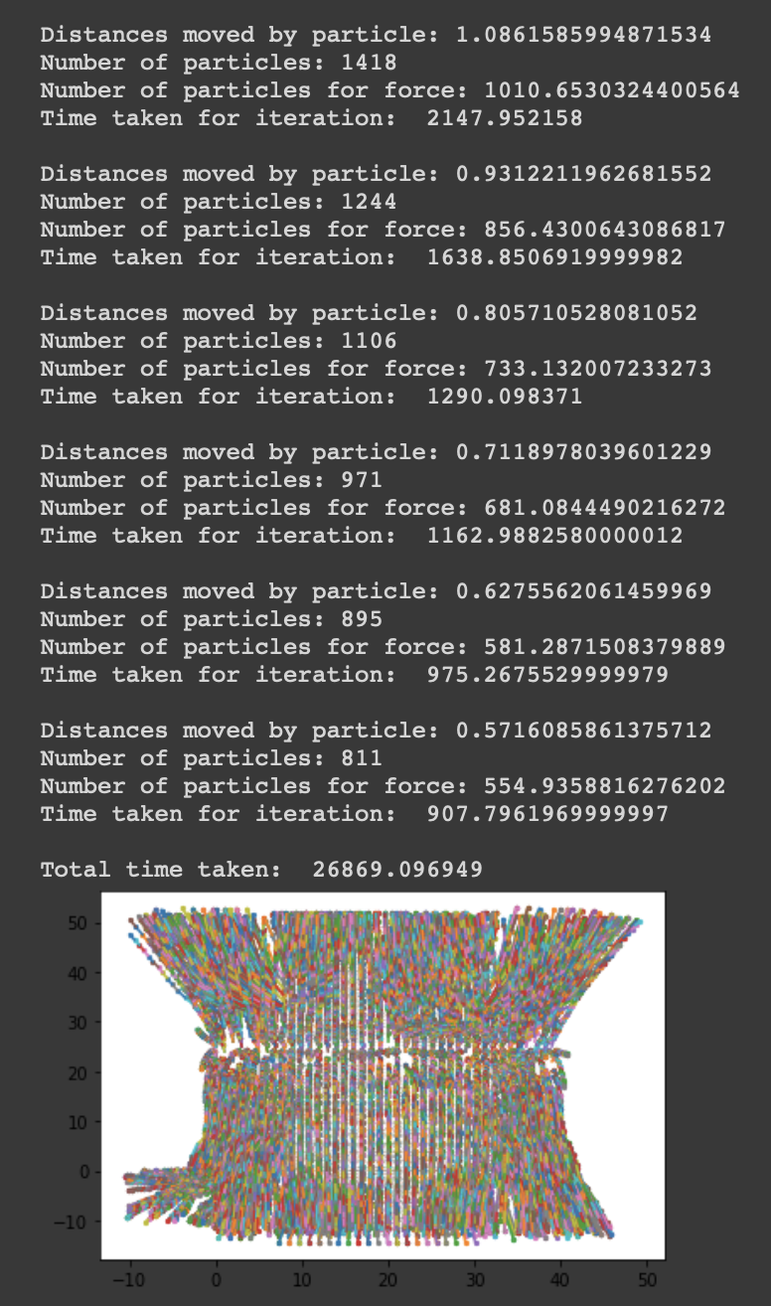
Improvements
Iterative process: We calculate position of the particles and force on the particles iteratively.
Observed convergence after a while, with particles moving lesser and lesser distance as the iterations progress.
As we can see, iteration drastically increases the time to get results. For 800 points the algorithm takes about 7 hours.
This makes speed improvements very important if we want this algorithm to be practical.

Slide 3
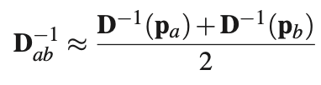
Speed Improvements
Pre-storing inverses of matrices with integer indices. This is used to compute the approximate inverses of matrices for the first few iterations.
In an iteration, we store the force between two particles once we calculate it. When we have to recalculate the force between two particles, we simply return the value.
Decreased the time for integration as the iterations progressed. The idea is that after some iterations, the particles will be close to their final positions and then we just have to fine tune it.
Approximate version of D_{ab}

Slide 4
Speed Improvements
Instead of assigning bins to particles at the start of every iteration, we do it on the fly as we calculate the positions of the particles after integration.
Vectorized Code
Rewrote all the functions to eliminate the use of for loops and instead used matrix multiplications to accomplish all the operations.
Drastically improved the time for computing the force on one particle due to all the other particles. 2x improvement in speed.

Slide 5
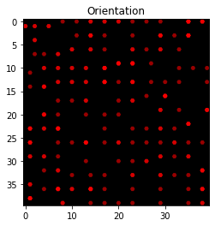
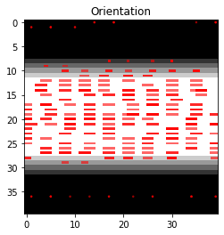
Results
Constant anisotropy of 1
Band of anisotropy = 25

Slide 6
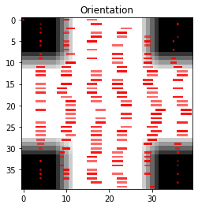
Results
Anisotropy = 25 on the bright regions

