Slide 1
WEB SECURITY SOLUTIONS
IWT PROJECT

Slide 2
GROUP DETAILS
MEMBERS :
ABHISHEK CHELAWAT 0801CS141004
ANUJ BHAI MEHTA 0801CS141013
ANUJ DUBEY 0801CS141014

Slide 3
1.
INTRODUCTION
Let’s start with the first set of slides

Slide 4
OVERVIEW
The concept of security applies to all information. Security relates to the protection of valuable assets against loss, disclosure, or damage. Valuable assets are the data or information recorded, processed, stored, shared, transmitted, or retrieved from an electronic medium.
The data or information must be protected against harm from threats that will lead to its loss, inaccessibility, alteration or wrongful disclosure. Hence, by this project, we aim to create a secure system which could be used in websites or which could be used to gain information about various threats and vulnerabilities or information regarding domain or network infrastructure.

Slide 5
SCOPE
The fact that integrating security solutions, may it be an additional layer of security using secure shell like HTTPS or the use of OTP / captchas are a difficult task to code along with
extra technical mainframe infrastructure that one has to establish has prevented organizations from investing into this field. By providing API’s for the above mentioned services, we will be creating a platform for all those entrepreneurs and organizations which lack the technicalities needed for creating a security system.

Slide 6
2.
FEATURES
Let’s start with the first set of slides

Slide 7
FEATURES
Easy to understand user Interface to enhance communication gap between user and system.
Different classes of users, like Computer Scientists, end users and administrators.
Network information groping utility integrated into the system to offer a one place destination for entire information.
Various domain scans available to retrieve data about dns.
Secret Message Sender using steganography.
Email Sending using Gmail’s SMTP Servers.
Facility to implement Flooding (Denial of Service Attack).
Various encryption methods available.
○ Chel’s Encryption
○ ABM Encryption.
○ Bey’s Encryption
○ MD5 (Message Direct Algorithm) Encryption

Slide 8
INTENDED USERS
There are four types of users that will be using this system:
1. Computer Scientists :-
They will have access to all the features of our system. Their main aim while using these utilities will be research, experimentation or other scientific purposes.
2. Administrator :-
They will have complete access to all the utilities and feature. Their main aim will be to manage and maintain the system.
3. End Users :-
They will have limited access. Features like arp scan and nmap will not be available to them. Their main aim when using these utilities will be to solve their problem or out of curiosity.
4. Computer programmers :-
They will have complete access of all the features. Their main aim while using these utilities will be to integrate these functionalities in their projects/ websites.

Slide 9
3.
REQUIREMENTS

Slide 10
FUNCTIONAL REQUIREMENTS
Simple Attacks :-
This module describes few of the most prevalent security attacks occurring over a network. Attacks mentioned here includes Denial of service, distributed Denial of service, flooding etc.
Steganography:-
Steganography is the practice of concealing a file, message, image, or video within another file, message, image, or video.
The advantage of steganography over cryptography alone is that the intended secret message does not attract attention to itself as an object of scrutiny. Plainly visible encrypted messages—no matter how unbreakable—arouse interest, and may in themselves be incriminating in countries where encryption is illegal.

Slide 11
FUNCTIONAL REQUIREMENTS
Recaptcha :
reCAPTCHA is a CAPTCHA -like system designed to establish that a computer user is human (normally in order to protect websites from bots ) and, at the same time, assist in the digitization of books. The reCAPTCHA service supplies subscribing websites with images of words that are hard to read for optical character recognition (OCR) software. The reCAPTCHA tests are displayed from the central site of the reCAPTCHA project, which
supplies the words to be deciphered. This is done through a JavaScript API with the server making a callback to reCAPTCHA after the request has been submitted.
Encryption :
Encryption is the process of encoding messages or information in such a way that only authorized parties can access it. Encryption does not of itself prevent interference, but denies the intelligible content to a would-be interceptor.

Slide 12
NON-FUNCTIONAL REQUIREMENTS
Performance requirement :-
The system can provide ease both at admin level or local level
and focus on program logic so that the task is done in systematic, efficient and in quantifiable approach.
Availability :-
The system should be available at all times, meaning the user can access it using a web browser, only restricted by the down time of the server on which the system runs. A customer friendly system which is in access of people around the world should work 24
hours. In case of a of a hardware failure or database corruption, a replacement page will be shown.
Security Requirement :-
The system use SSL (secured socket layer) in all transactions that include any confidential customer information. The system must automatically log out all customers after a period of inactivity

Slide 13
NON-FUNCTIONAL REQUIREMENTS
Maintainability:
A commercial database is used for maintaining the database and the application server takes care of the site. In case of a failure, a re-initialization of the project will be done. Also the software design is being done with modularity in mind so that maintainability can be done efficiently.
Portability:
The system is developed for secured purpose, so it is can’t be portable.
Reliability :-
The reliability of the overall project depends on the reliability of the separate components. The main pillar of reliability of the system is the backup of the database which is continuously maintained and updated to reflect the most recent changes

Slide 14
SCREENSHOTS
A PICTURE IS WORTH A THOUSAND WORDS

Slide 15
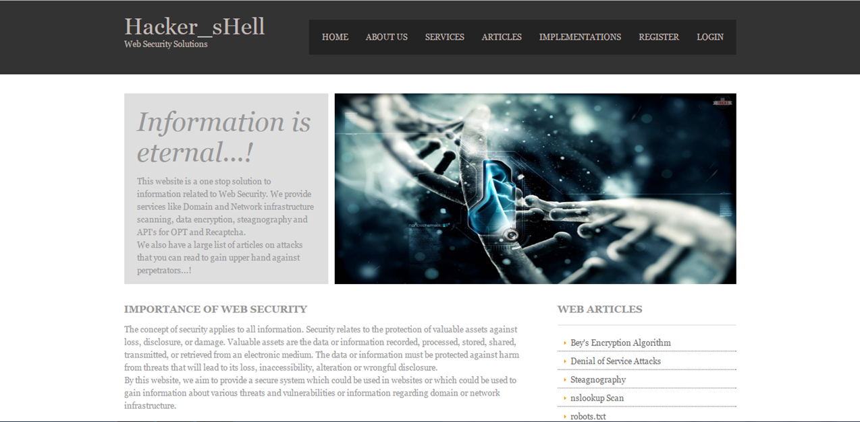
HOME PAGE

Slide 16
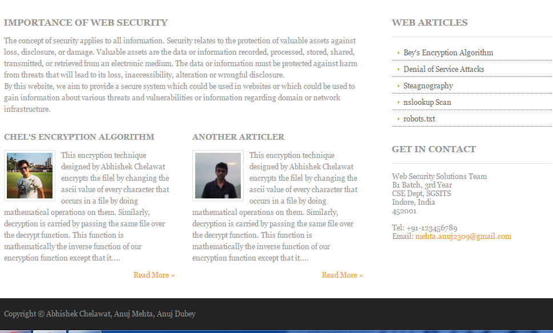
HOME PAGE

Slide 17
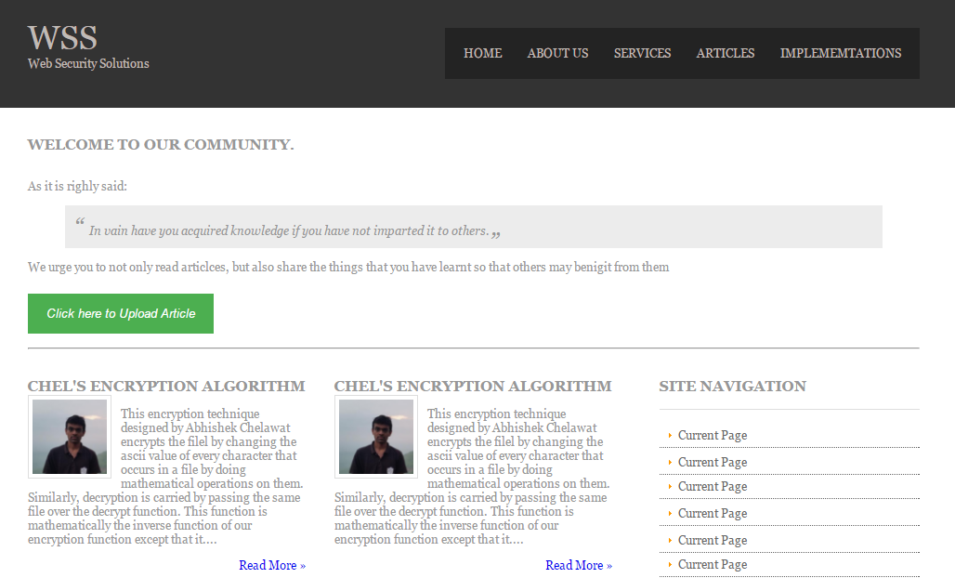
ARTICLES

Slide 18
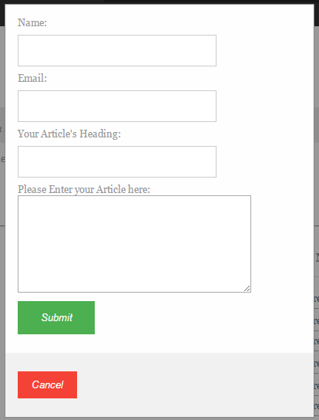
LOGIN

Slide 19
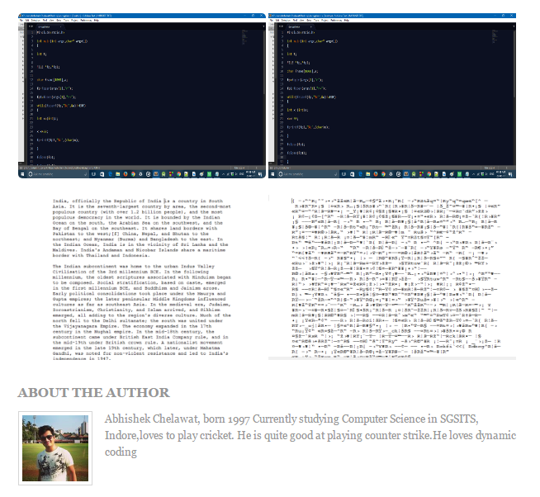
ENCRYPTION

Slide 20
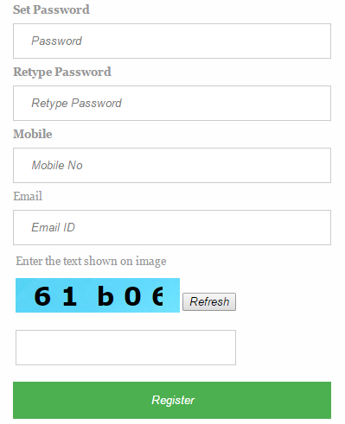
RECAPTCHA

Slide 21
THANKS!
Any questions?
You can find me at abhishek.chelawat@gmail.com

