Slide 1




Risk Mapping Dashboard: From text
to Spatial Mapping
MOOD Summer School 2023
Mehtab Alam SYED
CIRAD, UMR TETIS, France
mehtab-alam.syed@cirad.fr
This project has received funding from the European Union's Horizon Europe research and innovation programme under Grant Agreement No.874850

Slide 2

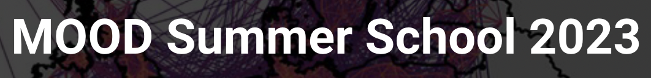
Context – Text Mining
Text Mining:
process of transforming unstructured text into structured
Format to identify meaningful patterns and new insight.
NLP
IE
IR
CL
Natural
language
Processing
Information
Extraction
Information
Retrieval
Clustering
This project has received funding from the European Union's Horizon Europe research and innovation programme under Grant Agreement No.874850

Slide 3
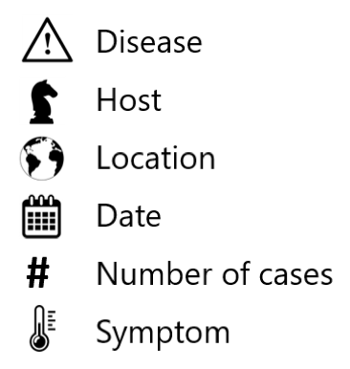

Context – Spatial Information
Spatial
Event
Thematic
Temporal
This project has received funding from the European Union's Horizon Europe research and innovation programme under Grant Agreement No.874850

Slide 4
Excercise
Exercise:
Explore the transformation of the Avian-Influenza article dataset into an Insightful Geographical Information Dashboard?
Steps:
Primary focus on extracting location data from the articles content (text) to uncover
geographic trends.
Visualizations include word cloud, top 10 countries, heatmaps, map clusters,
choropleth maps, and time-series heatmaps.
To achieve:
Emphasize understanding the global impact of Avian Influenza outbreaks.
Uncover valuable insights and facilitate a comprehensive overview of the distribution
of events.
Practical (to-do):
Gain practical experience in location extraction, data transformation, and creating visually informative dashboard.
This project has received funding from the European Union's Horizon Europe research and innovation programme under Grant Agreement No.874850

Slide 5


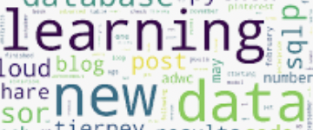
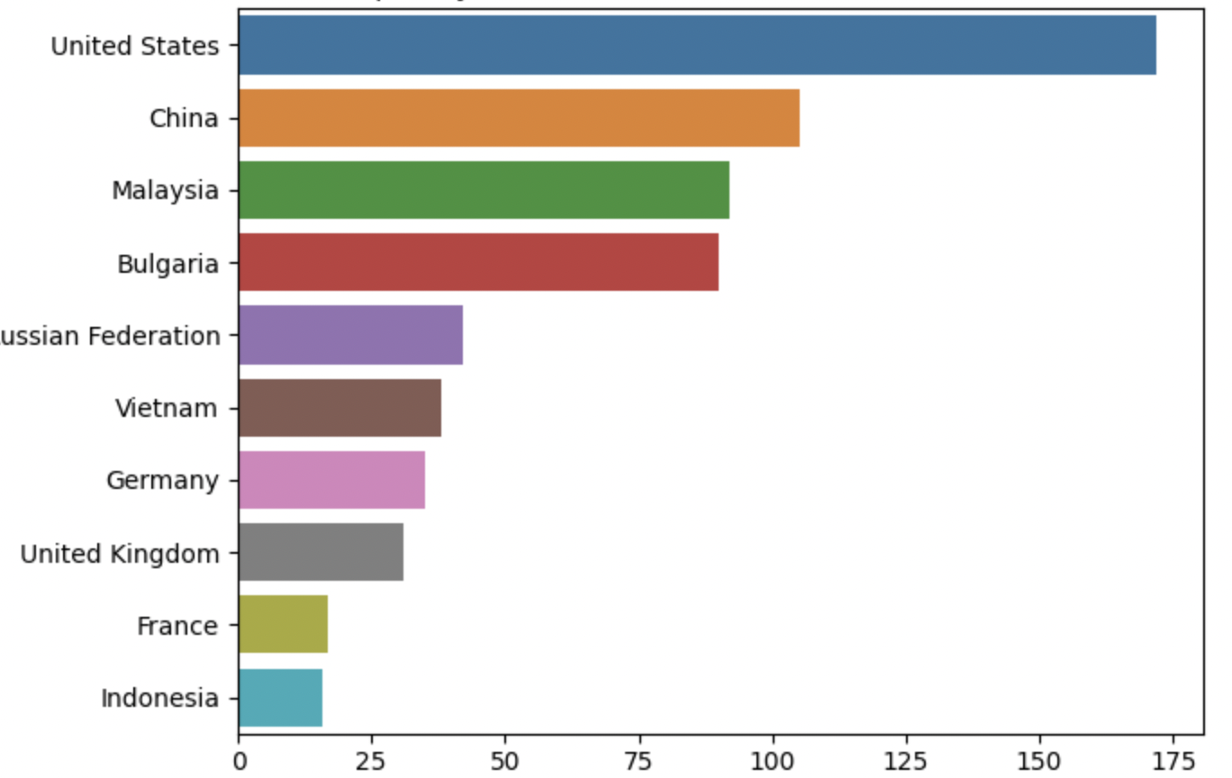
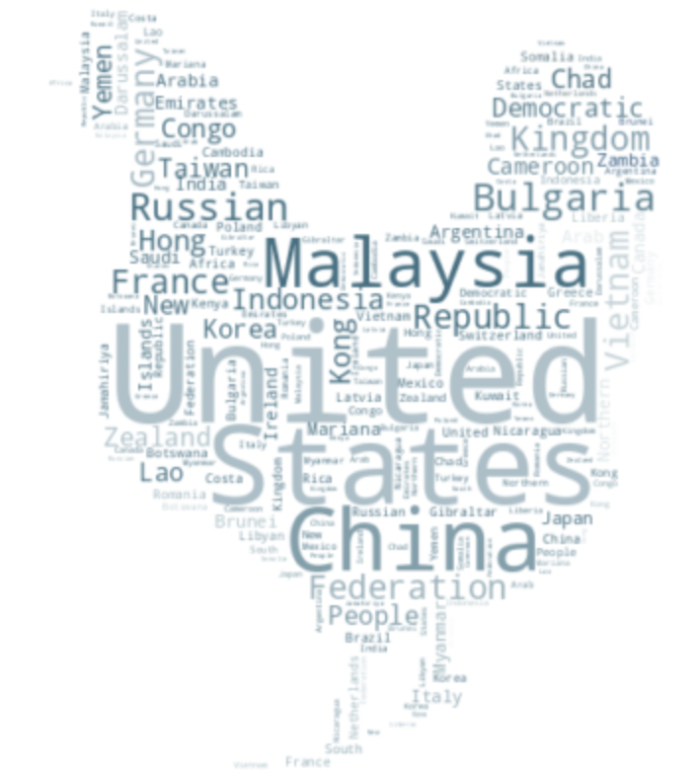

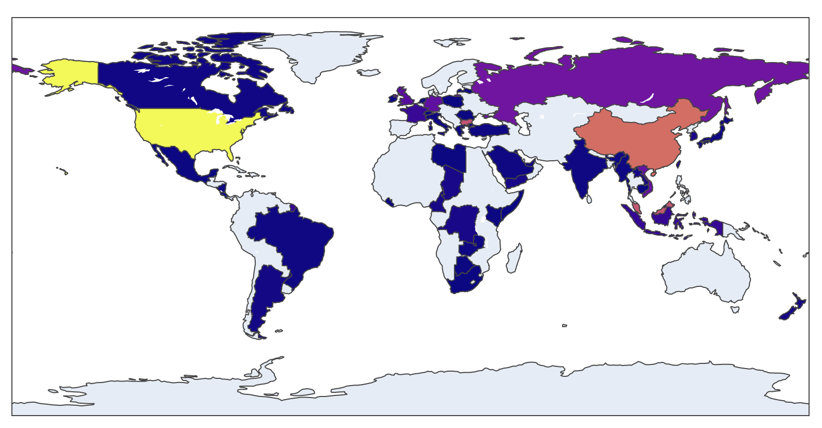
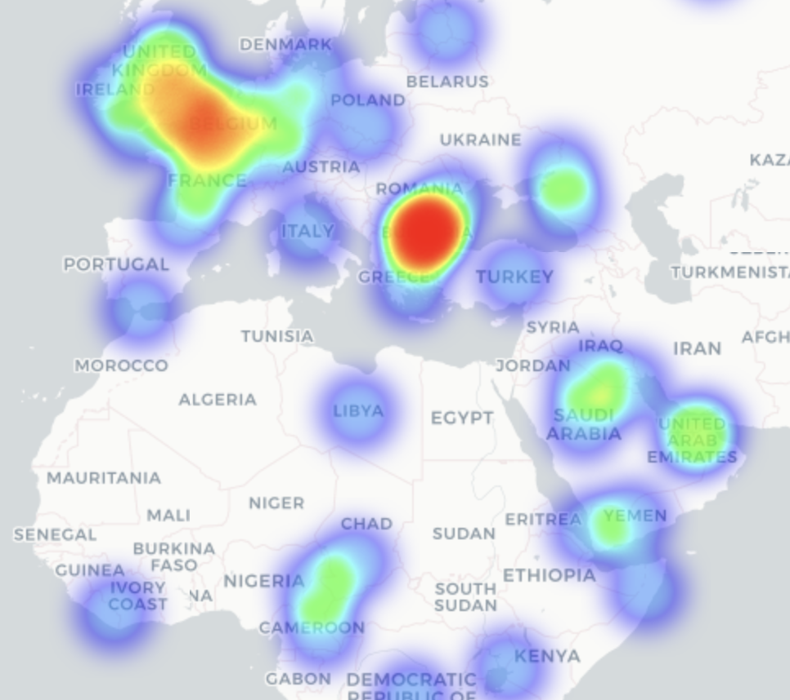
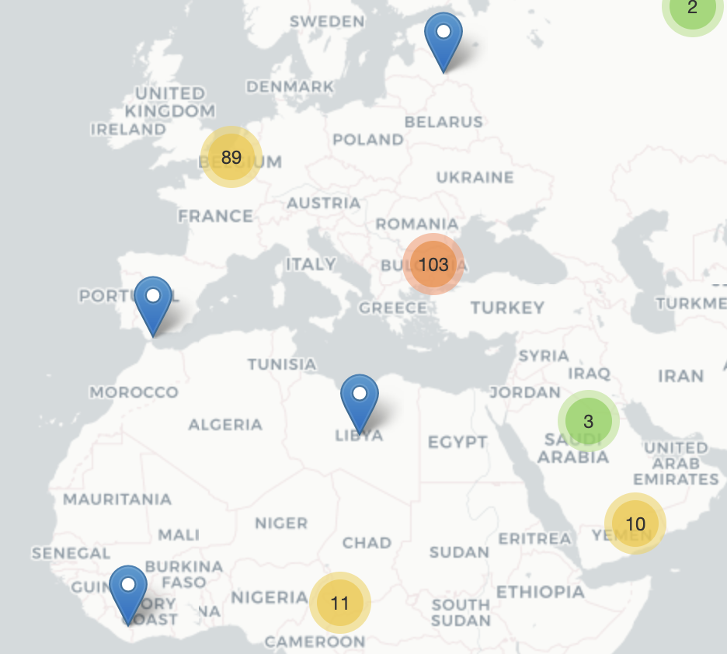





Excercise: Spatial Information Dashboard
Data Processing
Location Extraction
(Lat, lng) geocoding
Country Identification
Data manipulation
Dataset
This project has received funding from the European Union's Horizon Europe research and innovation programme under Grant Agreement No.874850

Slide 6
Practical Session
Practical Session Demo: Practical Demo
Let’s Start ;-) :
Google Colab Notebook: Create Empty Notebook
This project has received funding from the European Union's Horizon Europe research and innovation programme under Grant Agreement No.874850

