Slide 1

NORTHWIND TRADERS
Sales, Customer Behavior, and Employee Performance Analysis
Presented by: Mehtab Alam

Slide 2

Overview: Northwind Traders is a global supplier of specialty foods, importing and exporting products worldwide. The company deals with a diverse customer base and operates through multiple product categories and suppliers. To stay competitive in the wholesale market, it is crucial to analyze key performance metrics such as sales performance, customer behavior, inventory management, and employee performance.

Slide 3

Objective : The goal is to provide a comprehensive, user-friendly dashboard that delivers insightful analytics on:
Sales trends and patterns.
Customer segmentation.
Inventory management.
Employee performance.
Expected Impact:
Empower stakeholders to make data-driven decisions.
Facilitate better business operations and strategic planning.
Enhance competitive edge in the market.

Slide 4
Table | Description
Customers | Information about customers, including contact details, address, city, region, and country.
Employees | Employee details such as names, titles, hire date, and their reporting structure.
Orders | Order-specific data, including order dates, customer and employee IDs, shipping details, and freight costs.
Order Details | Specifics about products ordered, including product ID, unit price, quantity, and discount.
Products | Details about products such as name, category, price, stock, and reorder level.
Suppliers | Information about suppliers, including contact information and location.
Shippers | Shipping company details such as names and contact information.
Categories | Product categories with names and descriptions.
:

Slide 5
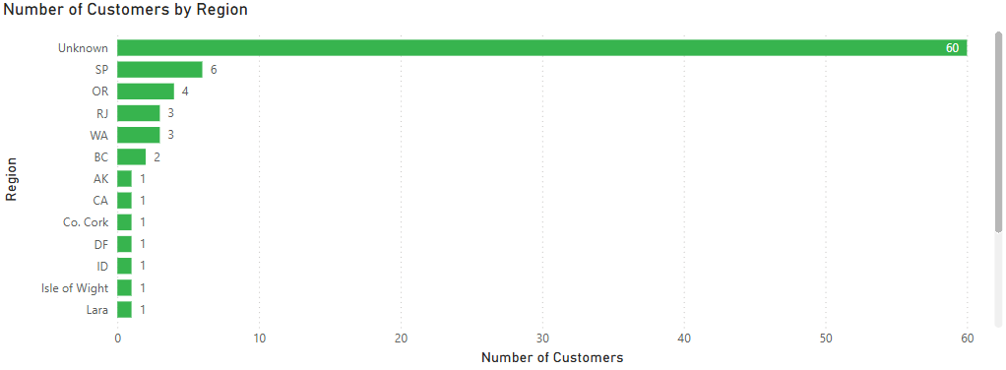
POWER BI
How does customer distribution vary across different regions or customer segments? Can we visualize it on a map or bar chart?
The data indicates that the largest segment of customers (60) are from unknown regions, as they did not provide their region details. This is followed by customers from SP, OR, RJ, and other regions.

Slide 6
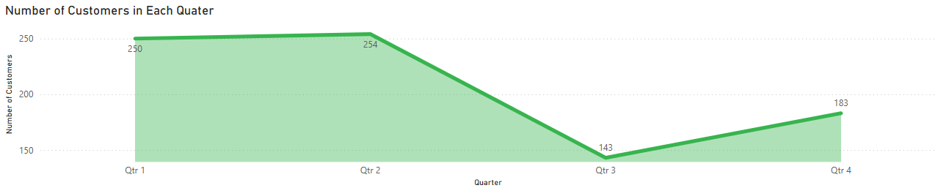
What is the trend in customer acquisition over time? Can we create a line chart or area chart to display it?
The data shows that customer acquisition begins to drop from Quarter 2, reaches its lowest point in Quarter 3, and then gradually increases from Quarter 3 to Quarter 4.

Slide 7
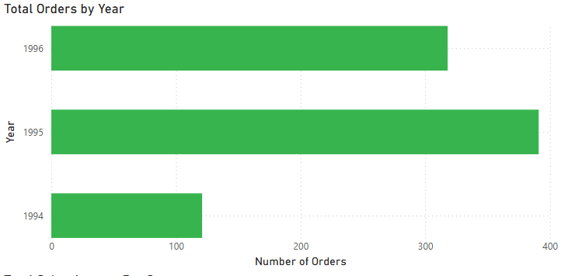
How does order volume change over time? Can we create a time series chart or stacked bar chart to visualize it?
The visual indicates that the highest number of orders was recorded in the year 1995, whereas the lowest number was observed in 1994.

Slide 8
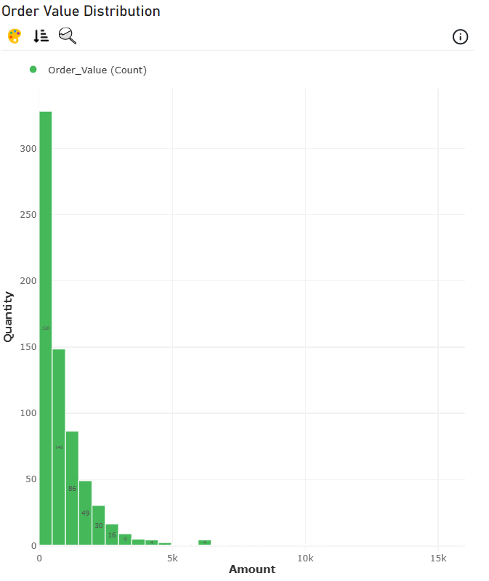
What is the distribution of order values? Can we create a histogram or box plot to display it?
The chart shows that the highest number of products (328) were sold within the value range of 0–500. In contrast, in the highest value range (6000–6500), only 4 products were sold.

Slide 9
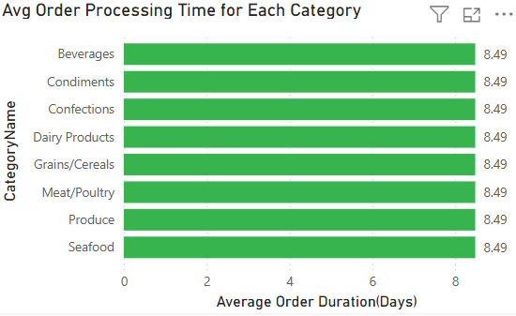
Can we visualize the average order processing time or shipping duration using a bar chart or box plot?
Here we can clearly see that the average Order Processing Time for every category is 8.49 Days

Slide 10
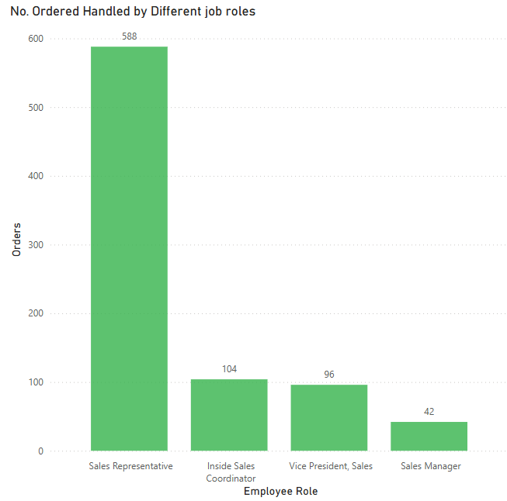
How does employee productivity vary across different departments or job roles? Can we create a stacked bar chart or grouped column chart to visualize it?
The visual representation shows that the most number (588) of orders were handled by the Sales Representatives team and the least number of order (42) were handled by Sales Mangers

Slide 11
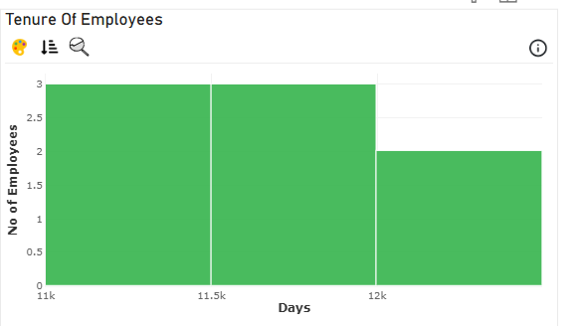
What is the distribution of employee tenure? Can we create a histogram or box plot to display it?
This visual representation clearly indicates that a total of five employees have worked between 11,000 and 12,000 days, while two employees have worked for over 12,000 days.

Slide 12
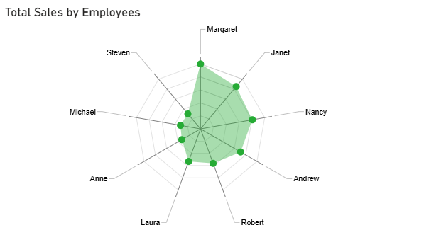
Can we visualize employee performance ratings or KPIs using a radar chart or bullet graph?
For the KPIs, I have used the total order amount handled by each employee.
It is observed that Margaret handled the highest order amount, while Steven handled the lowest.

Slide 13
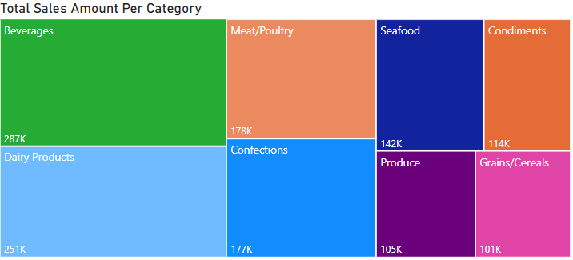
How does the sales volume vary across different product categories? Can we create a bar chart or treemap to display it?
The TreeMap chart indicates that the highest sales were achieved by the Beverages category (287K), while the lowest sales were recorded in the Grains/Cereals category (101K).

Slide 14
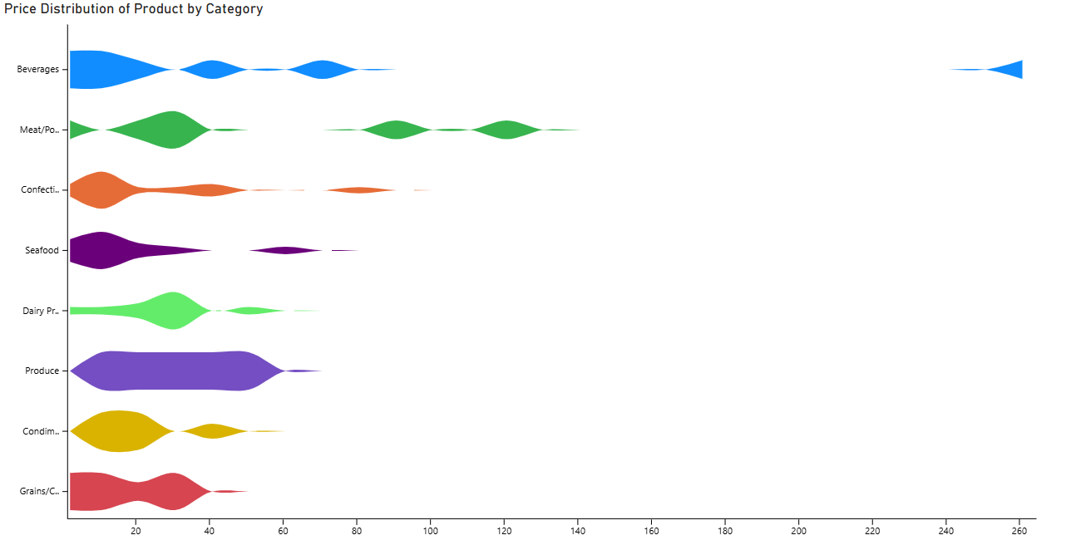
Can we visualize the pricing distribution of products using a box plot or violin plot.
The violin plot visually compares the price distribution across product categories. For example, the "Produce" category shows a broader and more irregular price distribution (wider violin shape) compared to "Confectionery," which has a narrower and more concentrated price range (thinner violin shape). This indicates greater price variability in "Produce" than in "Confectionery."

Slide 15
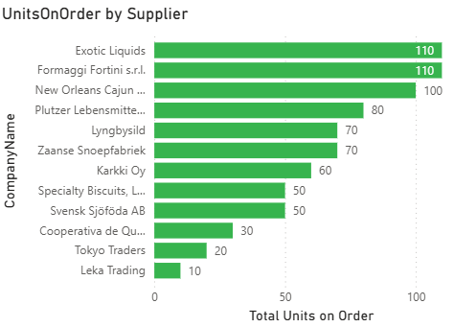
What is the distribution of supplier ratings or performance metrics? Can we create a bar chart or radar chart to visualize it?
For Performance metrices I have taken the numbers of units on order from each supplier.
In the bar graph it is clearly visible that the Exotic liquids and Formaggi Fortini has highest number of units on order

Slide 16
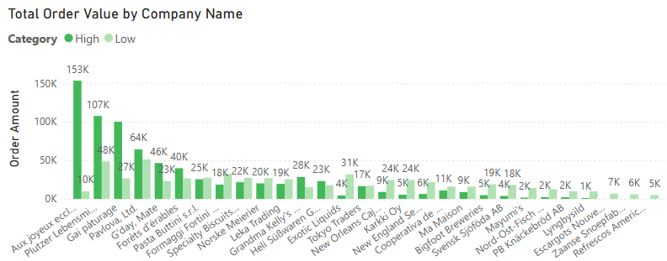
How does the cost or pricing structure vary across different suppliers? Can we create a box plot or stacked bar chart to display it?
In the column chart, it is evident that Aux joyeux ecclésiastiques, Plutzer Lebensmittelgroßmärkte AG, Gai pâturage, Pavlova Ltd., and G'day, Mate are the top five suppliers based on order value. For Aux joyeux ecclésiastiques, approximately 153K of the total order value comes from high-priced products (valued above 1000), while only 10K is contributed by products priced below 1000.

Slide 17
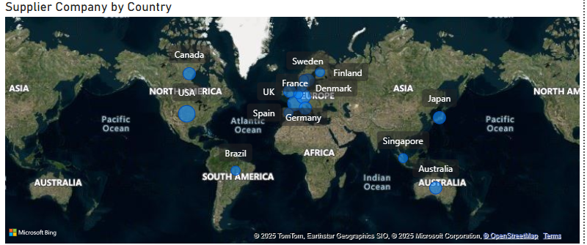
Can we visualize the geographical distribution of suppliers using a map or bubble chart?
From the map chart it is visible that most of the suppliers are European nations

Slide 18
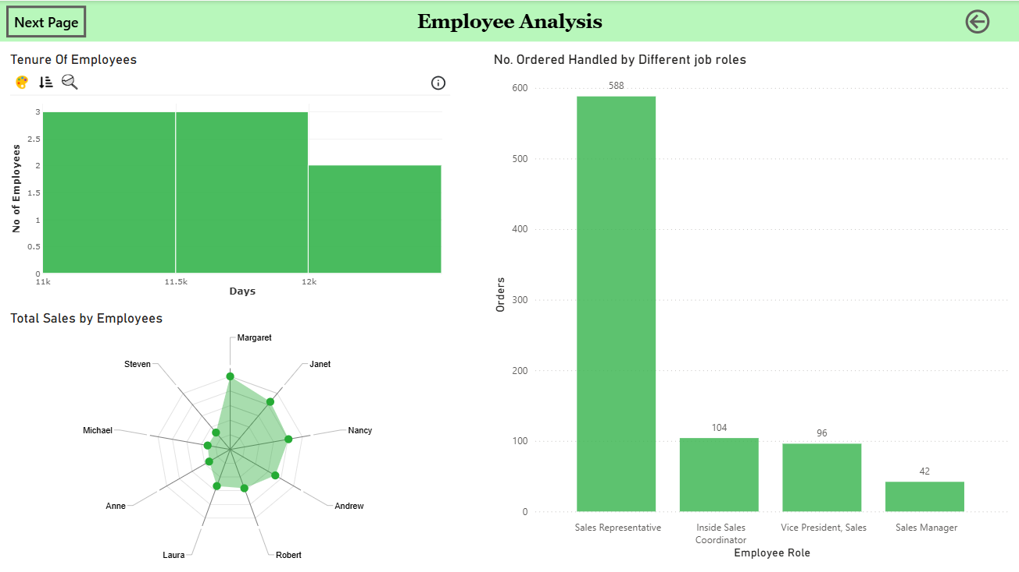

Slide 19
EXCEL
What are the key factors influencing customer retention or loyalty based on the dataset?
SELECT
CustomerID,
COUNT(OrderID) AS TotalOrders,
MIN(OrderDate) AS FirstOrderDate,
MAX(OrderDate) AS LastOrderDate
FROM
Orders
GROUP BY
CustomerID
ORDER BY
TotalOrders DESC;
CustomerID | TotalOrders | FirstOrderDate | LastOrderDate
SAVEA | 31 | 11/8/1994 0:00 | 5/31/1996 0:00
ERNSH | 30 | 8/17/1994 0:00 | 6/4/1996 0:00
QUICK | 28 | 9/5/1994 0:00 | 5/14/1996 0:00
FOLKO | 19 | 8/24/1994 0:00 | 5/27/1996 0:00
HUNGO | 19 | 10/6/1994 0:00 | 5/30/1996 0:00
HILAA | 18 | 8/16/1994 0:00 | 5/28/1996 0:00
RATTC | 18 | 8/22/1994 0:00 | 6/5/1996 0:00
From the given observation it is clear that the highest number of orders (31) are done under the CustomerID “SAVEA” between 1994 and 1996

Slide 20
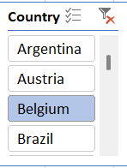
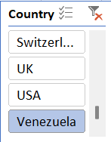
How do customer preferences vary based on their location or demographics? Can we explore this through interactive visualizations?
WITH Data AS (
SELECT
C.Country,
CC.CategoryName,
COUNT(O.OrderID) AS Total
FROM customers C
INNER JOIN orders O ON C.CustomerID = O.CustomerID
INNER JOIN order_details D ON D.OrderID = O.OrderID
INNER JOIN products P ON D.ProductID = P.ProductID
INNER JOIN categories CC ON P.CategoryID = CC.CategoryID
GROUP BY C.Country, CC.CategoryName
)SELECT
Country,
CategoryName,
Total From Data;
The chart clearly shows that the demand for products varies across countries. For example, Belgium is the highest consumer of products in the Confections category, whereas in Venezuela, the most ordered product category is Dairy Products.

Slide 21
Are there any interesting patterns or clusters in customer behavior that can be visualized to identify potential market segments?
select COALESCE(C.Region, 'Unknown') AS Region,Count(distinct O.OrderID) as Total_Customers,Round(SUM(D.UnitPrice*D.Quantity*(1-D.Discount)),0) as Total_Amount,
Round(AVG(D.UnitPrice*D.Quantity*(1-D.Discount)),0) as Average_Amount
from customers C inner join orders O
on C.CustomerID=O.CustomerID inner join order_details D
ON O.OrderID=D.OrderID
group by 1
order by 2 desc, 2 desc;
Considering the total amount, total number of customers, and average sales amount across different geographic regions, no discernible patterns emerge. For instance, the highest total sales are associated with moderate average sales amounts.

Slide 22
Are there any specific product categories or SKUs that contribute significantly to order revenue? Can we identify them through visualizations?
select C.CategoryName,SUM(D.UnitPrice*D.Quantity)as Revenue
from categories C inner join products P
ON P.CategoryID=C.CategoryID inner join order_details D
ON P.ProductID=D.ProductID
group by 1
The given visualization shows that the highest revenue is generated by Beverages while the lowest revenue making category is Grains/Cereals

Slide 23
Are there any correlations between order size and customer demographics or product categories? Can we explore this visually using scatter plots or heatmaps?
select C.CategoryID,count(D.OrderID) as Total_Ordere
from categories C inner join products P
ON C.CategoryID=P.CategoryID inner join order_details D
ON P.ProductID=D.ProductID
group by 1
As for product categories CategoryID is taken and total order for each id is calculated, and from the graphical representation it is clear that as the categoryID increases the number of order decreases.

Slide 24
How does order frequency vary across different customer segments? Can we visualize this using bar charts or treemaps?
Select C.Country,Count(O.OrderID) as Total_Orders
from Customers C inner join orders O
ON C.CustomerID=O.CustomerID
group by 1
order by 2 desc;
The given visualization states that Customers from Germany and USA orderd the most product respectively followed by Brazil,Framce and UK.

Slide 25
How does employee turnover vary across different departments or job roles? Can we visualize this using bar charts or heatmaps?
select E.Title,round(sum(D.UnitPrice*D.Quantity),0) as Turnover
from employees E inner join orders O
on E.EmployeeID=O.EmployeeID inner join order_details D
on O.OrderID=D.OrderID
group by 1
order by 2 desc;
The given data shows that the highest turnover (967841) was recorded under the title of Sales Representative.

Slide 26
Can we identify any patterns or clusters in employee skill sets or qualifications through visualizations? How can this information be used for talent management?
select E.FirstName,CASE
WHEN E.Notes LIKE '%Ph.D.%' THEN 'Ph.D.'
WHEN E.Notes LIKE '%MBA%' THEN 'MBA'
WHEN E.Notes LIKE '%MA%' THEN 'MA'
WHEN E.Notes LIKE '%BA%' THEN 'BA'
WHEN E.Notes LIKE '%BS%' THEN 'BS'
WHEN Notes LIKE '%BSC%' THEN 'BSC'
ELSE 'Unknown'
END AS Degree,count(O.OrderID) as total_orders
from employees E inner join orders O
ON E.EmployeeID = O.EmployeeID
group by E.FirstName,2
order by 3 desc;
The given Observations states that the Employees holding MA degree is responsible for highest number of order count followed by Employee with BA degree.

Slide 27
How does product demand fluctuate over different seasons or months? Can we visualize this through line charts or area charts?
select MONTHNAME(O.OrderDate) as Months,Sum(P.UnitsOnOrder) as OrderedUnits
from orders O inner join order_details D
ON O.OrderID=D.OrderID inner join products P
on D.ProductID=P.ProductID
group by 1
order by 2 desc;
The Given Chart shows that after April the number of order begins to drop and becomes lowest somewhere around July then again from August it starts to climb slowly and gains the highest around the month of February.

Slide 28
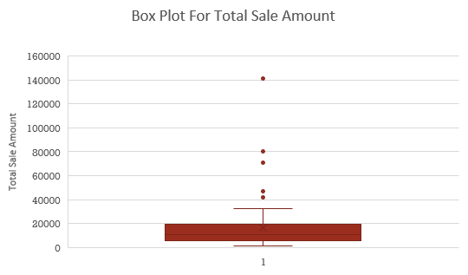
Can we identify any outliers or anomalies in product performance or sales using visualizations? How can this information be used for product optimization?
select P.ProductName,Count(Distinct D.OrderID) as Total_Count,Round(sum(D.UnitPrice*D.Quantity*(1-D.Discount)),0) as Total_Sales_Amount
from products P inner join order_details D
on P.ProductID=D.ProductID
group by 1;
The Given information shows that Sale Value of 41820,46825,71156,80369 141347 is a outlier .Successful products can be optimized through better marketing, improving distribution, and offering more options to customers.

Slide 29
Are there any correlations between supplier attributes (e.g., location, size, industry) and performance metrics (e.g., on-time delivery, product quality)? Can we explore this visually through scatter plots or heatmaps?
select S.Country,Sum( P.ReorderLevel) as Total_Order_Products
from suppliers S inner join products P
ON S.SupplierID=P.SupplierID inner join order_details D
on P.ProductID=D.ProductID inner join orders O
on O.OrderID=D.OrderID
group by 1;
The Chart and data shows that Suppliers from the Country of Germany,USA,Italy ,Australia and UK are the top 5 suppliers in number of reorder products while Brazil is the only country with 0 reorder products.

Slide 30
How does supplier performance vary across different product categories or departments? Can we visualize this using stacked bar charts or grouped column charts.
select C.CategoryName,ROUND(AVG(datediff(O.ShippedDate,O.OrderDate)),0) as average_Ship_Time
from categories C inner join Products P
ON C.CategoryID = P.CategoryID inner join order_details D
ON P.ProductID=D.ProductID inner join orders O
ON O.OrderID=D.OrderID
group by 1
order by 2 desc
The given visual representation shows that the supplier took at an average of 9 days to ship products under the category of Beverages , Condiments and Confections while it took only 7 days to ship the product under the categroy of Produce.

Slide 31
Can we identify any trends or patterns in supplier costs or pricing structures through visualizations? How can this information be used for procurement optimization?
select S.SupplierID,Round(Sum(D.UnitPrice*D.Quantity*(1-Discount)),0) as Total_Sales_Amount,Count(distinct O.OrderID) as Total_Orders,
Round(Sum(O.Freight),0) as Transport_Cost,Round(Sum(O.Freight)/ Sum(D.UnitPrice*D.Quantity*(1-Discount))*100,2) as percent
from suppliers S inner join products P
ON S.SupplierID=P.SupplierID inner join order_details D
ON D.ProductID=P.ProductID inner join orders O
ON D.OrderID=O.OrderID
group by 1
order by 2 desc;
From the observation, it is clear that as the total sales amount increases, the transportation cost share also increases. However, SupplierID 18 stands out, as it has the highest recorded sales but a very low transportation cost share, approximately 6%.

Slide 32
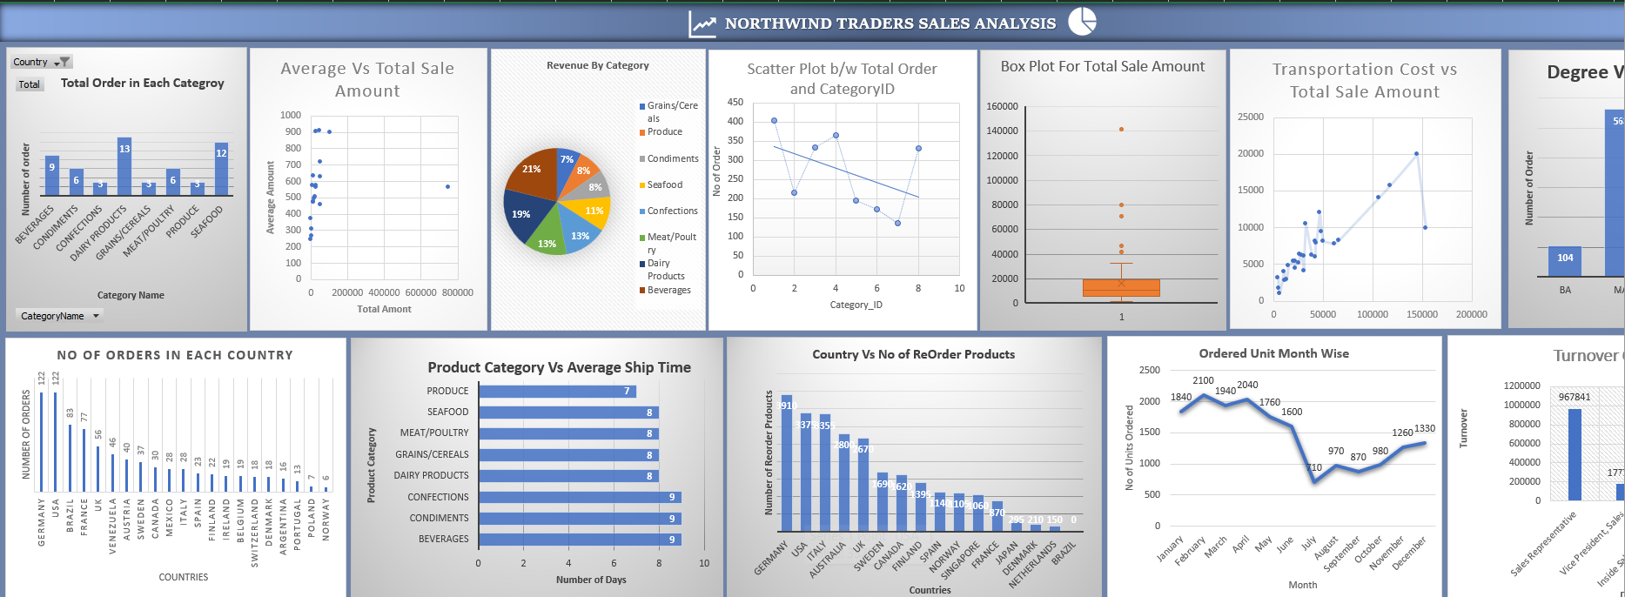
EXCEL DASHBOARD

Slide 33

THANK YOU

