Slide 1
euneva
Group 9
Jash Mehta
Aditya Sharma
Zackary Ren

Slide 2
Purpose
We improved upon an existing web application for a To-Do list, adding an implementation to web scrape Avenue to Learn (A2L) for quizzes and assignment information for current courses and displaying it in a organized manner.
Scope
The backend web-scraping is done through Python.
The frontend web application is made with React.

Slide 3
Background
Stakeholders
Students
Professors
Existing Implementation

Slide 4
Current Implementation
Functionality Added
Login.
Collect Current Courses.
Collect Assignment Information.
Collect Quiz Information.
Filter Information for upcoming/incomplete tasks.
Display Information in GUI

Slide 5
Software Qualities and Verification
Quality | Test Rating- Out of 5
User-friendliness | 4 – Even though a user guide is not presented, the application is very easy to navigate through and understand.
Portability | 5 – The usage of React to implement the frontend allows the application to be very portable making it usable on devices with HTML Support.
Performance | 5 – The performance of the web application is very smooth, the web-scraping however depends on the performance of A2L.
Usability | 5 – The application is very effective at collecting and displaying the information in an organized manner.

Slide 6
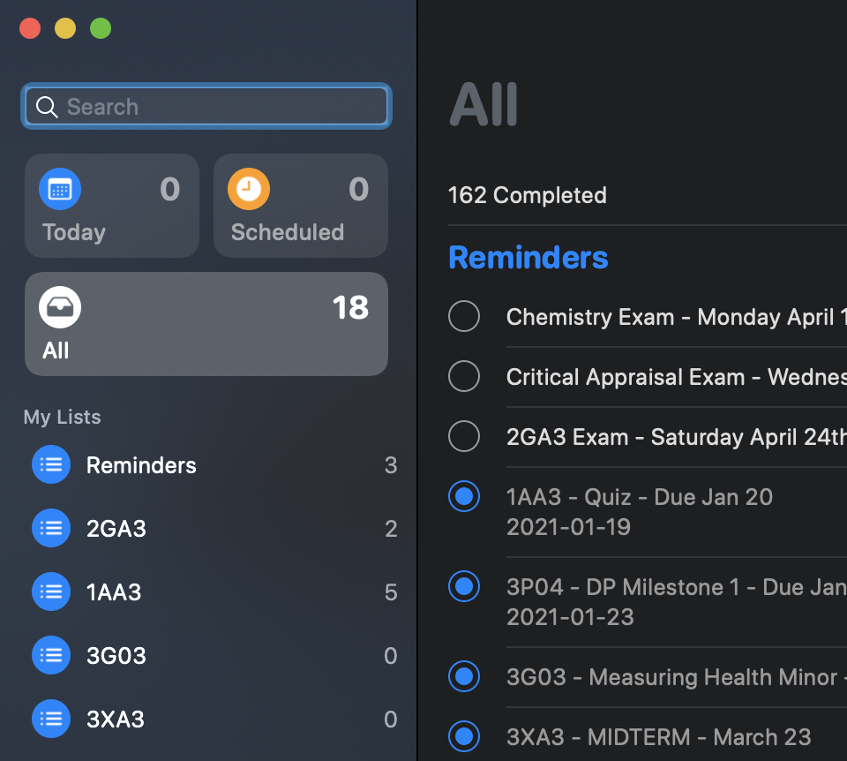
Next Features
Search Bar to find particular items
Adding users (login, sign up) rather than putting in information each time.
Grouping into “Today”, “Scheduled”, “All”, and “Courses”.

Slide 7
Questions?

