Slide 1
Exploratory Data Analysis
Large-Scale Retail Transaction Data
NextHikes IT Solutions • 100,000 transactions across 18 variables
Univariate • Bivariate • Multivariate Analysis | Outlier Detection | Correlation Study

Slide 2
Project Objective
Perform a complete exploratory analysis of retail transaction data to understand variable distributions, detect anomalies, measure relationships, and extract insights that are grounded in the actual data.
1
Univariate, bivariate & multivariate analysis
2
Outlier detection using IQR method
3
Correlation study across numerical variables
4
Skewness & kurtosis interpretation
5
Business insights validated against real data
Retail Transaction EDA | 2

Slide 3
Dataset Overview
100,000
18
0
0
Rows
Columns
Missing Values
Duplicate Rows
Data quality check (df.info() / df.head())
All 18 columns fully populated across 100,000 rows with correct data types — no imputation or row removal required. Date range (order_date): 1 Jan 2023 – 30 Dec 2025.
Numerical: age, product_price, quantity, discount_percentage, final_price, delivery_days
Categorical: gender, city, state, customer_segment, product_category, product_subcategory, payment_method, shipping_type, return_status
Retail Transaction EDA | 3

Slide 4
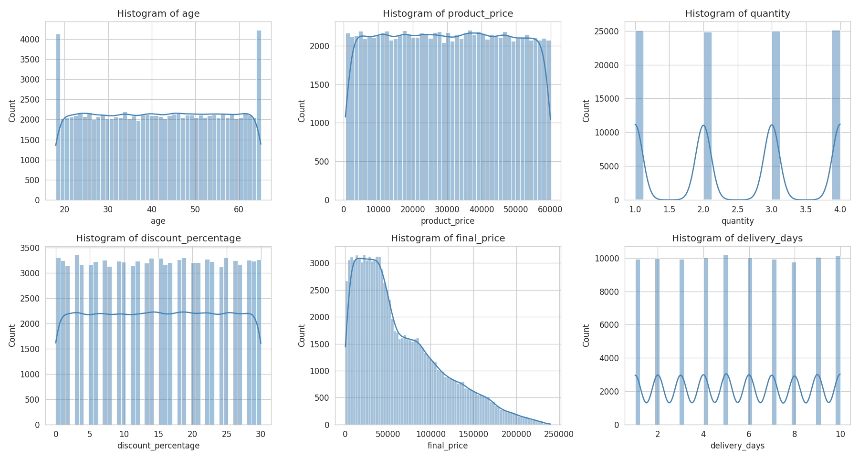
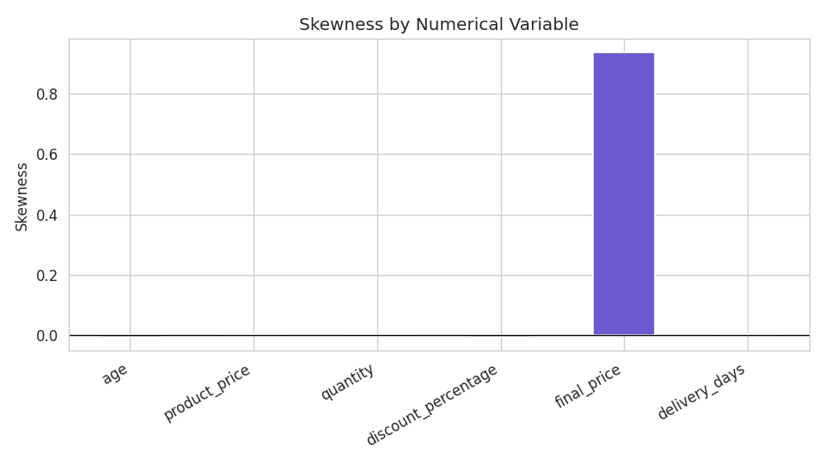
Univariate Analysis — Numerical Variables
Variable | Skew | Kurt
age | -0.01 | -1.20
product_price | 0.00 | -1.20
quantity | 0.00 | -1.37
discount_% | 0.00 | -1.20
final_price | 0.94 | 0.17
delivery_days | 0.00 | -1.22
Only final_price is meaningfully skewed — a mathematical result of combining price × quantity × (1 − discount).
Retail Transaction EDA | 4

Slide 5
Univariate Analysis — Categorical Variables
Overall Return Rate: 14.81% — closely matching the ~15% expected in the project brief.
Customer segments are almost evenly split (New 33.5% | Regular 33.4% | Premium 33.2%), and payment methods are similarly balanced — no segment or method dominates.
Retail Transaction EDA | 5

Slide 6
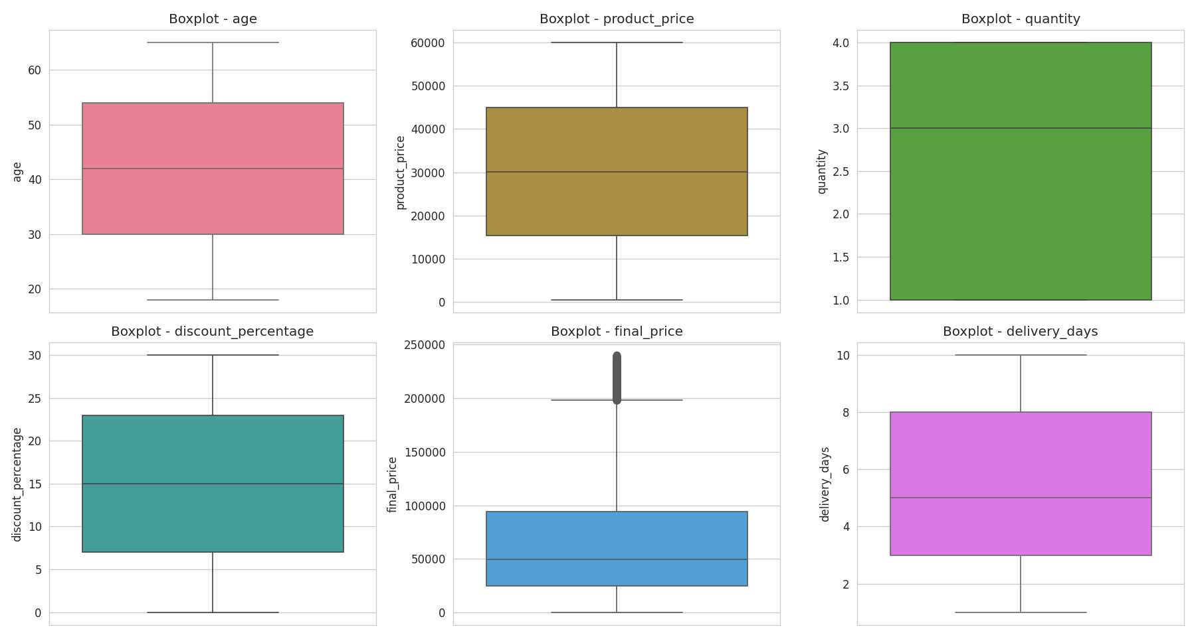
Outlier Detection using IQR Method
Variable | IQR Outliers
age | 0
product_price | 0
quantity | 0
discount_% | 0
final_price | 1,335
delivery_days | 0
Outliers appear only in final_price (~1.3% of orders). These are consistent with high-value transactions from combinations of higher prices, larger quantities, and lower discounts — retained rather than removed, since they may represent valid large purchases.
Retail Transaction EDA | 6

Slide 7
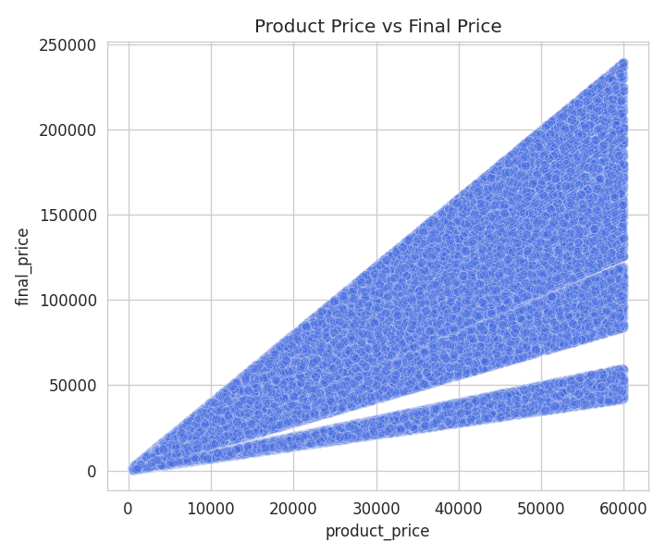
Correlation with Final Price
product_price has the strongest positive association with final_price (r = 0.731), followed by quantity (r = 0.575). discount_percentage shows only a weak negative association (r = -0.137).
Retail Transaction EDA | 7

Slide 8
Bivariate Insights
Premium customers spend marginally more (+1.1% vs New), and return rates stay within a tight 14.5–15.1% band across categories — Electronics, expected to have higher returns, actually has the lowest.
Retail Transaction EDA | 8

Slide 9
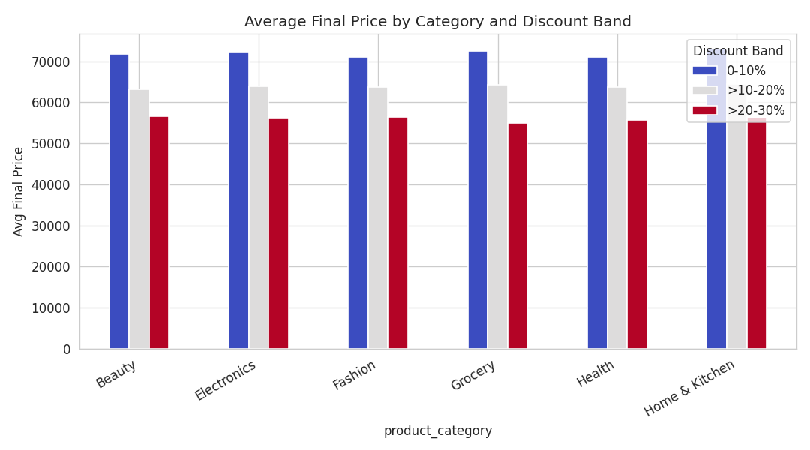
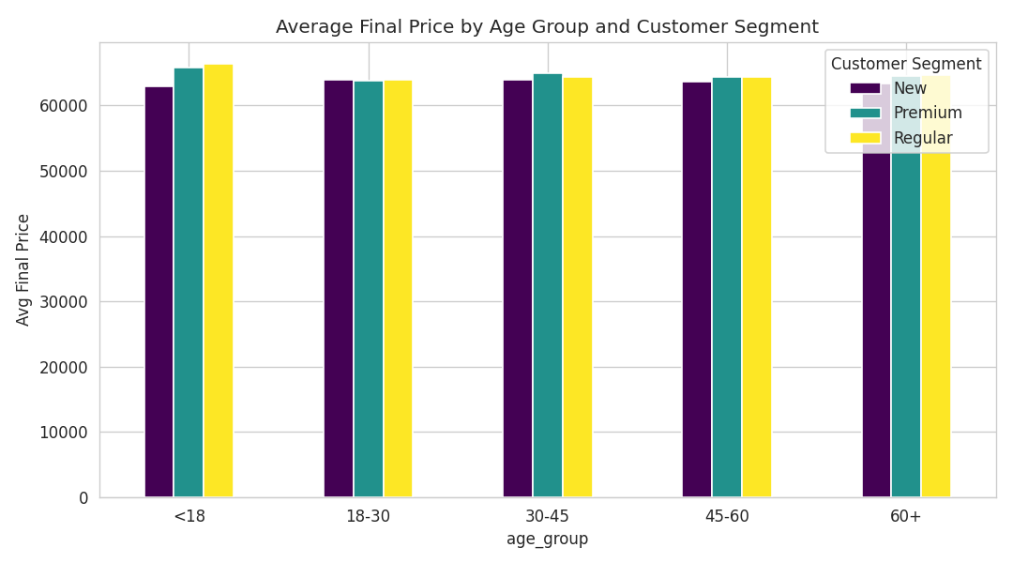
Multivariate Analysis — Discount & Age Effects
Avg transaction value falls steadily as discount rises in every category (mathematical, since final_price is discount-adjusted). Spending stays flat across age groups within each segment — no 30–45 spending peak for Premium customers, unlike the brief's example.
Retail Transaction EDA | 9

Slide 10
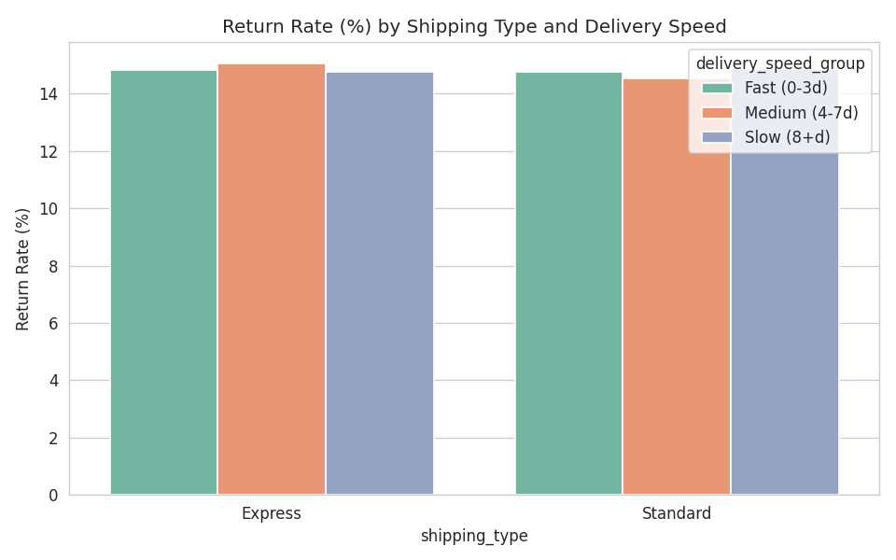
Multivariate Analysis — Shipping, Delivery & Significance
ANOVA — Does group membership affect spending?
Grouping | F-stat | p-value
customer_segment | 1.659 | 0.1904
product_category | 1.025 | 0.4008
No statistically significant difference in mean final_price was detected across customer segments or product categories (p > 0.05).
Return rate stays within a narrow 14.5–15.1% band regardless of shipping type or delivery speed — the brief's expected 'slow standard shipping → more returns' pattern is not supported here.
Retail Transaction EDA | 10

Slide 11
Additional Validation Checks
Multicollinearity (VIF)
Shipping vs Delivery Days
Delivery Days vs Returns
≈ 1.00
5.50 vs 5.51
r = 0.0005
VIF for all 5 independent variables
Avg delivery days: Express vs Standard
Correlation: delivery_days vs return_status
Well below the 5–10 concern threshold — formally confirms no multicollinearity among predictors.
Virtually identical — shipping type does not meaningfully predict delivery speed here.
Effectively zero — longer delivery does not raise return likelihood in this dataset.
Retail Transaction EDA | 11

Slide 12
Key Business Insights
Data quality is excellent — zero missing values, zero duplicates across 100,000 records.
1
product_price and quantity are the strongest positive associations with final_price; discount has only a weak negative association.
2
Outliers exist only in final_price (~1.3%) and were retained as plausible high-value transactions.
3
Customer segment, category, age, shipping, and delivery speed show only small differences in spending and return rate.
4
No statistically significant difference in mean final_price was found across customer segments or product categories (ANOVA, p > 0.05).
5
No multicollinearity among independent variables (VIF ≈ 1.00); delivery_days has no meaningful link to shipping type or returns.
6
Retail Transaction EDA | 12

Slide 13
Tools & Libraries Used
Python
Pandas
Core programming language
Data loading, cleaning, and manipulation
NumPy
Matplotlib
Numerical operations and array handling
Base plotting for charts and grids
Seaborn
SciPy
Statistical visualizations (histograms, boxplots, heatmaps)
Correlation testing (Pearson r, p-values) and ANOVA
Statsmodels
Jupyter Notebook
Variance Inflation Factor (VIF) for multicollinearity
Interactive environment for code, output, and interpretation
Retail Transaction EDA | 13

Slide 14
Conclusion
This EDA covered univariate, bivariate, and multivariate analysis, outlier detection, correlation with significance testing, ANOVA, and a formal multicollinearity check — validated against the actual dataset rather than assuming the brief's example findings would hold.
“The project brief contained expected findings, but I validated them against the actual dataset. Where the data differed from expectations, I reported the actual findings instead of forcing the expected conclusion.”
Key takeaway: EDA is not about confirming assumptions — it is about discovering and communicating what the data actually shows.
Thank you

