Slide 1
Mobile Phone Price Prediction
Prepared by
Jineshri Mehta
Nexthikes IT Solution
Which specifications drive phone prices, and how well can we predict them?

Slide 2
Overview
531
187
174 / 311 / 46
phone listings
phone models
budget / mid-range / premium
Goal: find which specifications drive mobile-phone prices and estimate a benchmark price from them
Main finding: processor class is the strongest price driver, followed by front camera, RAM and battery
Result: the selected Ridge (log price) model explains about 67% (cross-validation) to 86% (test set) of the price variation of unseen phone models
Limit: premium phones (above ₹30,000) are under-predicted – the model is a benchmarking aid, not a pricing system
Jineshri Mehta | Nexthikes IT Solution

Slide 3
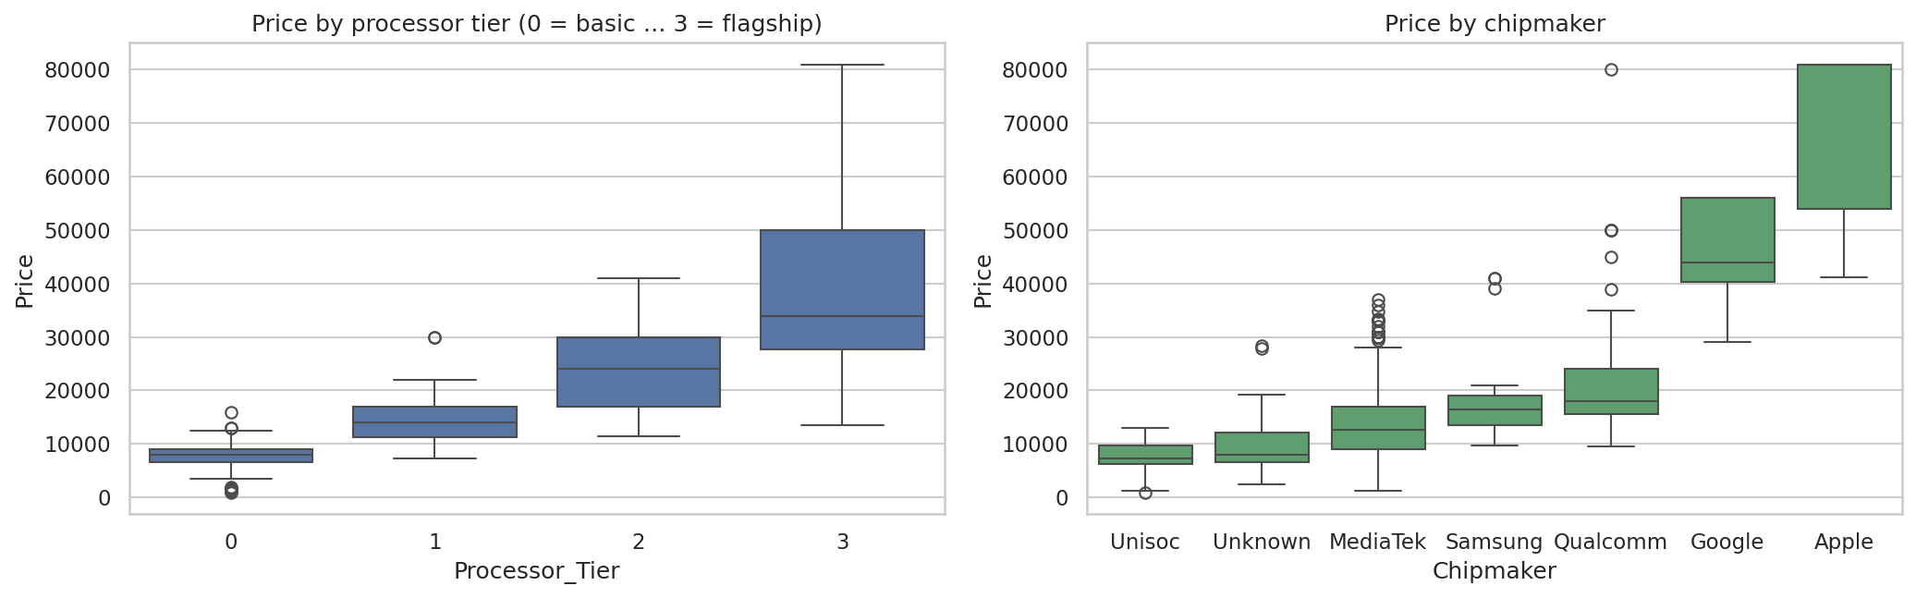
Processor class is the strongest price driver
₹7,999
basic chip
₹13,999
mid
₹23,999
upper-mid
₹33,844
flagship
Median price per processor tier. Storage adds more: 64 GB ₹9,999 → 128 GB ₹16,999 → 256 GB ₹29,999. An association, not proof that the chip alone causes the price.
Jineshri Mehta | Nexthikes IT Solution

Slide 4
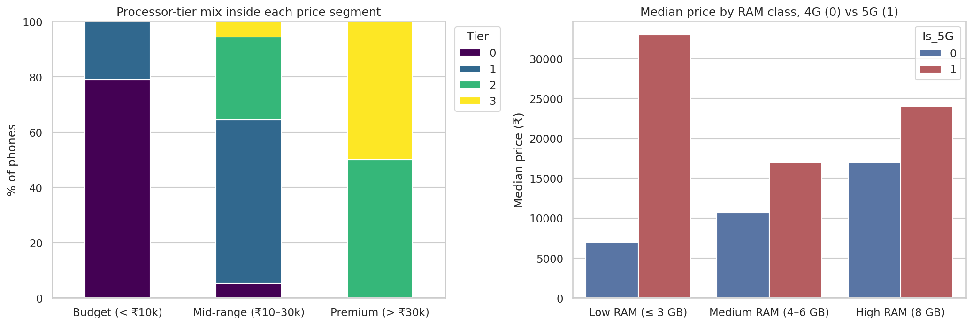
Price segments differ in chip and 5G
Budget: 79% basic chips, no 5G · Mid-range: tier 1–2 chips, 54% with 5G · Premium: all tier 2–3 chips
5G phones cost more at every RAM level (the “low RAM + 5G” bar comes from iPhones listed with 3–4 GB RAM in the source data)
Jineshri Mehta | Nexthikes IT Solution

Slide 5
Model performance
Model | Cross-validated RMSE ₹ | Test MAE ₹ | Test R²
Ridge (log price) (selected) | 6,290 | 2,111 | 0.86
Gradient Boosting | 6,322 | 2,894 | 0.79
Ridge (raw price) | 6,407 | 3,396 | 0.77
Linear Regression | 6,742 | 2,920 | 0.80
Selected by lowest cross-validated error, not by test score
Ridge (log price) and Gradient Boosting are practically tied: ₹6,290 vs ₹6,322, with a fold-to-fold spread above ₹2,500
Ridge (log) also scores best on the 101 test phones (MAE ₹2,111, R² 0.86) – and it is simple and explainable
Jineshri Mehta | Nexthikes IT Solution

Slide 6
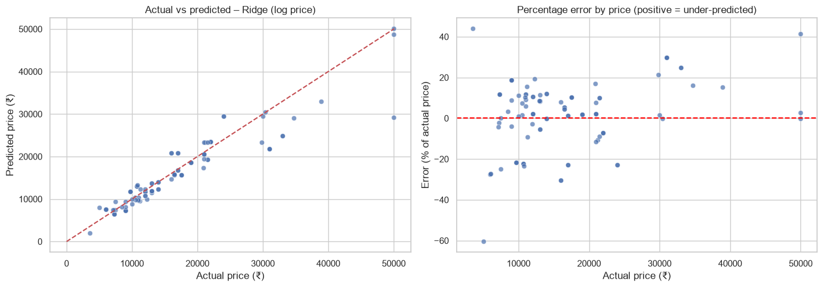
Accuracy depends on the price segment
₹1,255
₹1,595
₹7,075
Budget · average error
Mid-range · average error
Premium · average error
Best for mid-range phones (median error 8.6%). Budget phones have a higher % error (18.6%), and premium phones are the weak spot: almost all 11 are under-predicted. More premium data is a sensible next experiment, not a guaranteed fix.
Jineshri Mehta | Nexthikes IT Solution

Slide 7
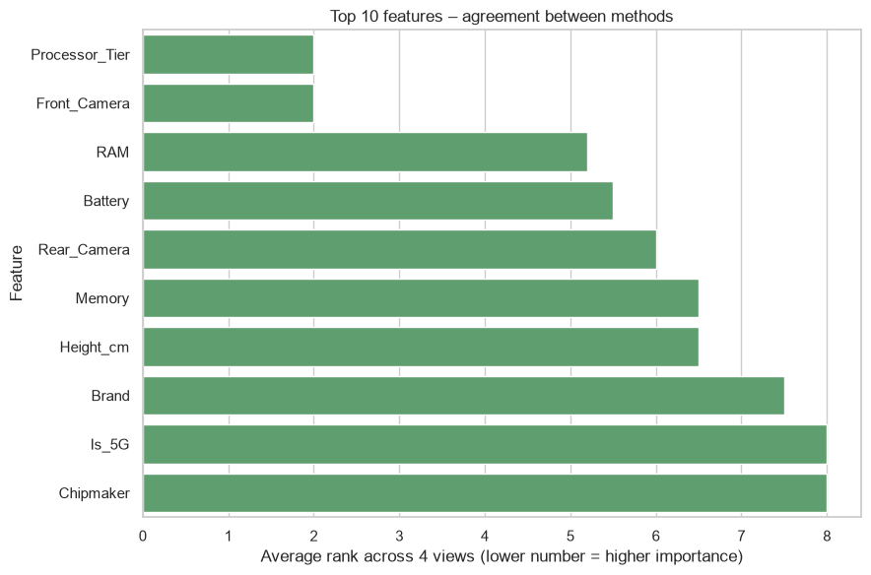
Which features matter most
Processor tier is #1 in every view
Front camera is a close second; RAM and battery follow – partly proxies for the market segment
Colour and AI lens add little predictive value
Test-set importance is for interpretation only; it changed no model choice
Average rank across four methods; lower number = higher importance.
Jineshri Mehta | Nexthikes IT Solution

Slide 8
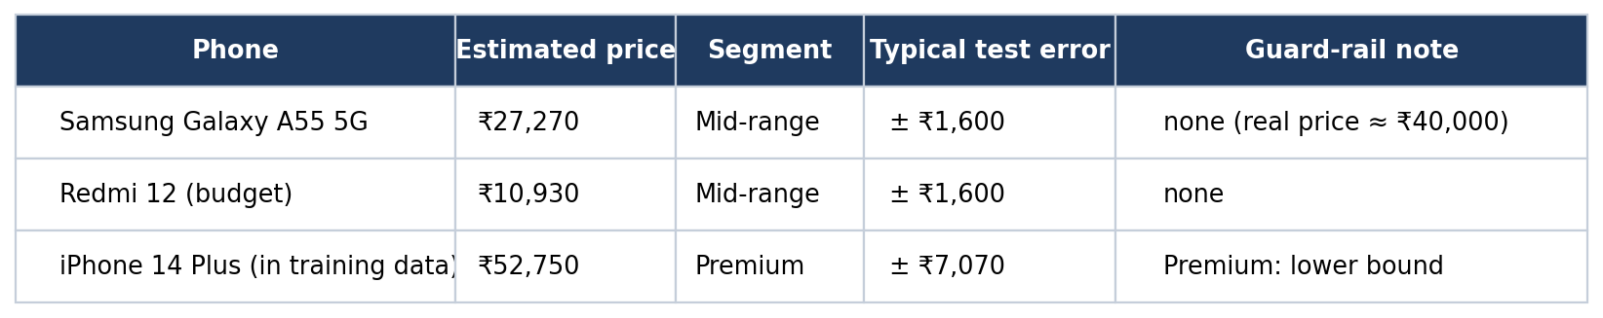
Price prediction tool
The selected Ridge (log price) pipeline is saved as a pickle file (mobile_price_model.pkl) and reloaded for prediction
Enter brand, memory, RAM, battery, cameras, height and processor – the tool rebuilds the same features and returns an estimate
Caution: the Galaxy A55 (real price about ₹40,000) is estimated at ₹27,270 without a warning, so treat estimates for high-end phones as lower bounds
Jineshri Mehta | Nexthikes IT Solution

Slide 9
Recommendations
1
Anchor price benchmarks on processor tier
2
Plan storage variants: ₹9,999 / ₹16,999 / ₹29,999 at 64 / 128 / 256 GB
3
Treat 5G as a mid-range-and-up feature
4
Do not rely on the model above ₹30,000; collect more premium data and re-test
5
Colour added little predictive value; also use demand, inventory and sales data
6
Use as a price-benchmarking aid; track error by segment monthly
Limitation: small data set (531 listings, 187 models); some brands and price segments are under-represented, so findings may not generalise to all phones on the market.
Jineshri Mehta | Nexthikes IT Solution

Slide 10
Appendix: method in brief (optional)
Data: 10 duplicates removed, camera text converted to numbers, 2 impossible heights set to missing and imputed with the training median
Feature engineering: brand, chipmaker, processor tier (0–3), colour family, 5G flag, feature-phone flag
Feature selection: mutual information on training data, inside the pipeline; PCA used for exploration only (6 of 11 numeric features keep ~90% of variance)
Validation: split by phone model; nested and repeated grouped cross-validation; one-hot Brand beat label encoding by about ₹250–300 RMSE (small versus the ₹1,900–2,500 spread)
Details: see the notebook
Jineshri Mehta | Nexthikes IT Solution

