Slide 1
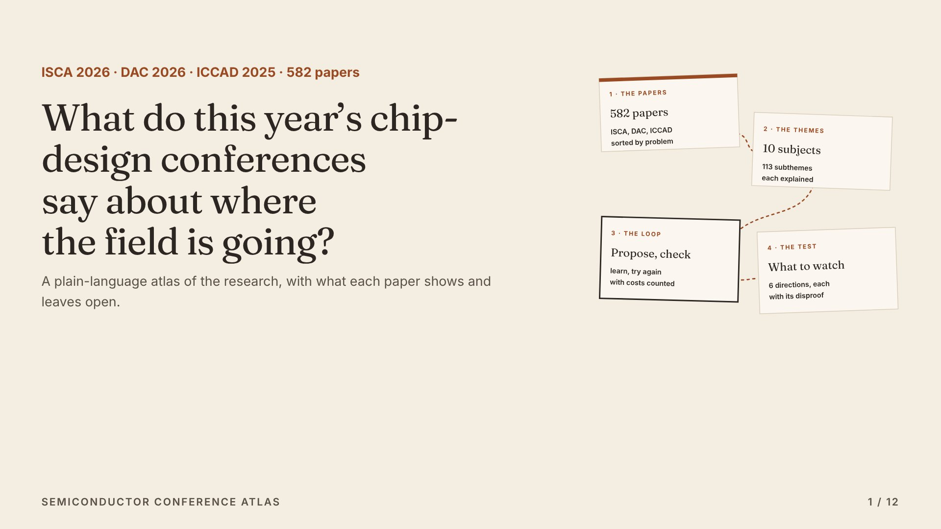
Notes:
This is an atlas of 582 papers from three chip-design conferences: ISCA, DAC and ICCAD. It asks one question. What do these papers, taken together, say about where chip and computer design is going?

Slide 2
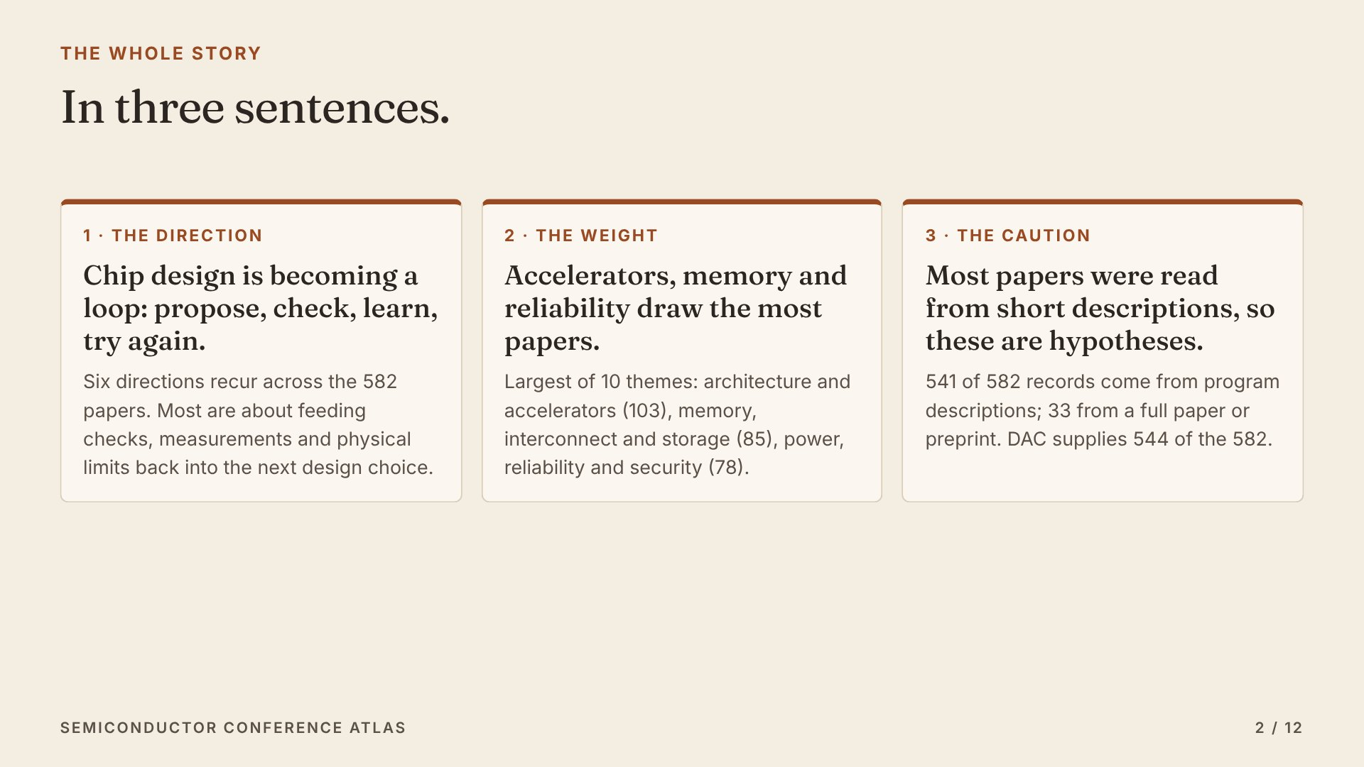
Notes:
Here is the whole story in three sentences. One: chip design is becoming a loop. Propose, check, learn, try again. Two: accelerators, memory and reliability draw the most papers. Three: most papers were read from short descriptions, so these are hypotheses, not proven trends.

Slide 3
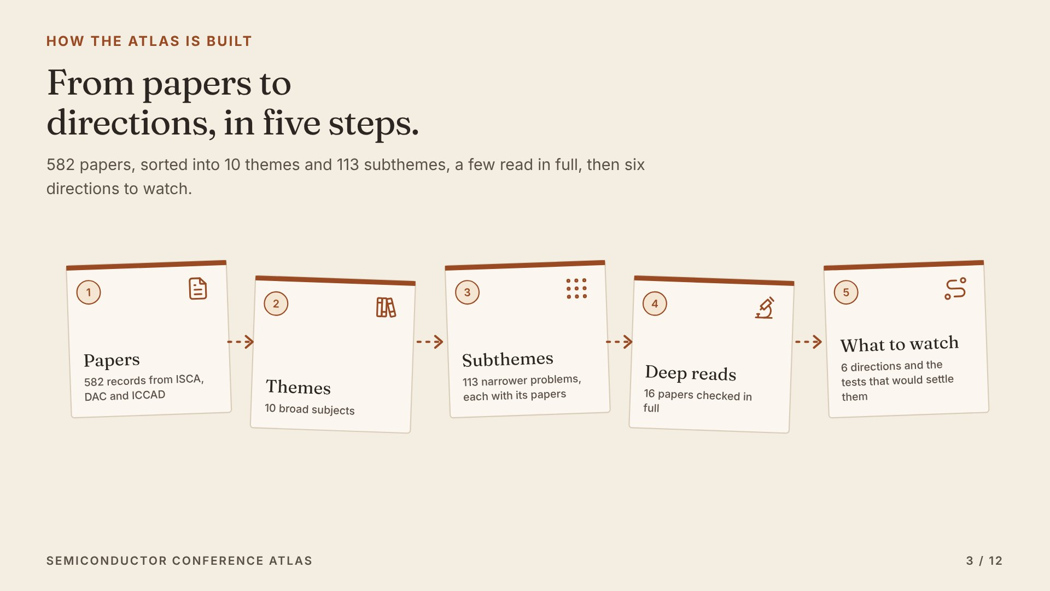
Notes:
The atlas works in five steps. Start with 582 paper records. Sort them into 10 broad themes, then 113 narrower subthemes, each explained in plain words. Read some papers in full. Then ask which directions keep coming back, and what test would confirm them.

Slide 4
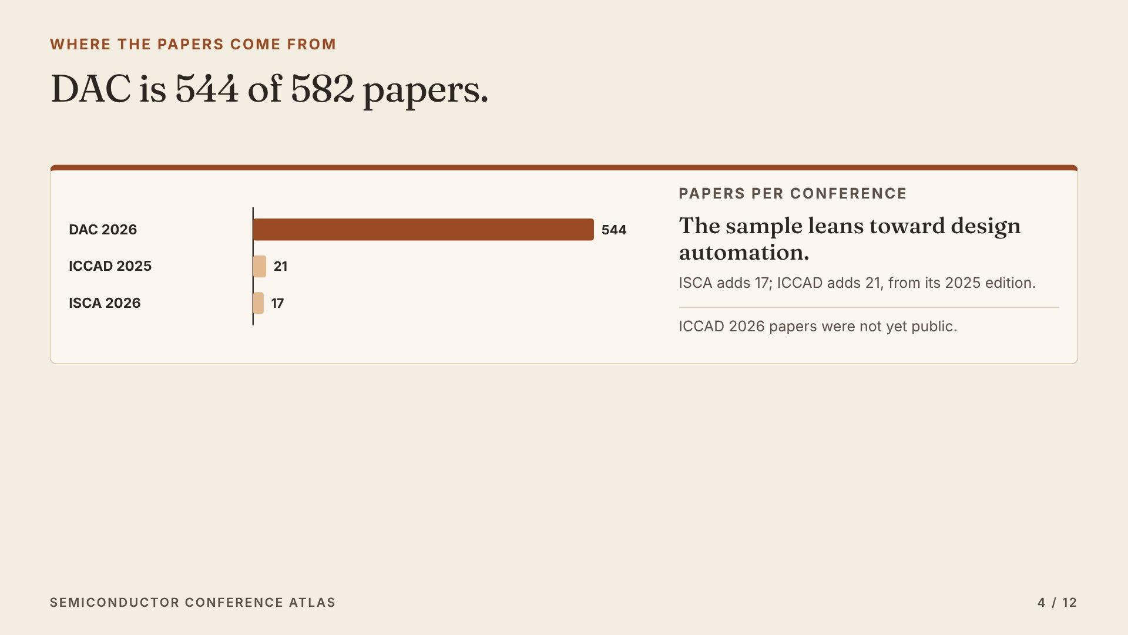
Notes:
First, where the papers come from. DAC, the Design Automation Conference, supplies 544 of the 582. ISCA, the main computer architecture conference, adds 17 selected papers. ICCAD's 2026 papers were not public yet, so 21 come from 2025. So the atlas leans toward design software.

Slide 5
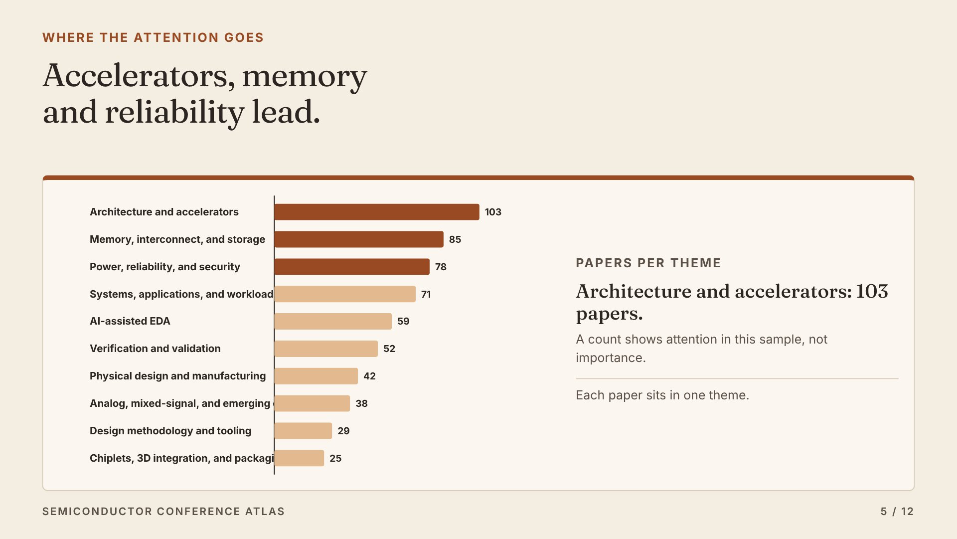
Notes:
Here is where the attention goes. Architecture and accelerators is the largest theme, with 103 papers. Memory, interconnect, and storage has 85. Power, reliability, and security has 78. A count shows where this sample spends its attention. It is not a ranking of importance.

Slide 6
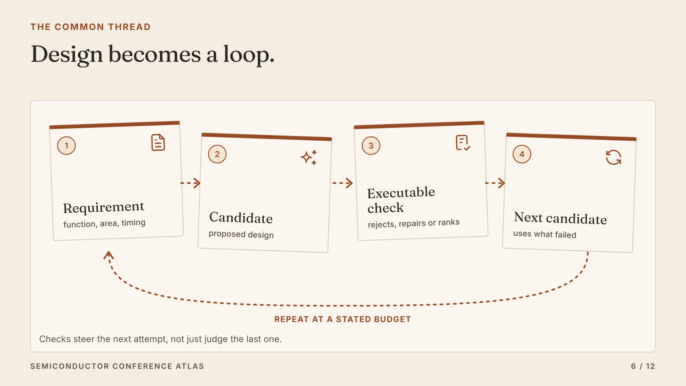
Notes:
The common thread is a loop. A model or a search proposes a design. Tools check it: does it compile, does it simulate correctly, does it meet timing? The check reports what failed, and the next attempt uses that. The hard question is cost: a fair test counts every model call, retry and check.

Slide 7
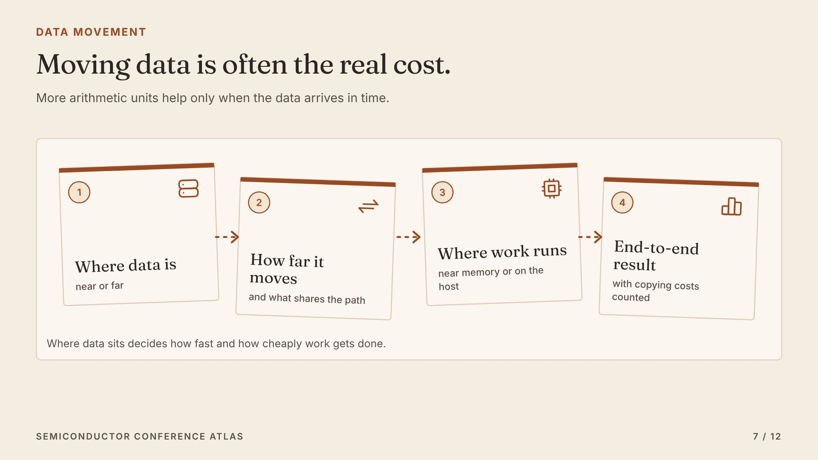
Notes:
The second direction is about data. A chip can have thousands of arithmetic units, but they wait if their inputs cannot arrive in time. So many papers decide where data sits, how far it moves, and whether to compute next to memory. The test is the end-to-end result, with every copy and wait counted.

Slide 8
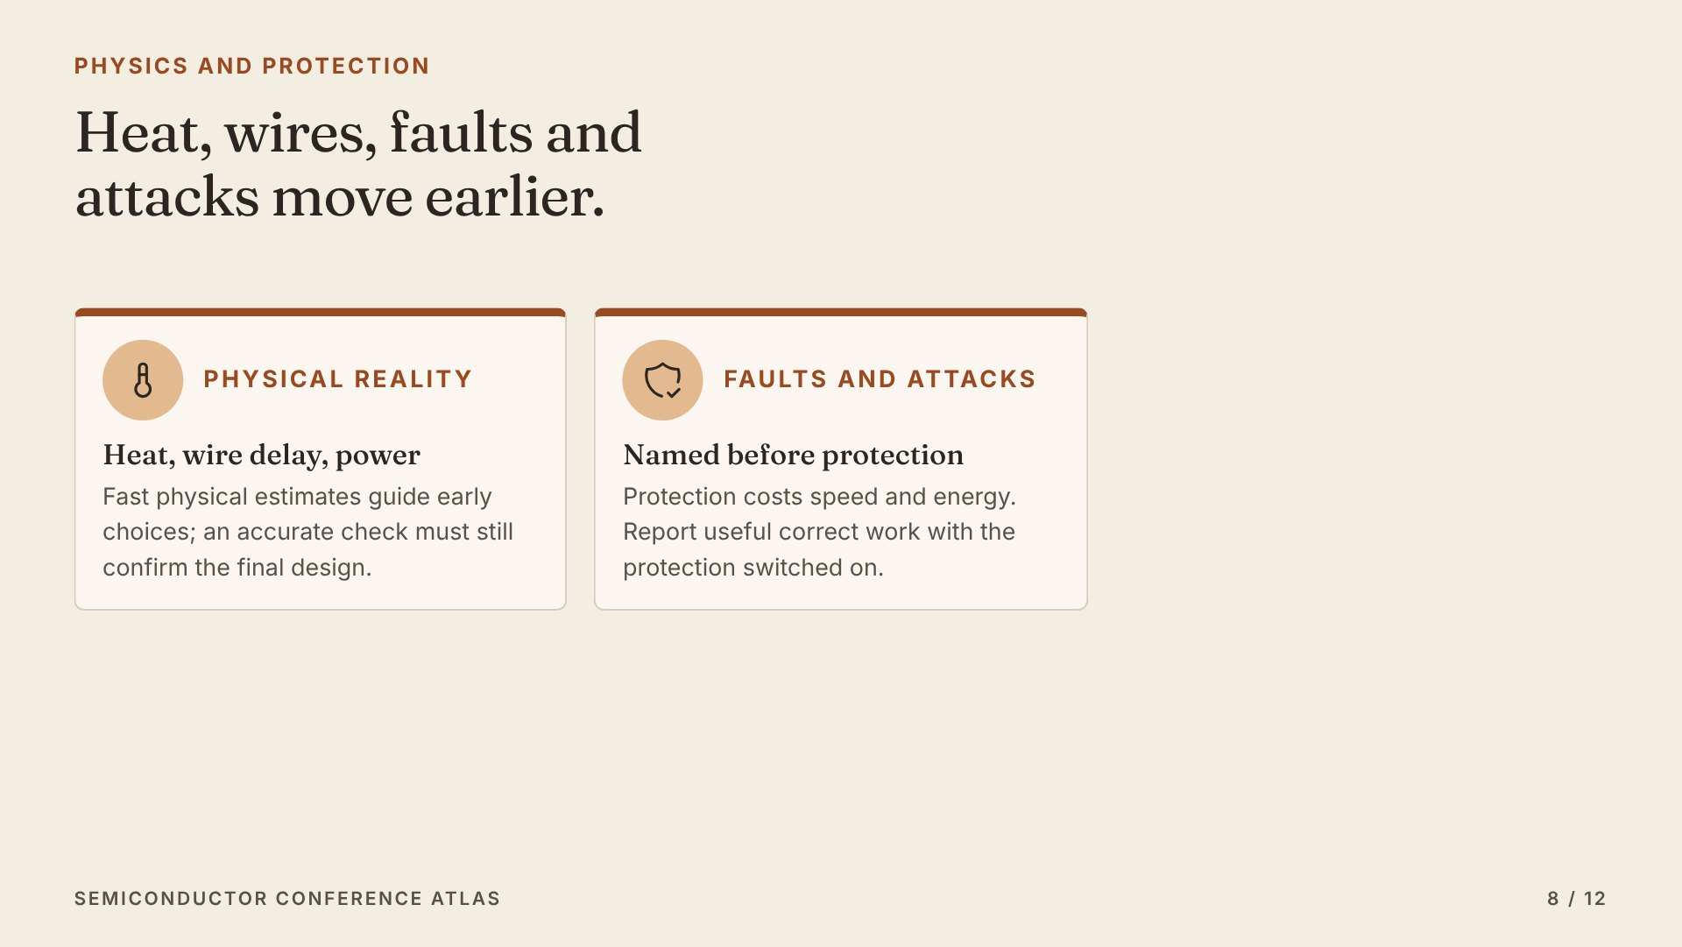
Notes:
Two more directions move physics and safety earlier. Heat, wire delay and power supply used to be checked at the end. Now fast estimates guide early choices, but the final design still needs an accurate check. Likewise, faults and attacks are named first, and the cost of protection is reported, not hidden.

Slide 9
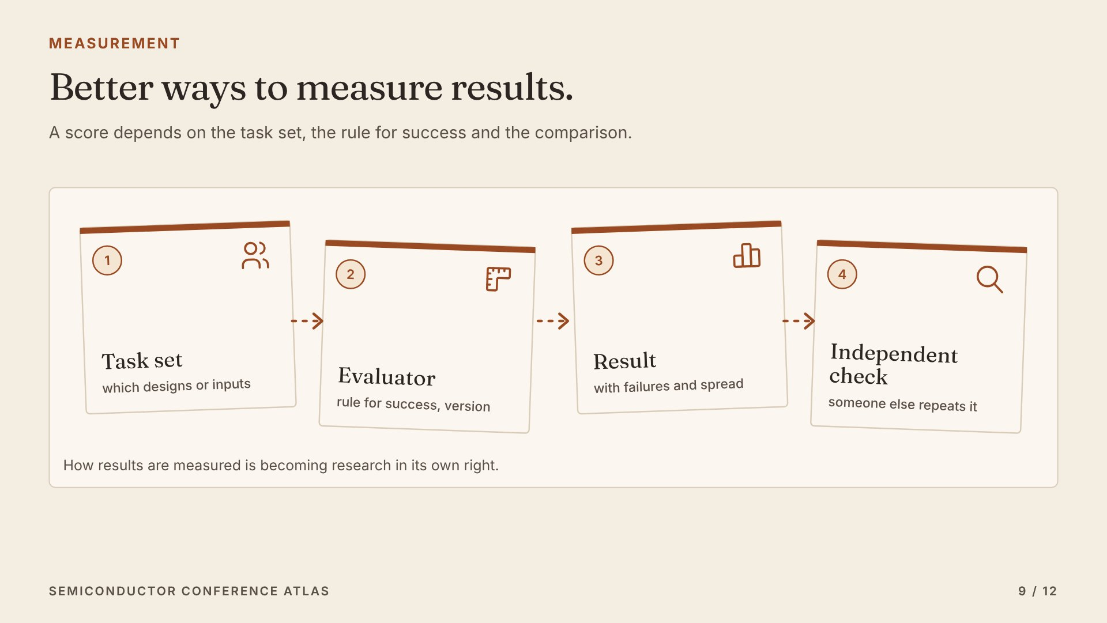
Notes:
The last direction is about measurement itself. A score means little without the tasks it was tested on, the rule for success, and the baseline. More papers now build benchmarks and release their tools. The test for this direction is simple: can someone else repeat the result and get the same answer?

Slide 10
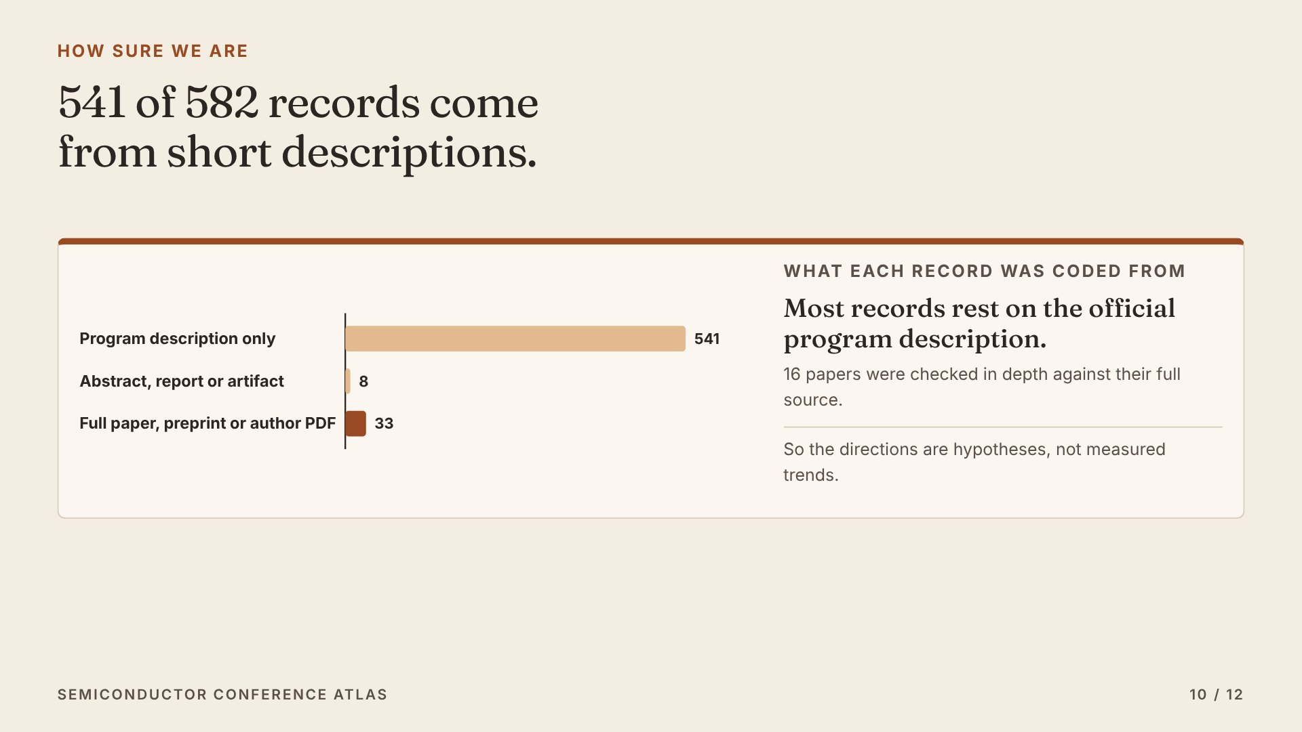
Notes:
Now, how sure can we be? 541 of the 582 records were coded from the short official program description. Only 33 come from a full paper, preprint or author PDF. 16 papers were checked in depth. So every direction here is a hypothesis to test, not a proven trend.

Slide 11
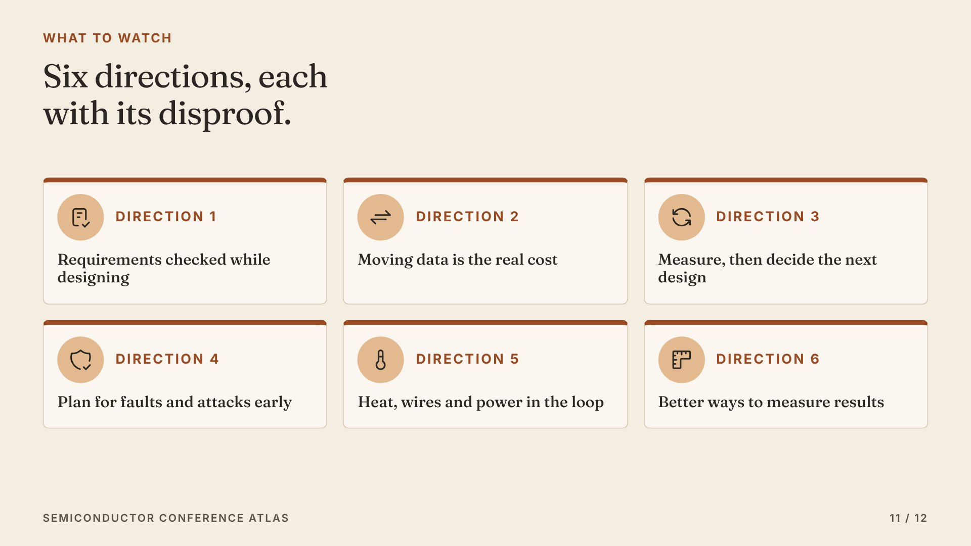
Notes:
Here are the six directions to watch. Requirements checked while designing. Data movement as the real cost. Measure, then decide the next design. Faults and attacks planned early. Physical limits in the loop. And better ways to measure. Each page names the paper that pushes back, and the result that would disprove it.

Slide 12
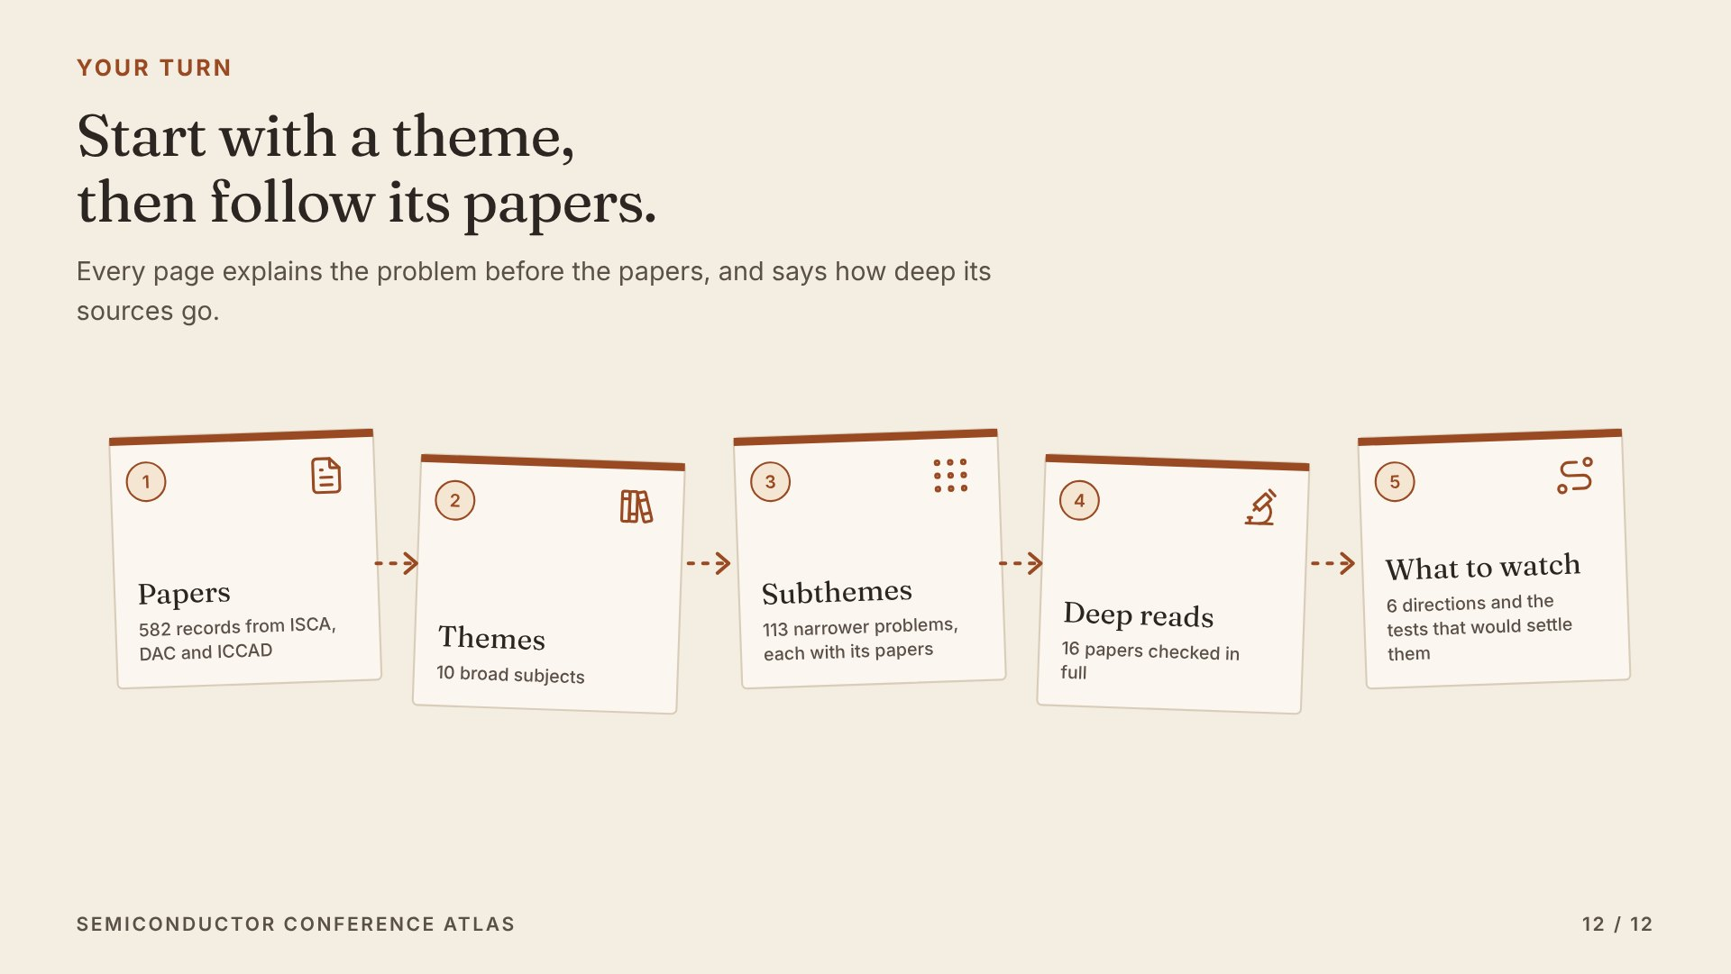
Notes:
To explore it yourself, start with a theme. Each one explains the technical problem in plain words, then links to its subthemes and every paper in them. Check the deep reads for papers read in full. Then open the six directions. Everything is linked from the big picture page.

