Slide 1
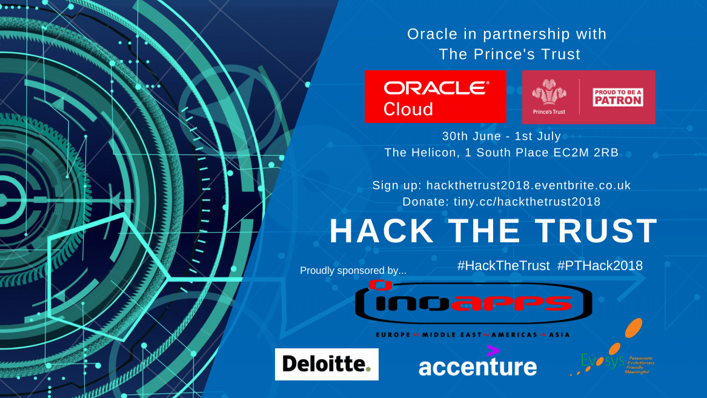
Notes:
Oracle in partnership with The Prince’s Trust are hosting a hackathon over the weekend of 30th June & 1st July with an expected number of 100 attendees; open to university students, hobbyist programmers and businesses. We expect a whole host of delegates such as engineers, software developers & architects, designers, analysts, researchers and anyone in between.
A hackathon provides a venue for creativity through technology. People with technical/non-technical backgrounds come together, form teams around a problem or idea, and collaboratively code a unique solution from scratch — these generally take shape in the form of websites, mobile apps and robotics.
The Prince’s Trust have kindly provided us with a large dataset consisting of various different social and professional skills within an age range of people from 11-30 years of age who want to develop. This dataset includes statistics & sources in order for delegates to tackle appropriate challenges.
The aim of the hackathon is to achieve new and innovative approaches to tackle the issues faced by the demographic that the Prince’s Trust data reflects, and to also make a positive impact to society by allowing The Prince’s Trust to use creative solutions to help young people in challenging circumstances.
The delegates will be solving problems, programming overnight and having lots of fun over our 24-hour Hack!
Throughout the event there will be plenty of food provided, prizes to be won, presenting opportunities and the potential of gathering stream analytic data for the hackathon social media coverage.
All proceeds from the event will be donated to The Prince’s Trust.
A great way to raise money for charity. An opportunity to build on the positive & ongoing relationship we have with the Prince’s Trust, as well an opportunity to find new, innovative & creative solutions to the problems faced by the Trust.
A great opportunity to develop, build & sustain new & ongoing relationships with developers. Great recognition & social media presence that Oracle are doing activities & events alongside the open source community. Changing the views and opinions of Oracle in the wider developer community.
Brings new opportunities for Oracle within the wider technology space. A great event to network and share knowledge. New business opportunities as well as to engage with customers after the event in order to set up workshops and build relationships with new customers.
Continues to showcase Oracle’s wider outreach and drive for STEM.
Hackathons are a lot of fun!

Slide 2





Challenges
We’ve developed these challenges based on the underlying issues that the Prince’s Trust members face, as well as what the data set reflects. These are all prevalent matters in modern day society and the hackathon aims to tackle these areas in innovative and creative ways.
There is open source government demographic data available as well as other sources such as Kaggle and ML scripts.
1
2
3
Bullying & Safeguarding
Education & Employment
Mental Health
4
5
Family Areas
Open Challenge

Slide 3
Challenges
1
2
3
Bullying & Safeguarding
Education & Employment
Mental Health
Find correlations and identifiers between different groups in the dataset (A-E) that reflects or indicates that bullying (cyber, physical or emotional etc) or a lack of safe guarding could lead to:
Lower education attainment
Exclusion from school
Substance abuse
Any other category
Use ML algorithms & predictive data analysis to pick up on these factors and to identify the likelihood of bullying based on social behaviour.
Focusing on a group (A-E) of your choice from the dataset, use ML algorithms to perform a full analysis to determine key factors that lead to or prevent people from attaining full time employment or retain full time employment.
For groups A & B focus more on education (school, university, college), upbringing, background as well as open source demographic data. For group D and E the focus will be on wider skills, e.g. soft skills, not taught in education system and contributing factors such as substance abuse, criminal record, personality traits etc.
By focusing on groups A, B, & C, use statistical probability analysis, predictions and ML algorithms to determine at what point the Prince’s Trust need to intervene to stop certain Mental Health conditions developing. For example; trigger or turning points in an individual’s life that leads them to display specific behavioural characteristics such as depression, anxiety etc. What is the best way for the Prince’s Trust to interact with such individuals and suggest coping mechanisms/prevention strategies.

Slide 4
Challenges
4
5
Family Areas
Open Challenge
How likely is it for individuals to be accepted into society & what challenges would they face when being accepted in society, based on the following subgroups;
Refugee & Asylum seekers
Ex-offenders
Single parents
Homeless
Care Leavers
Project how many people that come from these subcategories exhibit traits such as low self esteem, lack of direction in life and/or career. How likely is it that these traits will still be prevalent in their character in the future and what mechanisms can the Prince’s Trust use to change this?
Find the most common issues that exists within each group (A-E). Suggest some methods that can be put in place to prevent them from happening or lessen the impact. What can be done to detect these emerging trends?
Using projection metrics, open source demographic data, political influences & community presence etc, are these existing trends forecasted to get better or worse in the future?

