Slide 2
Executive Summary – Infrastructure Risk Overview
ID | Category | Highlights |  |  | Trend
INV | Asset Inventory |  | Networks | Jason L
 |  |  | Servers | Harris T
 |  |  | Endpoints | Ashley T
 |  |  | Database | Peter C
 |  |  | Applications | Sue L
SEB | Security Baseline |  | Networks | Cory J
 |  |  | Servers | Harris T
 |  |  | Endpoints | Wes M
 |  |  | Database | Peter C
VLL | Vulnerability Landscape |  | Networks | Pavan D
 |  |  | Servers | Yogesh S
 |  |  | Endpoints | Lloyd E
 |  |  | Database | Srinivasulu P
 |  |  | Applications | Sue L
MON | Security Monitoring |  | Overall | Jos V
IAM | Privileged Access |  | Overall | Brian S

Slide 3
Detailed Metrics - KRIs
Category of KRI | Defintion | Measure | Previous Score | Current Score | Risk Trend
Inventory | Accuracy and completeness of asset information | % of inventory completion (Owner / IT Custodian must be filled to be considered a complete inventory item.)
 |  | Networks
 |  | Servers | 67%
 |  | Endpoints
 |  | Database
 |  | Applications
 |  | # of unknown Assets (Those which are discovered but not found in the “source of truth” probably CMDB)
Security Baseline | Alignment with industry best practices | % of assets with security baseline (# of assets as a factor of whole estate, for which the baseline is Agreed. (Coverage)
 |  | Networks
 |  | Servers
 |  | Endpoints
 |  | Database

Slide 4
Detailed Metrics - KRIs
Category of KRI | Defintion | Measure | Previous Score | Current Score | Risk Trend
Security Baseline | Alignment with industry best practices | Networks
 |  | Servers
 |  | Endpoints
 |  | Database
Identity and Access Management | Measure of Privileged accounts | Total # of Admin accounts | None | None
 |  | # of 2FA Admin accounts | None | None
 |  | # of Generic Admin accounts without owner | None | None
Vulnerability Landscape | Measure of Vulnerabilities in infrastructure | % of assets with High and critical (4&5) vulnerabilities
 |  | Networks
 |  | Servers
 |  | Endpoints
 |  | Database
 |  | Applications

Slide 5
Detailed Metrics - KRIs
Category of KRI | Defintion | Measure | Previous Score | Current Score | Risk Trend
Vulnerability Landscape | Are we in Control ? | Average Time to Remediate last cycle (in # of Days)
 |  | Networks
 |  | Servers
 |  | Endpoints
 |  | Database
 |  | Applications
 | What is our Risk ? | Average Age of Open Vulnerabilities (in # of Days)
 |  | Networks
 |  | Servers
 |  | Endpoints
 |  | Database
 |  | Applications
Monitoring | Measure of assets not monitored | % of Assets not being monitored
 |  | Networks

Slide 6
Detailed Metrics - KRIs
Category of KRI | Defintion | Measure | Previous Score | Current Score | Risk Trend
Monitoring | Measure of assets not monitored | Servers
 |  | Endpoints
 |  | Database
 |  | Applications

Slide 7


Slide 8
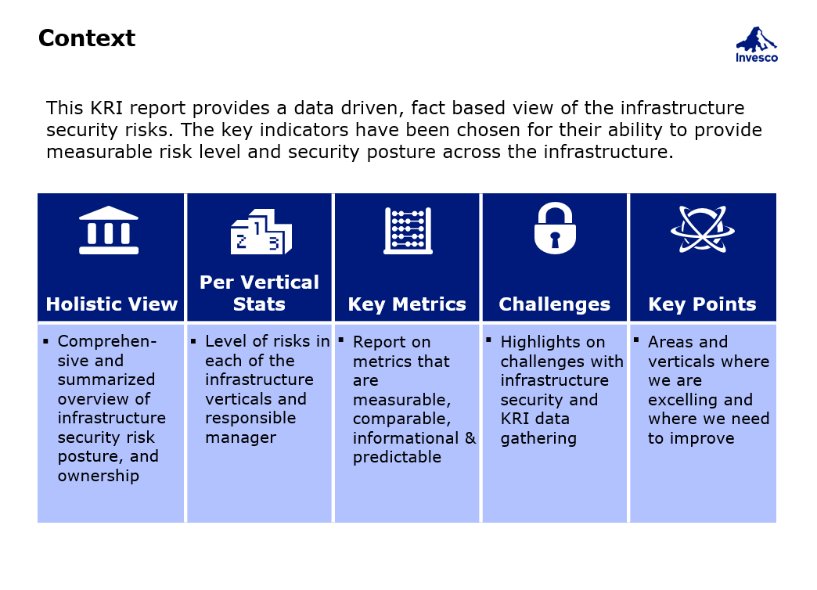

Slide 9
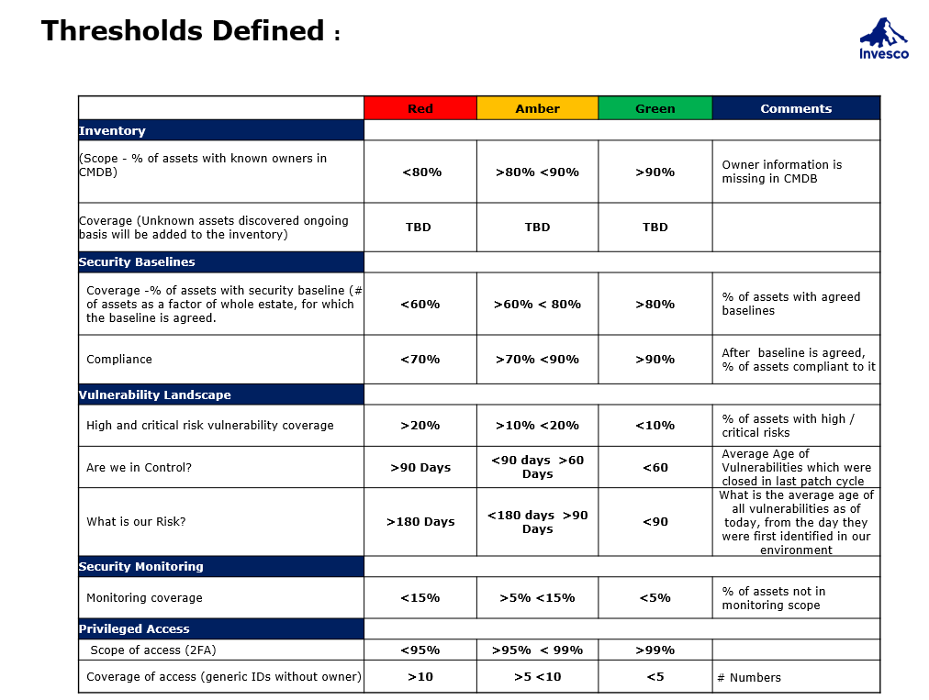

Slide 10
