Slide 2
Executive Summary – Infrastructure Risk Overview
ID | Category | Highlights |  |  | Trend
INV | Asset Inventory |  | Networks
 |  |  | Servers
 |  |  | Endpoints
 |  |  | Database
 |  |  | Applications
SEB |  |  | Networks
 |  |  | Servers
 |  |  | Endpoints
 |  |  | Database
VLL |  |  | Networks
 |  |  | Servers
 |  |  | Endpoints
 |  |  | Database
 |  |  | Applications
MON |  |  | Overall
IAM |  |  | Overall

Slide 3
Detailed Metrics - KRIs
Category of KRI | Defintion | Measure | Previous Score | Current Score | Risk Trend
Inventory | Accuracy and completeness of asset information | % of inventory completion (Owner / IT Custodian must be filled to be considered a complete inventory item.)
 |  | Networks | 44% | 34%
 |  | Servers | 45% | 64%
 |  | Endpoints | 12% | 34%
 |  | Database | 65% | 53%
 |  | Applications | 87% | 12%
 |  | # of unknown Assets (Those which are discovered but not found in the “source of truth” probably CMDB) | 5777 | 6543
Security Baseline | Alignment with industry best practices | % of assets with security baseline (# of assets as a factor of whole estate, for which the baseline is Agreed. (Coverage)
 |  | Networks | 78% | 54%
 |  | Servers | 89% | 12%
 |  | Endpoints | 9% | 87%
 |  | Database | 67% | 98%

Slide 4
Detailed Metrics - KRIs
Category of KRI | Defintion | Measure | Previous Score | Current Score | Risk Trend
Security Baseline | Alignment with industry best practices | Networks | 45% | 67%
 |  | Servers | 88% | 35%
 |  | Endpoints | 99% | 23%
 |  | Database | 67% | 12%
Identity and Access Management | Measure of Privileged accounts | Total # of Admin accounts | 78 | 43
 |  | # of 2FA Admin accounts | 98 | 54
 |  | # of Generic Admin accounts without owner | 90 | 74
Vulnerability Landscape | Measure of Vulnerabilities in infrastructure | % of assets with High and critical (4&5) vulnerabilities
 |  | Networks | 56% | 26%
 |  | Servers | 89% | 85%
 |  | Endpoints | 89% | 23%
 |  | Database | 98% | 84%
 |  | Applications | 34% | 25%

Slide 5
Detailed Metrics - KRIs
Category of KRI | Defintion | Measure | Previous Score | Current Score | Risk Trend
Vulnerability Landscape | Are we in Control ? | Average Time to Remediate last cycle (in # of days)
 |  | Networks | 45 days | 54 days
 |  | Servers | 56 days | 25 days
 |  | Endpoints | 76 days | 86 days
 |  | Database | 65 days | 24 days
 |  | Applications | 54 days | 86 days
 | What is our Risk ? | Average Age of Open Vulnerabilities (in # of days)
 |  | Networks | 89 days | 24 days
 |  | Servers | 77 days | 98 days
 |  | Endpoints | 45 days | 86 days
 |  | Database | 9E+1 days | 78 days
 |  | Applications | 23 days | 56 days
Monitoring | Measure of assets not monitored | % of Assets not being monitored
 |  | Networks | 34% | 56%

Slide 6
Detailed Metrics - KRIs
Category of KRI | Defintion | Measure | Previous Score | Current Score | Risk Trend
Monitoring | Measure of assets not monitored | Servers | 87% | 25%
 |  | Endpoints | 9E+1% | 12%
 |  | Database | 67% | 23%
 |  | Applications | 23% | 32%

Slide 7
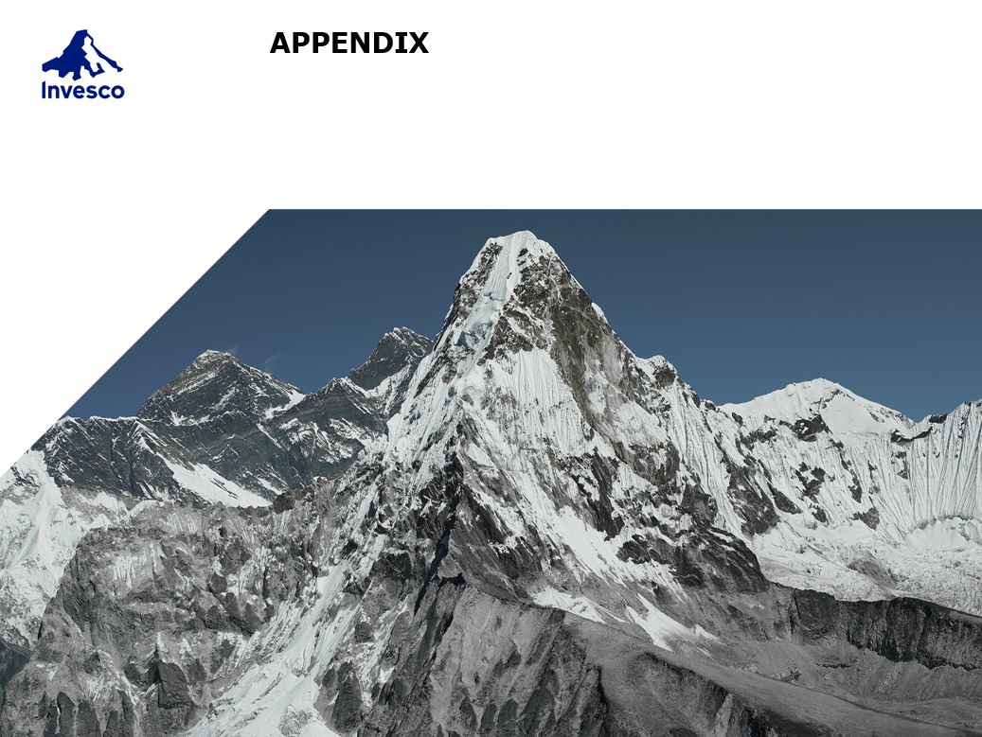

Slide 8
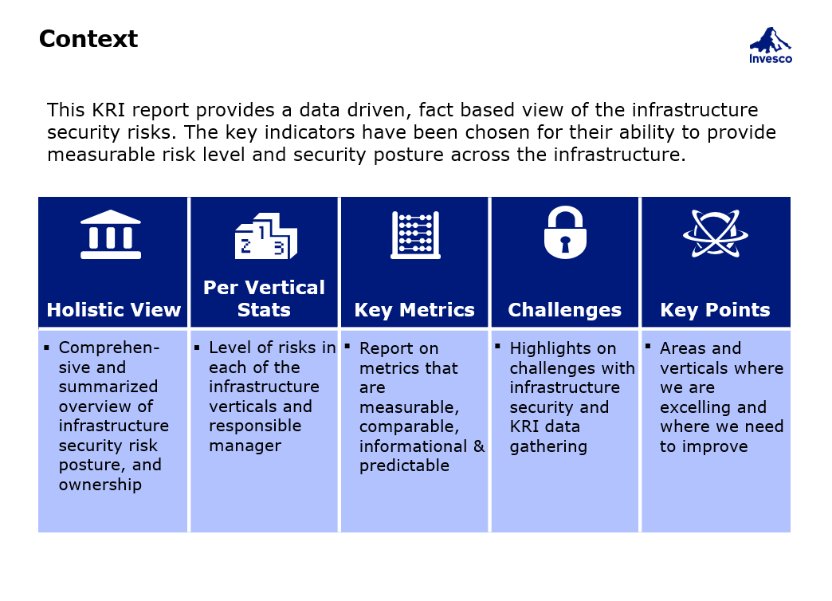

Slide 9
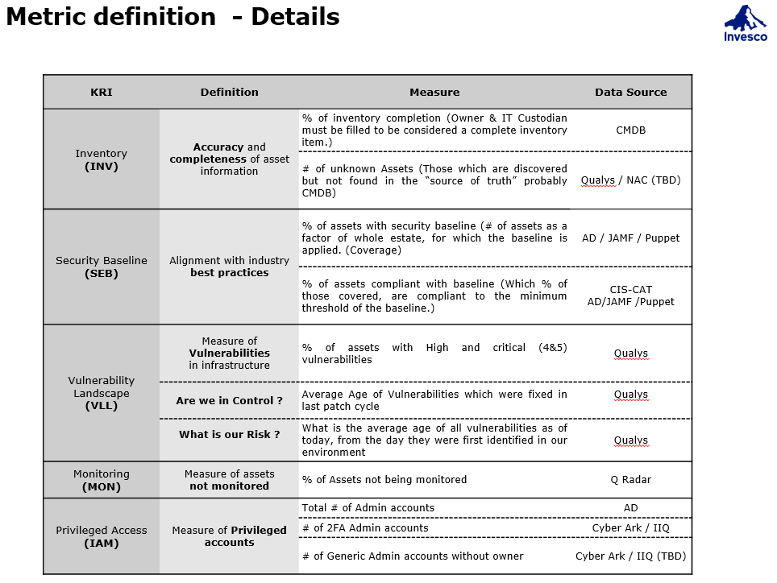

Slide 10
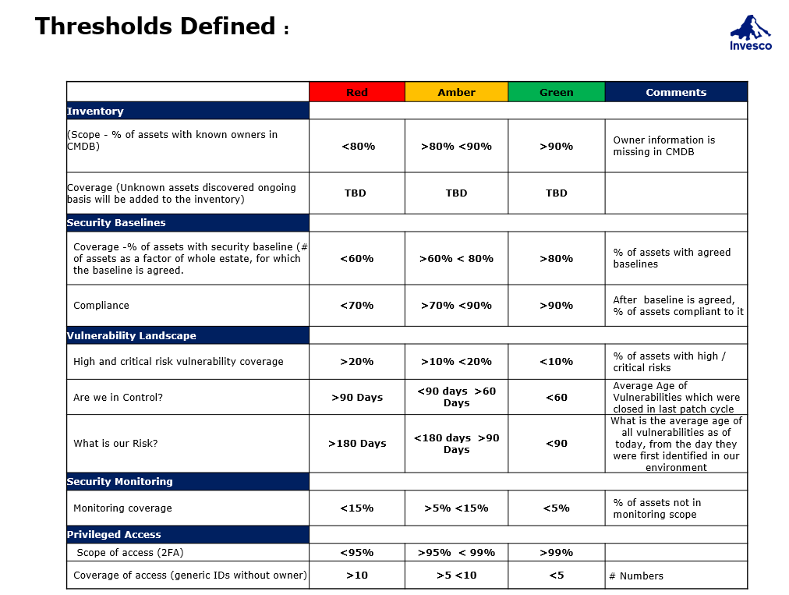

Slide 11
