Slide 1

Internship
Priyanka Mehta
E18CSE134
EB04

Slide 2
Contents
01. Introduction
02. About the organization
Summary about what and where I spend my two months of the Internship.
Information about the organization.
03. About my Work
04. Timeline
05. Learnings
A description about what I did in the training and the internship, basically what project I was working on.
Contains week-wise information about what I did in my project and how I completed it.
Description about the technologies I used and learnt.

Slide 3

Introduction
This semester I have done two internships:
Application Security Intern at MoveInSync (11th August to 15th November)
Application Security Intern at DRDO (15th November onwards)

Slide 4


Application Security Intern at MoveInSync
I worked at MoveInSync for a period of 3 months as an Application Security Intern. During the duration of my work, I expanded my knowledge in various things like API Testing, Web Application Testing and Mobile Application Testing.
I also got the experience to use professional tools like Burp suite Pro, Postman, GenY Motion, Android Emulator, etc. The security team of the company was new so majorly I was handling the work, because of which I learnt how to multi task, manage time, take responsibility, etc in a company.

Slide 5

Application Security Intern at DRDO
It has been 2 weeks since the starting of my internship at DRDO.
In these two weeks I was a part of one project which was related to Bulk Mailing. I have learnt about various things like phpList, local hosting, web development using php.
I also got to learn to create web shells that includes all possible capabilities and stealth techniques. There are many experienced people in my department, and they have helped to expand my knowledge me as well.

Slide 6

ABOUT THE COMPANY
MoveInSync is a product-based company that has two products (applications) as of now MoveInSync and WorkInsync. Recently they have clubbed the two applications and named it as MoveInSync | WorkInSync. Their application provides one-app solution that allows employees to work from anywhere in the new hybrid work environment. It also allows employees to gain additional flexibility of choosing when and where to work from. Their application has many features for employees like cab booking, desk booking, etc
Address: No. 439, 17th Cross Road, Sector 4, HSR Layout, Bengaluru, Karnataka 560102
Working Hours: Flexible
Email: Sales@moveinsync.com
Phone Number: 08061937937

Slide 7
ABOUT THE COMPANY
The Defence Research and Development Organisation (DRDO) is an Indian government body responsible for the development of military technologies. It is based in New Delhi. There are various centres/labs of DRDO across India. At a time, various projects are undertaken and handled.
Address: Rajaji Marg, Vijay Chowk Area, Central Secretariat, New Delhi, Delhi 110004
Working Hours: Depends on Work Requirement
Phone: 011 2300 7002

Slide 8
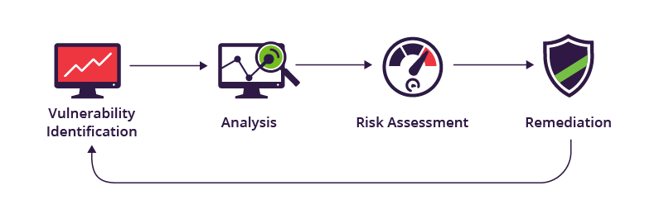
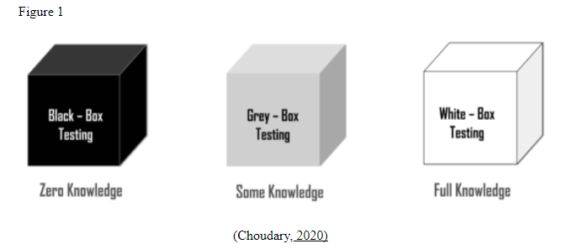
About My Work
At MoveInSync my work was to handle Vulnerability Assessment and (Grey Box) Penetration Testing of Web Application, APIs, Mobile Application (Android) .
For doing the complete testing of the applications I used tools like Burp suite, Postmen, GenY Motion. I also used various browser extensions while testing like wappalyzer, cookie-editor, Retire.js.
My approach of doing the testing was to first do a walkthrough of the application, understand the application flow and then start checking for all the issues listed in the OWASP Top 10 standards. After finding all the security related issues my task was to update about the same on JIRA and assign the tickets to the developers. I also revalidated the reports given by the external VAPT team.

Slide 9

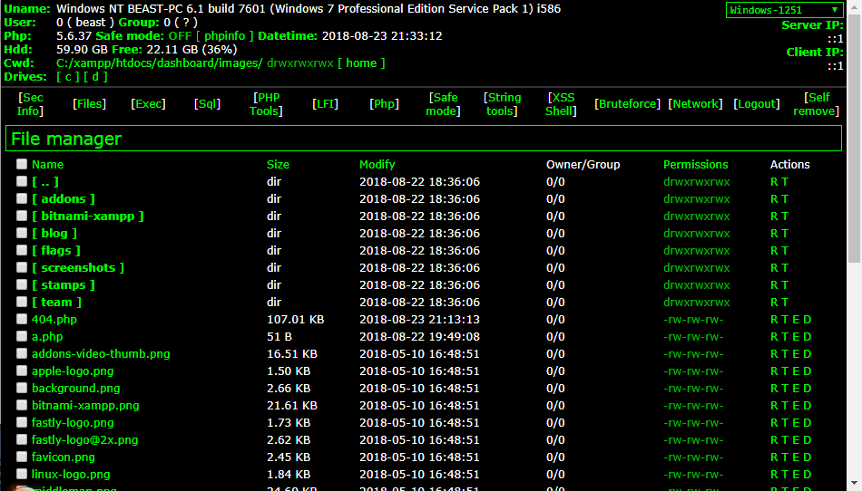
About My Work
At DRDO there are various projects one can choose to be a part of. I chose to be a part of the web shell development project and bulk mailing project.
In the web shell project, we developed various web shells as per recent security standards. Web shells generated included all possible capabilities and stealth techniques. A management console was also made for managing various web shells with varying functionalities.
For the bulk mailing project, we used the phpList and made modifications according to requirements.

Slide 10
Timeline
Week 1 – Week 2
Week 3 – Week 4
Knowledge Transfer from one of the employees. I was told about all the services, applications in use, walkthrough of the applications. I started doing API security testing
I made a security checklist for API testing, web application testing and mobile application testing. Handled some unfixed tickets on JIRA.
Week 5 – Week 6
Week 7 – Week 8
There are two services that the company Moveinsync is focusing on – Moveinsync and Workinsync. My head again gave me a walkthrough of the Workinsync application again so that I can start of with the web application security testing.
The company also get an external VAPT done. Week 7 and Week 8 were fully focused on re-validating the external report and getting the issues fixed. I also started exploring about mobile application security testing.

Slide 11
Timeline
Week 9System Hacking
Malware Threats
Sniffing
Week 10
Week 9 was totally focused on finishing the set up for mobile application testing as it was the requirement of the company. I explored various methods – Android Emulator + Burp suite, GenY Motion + Burp suite, Testing from physical device, etc.
Validated the mobile application related tickets. This week I did internal mobile application testing also and raised tickets on JIRA. This week I also validated the report that one of the company's client gave and assigned the issues to the developer.
Week 11
Week 12
This week a new intern joined and so I did the Knowledge transfer to him. I introduced him to all the services, tools used, setup, etc. I also did a walkthrough for him for all the application.
This was my last working week at Moveinsync and so this week I was fully focused on completing all my tasks that were pending.

Slide 12
Timeline
Week 1:
The first week included the knowledge transfer, overview of how things are done at DRDO. I was told about the guidelines/rules to be followed. In the first week I became a part of the web shell development project. I learnt how web shells are created and what all techniques are done to make the web shell undetectable.
Week 2:
In week 2 I became a part of the bulk mailing project. We initially started off this project by writing our own PHP code for bulk-mailing. Then we switched to phpList because of all the functionalities we had. We then made modifications to the source code of the phpList according to our requirements

Slide 13
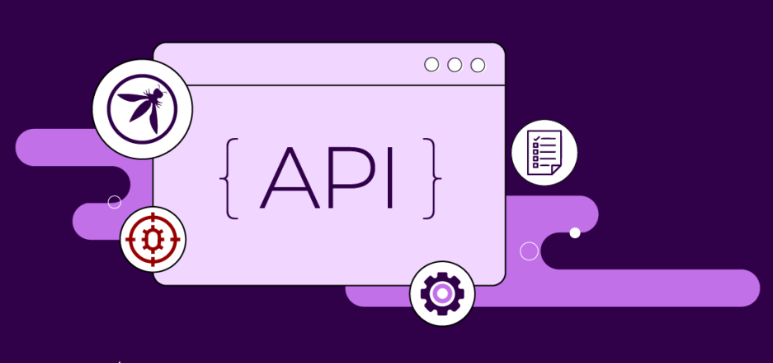
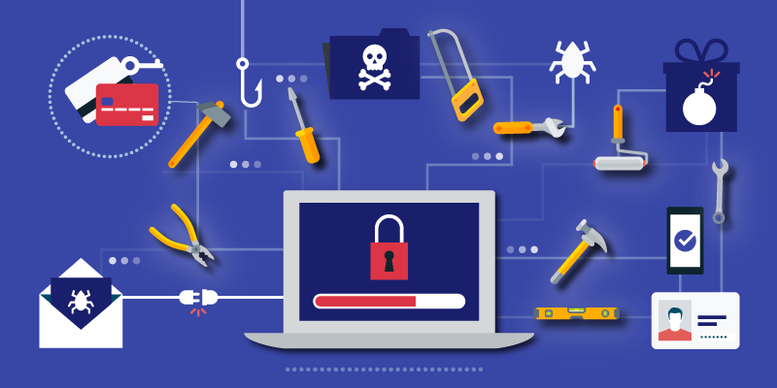

Learnings
API Security Testing: API security testing is the process of examining APIs for vulnerabilities, with the goal of exposing any possible security flaws for the technical team to address. I learnt about the tool named Postman.
Web Application Security testing: Web application security testing is the process of evaluating, assessing, and reporting on a Web application's security level. I expanded my knowledge on both automated testing using Burp suite and manual testing.
Mobile Application Security Testing: Mobile Application Security Testing is the process of evaluating, assessing, and reporting on a Mobile application's security level. It entails putting a mobile app through its paces as though it were being attacked by a rogue user. I covered Android application testing. For the same I explored many tools like Android Emulator, GenY Motion, etc.

Slide 14






Learnings
Burp suite Pro: Burp Suite is a proxy-based tool for evaluating web-based application security and doing hands-on testing. The professional version of burp suite has a variety of tools and more options than the community version.
Postman: Postman is a tool for developers/programmers that makes it simple to create, distribute, test(be it functional level testing or security level), and document APIs.
GenY Motion: Genymotion is a popular Android emulator that uses VirtualBox as its foundation. It was used in the mobile application testing process
Wappalyzer: Wappalyzer is a browser extension that can be used to know about the technologies used in any website.
Cookie-Editor: Cookie-Editor is a browser extension that allows us to do the common cookie operations – create, delete, modify.
Retire.js: Retire.js is a browser extension that allows to know about if the website is using any vulnerable library.

Slide 15
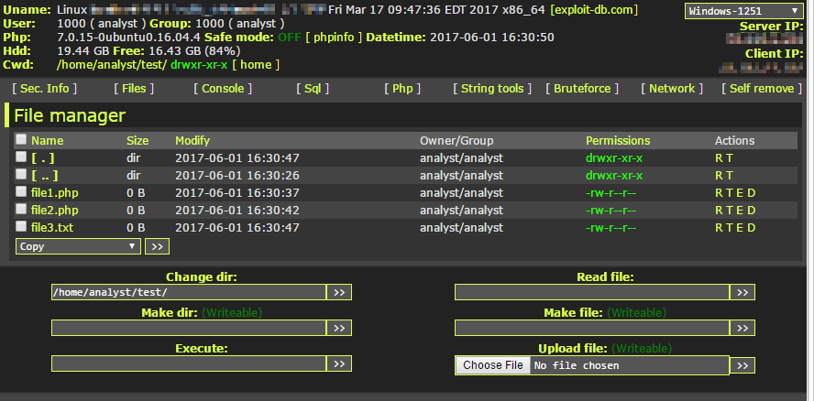



Learnings
Creation of web shells: How to create web shell that have a wide variety of capabilities and is also undetectable.
How to make a web shell undetectable: Code Obfuscation, use of shellshock, encryption.
How to incorporate file manager into a web shell.
How to create bulk mailer using php.
phpList: phpList is an open-source mailing list management program. It is intended for the distribution of information to a group of recipients, such as newsletters, news, and advertisements. It's written in PHP, and the data is stored in a MySQL database.
How to avoid the emails from landing into spam.

Slide 16

YouTube Video Link:
https://youtu.be/j4el04bLvn4

Slide 17
GitHub Repository Link:
https://github.com/mehtapriyanka123/internship/

Slide 18
LinkedIn Post Link:
https://www.linkedin.com/posts/priyanka-mehta-617a281a8_opportunity-career-experience-activity-6870382172541399040-lA6Y

Slide 19
Thank you

