Slide 1
Farmerce
Student Name: Shloka Kanodia, Niyati Mehta, Rutvi Mehta, Mohit Valsangkar
Roll No: B034, B041, B042, B092
Faculty Mentor: Prof. Krishna Samdani

Slide 2
Outline
Motivation
Introduction
Tools & Techniques
Simulation & Results
Conclusion
Future Work
Reference

Slide 3
Motivation
The vegetable and fruits market organiser and billing system is a software tool especially built for farmers in rural areas who struggle to reach the urban customers and even if they do it is indirect and they aren’t paid appropriately due to the middle men.
As India industrializes, more and more people will start to care about the quality of their food. In the meantime, due to the lockdowns, many people are now searching online for their groceries.
This has created a unique opportunity for online grocers, which our program, Farmerce, intends to solve.

Slide 4
Introduction
Farmerce is an easy to use, convenient program which allows farmers and users to buy graded fruits and vegetables. The prices shown are inclusive of taxes, so what the users see is the price they pay. The users can pay via a multitude of options convenient to them.
Due to the multiple lockdowns, many people are now searching online for their groceries, this has created a unique opportunity for online grocery sellers, which our program, Farmerce, intends to monetize for the farmers.

Slide 5
Introduction
We have analysed popular grocery buying platforms such as Bigbasket, Grofers, etc. and realised that the registration process isn’t very easy to understand and follow for the farmers.
These platforms also don’t have the option of Grade(quality) of the produce which is one of the main reasons we feel customers prefer buying groceries physically.

Slide 6
Introduction
With the grade option provided by us we make sure that the customer is paying appropriately for the quality expected with each and every order.
The Grade option is also conducive for use by Canteens, Caterers and Restaurants who don’t mind a slightly lesser quality for a drastically lesser price; one of the main reasons these sales channels still use contract and personal contact systems which we intend to overcome.

Slide 7
Introduction
The problem faced by the farmers is also that they throw away, use as fertiliser or sell at negligible prices, the produce that isn’t of very good quality.
We will be solving these wastage issues and make sure that the Canteens, Caterers and Restaurants can contact them and also benefit by not being bound under contracts for every order in terms of required pre-order quantity too.
Since we are just starting off, we will be a non-profit organisation and use our program to help the farmers and solve the various communication and wastage problems for no charges.

Slide 8
Introduction
We will also be providing farmers consultations for registering on our website and guiding them for free in the initial stages though we plan to monetise the program later with advertisements on the application in the future.

Slide 9
User Experience
SignUp/SignIn options are given to the user.
Registration asks the user for the full name, username and password.
Next, for the login the username and password is asked for again and verified.
After that the user is asked whether he/she wants to buy fruits/vegetables with grade options.
They are then asked to enter the code of the product they want to buy and after that the quantity.

Slide 10
User Experience
Next the choice for either continuing to shop for vegetables/fruits, going to the cart, or logout options are given.
After going to the cart the user is asked whether they want to add/remove a product or generate the bill.
If the option for add/ remove is selected the user using unique codes displayed for each product can make changes.

Slide 11
User Experience
After the final bill is produced the user is guided towards the payment gateway.
For the payment gateway the user is first asked for their detailed address after which a payment option (COD,UPI,Netbanking,Credit card)has to be chosen; accordingly further details will be asked for, from the user. Payment confirmation message will then be displayed.

Slide 12
Farmer Experience
The farmer is asked for their Username and Password which is verified after which the stored details regarding the farmer’s name, account no. , IFSC code is confirmed with the farmer.
Next, options for checking fruit/vegetable stocks and logout option is given. If any stock checking is selected, update quantity(which gets reflected on user side),restock, back and payment options are displayed.
For updating quantity unique code for each product is used

Slide 13
Farmer Experience
. If payment is selected account number and IFSC is asked from the farmer which is checked, if it matches then the balance amount is transferred and appropriate message it displayed.

Slide 14
Tools & Techniques
In making this project, we have made use of various tools and techniques.
In these slides, we have detailed them.
The only major tool used in this project is the compiler.
We have used two major compliers: Codeblocks and VSCode.

Slide 15
Tools & Techniques
Why we are using CodeBlocks and VS Code?
Advantages of Code Blocks: -Codeblocks is the standard IDE we have been using in the lectures, hence making it the default IDE of the group.
It is easy to use and it gives an incredible debug framework including improved tools such as full code/information breakpoints, custom memory dumps, user-defined watches, disassembly listing, and call stack.
As a result, it was used for the majority of the debugging of the code.

Slide 16
Tools & Techniques
Advantages of VS Code: -VS Code has a great GUI which helps organize and beautify our code with syntax highlighting, bracket-matching, auto-indentation, box-selection, snippets, and more.
Hence, it was used to write the majority of the code was written in VS Code

Slide 17
Tools & Techniques
Techniques: Functionalities:
1.Structures:
Structure is a user-defined datatype in C language which allows us to combine data of different types together. Structure helps to construct a complex data type which is more meaningful.
We have used structures in the login part of our program. A structured array login is defined which has 4 categories: char username[10]; char password[10]; char fname[20]; char lname[20]. The code asks the person to either login or register with us, and according to the choice they are directed towards the respective pages.
We have created a system where the user can dynamically make an account with us and can login with those credential , which is implemented by the inbuilt strcmp() function.

Slide 18
Tools & Techniques
2.Switch case:
A switch statement allows a variable to be tested for equality against a list of values. Each value is called a case, and the variable being switched on is checked for each switch case with a break statement within each case.
We have used switch cases in various parts of our program-
In the user side it is used for switching between options like ordering fruits/vegetables/logging out. It is also used for ordering different fruits / vegetables displayed in the list. After ordering the above things switch case is used to switch between preferred actions like continue shopping, go to cart, generate bill and log out. Once the user enters the cart, switch case is used to provide options like products, removing products and displaying the bill.
In the farmers side of the program, switch case is used to switch between options provided like check vegetables/fruits stock or log out. Overall, switch is a very useful functionality which has been used efficiently throughout the code.

Slide 19
Tools & Techniques
3. If-else statement
The if-else statement in C is used to perform the operations based on some specific condition. The operations specified in if block are executed if and only if the given condition is true.
We have used if-else statements in almost each part of our code since it is a very useful functionality in c language.
In the user side: if else statements are firstly used inside each case of each fruit/vegetable to check if there is sufficient quantity of the product available for the user to buy. After the customer buys everything he/she needs and proceeds towards the cart, if else statement is used to print the quantity of product ordered by the customer, as well as, remove the product from his cart, if necessary, for the convenience of the customer.
In the farmer side: if else statements are used to switch between options like updating individual fruis/vegetables quantities, restocking all quantities to 10 and on the spot payment made to the farmer as well as ,within each of these options, if else statements are also used to select which quantities he wants to update . If else statements are also used to calculate the total payment to be made to the farmer for the produce he has provided.

Slide 20
Tools & Techniques
4. Arrays
An array is a collection of data items, all of the same type, accessed using a common name. A one-dimensional array is like a list; A two dimensional array is like a table
We have used a 2 D array in our program which asks the user to enter his address for the delivery of the products he has ordered. The array stores various parts of the address like flat number, building name, city,pincode etc. 2D character array is really helpful here since it is an efficient way to store a very long address entered by the user in a systematic form.

Slide 21
Tools & Techniques
5. Go-To and Jump Statements:
A goto statement in C programming provides an unconditional jump from the 'goto' to a labelled statement in the same function.
Go- to and label is used in every part to code to maintain flow of the program as desired like switching between user -farmer accounts or switching between vegetables ,fruits ordering and different functionalities present in those.

Slide 22
Tools & Techniques
6. Pointers
A pointer is a variable whose value is the address of another variable, i.e., direct address of the memory location
We have used the call by reference method , which employs pointers to be passed into a function. In the farmers side of code, the variable storing the total amount payable to the farmer is passed by reference into the payments function which helps the code to transfer money to the farmer adequately.

Slide 23
Tools & Techniques
7. Functions
A function is a block of code that performs a specific task. C allows you to define functions according to your need. These functions are known as user-defined functions.
We have used a user defined function called payment() in our program in the farmer side of the code. The main work of this function is to display the total profit made by the farmer by selling is produce , asking for the farmer's bank details and transferring the desired amount into his account.

Slide 24
Tools & Techniques
8. For loop
A for loop is a repetition control structure that allows you to efficiently write a loop that needs to execute a specific number of times.
We have used for loop inside the user payment part of the code where the user has to pay the bill of items he ordered. The for loop displays the address entered by the user for delivery of the products and gives an option to check if the address is correct.

Slide 25
Tools & Techniques
Libraries:
Stdio.h and Conio.h-- (standard header file for input/output)
String.h- usage of functions like comparing 2 strings for login( strcmp())
Stblib.h - usage of functions like clear screen (system(“CLS”))

Slide 26
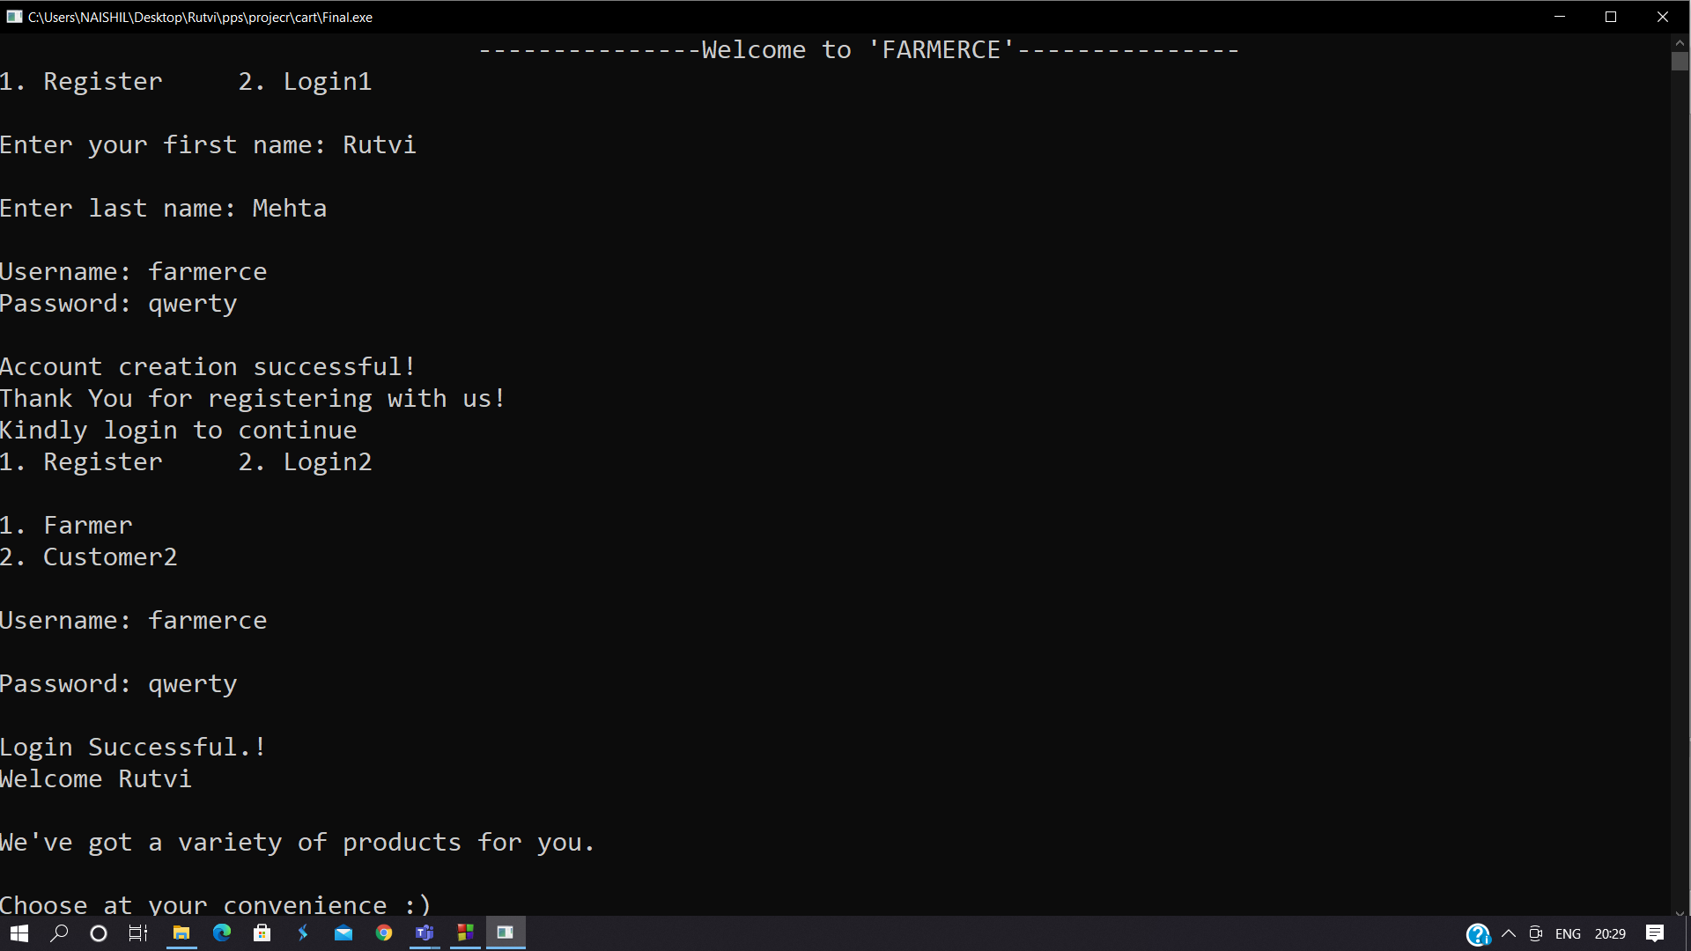
Simulation & Results
Figure: 3.1 User registration and login

Slide 27
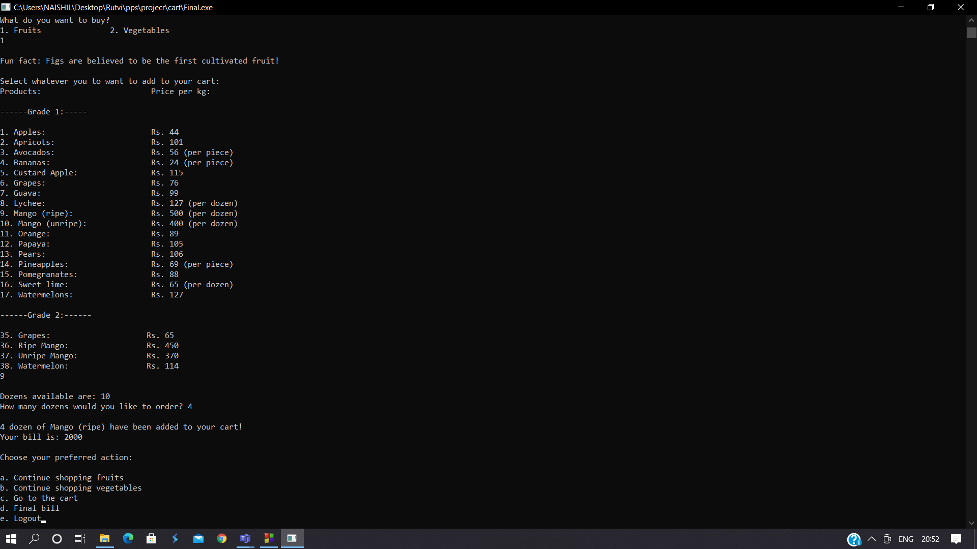
Simulation & Results
Figure 3.2: Customer option to order fruits or vegetables. Order here: 4 dozen ripe mangoes.

Slide 28
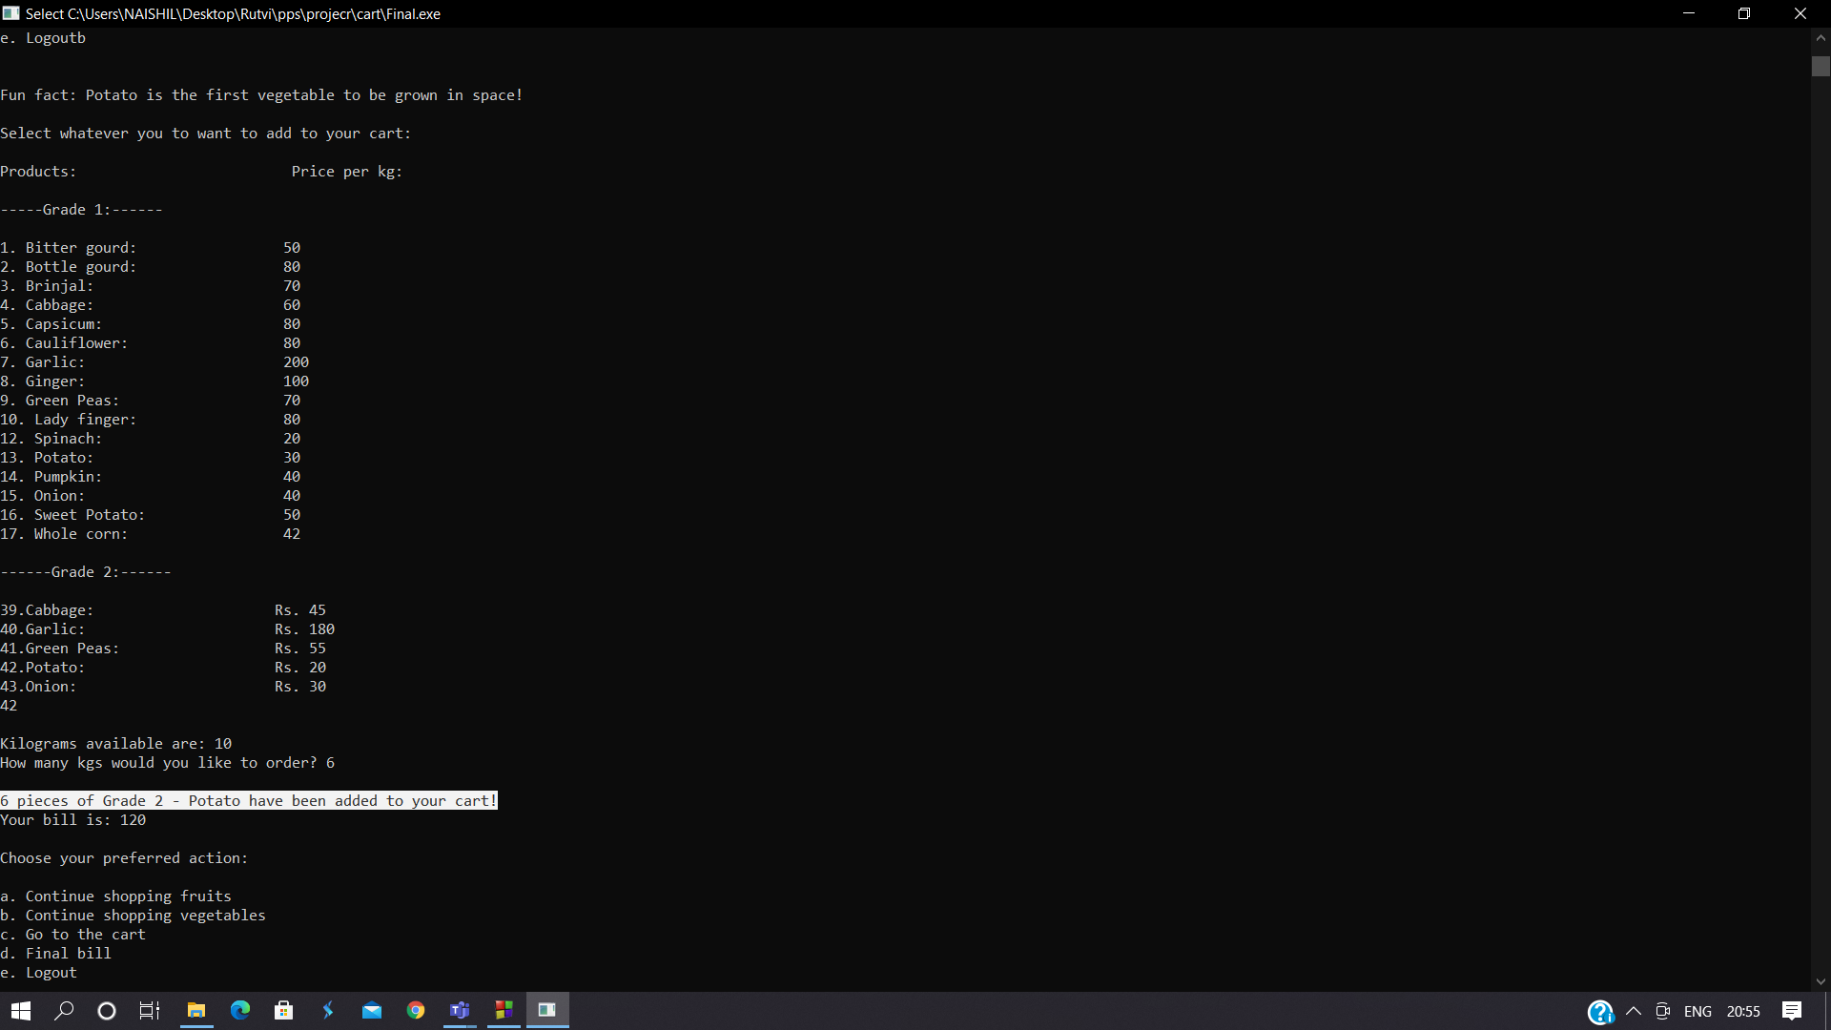
Simulation & Results
Figure 3.3: Continue to order for vegetables. Order: 2 kgs - Grade 2 Potatoes.

Slide 29
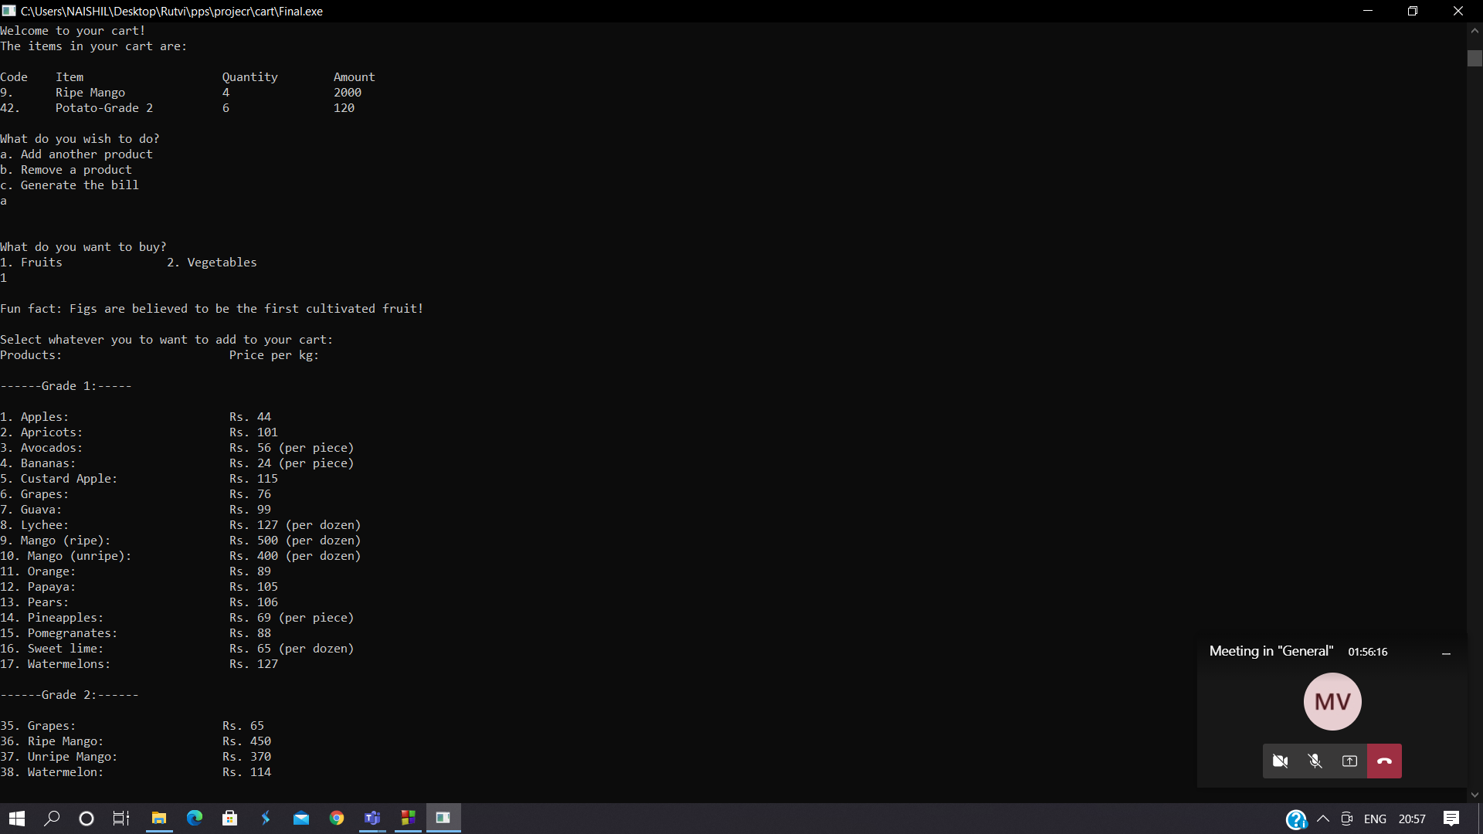
Simulation & Results
Figure 3.4: Working of Cart. Add product option in cart

Slide 30
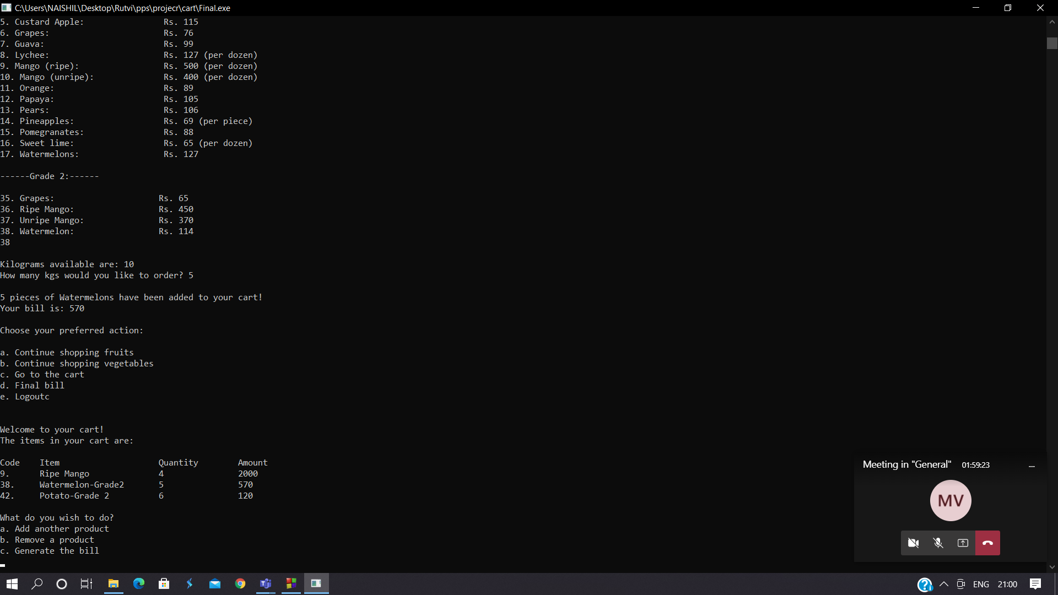
Simulation & Results
Figure 3.5: Product added: 5 kgs of Grade 2 – Watermelons and its addition in the cart.

Slide 31
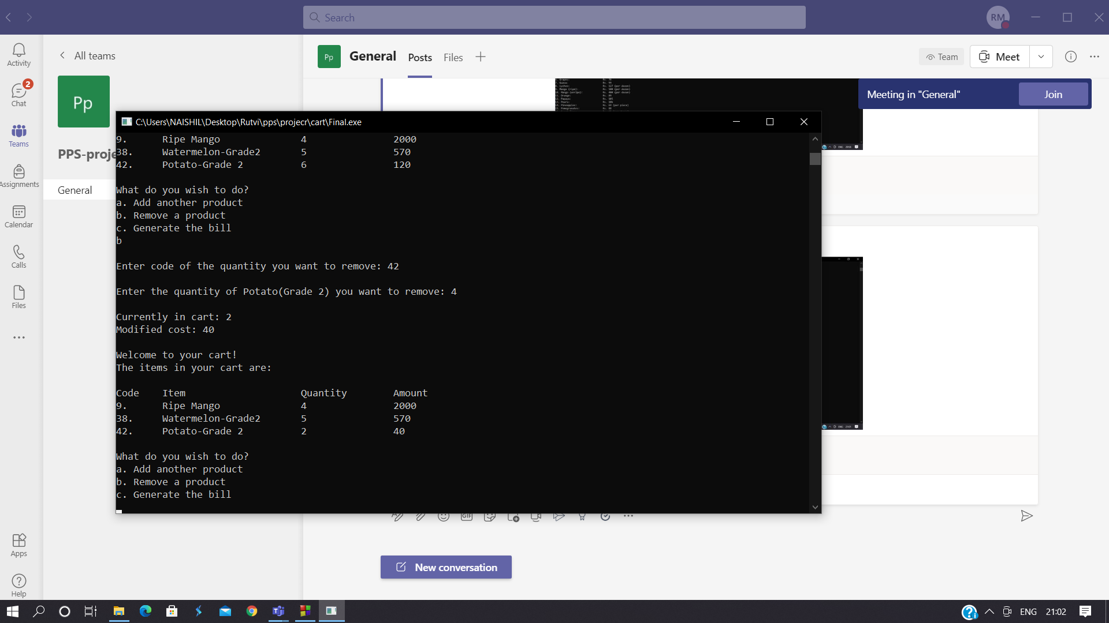
Simulation & Results
Figure 3.6: Remove product function in cart. Product removed: Grade 2 Potatoes and further chnages in cart.

Slide 32
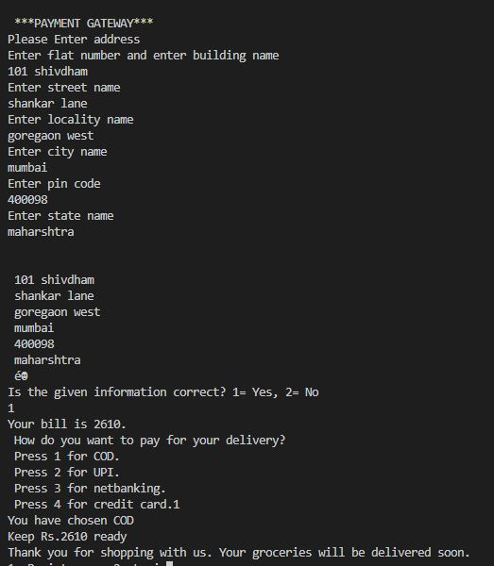
Simulation & Results
Figure 3.7: Bill generation - User payment. Input of address and payment via Cash on delivery

Slide 33
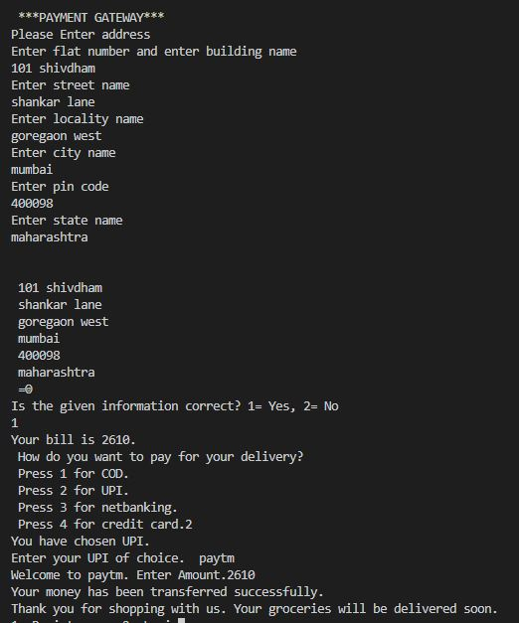
Simulation & Results
Figure 3.8: User payment via UPI

Slide 34
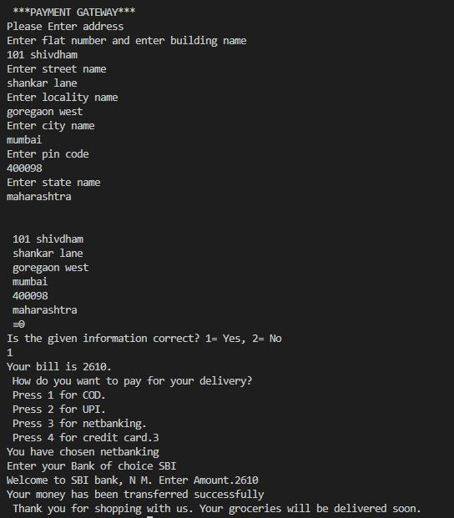
Simulation & Results
Figure 3.9: User Payment via Netbanking

Slide 35
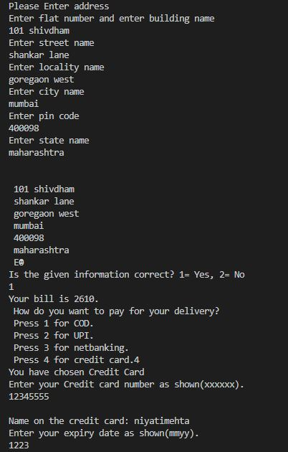
Simulation & Results
Figure 3.10: User payment via credit card part 1

Slide 36
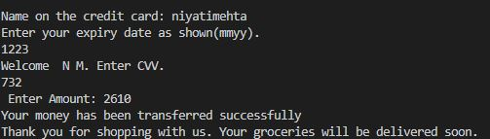
Simulation & Results
Figure 3.11: User payment via credit card part 2

Slide 37
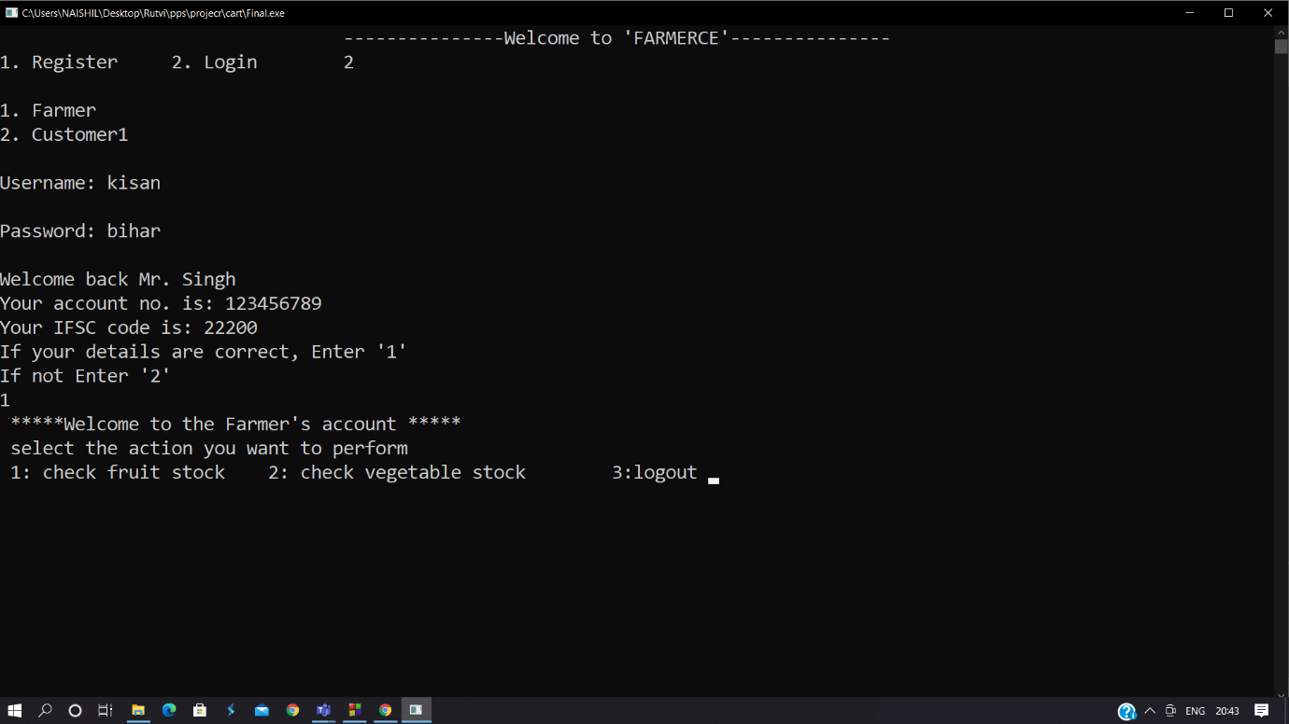
Simulation & Results
Figure 3.12: Pre-defined account of farmer. Username: kisan, password: bihar

Slide 38
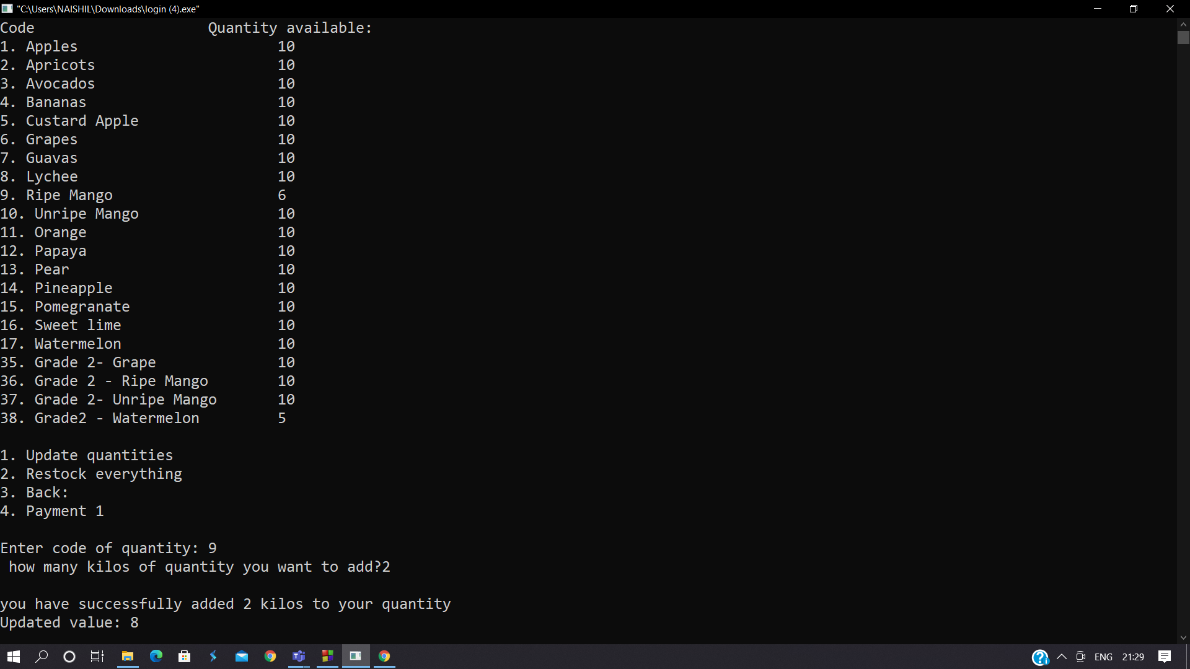
Simulation & Results
Figure 3.13: Updating quantities by farmer

Slide 39
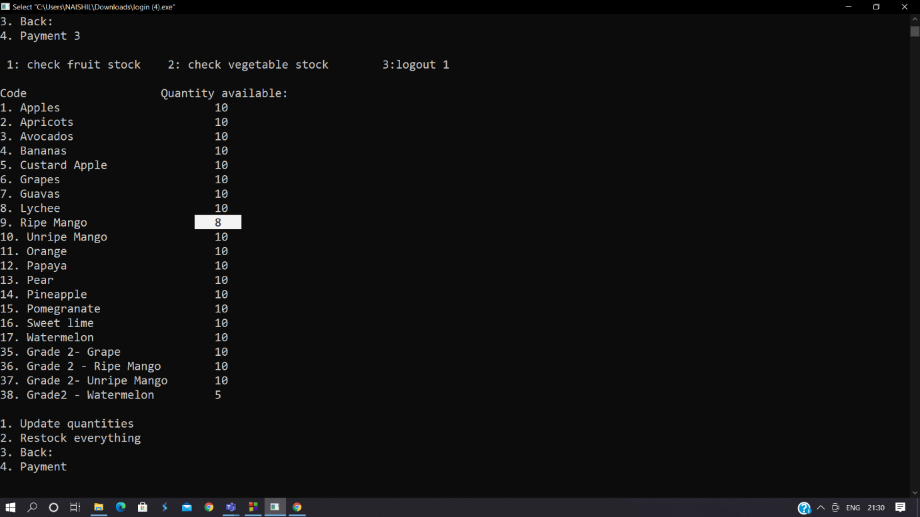
Simulation & Results
Figure 3.14 : Quantity updated

Slide 40
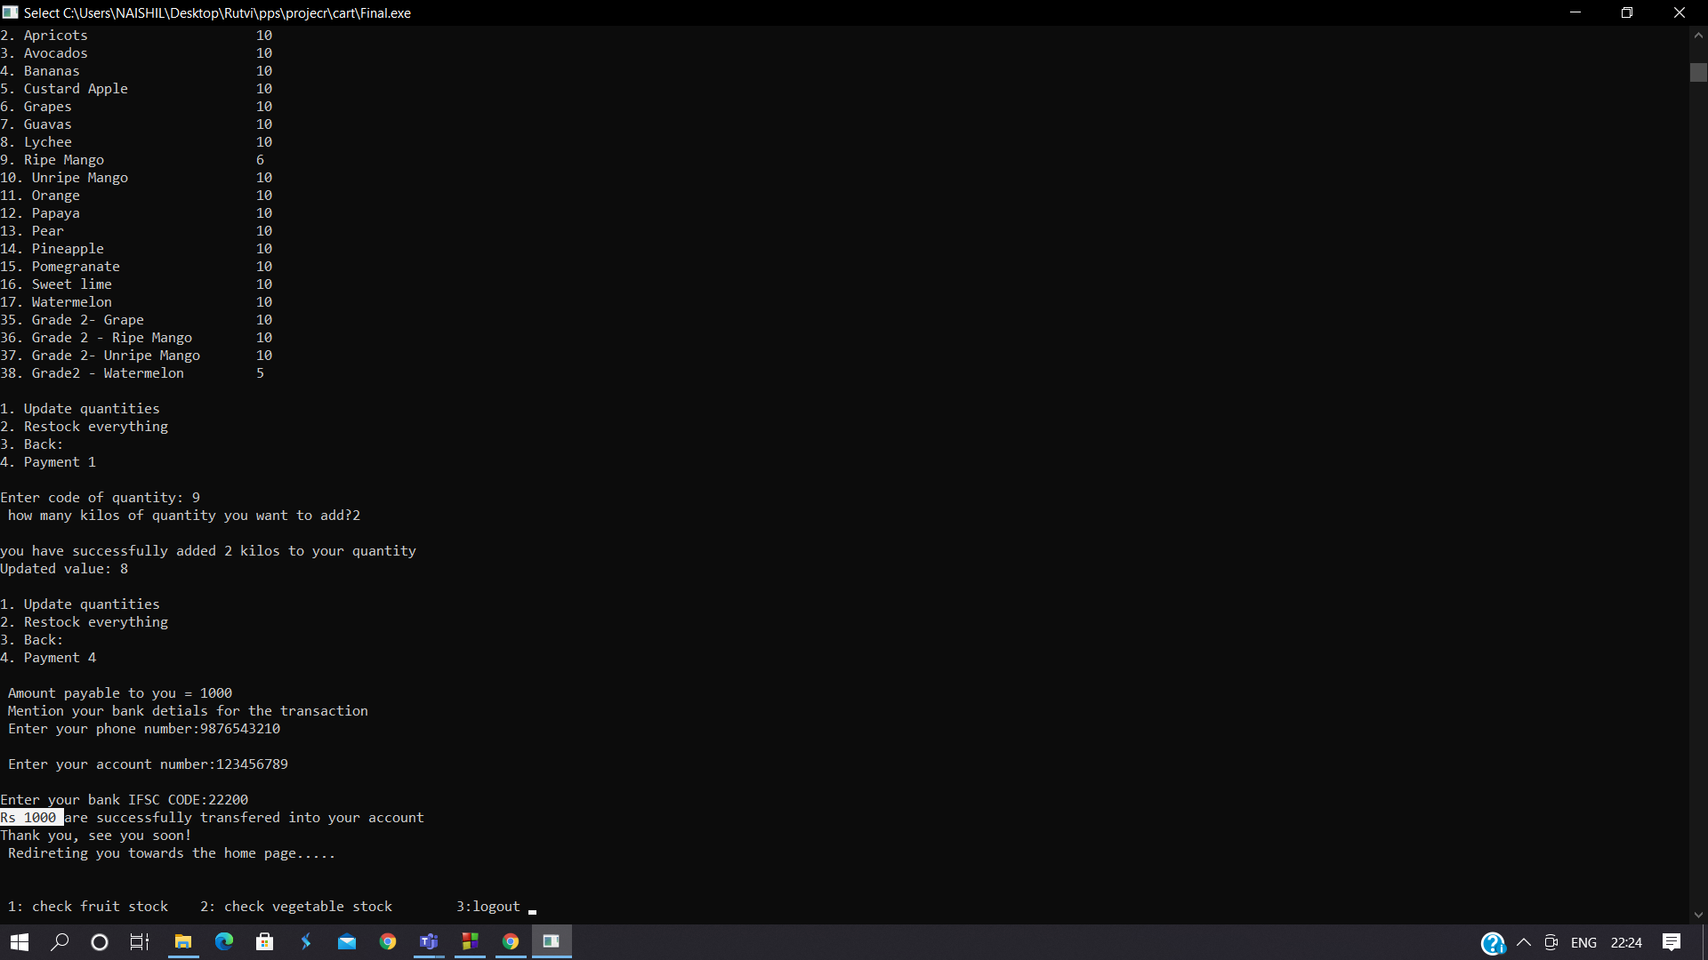
Simulation & Results
Figure 3.15: Payment for updating quantity

Slide 41
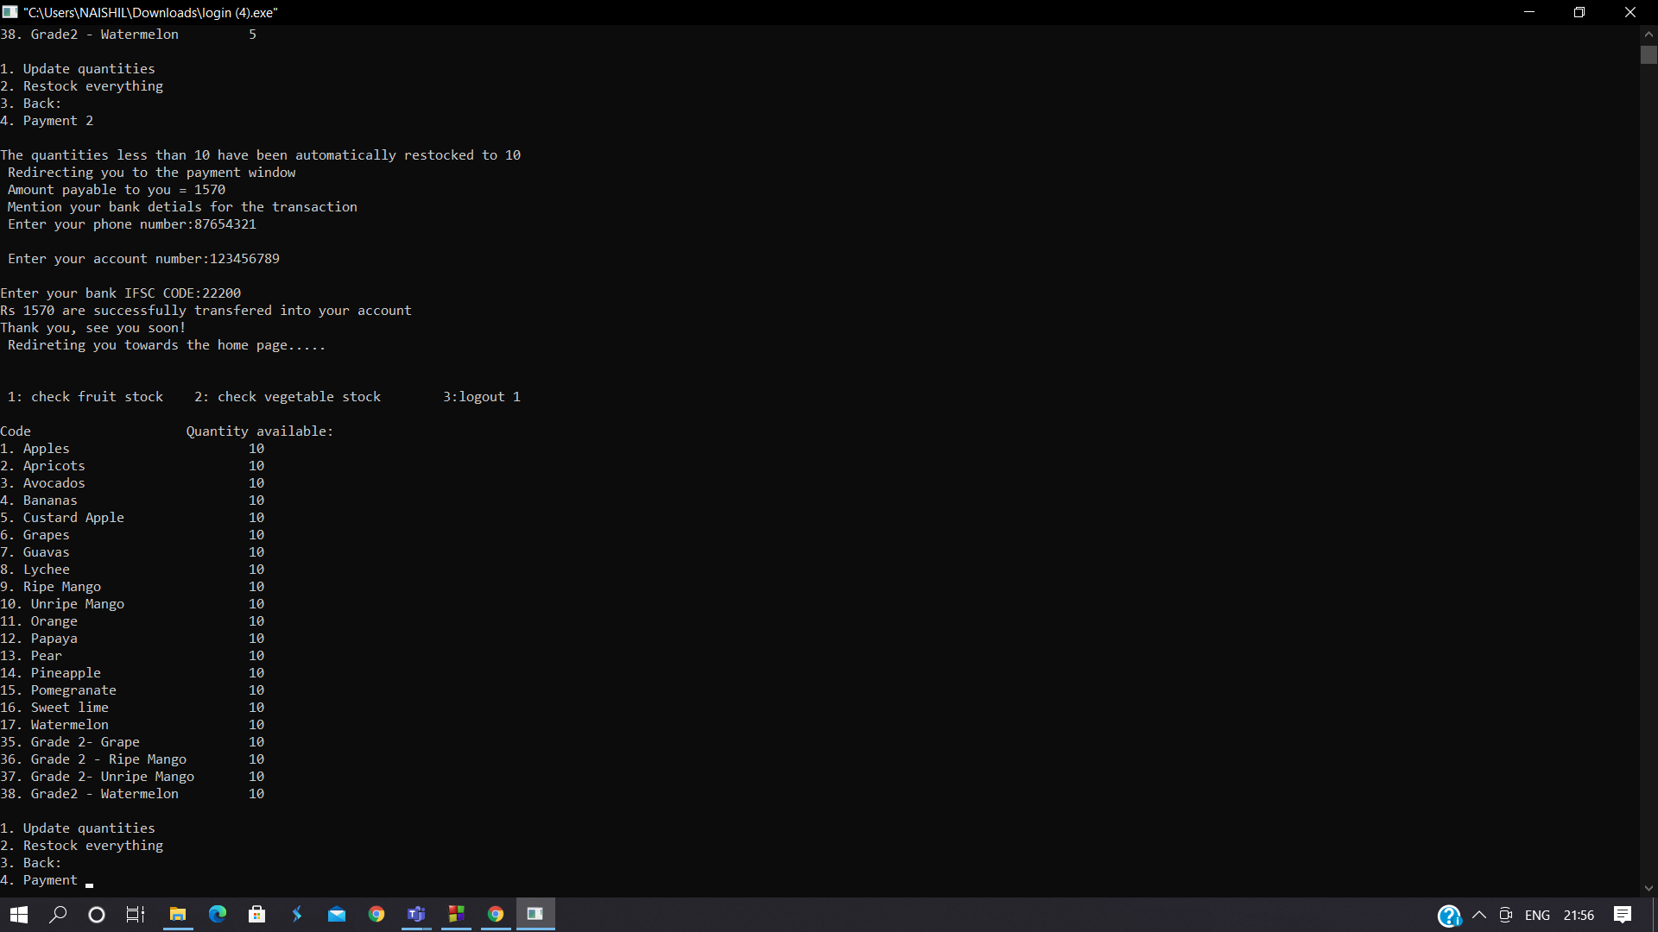
Simulation & Results
Figure 3.16: Payment for Restocking by farmer and its result.

Slide 42
Conclusion
In conclusion, the system is very user friendly and secure.
It will provide a bridge between the farmers and the consumers. The system we have made is basic but extremely efficient and precise.
We have tried to solve the communication, pricing and wastage issues through our program after careful analysis of existing platforms and have planned a lot of upgrades and the implementation of new ideas for this system. We conclude the project with the hope that you will be using our system and encouraging us for future work too.

Slide 43
Future Work
In the future we are planning to make an application for the farmers and the customers to use.
We are also planning to have filters so that customers can have an easier and faster experience with ordering.
We are planning to have an option of pre-saving address details(multiple-home,work,etc.), billing details, etc. for the customers’ convenience. A detect location automatically or select location manually as the application is opened option is something we are planning to execute.

Slide 44
Future Work
We will be having a My Orders option to track current orders and display previous orders; once we expand with a wider customer base and farmer bases we will have customer support options for example chat, using AI and calls for any grievances or extra information.
A frequently asked questions for saving the customers and our time which would solve problems quickly will be made available. We will be having an option wherein customers can choose the date and time convenient to them for delivery and many offers and discount code options too.
Specific sale days for discounted prices once a year to boost our customer relations is also something we wish to implement in the future.

Slide 45
Future Work
Additional things we would like to add are
i) Monetisation-The current version of the program does not have an effective monetisation platform built for the company. In the future, we plan to add a larger, more robust payment system. In addition, we plan to move our monetization away towards an advertisement based model.
ii)Better quality controls- Future versions of the program will allow more tools for the audience to inspect their products, like images and instant access to farmer quality certificates.
iii)Expanded inventory- Future versions of the code will allow farmers to allow for other groceries, like dairy,spices and meats to be sold on the platform.

Slide 46
Reference
To Make our code and write our report, we have consulted these sources: https://stackoverflow.com/questions/61692985/create-a-simple-registration-and-login-system-with-c
https://www.youtube.com/watch?v=aF1ItWvy9ZY
https://github.com/IstiyakV/Simple-Sign-Up-and-Login-System-with-C-Programming
https://www.codeproject.com/Questions/5250264/C-programming-language-login-feature

Slide 47
Reference
https://youtu.be/AefKSoNpZtQ
https://www.quora.com/How-can-I-create-a-login-system-in-C
https://sourcecodeera.com/blogs/Samath/Supermarket-Management-System-in-C.aspx
https://www.tutorialspoint.com/cprogramming/c_functions.htm
https://www.javatpoint.com/c-array#:~:text=An%20array%20is%20defined%20as,%2C%20double%2C%20float%2C%20etc.
https://www.tutorialspoint.com/cprogramming/c_structures.htm

Slide 48
THANK YOU

