Slide 1
MFCC
Mel-frequency cepstral coefficients

Slide 2
MFCC algorithm is a technique generally use to extract information (feature) out of a human voice which is unique to every user which is used to perform Voice Recognition
MFC coefficients algorithm takes voice sample as inputs. After processing, it calculates coefficients unique to a particular sample

Slide 3
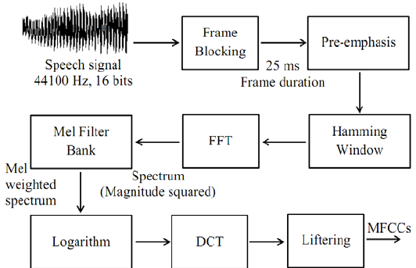
Block diagram for obtaining MFC coefficient

Slide 4
Frame blocking
Frame the signal into 20-40 ms frames. 25ms is standard. This means the frame length for a 16kHz signal is 0.025*16000 = 400 samples. Frame step is usually something like 10ms (160 samples), which allows some overlap to the frames. The first 400 sample frame starts at sample 0, the next 400 sample frame starts at sample 160 etc. until the end of the speech file is reached. If the speech file does not divide into an even number of frames, pad it with zeros so that it does.
One set of 12 MFCC coefficients is extracted for each frame**

Slide 5
Pre-emphasis
The goal of pre-emphasis is to compensate the high-frequency part that was suppressed during the sound production mechanism of humans. Moreover, it can also amplify the importance of high-frequency formants

Slide 6


Discrete Fourier Transform of the frame
where is an sample long analysis window (e.g. hamming window), and is the length of the DFT. The periodogram-based power spectral estimate for the speech frame is given by:
This is called the Periodogram estimate of the power spectrum
We would generally perform a 512 point FFT and keep only the first 257 coefficents**

Slide 7
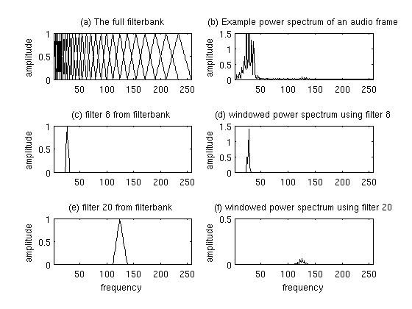
Compute the Mel-spaced filterbank. This is a set of 20-40 (26 is standard) triangular filters that we apply to the periodogram power spectral estimated before.

Slide 8
Take the log of each of the 26 energies from step 3. This leaves us with 26 log filterbank energies.
Take the Discrete Cosine Transform (DCT) of the 26 log filterbank energies to give 26 cepstral coefficents. For ASR, only the lower 12-13 of the 26 coefficients are kept.
The resulting features (12 numbers for each frame) are called Mel Frequency Cepstral Coefficients.

Slide 9
How to Implement ?
The formula for converting from frequency to
Mel scale is:
To go from Mels back to frequency:

Slide 10
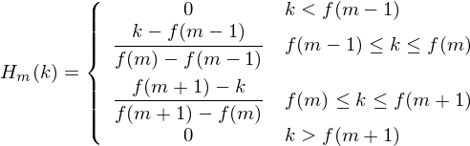
Cont.
Convert the frequncies to fft bin numbers we need to know the FFT size and the sample rate, f(i) = floor((nfft+1)*h(i)/samplerate)
Now we create our filterbanks. The first filterbank will start at the first point, reach its peak at the second point, then return to zero at the 3rd point. A formula for calculating these is as follows:
where M is the number of filters we want, and f( ) is the list of M+2
Mel-spaced frequencies.

Slide 11
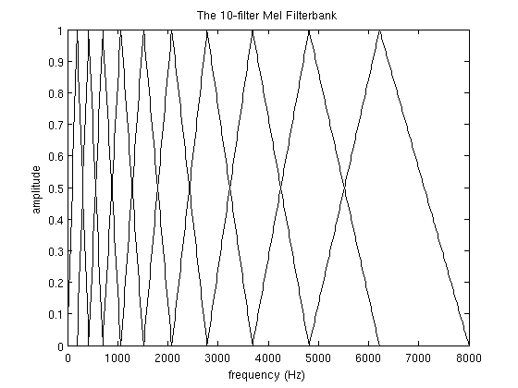
The final plot of all 10 filters overlayed on each other is:

Slide 12

Increases ASR performance by adding delta coefficient **
To calculate the delta coefficients, the following formula is used:
where is a delta coefficient, from frame computed in terms of the static coefficients to . A typical value for is 2. Delta-Delta (Acceleration) coefficients are calculated in the same way, but they are calculated from the deltas, not the static coefficients.

