Slide 1
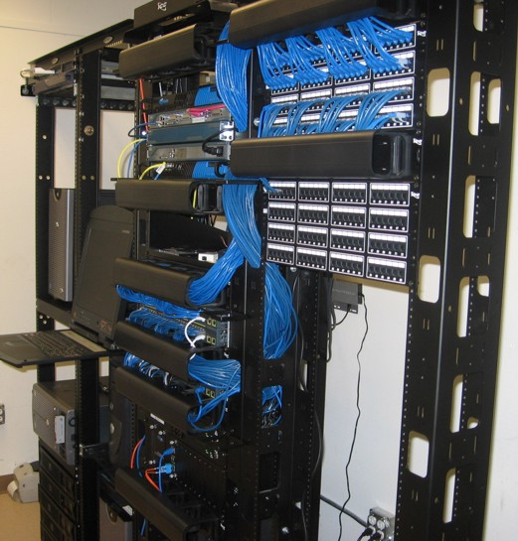
NETWORKING-BASICS
Lokesh Walase ( TY-Comp, Coep)
lokeshw24@gmail.com
GNU Free Documentation License
Version 0.1

Slide 2

What comes to your mind when I say “network” ??

Slide 3
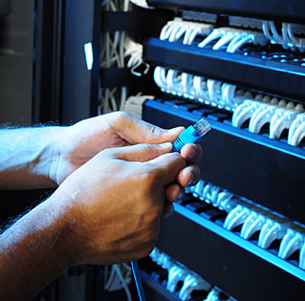
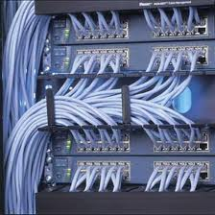
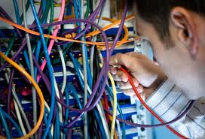
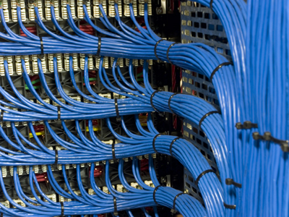

OK, but we are going for something different....

Slide 4
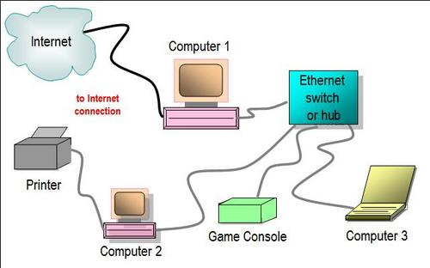
What is a Network ?
Interconnection of devices ie printers , computers , telephones etc
“Physical Connectivity” among two or more devices

Slide 5
What is networking ?
Communication between interconnected devices
TYPES : ( geographical scope )
  LAN( Local Area Network ) ie within room, building or a university.
  MAN( Metropolitian Area Network ) ie spans entire city.
  WAN( Wide Area Network ) ie connects different cities, states , countries .

Slide 6
What do I need to set up network ?
Devices like computer , printers , telephones etc
NIC ( Network Interface Card ) : it “physically” attaches a computer to a network .
Media : 1.Hub( always “Broadcasting” )
  2.Switch( 1st “Broadcasting” & then “Unicasting” )

Slide 7
Requirements of network
3.Routers( connects different networks )
Cables are used to connect NIC with hub/switch/routers
For LAN we use CAT5 or CAT6 cables with RJ-45 connector ( Registered Jack )

Slide 8
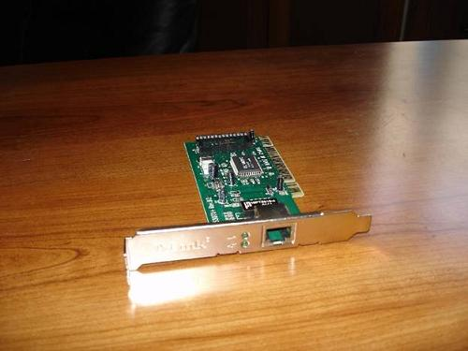
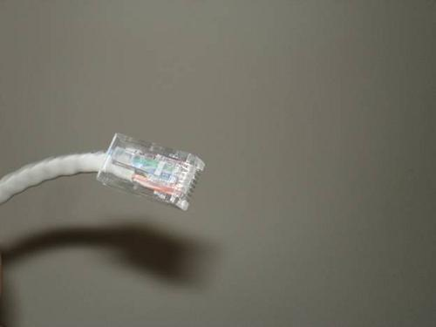
Ethernet NIC card & Ethernet Connector with RJ-45 connector

Slide 9
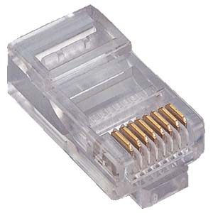
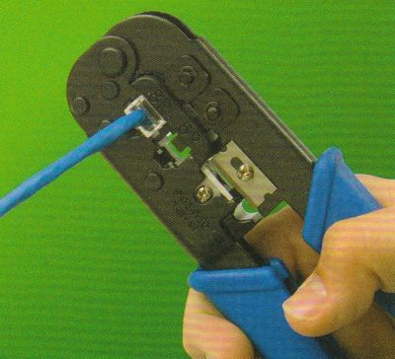
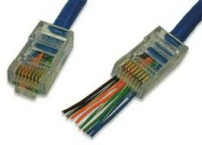
RJ-45 connector & Crimper

Slide 10
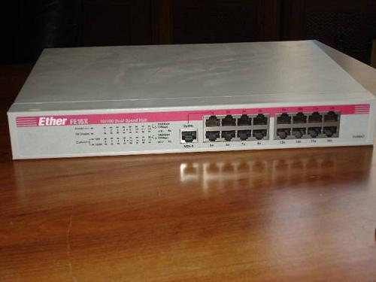
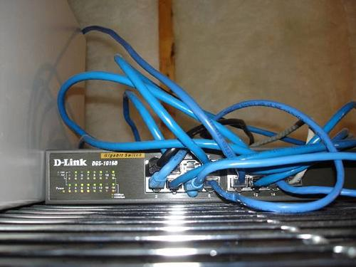
Hub & Switch

Slide 11
Addressing in Networking
Two types of address exists :
  1.MAC address ie “Physical” Address ( 48 bit )
  2.IP address ie “Logical” Address ( Ipv4 is 32bit & Ipv6 is 128 bit)
Right now Ipv4 is in use.
Command to find MAC & IP address is : “ifconfig”

Slide 12
Addressing in Networking
MAC( Media Access Control ) address also called as : link-level addr, ethernet addr, station addr, H/W addr .
Each NIC is programmed at factory with unique MAC..
48-bits =
  Top 24 bits: vendor id
  Bottom 24 bits: node id

Slide 13
MAC address
Website to check your MAC address :
http://www.coffer.com/mac_find/

Slide 14
Ipv4 Addresses
32 bit number ( 4-octets of 8bits ) - Expressed in “dotted-quad” notation, e.g. 164.112.128.1
Two types :
  1. Public
  2. Private

Slide 15
Five Classes in Public IP
Class A :
  8bits( Net ID) + 24bits( Host ID)= 32bits
  Range : 0.x.y.z to 127.x.y.z
  Total nodes in a network of type Class A is ( 2^7 )*(2^24-2)

Slide 16
Five Classes in Public IP
Class B :
  16bits( Net ID) + 16bits( Host ID)= 32bits
  Higher 2bits are “10”
  Range : 128.x.y.z to 191.x.y.z
  Total nodes in a network of type Class B is ( 2^14)*(2^16-2)

Slide 17
Five Classes in Public IP
Class C :
  24bits( Net ID) + 8bits( Host ID)= 32bits
  Higher 3 bits are “110”
  Range : 192.x.y.z to 223.x.y.z
  Total nodes in a network of type Class C is ( 2^21)*(2^8-2)
Thus , Net-ID does work of “local router” .

Slide 18
Five Classes in Public IP
Classes A,B,C support “unicasting” .
Class D : ( supports “multicasting” , group emails )
  Higher 4 bits are (1110)
  Range is (224).x.y.z to (239).x.y.z
Class E : ( research & future purpose )
  Higher 4 bits are (1111)
  Range is (240).x.y.z to (253).x.y.z

Slide 19
Lets see an example
If IP addr of system = 78.65.76.88 , find its “net ID” , 1st host , last host & “Directed Broadcast Address” ( DBA )
ANS: 78.0.0.0 , 78.0.0.1 , 78.255.255.254 , 78.255.255.255 ( in that order )
“DBA” is used if packet has to be transmitted to all systems in a network.
Make all “host ID” bits as “1” .

Slide 20
One More Example...
If IP addr of system = 203.89.79.66 , find its “net ID” , 1st host , last host & “Directed Broadcast Address” ( DBA )
ANS : 203.89.79.00 , 203.89.79.01 , 203.89.79.254 , 203.89.79.255

Slide 21
Limited Broadcast Address
It is 255.255.255.255 .
Used to send packet to all nodes within “same” network .
Till now all we saw was “2-level hierarchy”.
But what is actually used is “3-level heirarchy” , it has concept of “subnetting”.

Slide 22
Ranges of Private IP addr
Till now all were “public”, now “private”IP's-
1.)10.0.0.0 to 10.255.255.255 OR
2.)172.16.0.0 to 172.31.255.255 OR
3.)192.168.0.0 to 192.168.255.255.
Can you guess the class-type of each ??
NOTE: 1.) has only 1 network , 2.) has max 16 networks & 3.) has max 256 networks .

Slide 23
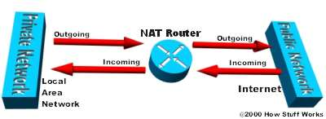
Need of NAT router
Network Address Translation .
Agent between public & private network.
Hides entire IP addr space behind single /group of IP addr.

Slide 24
DHCP & DHCP server
Computers on IP networks must be configured b4 communication.
For eg, they must be given IP addr , default route etc .
This could be done manually. But DHCP does this for us.
It is – Dynamic Host Control Protocol .

Slide 25
DHCP & DHCP server
DHCP is controlled by a DHCP-server.
DHCP enabled on your computer means you are letting DHCP server assign a IP( from a defined range of nos. )
DHCP server assigns a device IP , subnet mask , default gateway .

Slide 26
DNS & DNS server
Domain Name System
Std technology for managing names of websites & Internet domains .
DNS server is like look-up table.
Can you think of something similar that we already use ??

Slide 27
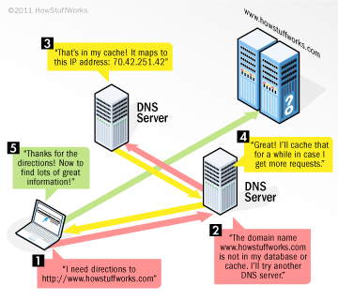
DNS & DNS servers
DNS servers communicate with each other using private protocols.
All DNS servers are arranged in heirarchy .
cat /etc/resolv.conf

Slide 28
Networking commands
ifconfig: display current config for all NIC's
ifconfig eth0 down : disable network card
ifconfig eth0 up : enable network card
host moodle.coep.org.in : DNS test
traceroute www.whatismyip.com
tracepath www.whatismyip.com

Slide 29
Networking commands
ping localhost : if error then NIC is not physically installed or is bad .
ping moodle.coep.org.in : check connection
netstat -rn : ??

Slide 30
ssh & scp
Ssh – secure shell , scp- secure copy.
Try this : ssh student@10.1.26.x
Try this : scp document.pdf student@10.1.26.x: ( send file at home folder of student )
Several combinations for scp at : http://www.examplenow.com/scp/

