Slide 1
ETERNITY
SOEN 6011
Software Engineering Process
Deliverable 1
Name :- Vandit Digneshbhai Mehta
Student ID :- 40232414
Function :- F4: Γ(x) (Gamma Function)
Thursday
11th July,2024

Slide 2
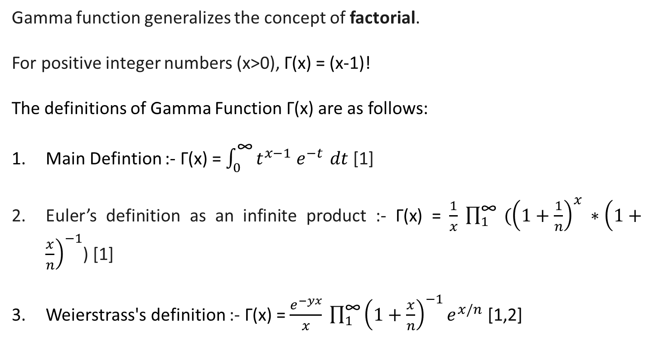
Gamma Function : Γ(x)
Gamma function generalizes the concept of factorial.
For positive integer numbers (x>0), Γ(x) = (x-1)!
The definitions of Gamma Function Γ(x) are as follows:
Main Defintion :- Γ(x) = $\int_{0}^{\text{∞}}{t^{x−1} e^{−t }dt}$ [1]
Euler’s definition as an infinite product :- Γ(x) = $\frac{1}{x} \prod_{1}^{\text{∞}}{ ({\left(1+\frac{1}{n}\right)}^{x} ∗{\left(1+\frac{x}{n}\right)}^{−1}}$) [1]
Weierstrass's definition :- Γ(x) = $\frac{e^{−yx}}{x} \prod_{1}^{\text{∞}}{{\left(1+\frac{x}{n}\right)}^{−1}e^{x/n}}$ [1,2]

Slide 3
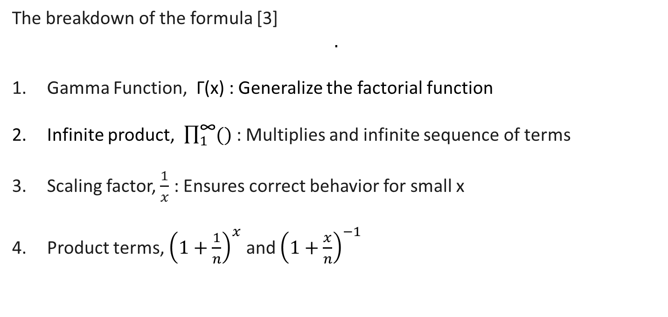
Euler’s definition as an infinite product
The breakdown of the formula [3]
$$.$$
Gamma Function, Γ(x) : Generalize the factorial function
Infinite product, $\prod_{1}^{\text{∞}}{()}$ : Multiplies and infinite sequence of terms
Scaling factor, $\frac{1}{x}$ : Ensures correct behavior for small x
Product terms, ${\left(1+\frac{1}{n}\right)}^{x}$ and ${\left(1+\frac{x}{n}\right)}^{−1}$

Slide 4
Assumptions
Positive Input :- Assumes x is a positive real number. Validates it by checking x>0, otherwise an exception is thrown [4].
Convergence :- Uses 100,000,000 iterations to approximate the infinite product [5].
Numerical Stability :- Assumes calculations remain numerically stable i.e negligible risk of overflow or underflow [5].
Precision :- Assumes double-precision floating points arithmetic is sufficient. Minor inaccuracies are considered negligible [4].

Slide 5
REQUIREMENTS SPECIFICATIONS
IDENTIFIER | TITLE | DESCRIPTION | RATIONALE | ASSUMPTIONS
RQ-Input-Validation | Input Validation | The function shall validate the input parameter x to ensure it is a positive real number. | The Gamma function is not defined for non-positive numbers, and therefore input validation is necessary. | None
RQ-COMPUTE-GAMMA | Computation of Gamma Function | The function shall compute the Gamma function Γ(x) using Euler's infinite product formula. | Euler's formula provides a method to compute the Gamma function for positive real numbers x | The function assumes x is a positive real number.

Slide 6
REQUIREMENTS SPECIFICATIONS
IDENTIFIER | TITLE | DESCRIPTION | RATIONALE | ASSUMPTIONS
RQ-INF-PROD | Infinite Product Calculation | The function shall compute an approximation of the Gamma function by iterating specific number of times. | A finite number of terms are used to approximate the infinite product. | The number of iterations (maxIterations) is set to a large value to achieve sufficient precision.
RQ-PERF-CONS | Performance Considerations | The function shall handle large values of x efficiently to ensure reasonable execution time. | Performance is critical, especially when computing the Gamma function with a large number of iterations. | Increasing maxIterations may impact performance, and practical limits should be considered to balance between accuracy and execution time.

Slide 7
REQUIREMENTS SPECIFICATIONS
IDENTIFIER | TITLE | DESCRIPTION | RATIONALE | ASSUMPTIONS
RQ-EX-HANDLING | Exception Handling | The function shall throw an IllegalArgumentException if x is non-positive. | Ensures that the function adheres to the Gamma function's domain restriction, preventing invalid computations. | None
RQ-OUT-PREC | Output Precision | The function shall return a sufficiently accurate approximation of Γ(x) based on the chosen number of iterations. | Accuracy is crucial for applications requiring precise computations of the Gamma function. | The function uses Euler's formula to meet typical precision requirements for scientific and engineering applications.

Slide 8
References
https://en.wikipedia.org/wiki/Gamma_function
https://mathworld.wolfram.com/GammaFunction.html
https://www.britannica.com/science/gamma-function
https://www.youtube.com/watch?v=2RSqGJ-t1xE&t=127s
https://math.libretexts.org/Bookshelves/Analysis/Complex_Variables_with_Applications_(Orloff)/14%3A_Analytic_Continuation_and_the_Gamma_Function/14.02%3A_Definition_and_properties_of_the_Gamma_function

Slide 9
Thank you

