Slide 1
ETERNITY
SOEN 6011
Software Engineering Process
Deliverable 2
Name :- Vandit Digneshbhai Mehta
Student ID :- 40232414
Function :- F4: Γ(x) (Gamma Function)
Thursday
25th July,2024

Slide 2
INDEX
A quick recap
Graphical User Interface
Functional Requirements
Non-Functional Requirements
Interface Requirements
User Requirements
References

Slide 3
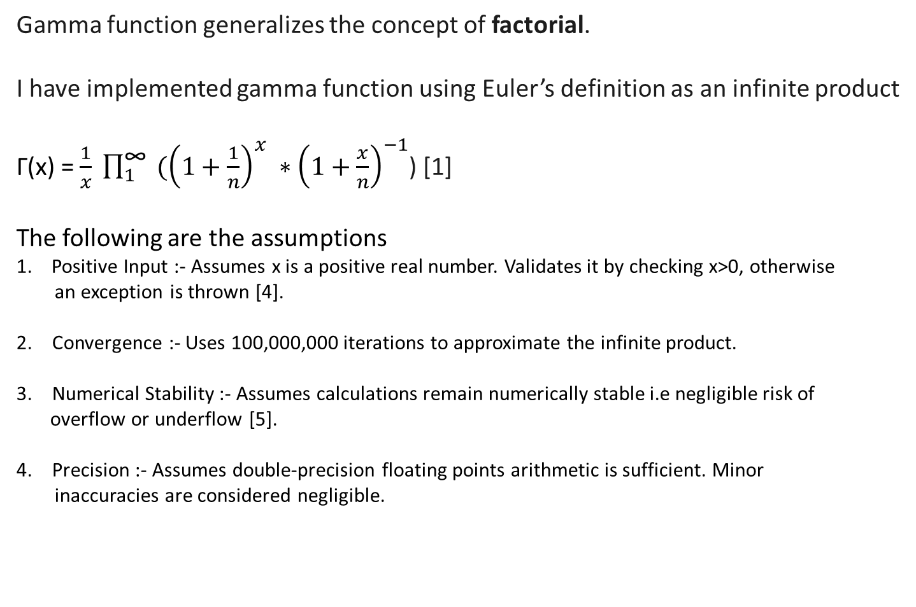
A QUICK RECAP
Gamma function generalizes the concept of factorial.
I have implemented gamma function using Euler’s definition as an infinite product
Γ(x) = $\frac{1}{x} \prod_{1}^{\text{∞}}{ ({\left(1+\frac{1}{n}\right)}^{x} ∗{\left(1+\frac{x}{n}\right)}^{−1}}$) [1]
The following are the assumptions
1. Positive Input :- Assumes x is a positive real number. Validates it by checking x>0, otherwise
an exception is thrown [4].
Convergence :- Uses 100,000,000 iterations to approximate the infinite product.
Numerical Stability :- Assumes calculations remain numerically stable i.e negligible risk of
overflow or underflow [5].
Precision :- Assumes double-precision floating points arithmetic is sufficient. Minor
inaccuracies are considered negligible.

Slide 4
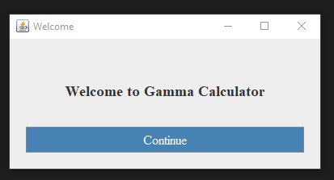
GUI
Welcome Screen

Slide 5
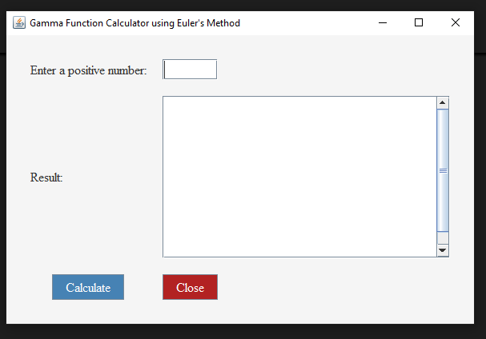
GUI
2. On pressing Continue

Slide 6
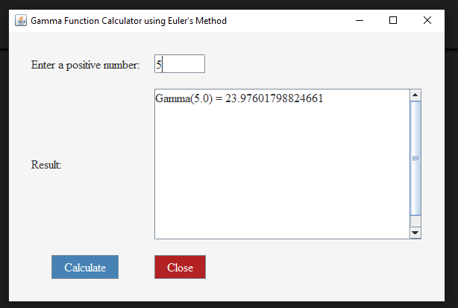
GUI
3. User Enters a number and press Enter

Slide 7
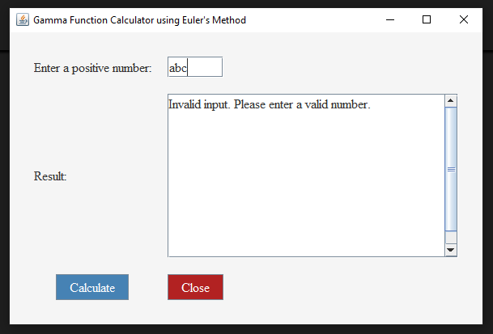
GUI
3. User Enters an incorrect output. The error message shown is helpful to users

Slide 8
Functional Requirements
Identifier :- FR1
User Input: Allow users to enter a positive number, validating the input and displaying clear error messages for invalid entries. Support both keyboard (Enter key) and mouse (click event) interactions [1].
Calculation: Compute the gamma function accurately and efficiently, handling large inputs to prevent performance issues [2].
Display: Show the result clearly and readably, including error messages for invalid inputs or calculation errors. Design the result display to handle large outputs gracefully with features like a scrollable text area [1].
Rationale: Ensure the core functionality meets user needs with a user-friendly interface, accurate and efficient calculations, and clear error handling for improved usability and reliability.
Assumptions: Users will input valid positive numbers, are familiar with the gamma function, the system will run in a Java Swing environment, and has sufficient computational resources

Slide 9
Non-functional Requirements
Identifier :- NFR1
Usability: Ensure the GUI is intuitive and easy to use, providing a seamless user experience [1].
Performance: Efficiently compute the gamma function, maintaining responsiveness even for large inputs [2].
Reliability: Implement proper error handling for invalid inputs or exceptions to ensure system stability.
Scalability: Handle varying sizes of user inputs and display results appropriately, ensuring the system can grow with user needs.
Rationale: Enhance user satisfaction and system efficiency by providing a robust and user-friendly application.
Assumptions: The application will handle a wide range of input values, maintaining performance and usability.

Slide 10
Interface Requirements
Identifier :- IR1
User Interface: Include labels, text fields, buttons, and a result display area to ensure all necessary components for interaction are present [3].
Accessibility: Choose font sizes and styles for readability, ensuring that the interface is accessible to all users.
Rationale: Ensure the system is accessible and easy to navigate, enhancing the overall user experience.
Assumptions: Users have varying levels of technical proficiency and may require a straightforward, intuitive interface.

Slide 11
Technical Requirements
Identifier :- TR1
Development Tools: Use Java Swing for GUI implementation to provide a consistent and reliable interface [4].
Event Handling: Properly handle button clicks and key presses to ensure responsive and accurate user interactions.
Rationale: Ensure the system is built on a solid technical foundation, facilitating development and maintenance [4].
Assumptions: Developers are familiar with Java Swing and event handling, ensuring effective implementation and troubleshooting.

Slide 12
User Requirements
Identifier :- UR1
User Interaction: Provide easy input, calculation trigger, and clear result display to enhance user experience [5].
Rationale: Ensure the system meets the practical needs of its users, making it effective and user-friendly.
Assumptions: Users will appreciate a straightforward and user-friendly interface, facilitating their interaction with the system.

Slide 13
References
https://www.altexsoft.com/blog/functional-and-non-functional-requirements-specification-and-types/
https://en.wikipedia.org/wiki/Functional_requirement
https://www.ppi-int.com/resources/systems-engineering-faq/what-are-interface-requirements-specifications-interface-design-descriptions-interface-control-documents-and-how-do-they-relate/
https://www.techtarget.com/whatis/definition/technical-requirements
https://maddevs.io/glossary/user-requirement-specification/

Slide 14
Thank you

