Slide 1
Data Mining - CS619 73624
Implementation using WEKA MIDTERM PROJECT
TEAM MEMBERS:
Ehtesham, Muhammad
Barde, Bhavesh Pravin
Jha, Shivam
Punmiya, Yogesh Mahipal
Vishwanath, Nithish Kumar

Slide 2
Objective & Tools
Exploring machine learning models using WEKA
Use appropriate datasets for each model
Evaluate using accuracy, ROC, and confusion matrices

Slide 3
Workflow
1. Dataset Selection
2. Model Training
3. Evaluation & Confusion Matrix
4. Result Comparison
WEKA used for classification, clustering, regression, and association.

Slide 4
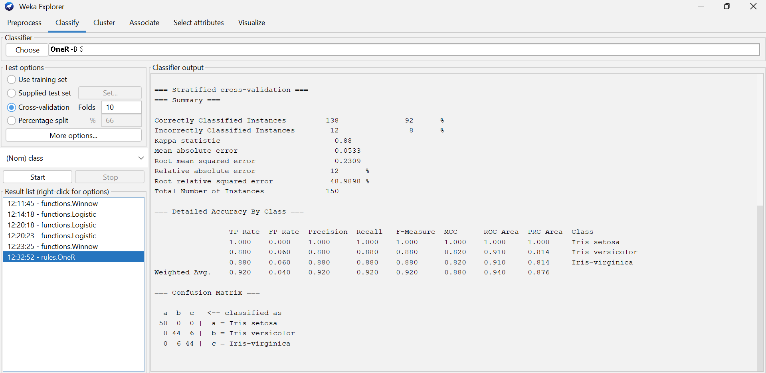
OneR (One Rule)
Dataset: IRIS.arff
Rule: Petal length thresholds
Accuracy: 92%
Perfect for Setosa, overlap between Versicolor & Virginica
Kappa = 0.88, ROC = 0.94

Slide 5
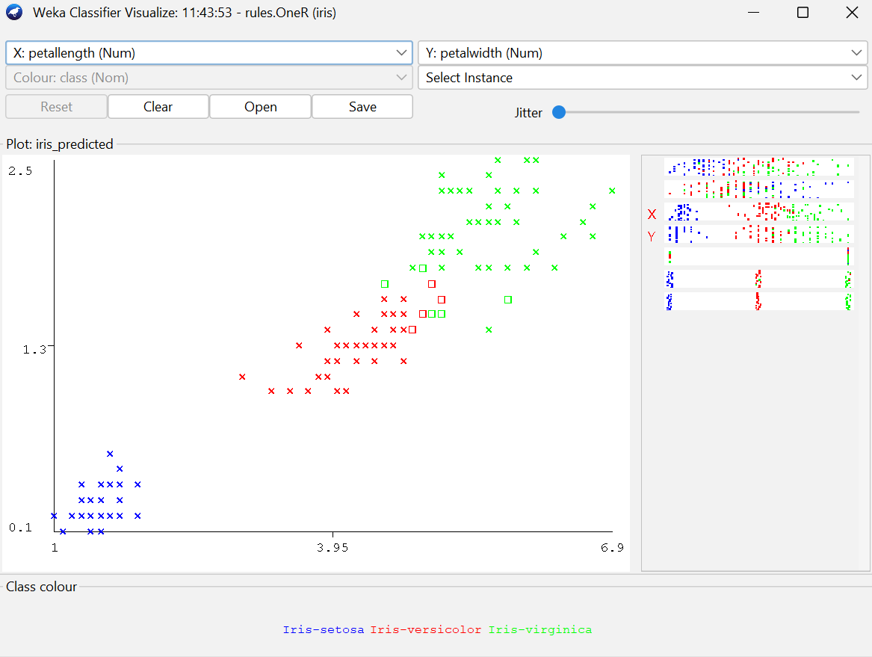
Distinct separation: Iris-setosa (blue) is clearly isolated with small petal length and width values.
Class overlap: Iris-versicolor (red) and Iris-virginica (green) overlap in the middle region, leading to some misclassifications.

Slide 6
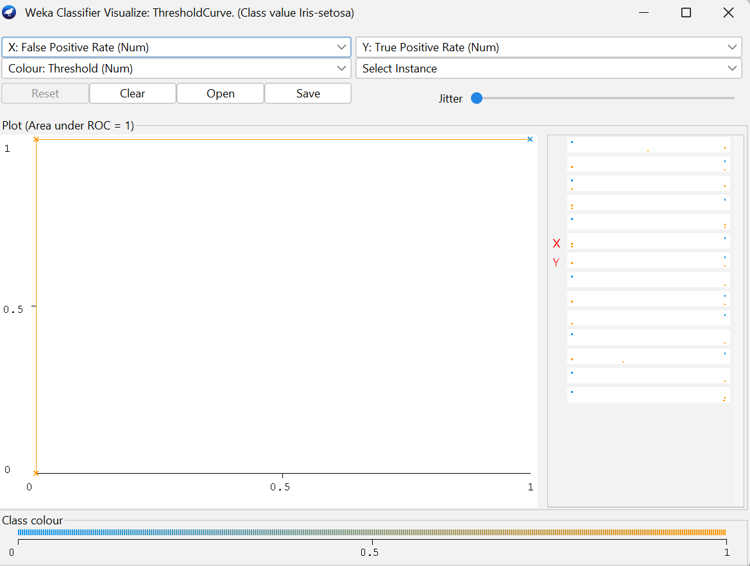
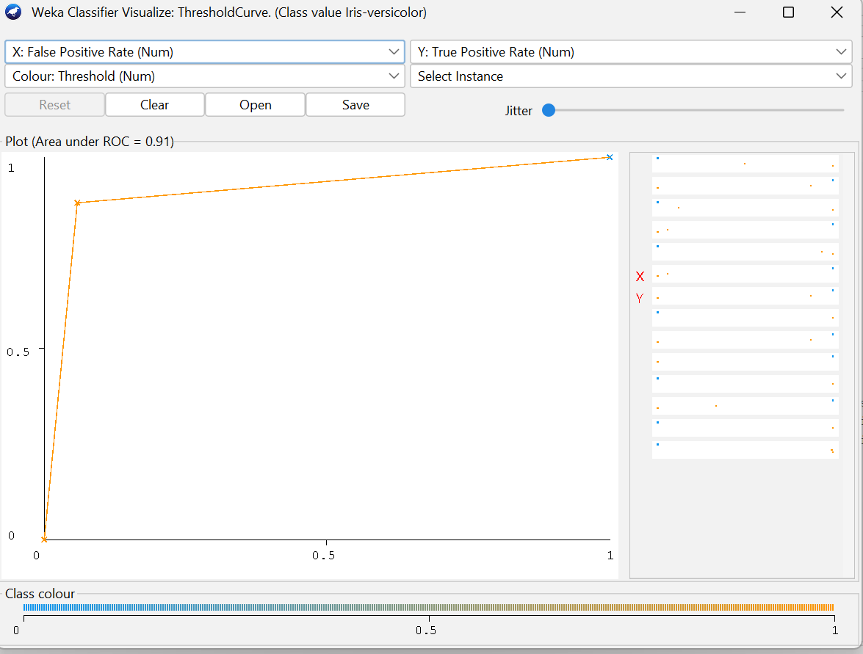
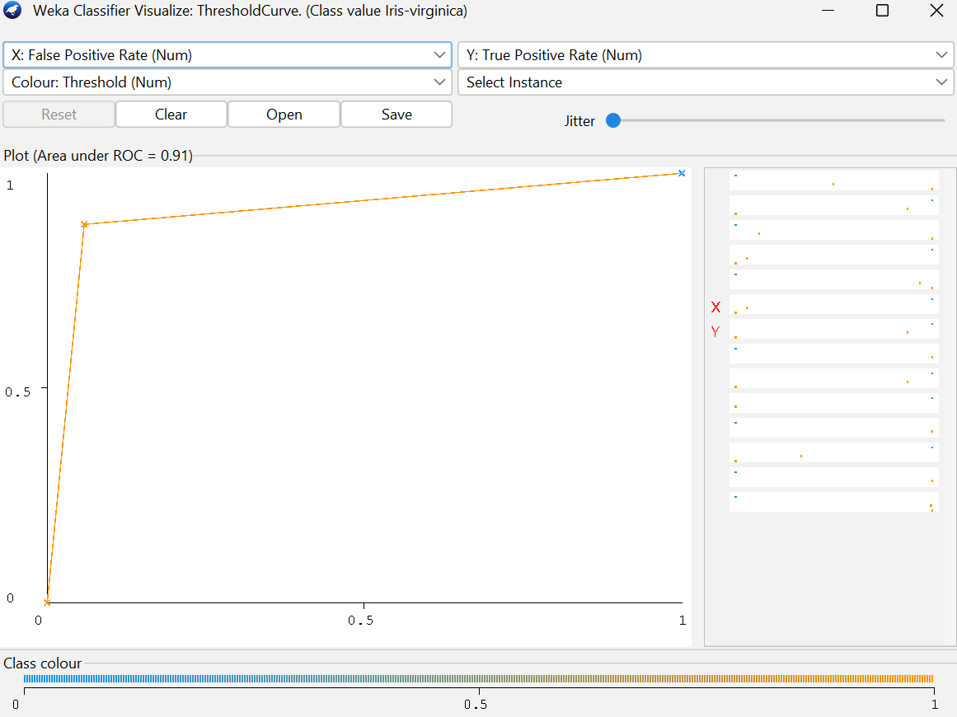
ROC CURVE COMPARISON

Slide 7
ROC SUMMARY
The Iris-setosa class achieves a perfect ROC area (AUC = 1.0), indicating flawless classification with zero overlap between true and false positives.
Both Iris-versicolor and Iris-virginica show high AUC values of 0.91, reflecting excellent model performance and strong discriminative ability.
The curves for Versicolor and Virginica are slightly less steep than Setosa’s, showing minor overlap between these two classes.
The steep rise near the Y-axis across all curves indicates high true positive rates and low false positive rates.
Overall, the model demonstrates robust predictive capability, with Setosa being the most clearly separable species and the other two exhibiting minimal confusion.

Slide 8
Naive Bayes Family
SIMPLE NAIVEBAYES
BAYES NET
NAÏVE BAYES MULTINOMIAL
NAÏVE BAYES UPDATEABLE
Dataset: IRIS.arff

Slide 9
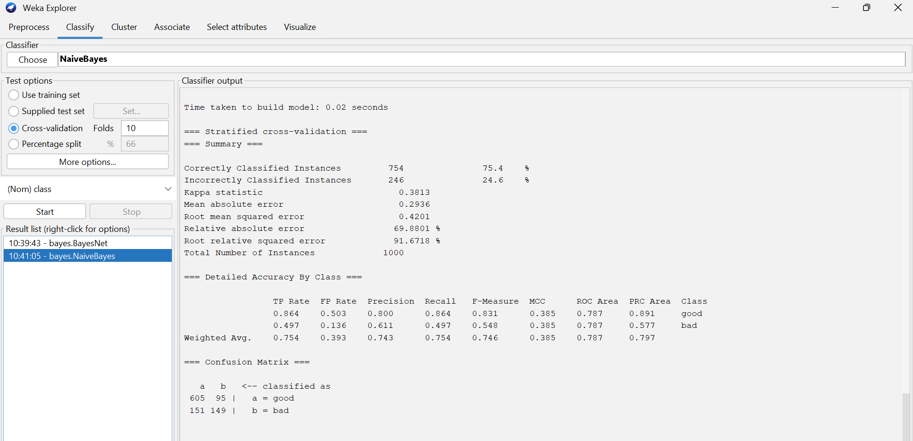
Simple Naïve Bayes
Accuracy: 96.0%
Kappa statistic: 0.94 (strong agreement)
Precision/Recall (Iris-setosa): 1.000 / 1.000
Precision/Recall (Iris-versicolor): 0.923 / 0.960
Precision/Recall (Iris-virginica): 0.958 / 0.920
ROC Area: 0.994 (excellent discrimination)

Slide 10
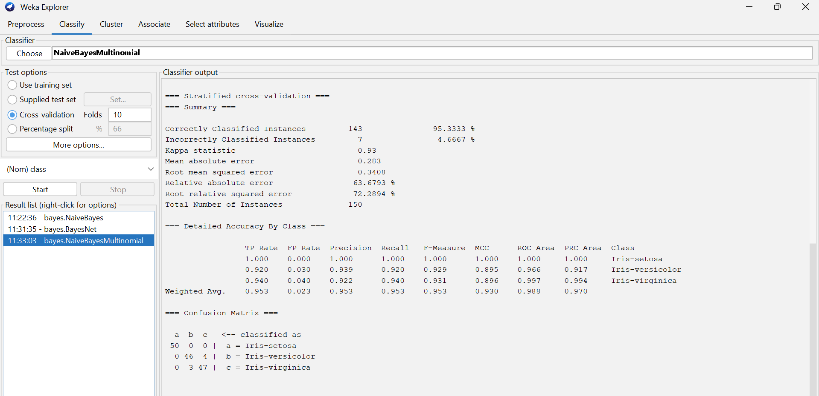
Naïve bayes Multinomial
Accuracy: 95.3%
Kappa statistic: 0.93 (strong agreement)
Precision/Recall (Iris-setosa): 1.000 / 1.000
Precision/Recall (Iris-versicolor): 0.939 / 0.920
Precision/Recall (Iris-virginica): 0.922 / 0.940
ROC Area: 0.988 (excellent discrimination)

Slide 11
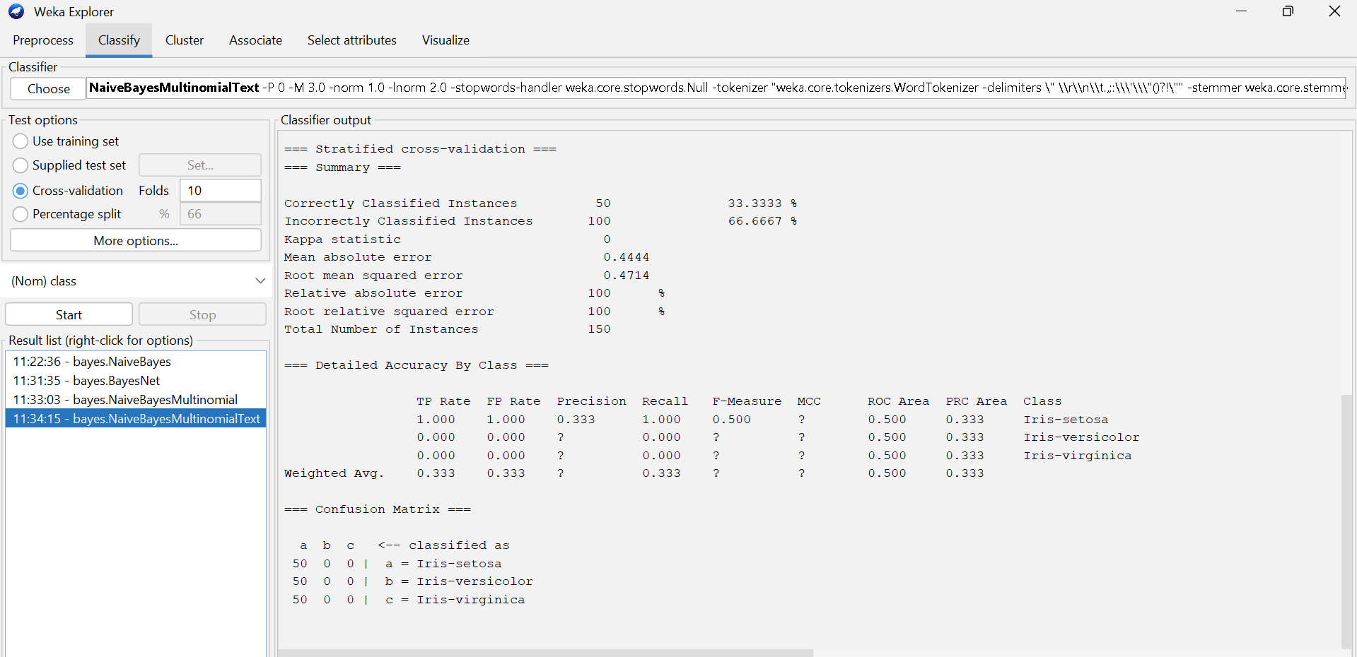
Naïve Bayes Multinomial text
Accuracy: 33.3%
Kappa statistic: 0.44 (moderate agreement)
Precision/Recall (Iris-setosa): 0.333 / 1.000
Precision/Recall (Iris-versicolor): 0.000 / 0.000
Precision/Recall (Iris-virginica): 0.000 / 0.000
ROC Area: 0.500 (poor discrimination)

Slide 12
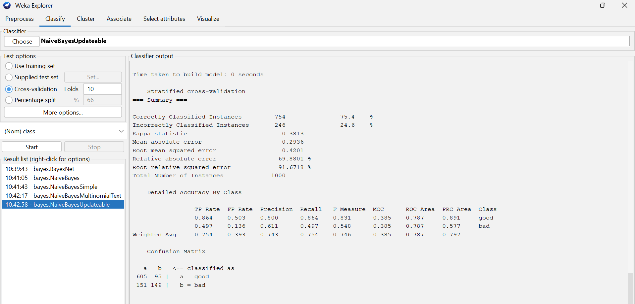
Naïve Bayes Updateable
Accuracy: 96.0%
Kappa statistic: 0.94 (strong agreement)
Precision/Recall (Iris-setosa): 1.000 / 1.000
Precision/Recall (Iris-versicolor): 0.923 / 0.960
Precision/Recall (Iris-virginica): 0.958 / 0.920
ROC Area: 0.994 (excellent discrimination)

Slide 13
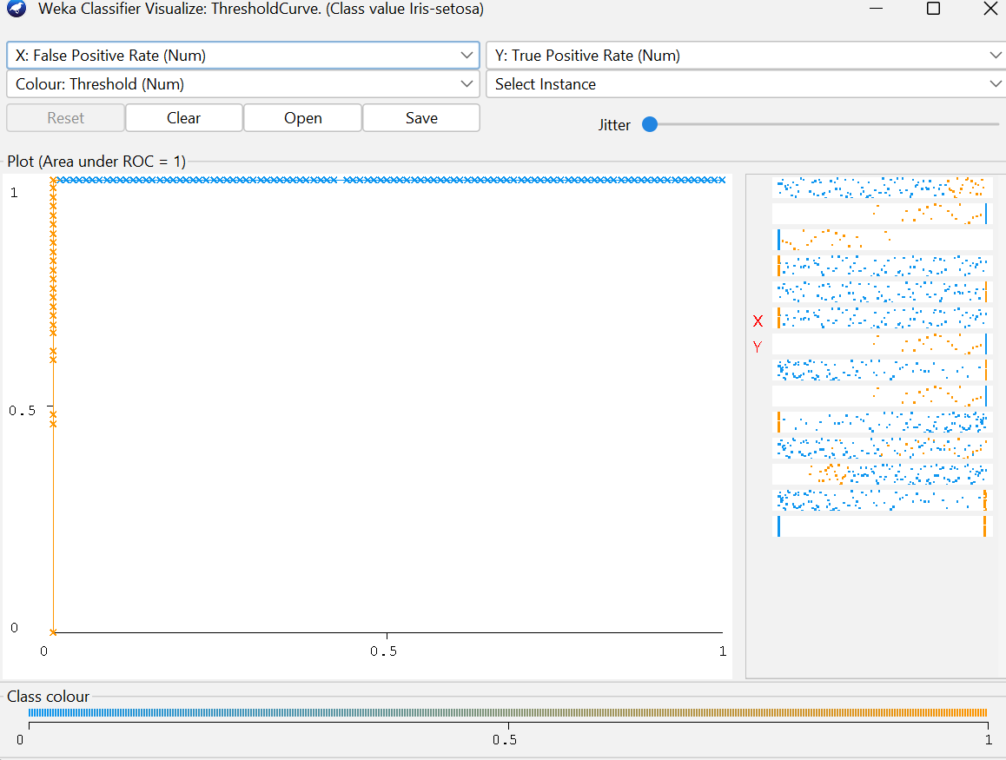
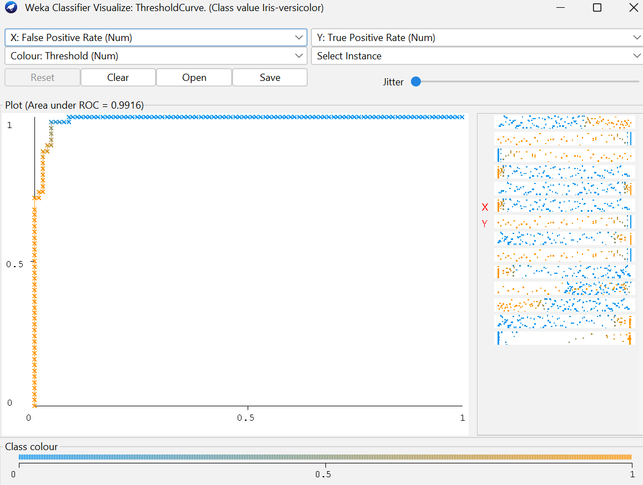
ROC CURVE COMPARISON

Slide 14
ROC summary
The Iris-setosa ROC curve achieves a perfect AUC of 1.0, confirming that the classifier distinguishes this class with complete accuracy and no false positives.
The Iris-versicolor and Iris-virginica classes both show AUC values around 0.9918, indicating near-perfect discrimination performance.
All three curves rise sharply toward the top-left corner, demonstrating high sensitivity and specificity.
The minimal difference between Versicolor and Virginica curves suggests very low overlap in their predicted probabilities.
Overall, the ROC comparison highlights that the model performs exceptionally well across all classes, with Setosa being perfectly separable and the other two showing almost ideal classification boundaries.

Slide 15
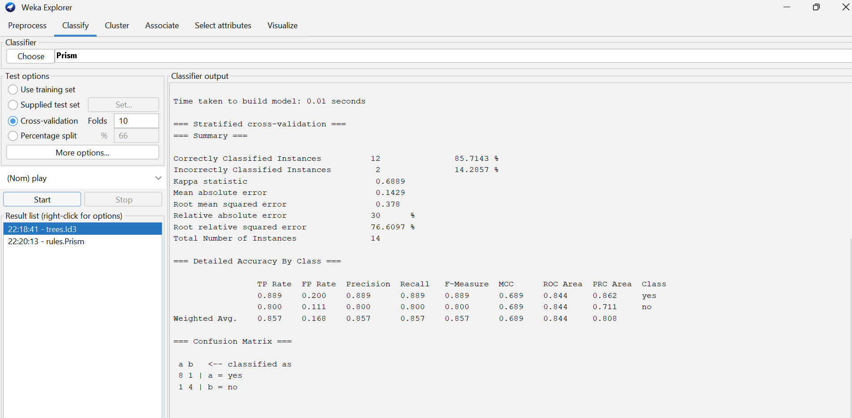
Decision Tree (ID3)
Dataset: weather.nominal
Accuracy: 85.71%
Kappa Statistic: 0.689 (substantial agreement)
ROC Area: 0.844 (good discrimination)
Interpretation: Balanced and consistent performance across classes (“yes” and “no”), showing reliable classification with good generalization.

Slide 16
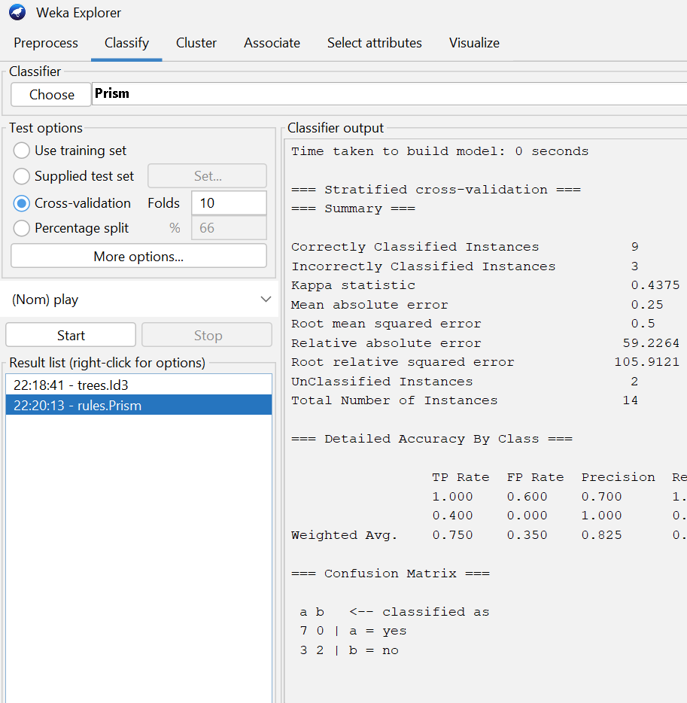
Decision Rule PRISM
Dataset: weather.nominal.arff
Accuracy: 64.3%
Bias toward predicting 'yes'
Lower coverage for minority class

Slide 17
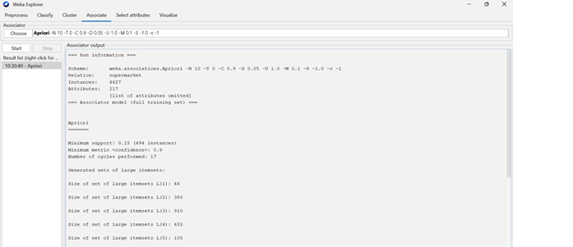
Apriori (Association Rule)
Dataset: SUPERMARKET.arff
Min Confidence: 0.9
Min Support: 0.1
Example rule: Biscuits → Bread & Cake
Confidence: 92%
Lift = 1.27 (positive correlation)
Indicates a strong association between Biscuits, Bread, and Cake purchases.

Slide 18
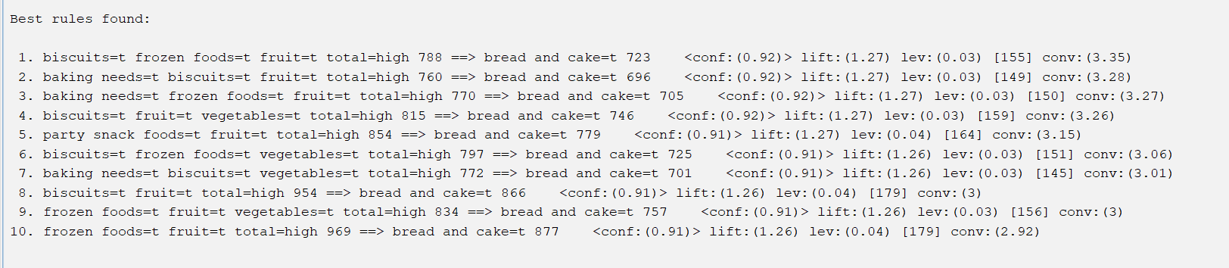
If a customer buys biscuits, frozen foods, and fruits with a high total spending, there is a 92% probability they will also buy bread and cake.
A lift value of 1.27 indicates that this combination is 27% more likely to occur together than by random chance, showing a meaningful positive association.
Across the top 10 rules, confidence values ranged from 0.91–0.92, all above the minimum threshold (0.9).
Conviction values around 3.0–3.3 suggest strong implication strength, while leverage values near 0.03–0.04 show moderate improvement over chance.

Slide 19

Linear Models
SIMPLE Regression
Multiple regression
Logistic Regression
Winnow

Slide 20
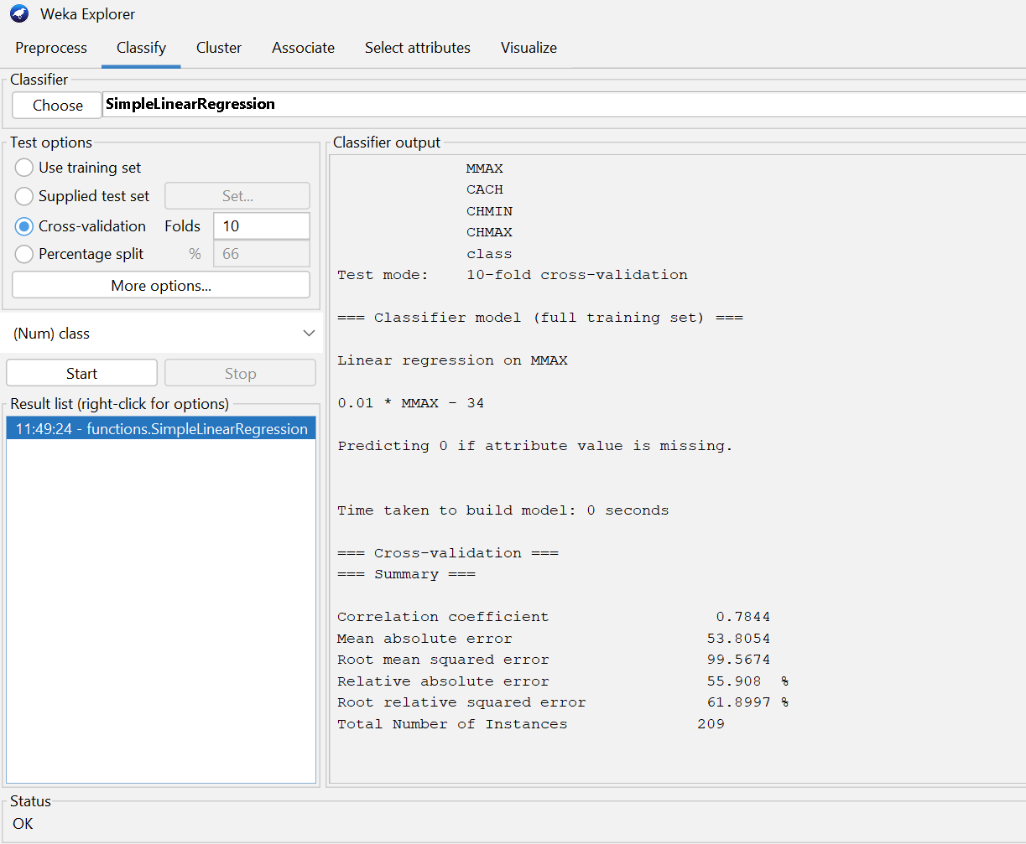
Simple linear regression
DATASET: CPU.arff
Predictor: MMAX (independent variable/input)
Response: CPU performance (class) (output)
Regression Equation:
class=0.01(MMAX)−34
Correlation Coefficient: 0.7844 → Moderately strong positive relationship
Mean Absolute Error (MAE): 53.8
Root Mean Squared Error (RMSE): 99.6
Indicates increasing memory (MMAX) improves CPU performance, but other factors also influence it.

Slide 21
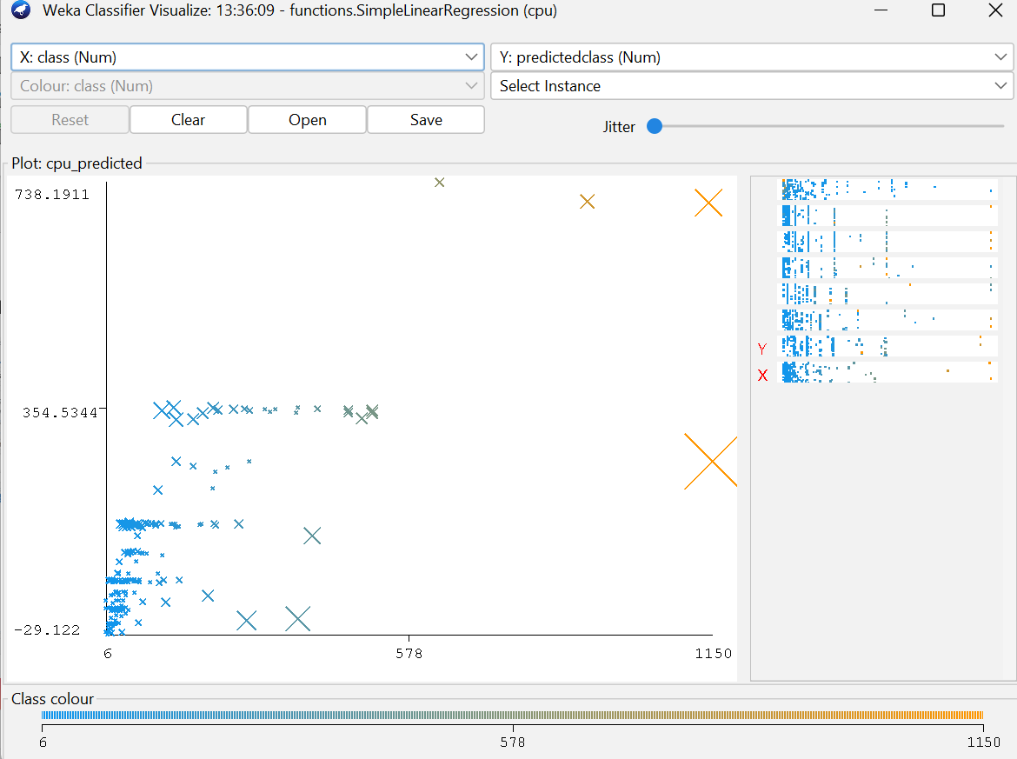
Plot representing simple linear regression
The plot visualizes the relationship between the actual and predicted CPU performance values using a simple linear regression model.
Most data points (in blue) are clustered near the lower range, indicating that the majority of CPUs in the dataset have relatively lower performance values.
The predicted vs. actual values show a generally linear trend but with some dispersion, suggesting that while the model captures the general relationship, there is noticeable variance for higher CPU values.
A few outliers with large marker sizes (in orange) indicate instances where prediction error is significant, often for extreme performance values.
Overall, the visualization suggests that the model performs reasonably well for moderate data ranges but struggles slightly at the extremes, which could be improved with more complex regression or feature interaction terms.

Slide 22
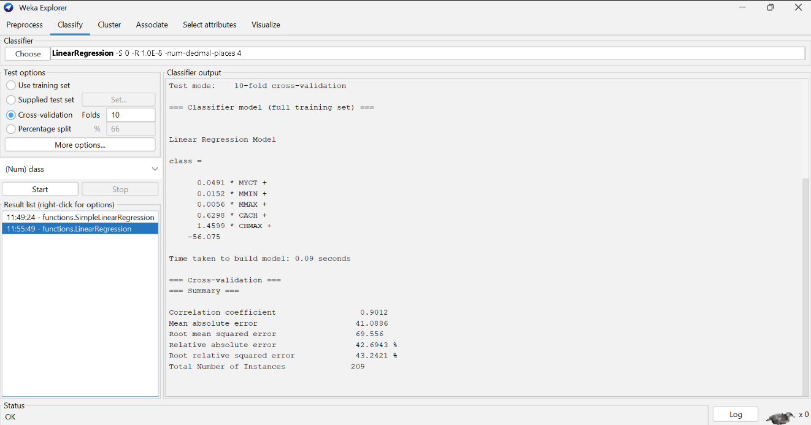
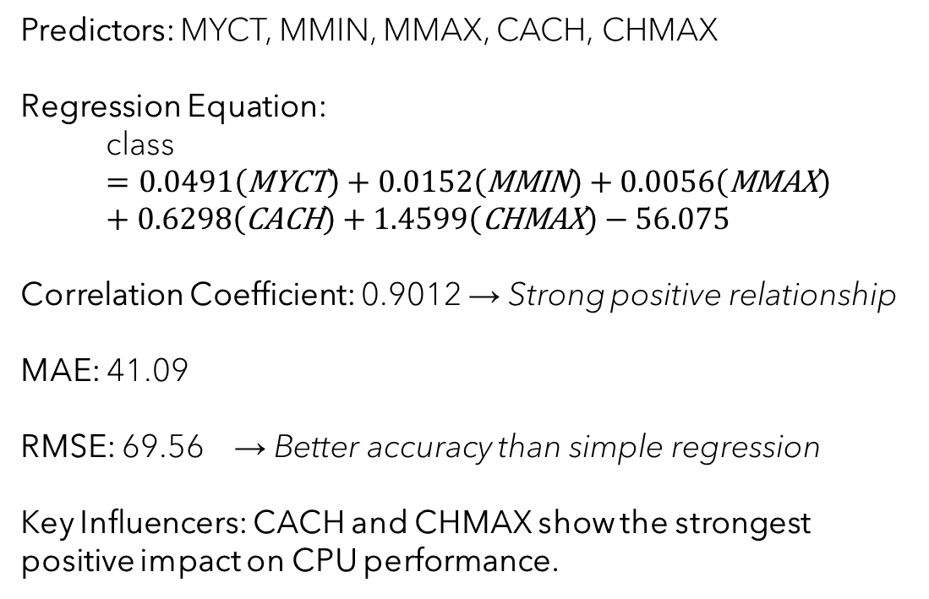
Multiple Regression
DATASET: CPU.arff
Predictors: MYCT, MMIN, MMAX, CACH, CHMAX
Regression Equation:
$$\text{class}=0.0491\left(\text{MYCT}\right)+0.0152\left(\text{MMIN}\right)+0.0056\left(\text{MMAX}\right)+0.6298\left(\text{CACH}\right)+1.4599\left(\text{CHMAX}\right)−56.075$$
Correlation Coefficient: 0.9012 → Strong positive relationship
MAE: 41.09
RMSE: 69.56 → Better accuracy than simple regression
Key Influencers: CACH and CHMAX show the strongest positive impact on CPU performance.

Slide 23
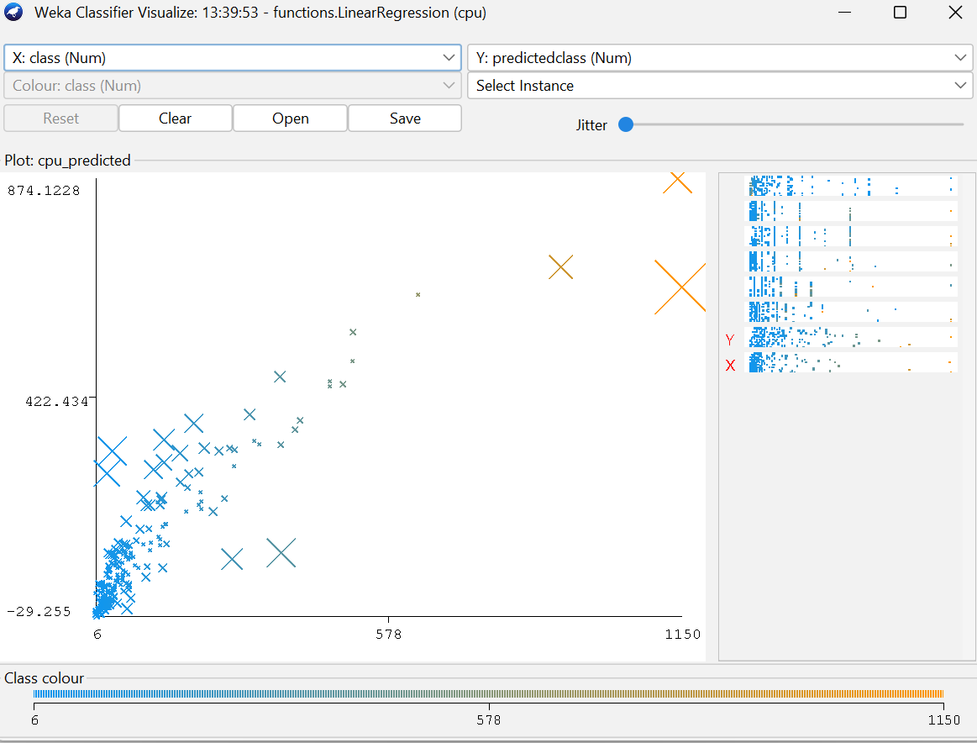
Plot representing Multiple linear regression
The scatter plot shows the relationship between actual and predicted CPU performance values using a multiple linear regression model.
A clear upward trend is visible, indicating that as actual CPU performance increases, predicted values also rise — suggesting a strong positive correlation captured by the model.
Compared to simple linear regression, the data points are more closely aligned along the diagonal, reflecting improved prediction accuracy.
The larger orange markers correspond to high-performance CPUs, where prediction variance slightly increases, likely due to fewer samples in that range.
Overall, the model effectively generalizes CPU performance with better fit and reduced error, outperforming simple linear regression in handling data spread and variance.

Slide 24
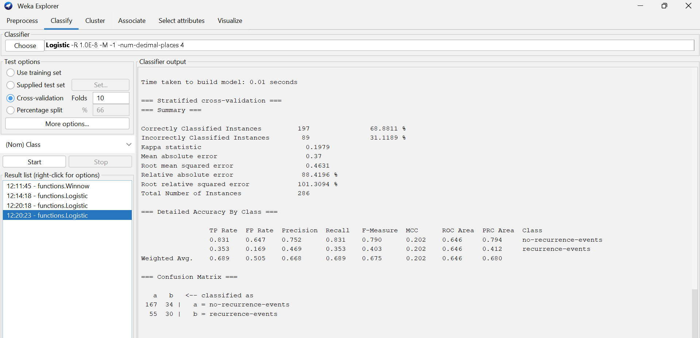
Logistic Regression
Dataset: Breast cancer.arff
Accuracy: 68.88%
Kappa Statistic: 0.1979 → Weak agreement
ROC Area (AUC): 0.646 → Moderate discrimination ability
Observation: Model predicts non-recurrence cases more accurately; recurrence cases need improved feature differentiation.

Slide 25
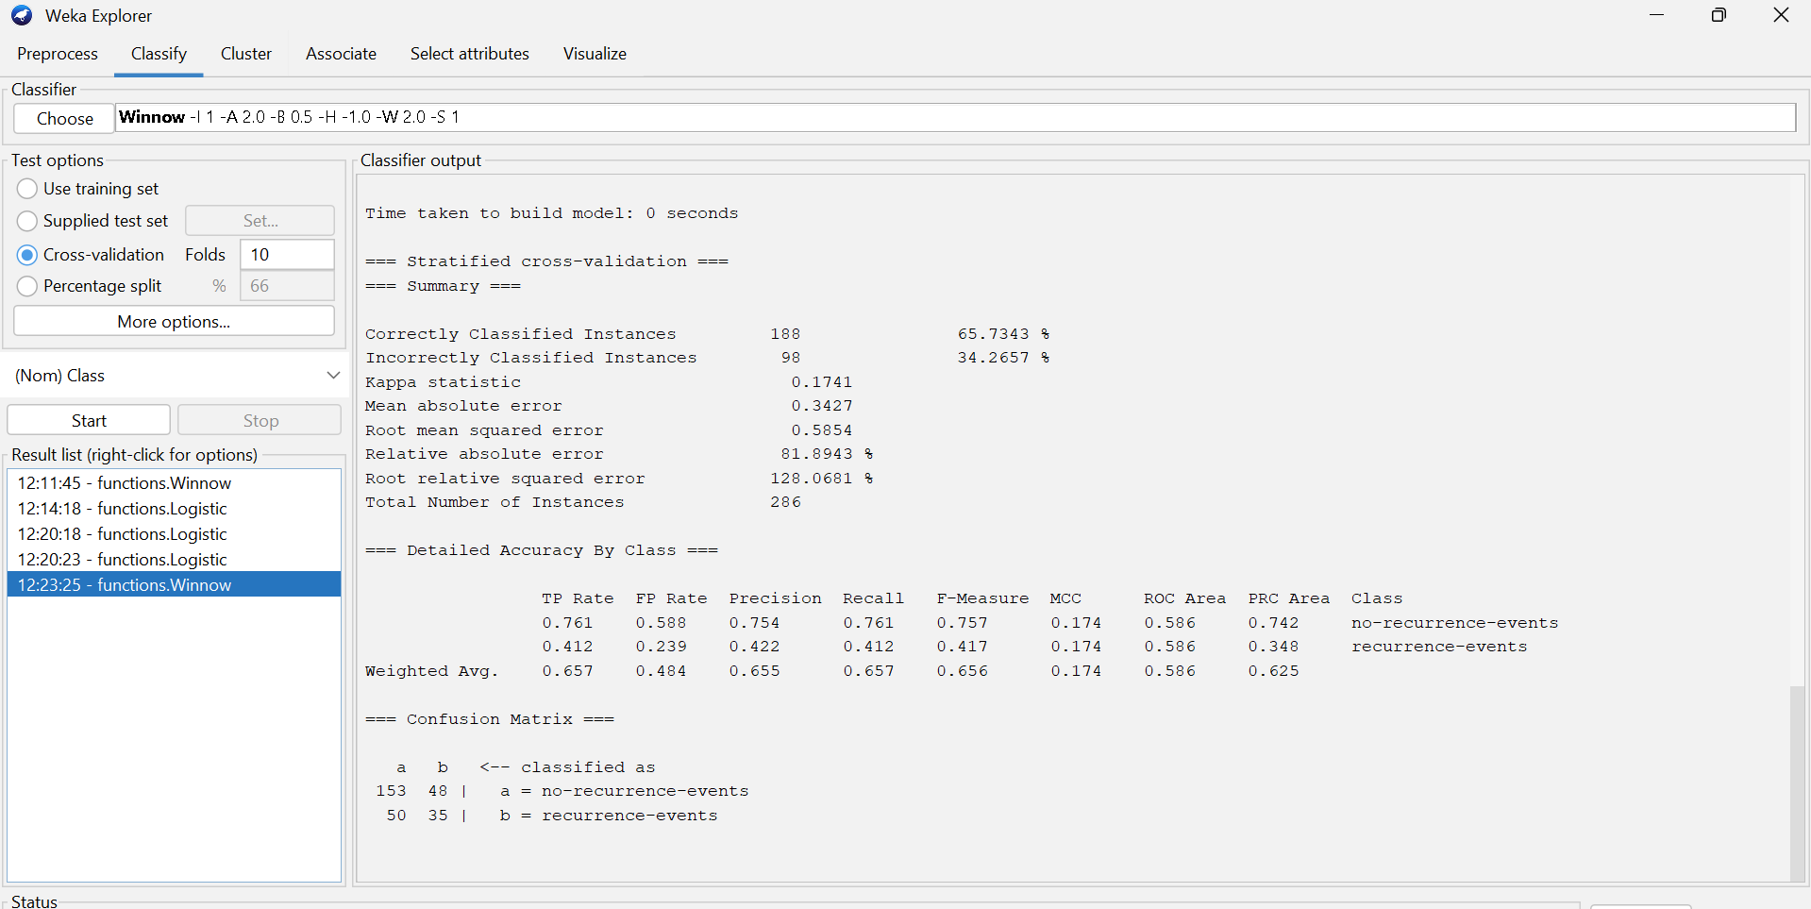
Winnow Model
Dataset: Breast cancer.arff
Accuracy: 65.73%
Kappa Statistic: 0.1741 (weak agreement)
ROC Area: 0.586 (low discrimination ability)
Observation:
The model shows limited predictive strength, performing moderately for no-recurrence cases but poorly for recurrence events — suggesting the need for additional or better-quality features.

Slide 26
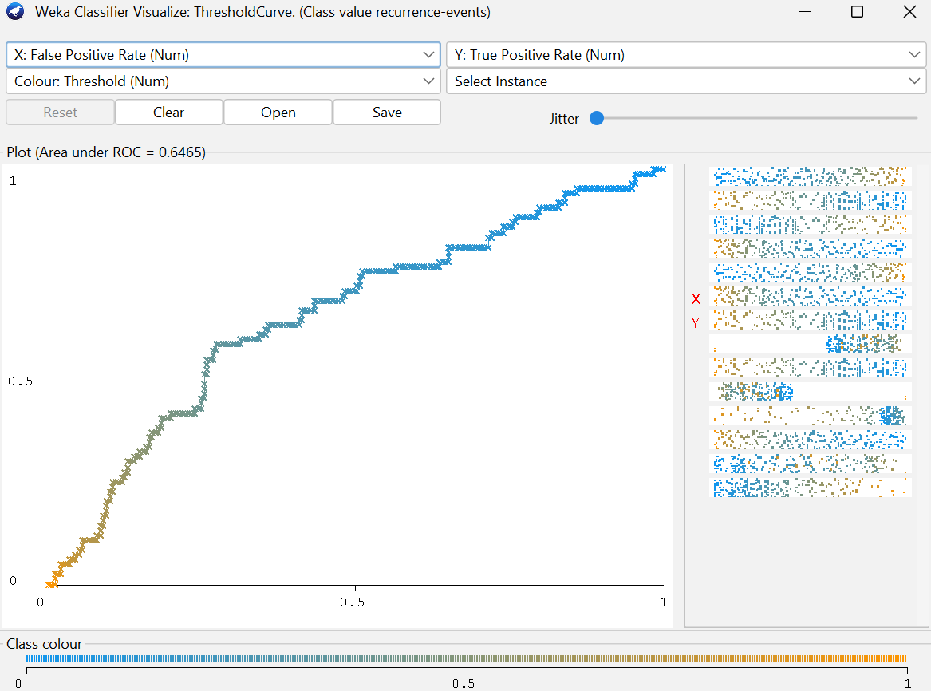
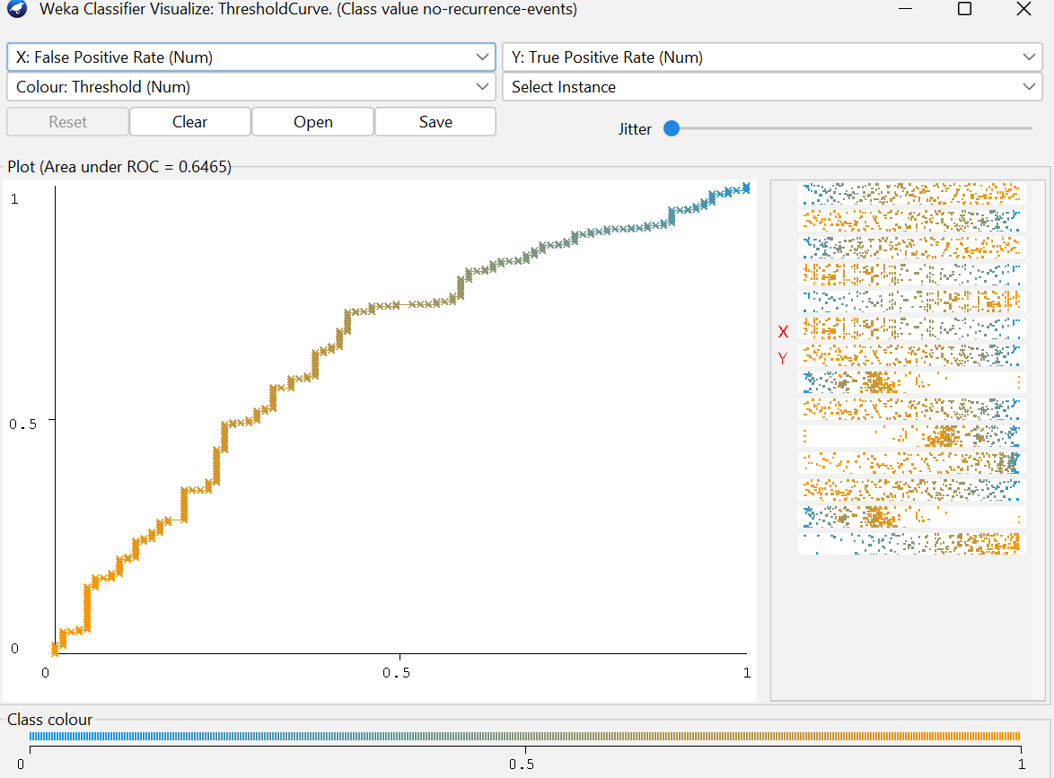
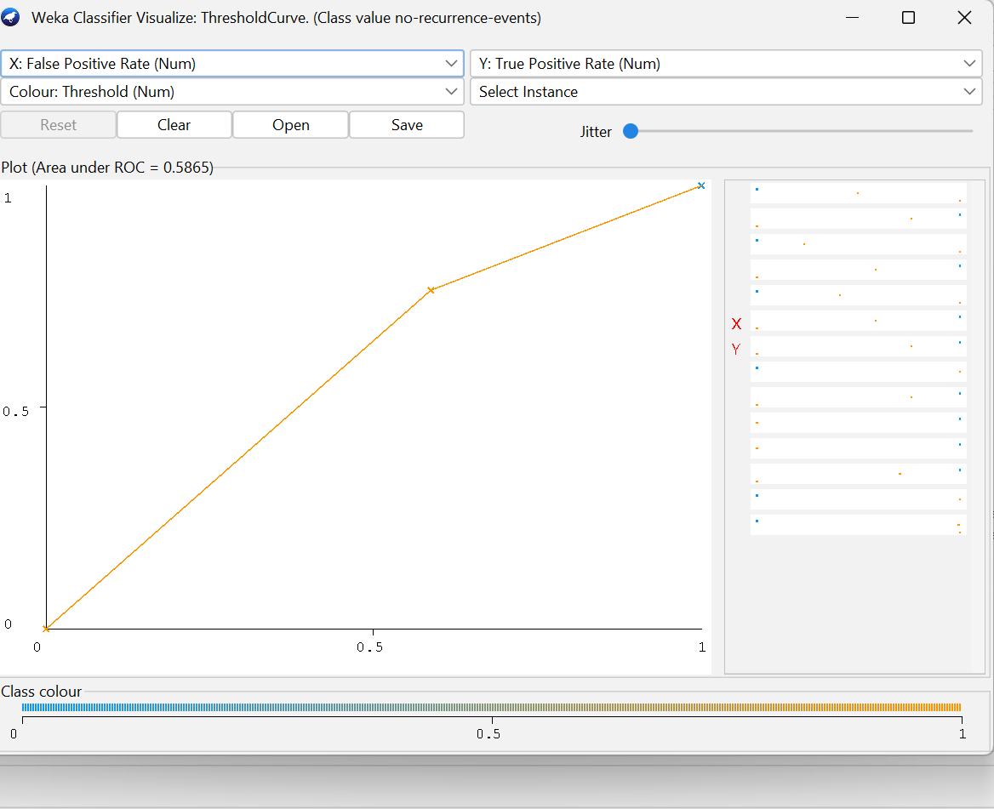
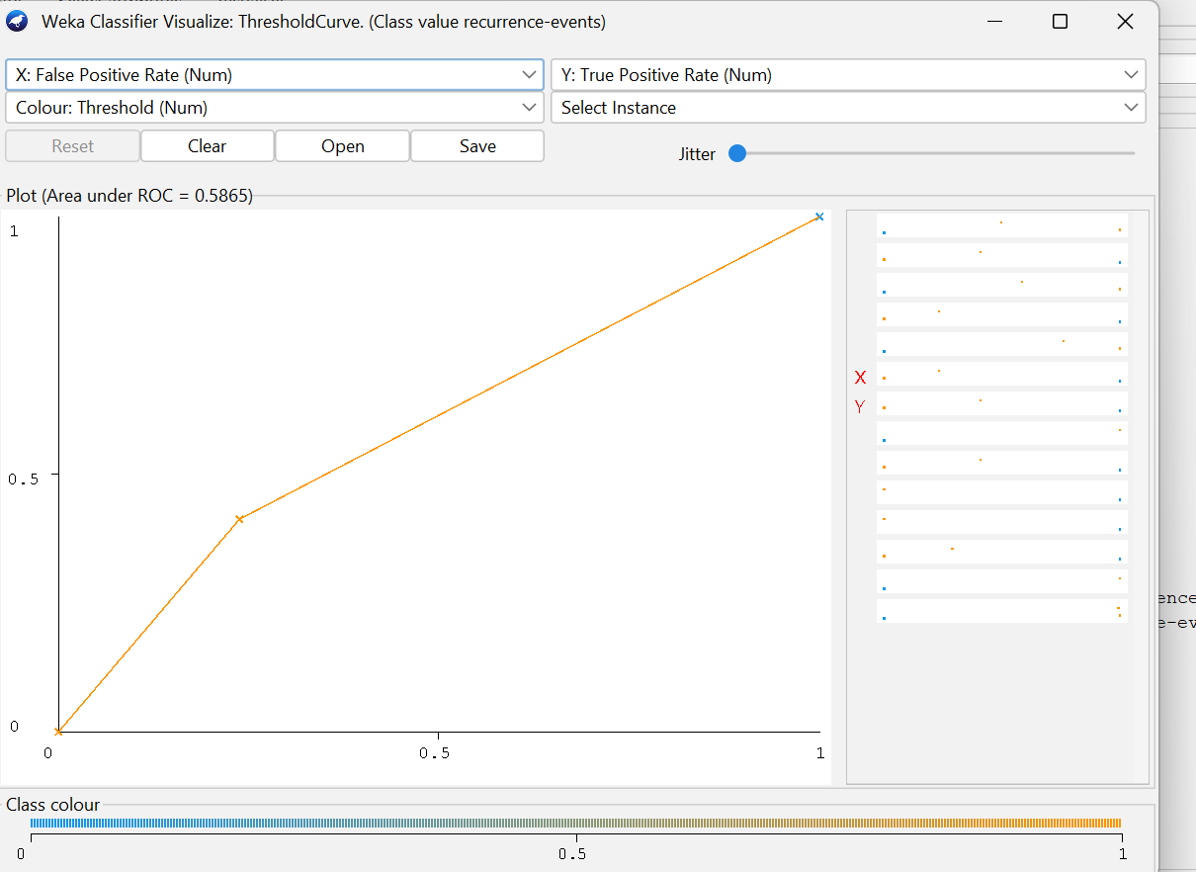
ROC – LOGISTIC VS WINNOW MODELS

Slide 27
ROC SUMMARY
Model | AUC (Approx.) | Interpretation
Winnow | 0.6465 | Shows better discriminative ability, correctly distinguishing recurrence vs non-recurrence cases more effectively. The curve rises above the diagonal earlier, indicating improved sensitivity.
Logistic Regression | 0.5865 | Indicates moderate performance, only slightly better than random guessing. The ROC curve remains closer to the diagonal line, showing weaker separation between classes.

Slide 28
Metrics Comparison – Logistic Vs Winnow model
Metric | Winnow | Logistic Regression
Accuracy | 65.73% | 68.88%
Kappa Statistic | 0.1741 (Weak agreement) | 0.1979 (Slightly better agreement)
Mean Absolute Error (MAE) | 0.3427 | 0.37
Root Mean Squared Error (RMSE) | 0.5854 | 0.4631
ROC Area (AUC) | 0.586 (Low discrimination) | 0.646 (Moderate discrimination)
F-Measure (Weighted Avg.) | 0.656 | 0.675
Best Predicted Class | No-recurrence-events | No-recurrence-events
Logistic Regression is preferable when aiming for better general classification.

Slide 29
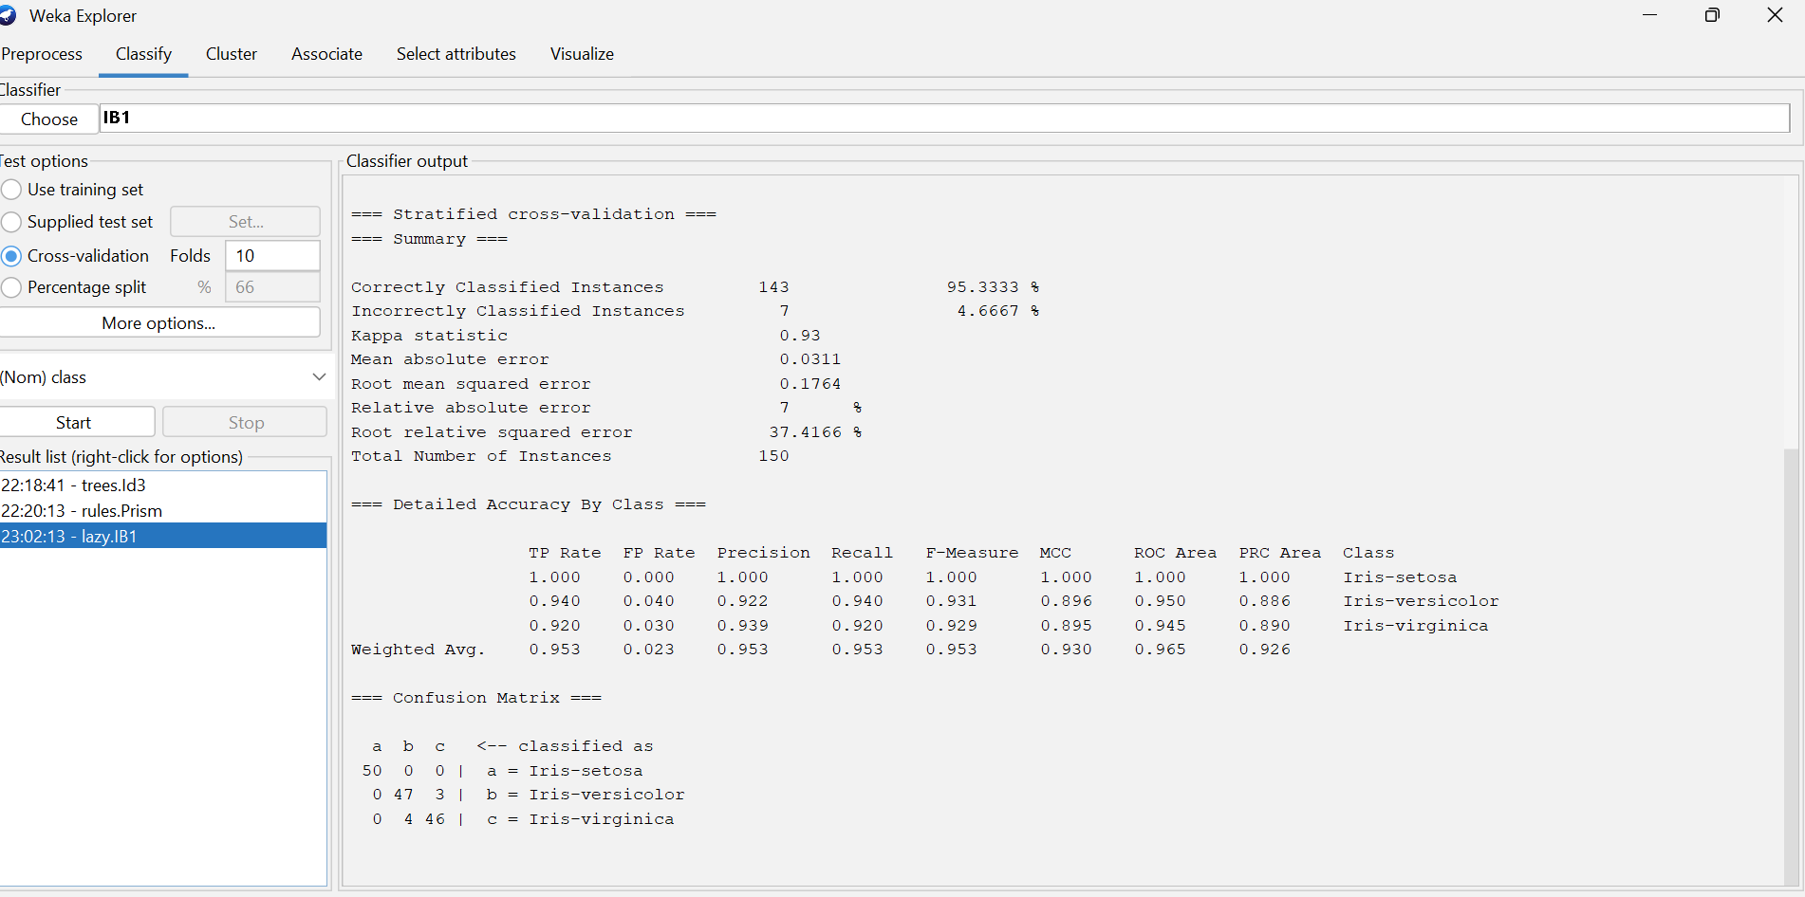
Instance-Based Learning (IB1)
Dataset: IRIS.arff
Accuracy: 95.3%
Perfect for Setosa, minor overlap for others
Captures local similarity effectively

Slide 30
Clustering Models
SimpleKMeans
Cobweb
Hierarchical
Dataset: Iris.arff

Slide 31
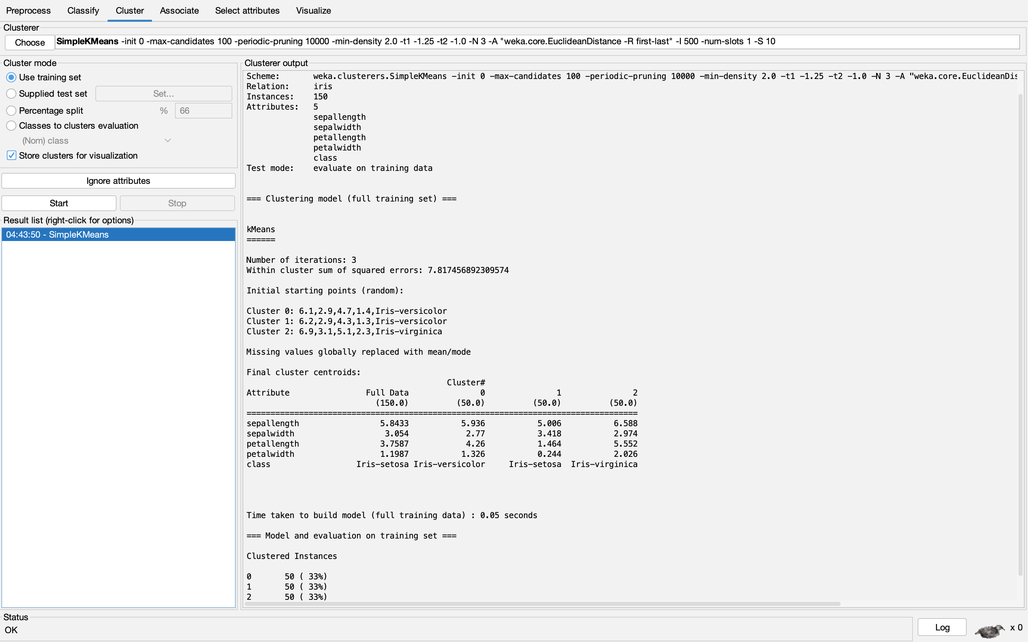
SIMPLEK MEANS
Number of clusters: 3 (matching the three Iris species)
Iterations performed: 3
Within-cluster sum of squared errors: 7.8175
Key attributes influencing clustering: Petal length and petal width
Cluster centroids clearly separate the three species, showing distinct patterns across flower dimensions.
Observation:
Clustering aligns perfectly with the known species groups — indicating strong natural separability in the Iris dataset.

Slide 32
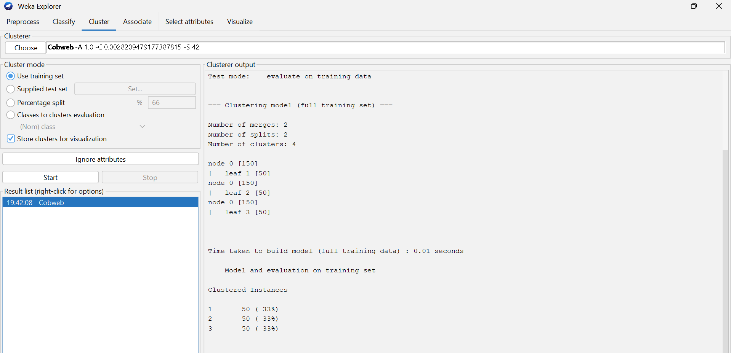
COBWEB
Number of clusters: 4
Number of merges: 2
Number of splits: 2
Model structure: Hierarchical clustering with nodes and leaf groupings (node 0 branches into 3 leaves).
Observation:
Cobweb algorithm formed hierarchical clusters that closely align with the three Iris species, showing its ability to adaptively organize data without prior class labels.

Slide 33
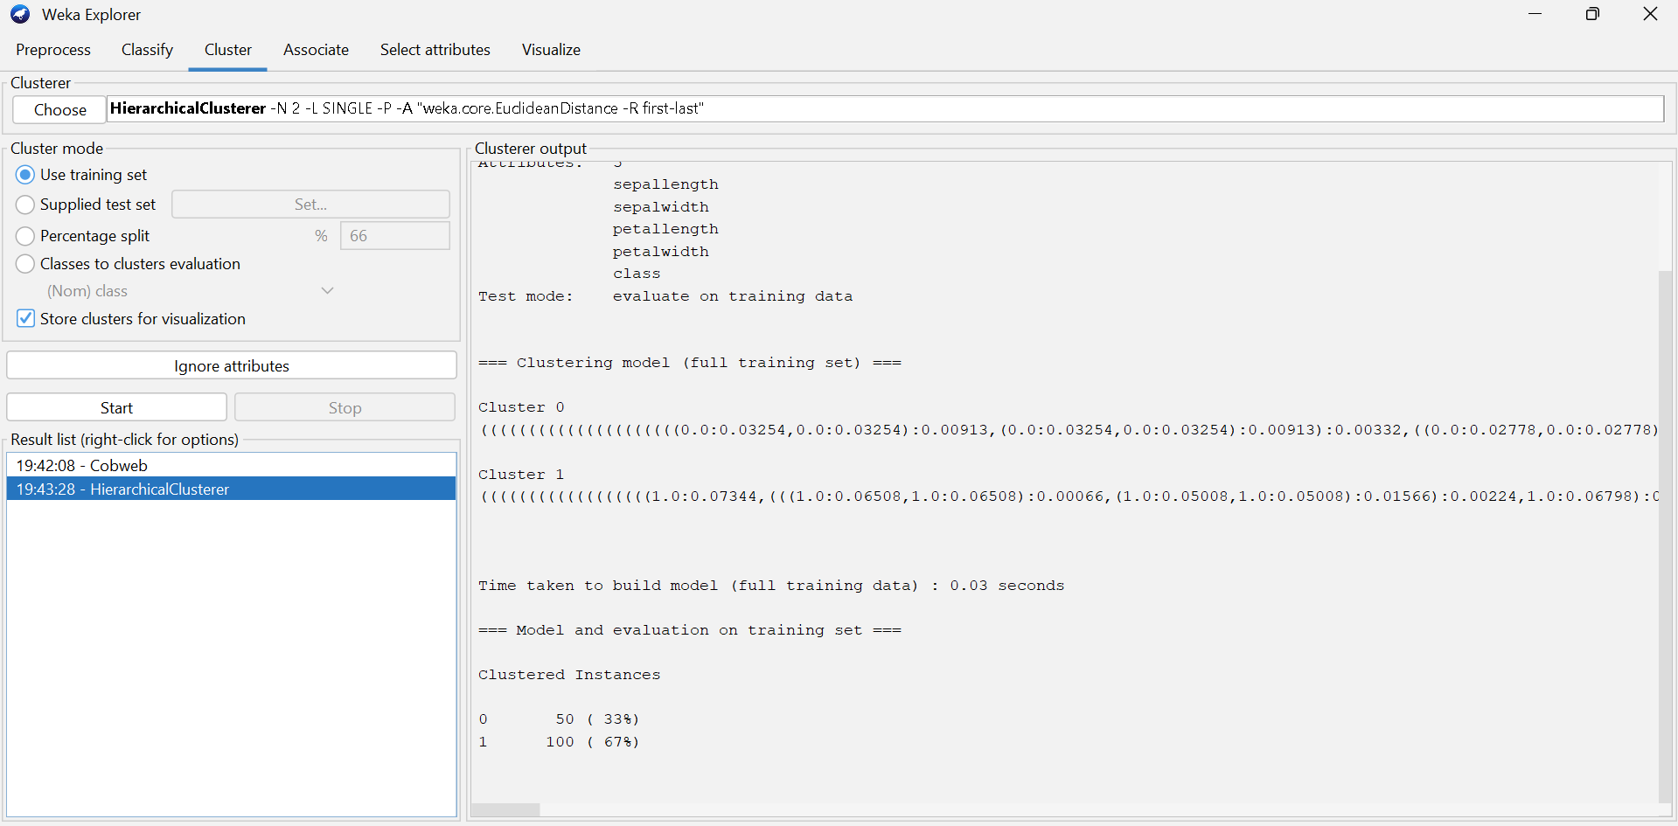
hierarchical
Linkage method: Single linkage (nearest neighbor)
Distance measure: Euclidean distance
Number of clusters formed: 2
Clustered instances:
Cluster 0 → 50 (33%)
Cluster 1 → 100 (67%)
Observation:
The model grouped Iris-setosa distinctly into one cluster (Cluster 0) and combined Iris-versicolor and Iris-virginica into another (Cluster 1), showing strong separation for setosa but overlap between the other two species.

Slide 34
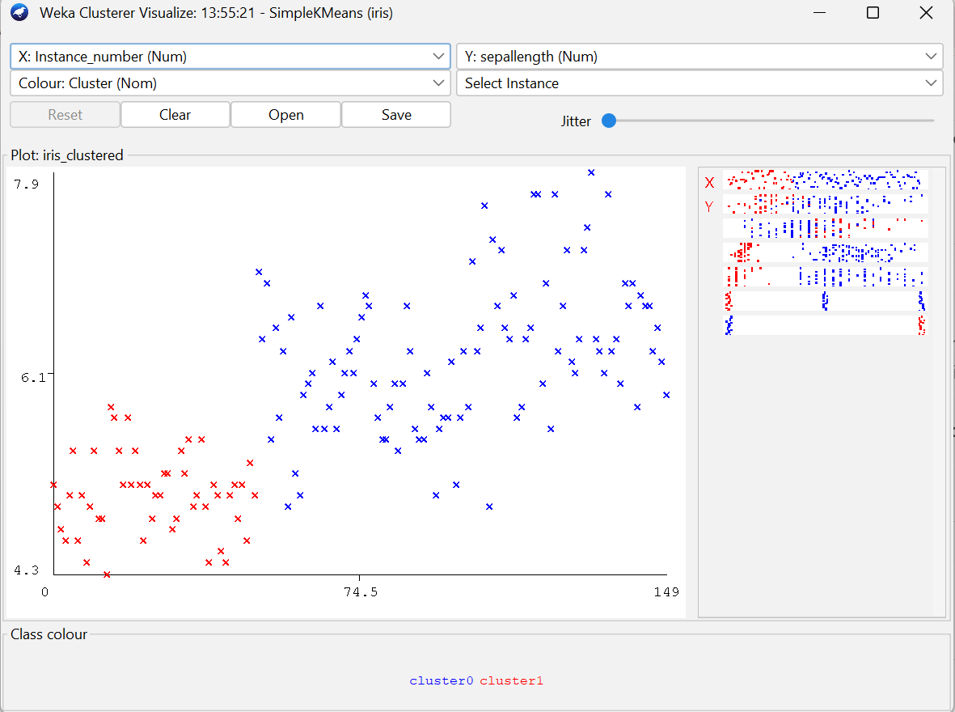
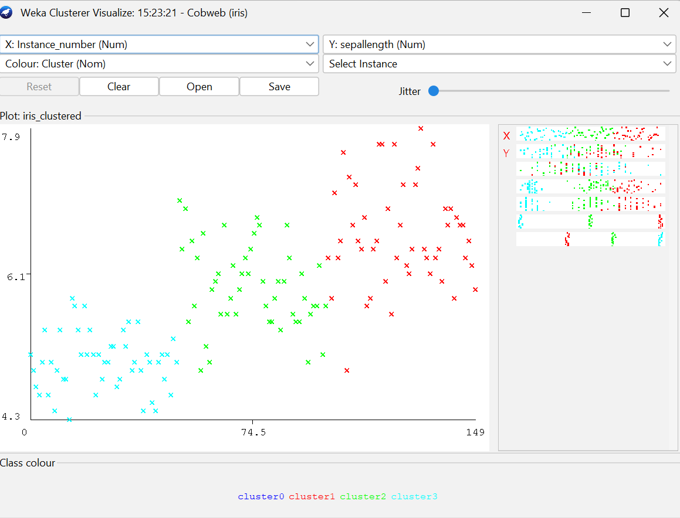
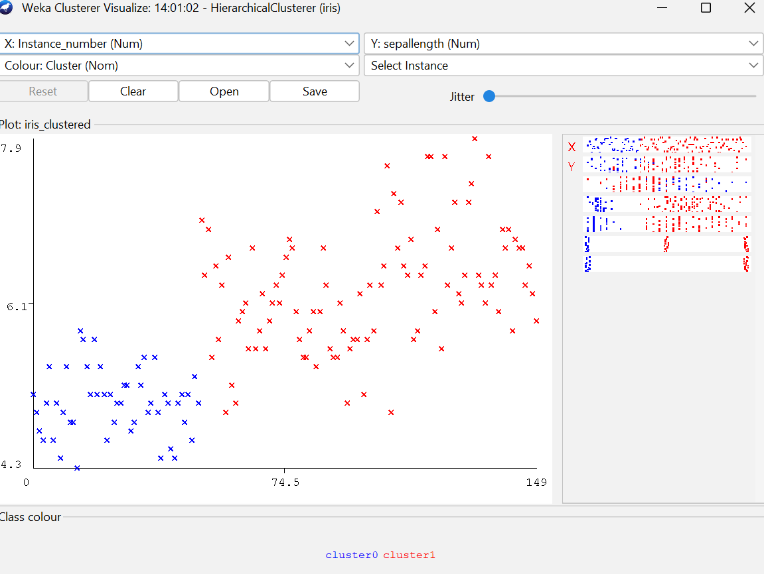
ROC COMPARISON

Slide 35
ROC SUMMARY
SimpleKMeans produced two clean, well-separated clusters, effectively distinguishing major Iris groups based on sepal length.
Cobweb generated four conceptual clusters, offering finer granularity but with slight overlap — useful for identifying subtle internal variations.
Hierarchical clustering created three levels of grouping, visually mapping how clusters merge step-by-step , aligning closely with the three Iris species.

Slide 36
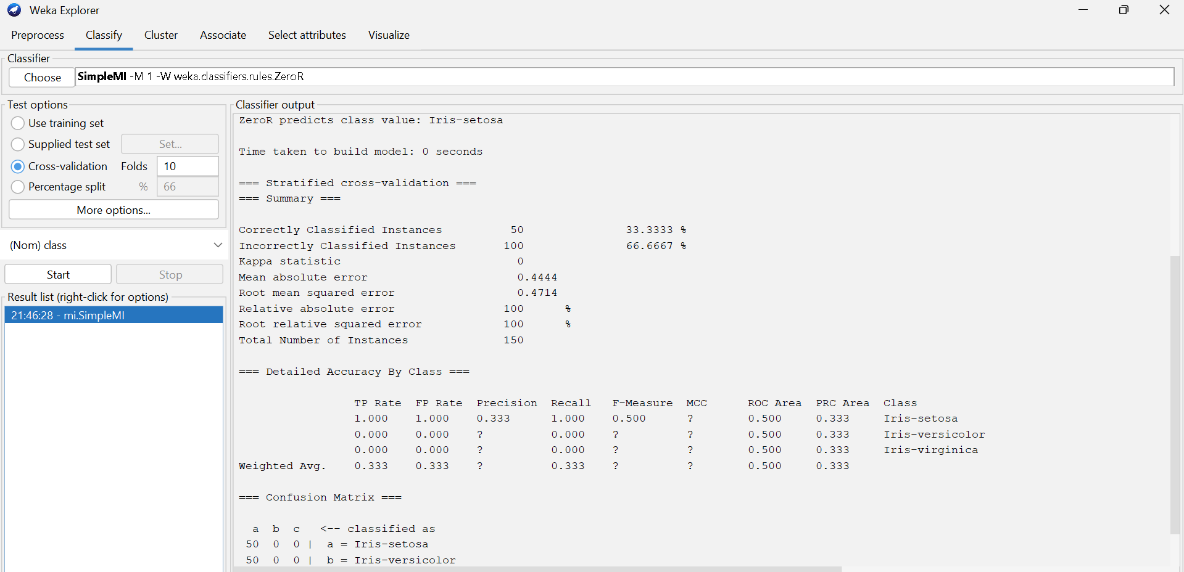
Multi-Instance Learning
SIMPLE MI for iris dataset
Classifier: ZeroR (predicts majority class only – Iris-setosa)
Accuracy: 33.33%
Kappa Statistic: 0.0 (no agreement beyond chance)
ROC Area: 0.5 (no discrimination ability)
Observation:
The model predicts only the majority class (Iris-setosa) for all instances, giving poor performance. Serves as a baseline reference for evaluating other classifiers.

Slide 37
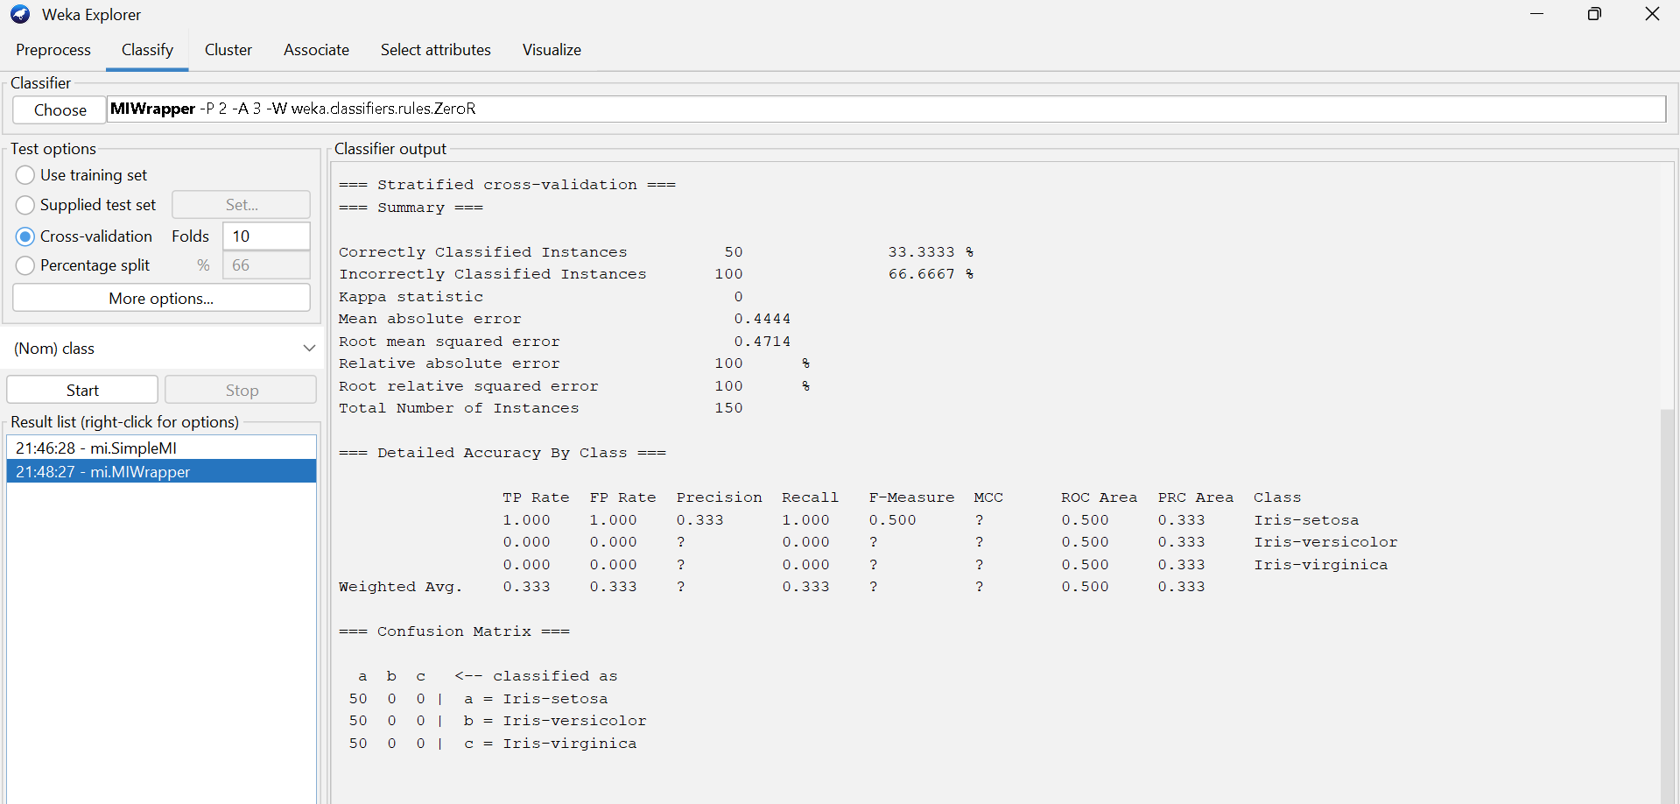
MI WRAPPER (ZeroR Base) for Iris dataset
Classifier: MIWrapper using ZeroR as the base learner
Accuracy: 33.33%
Kappa Statistic: 0.0 (no correlation between prediction and actual class)
ROC Area: 0.5 (no discrimination capability)
Observation:
Like the SimpleMI model, MIWrapper with ZeroR predicts only the majority class (Iris-setosa).
Acts as a baseline multi-instance learning model with no meaningful classification power.

Slide 38
ACCURACY SUMMARY BY DATASETS
Model | Type | Accuracy / Key Result
Naïve Bayes | Probabilistic Classifier | 96.0% – Excellent accuracy, perfect Setosa separation
Naïve Bayes Multinomial | Probabilistic Classifier | 95.3% – High accuracy, minor overlap
Naïve Bayes Updateable | Probabilistic Classifier | 96.0% – Matches Naïve Bayes, efficient for streaming
OneR | Rule-Based | 93.3% – Simple single-rule model, strong performance
IB1 | Instance-Based | 95.3% – High accuracy, small misclassification
SimpleMI / MIWrapper | Multi-Instance | 33.3% – Predicts majority class only (baseline)
SimpleKMeans | Clustering | Formed 3 clusters matching species
Cobweb | Clustering | Formed 4 adaptive clusters; hierarchical
Hierarchical | Clustering | 2 clusters; Setosa isolated clearly
Iris Dataset (Classification & Clustering)

Slide 39
ACCURACY SUMMARY BY DATASETS
Iris Dataset (Classification & Clustering)
Model | Type | Accuracy / Key Result
Naïve Bayes | Probabilistic Classifier | 96.0% – Excellent accuracy, perfect Setosa separation
Naïve Bayes Multinomial | Probabilistic Classifier | 95.3% – High accuracy, minor overlap
Naïve Bayes Updateable | Probabilistic Classifier | 96.0% – Matches Naïve Bayes, efficient for streaming
OneR | Rule-Based | 93.3% – Simple single-rule model, strong performance
IB1 | Instance-Based | 95.3% – High accuracy, small misclassification
SimpleMI / MIWrapper | Multi-Instance | 33.3% – Predicts majority class only (baseline)
SimpleKMeans | Clustering | Formed 3 clusters matching species
Cobweb | Clustering | Formed 4 adaptive clusters; hierarchical
Hierarchical | Clustering | 2 clusters; Setosa isolated clearly

Slide 40
CPU Dataset (Regression)
Model | Type | Performance Summary
Simple Linear Regression | Regression | Correlation = 0.7844, MAE = 53.8, RMSE = 99.6 → Moderate fit
Multiple Linear Regression | Regression | Correlation = 0.9012, MAE = 41.09, RMSE = 69.56 → Stronger model, better prediction accuracy

Slide 41
Breast Cancer Dataset (Binary Classification)
Model | Type | Accuracy / Key Result
Logistic Regression | Classification | 68.88%, Kappa = 0.1979, ROC = 0.646 → Moderate performance
Winnow | Classification | 65.73%, Kappa = 0.1741, ROC = 0.586 → Slightly weaker than Logistic Regression

Slide 42
Supermarket Dataset (Association Rule Mining)
Model | Type | Key Result
Apriori | Association | Support = 0.10, Confidence = 0.90, Lift = 1.27 → Strong rule: Biscuits → Bread & Cake

Slide 43
Conclusion
Naïve Bayes and IB1 achieved the highest accuracy (~96%) on the Iris dataset, proving strong class separability.
Multiple Linear Regression on the CPU dataset showed a strong correlation (0.90) and improved prediction accuracy.
Logistic Regression outperformed Winnow on the Breast Cancer dataset, offering more reliable classification.
Apriori effectively uncovered meaningful association rules (Biscuits → Bread & Cake, 92% confidence, Lift 1.27).
Clustering models (K-Means, Cobweb, Hierarchical) successfully grouped Iris species, confirming natural data structure.
Overall Insight:
Different models excel in different domains — WEKA demonstrates that model selection depends on dataset type and objective.

Slide 44
CONCLUSION
Naïve Bayes and IB1 achieved the highest accuracy (~96%) on the Iris dataset, proving strong class separability.
Multiple Linear Regression on the CPU dataset showed a strong correlation (0.90) and improved prediction accuracy.
Overall Insight:
Different models excel in different domains — WEKA demonstrates that model selection depends on dataset type and objective.
Logistic Regression outperformed Winnow on the Breast Cancer dataset, offering more reliable classification.
Apriori effectively uncovered meaningful association rules (Biscuits → Bread & Cake, 92% confidence, Lift 1.27).
Decision Tree (ID3) outperformed Prism on the weather.nominal dataset, delivering higher accuracy and better class balance for reliable prediction.
Clustering models (K-Means, Cobweb, Hierarchical) successfully grouped Iris species, confirming natural data structure.

