Slide 1

Predicting Diabetes Disease Progression with Linear Regression
Muhammad ehtesham

Slide 2
Project Overview & Objectives
Predict the progression of diabetes in patients one year after baseline
Build and evaluate linear regression models to identify the most predictive features of disease progression.
Start with single-feature models before moving to multi-feature models

Slide 3
Methodology
Single Feature Prediction
Enhanced Prediction Using Feature Combinations
Predict Using ALL Features To Build A More Comprehensive And (Likely) More Accurate Model.
Model Performance Across Training Set Sizes

Slide 4
TASK 1: Single Feature Prediction
Objective: Find The Single Best Feature For Predicting Disease Progression.
Process:
For Each Of The 10 Features, A Separate Linear Regression Model Was Trained.
The Model Used Only That One Feature To Predict The Target Y.
Model Performance Was Evaluated Using Mean Squared Error (MSE).
Evaluation Metric:
Mean Squared Error (MSE): Measures The Average Squared Difference Between The Actual And Predicted Values. Lower MSE = Better Model

Slide 5
Results:
I trained 10 different models, one for each feature.
The model's performance (MSE) was compared to identify the winner.
Feature | Mean Squared Error (MSE)
BMI | 3890.46
S5 | 4031.00
S4 | 4831.14
BP | 4774.11
S3 | 5005.66
S6 | 5062.38
S1 | 5663.32
AGE | 5720.55
S2 | 5750.24
SEX | 5918.89

Slide 6
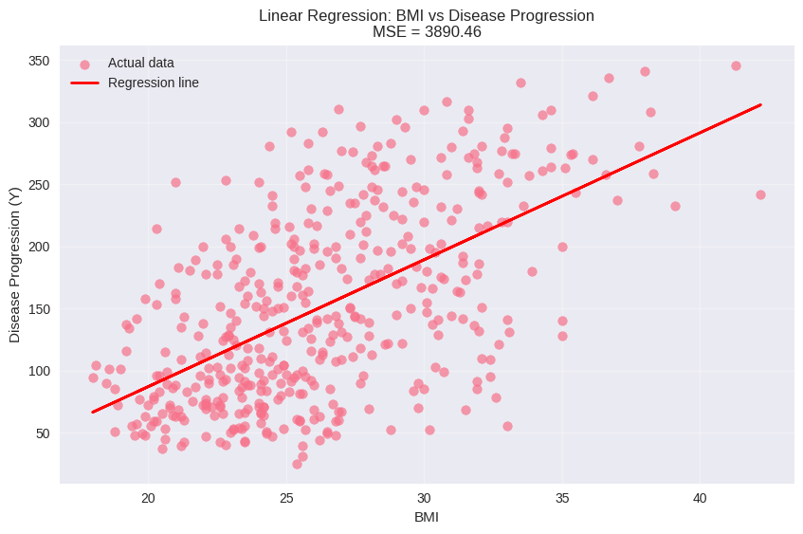
Visualization: The Best Model
BMI vs. Disease Progression

Slide 7
TASK 2: Two-Feature (Pairwise) Prediction
Objective: Identify The Optimal Combination Of Two Features That Together Provide The Most Accurate Prediction Of Diabetes Progression.
Approach: Exhaustive Testing Of All Possible Feature Pairs Using Bivariate Linear Regression.
Process:
  Generate All Unique Pairs From 10 Features (45 Total Combinations)
  For Each Pair, Train A Separate Linear Regression Model
  Evaluate Each Model Using Mean Squared Error (MSE)
  Identify The Pair With Lowest MSE

Slide 8
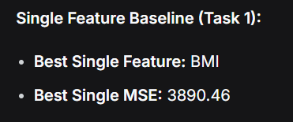
Results:
The top 5 pairs by MSE are:
Feature Pair | Mean Squared Error (MSE) | Improvement vs Single BMI
(BMI, S5) | 3205.19 | 17.6% improvement
(BMI, BP) | 3581.69 | 7.9% improvement
(BMI, S4) | 3638.17 | 6.5% improvement
(BMI, S3) | 3669.26 | 5.7% improvement
(BP, S5) | 3695.05 | 5.0% improvement
Key Insights:
Best Performance: BMI + S5 combination reduces error by 17.6% compared to using BMI alone
BMI Dominance: BMI appears in 4 of the top 5 pairs, confirming its importance
Blood Serum Impact: S5 (possibly blood sugar related) significantly enhances prediction when combined with BMI
Performance Range: Top pairs show 5-18% improvement over single-feature approach

Slide 9
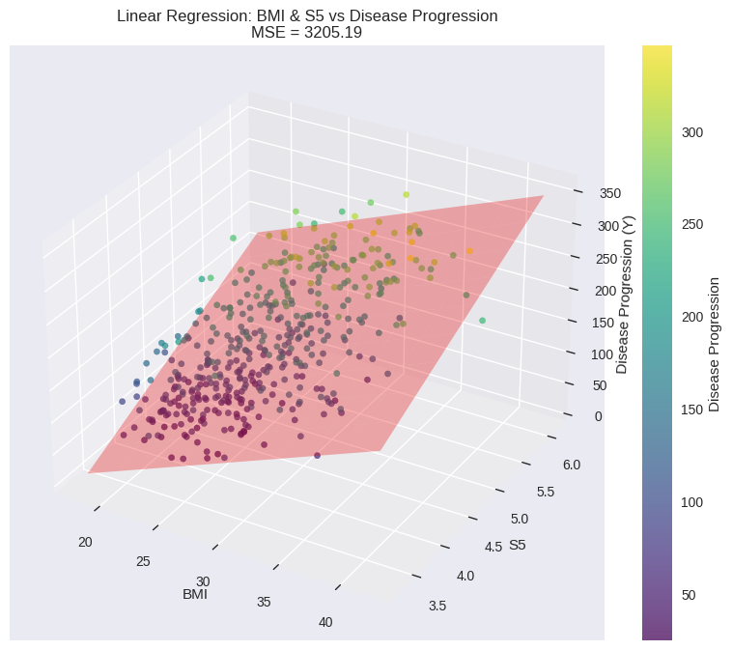
Visualization:
A Clear Positive Correlation Exists higher BMI And S5 Levels Predict More Severe Disease Progression.

Slide 10
Task 3: Comprehensive Model Using All Features
Objective
To Develop A More Accurate And Holistic Predictive Model For Diabetes Progression By Leveraging The Complete Set Of Patient Biomarkers And Clinical Data.
Approach
Model Selection: Employed Multi-variable Linear Regression.
Feature Set: Utilized All 10 Available Features (Age, Sex, Bmi, Bp, S1-s6).
Process
  Trained The Model On The Entire Dataset.
  The Model Learned A Unique Coefficient (Weight) For Each Feature, Quantifying Its Individual Impact On The Predicted Disease Progression Score.
  Calculated The Mean Squared Error (Mse) To Evaluate Performance.

Slide 11
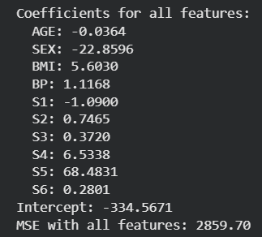
Results
Final MSE: 2859.70
This Represents A ~11% Improvement In Accuracy Over The Two-feature (BMI & S5) Model, Confirming That Additional Features Provide Critical Predictive Information.
Feature Impact Analysis
The Model's Coefficients Reveal The Relative Influence Of Each Factor:
Strongest Positive Drivers ➚ | Strongest Negative Drivers ➘
S5: 68.48 | SEX: -22.86
S4: 6.53 | S1: -1.09
BMI: 5.60

Slide 12
Task 4: Model Performance Across Training Set Sizes
Objective
To Evaluate How The Amount Of Training Data Affects Our Linear Regression Model's Performance
Approach
Trained Multiple Linear Regression Models Using All 10 Features
Systematically Varied The Training Set Size: 20, 50, 100, 200 Samples
For Each Size:
  Calculated Training MSE (Performance On Seen Data)
  Calculated Validation MSE (Performance On Unseen Data)
  Compared The Difference To Assess Overfitting

Slide 13
Experimental Results
Training vs Validation Performance
Training Size | Training MSE | Validation MSE | Difference
20 | 2,066.51 | 15,905.60 | 13,839.09
50 | 2,863.62 | 3,907.02 | 1,043.40
100 | 3,150.51 | 3,423.45 | 272.93
200 | 2,854.95 | 3,014.92 | 159.97
Key Observations:
Extreme overfitting with only 20 training samples
Rapid improvement in generalization as training data increases
Stabilization around 100-200 samples

Slide 14
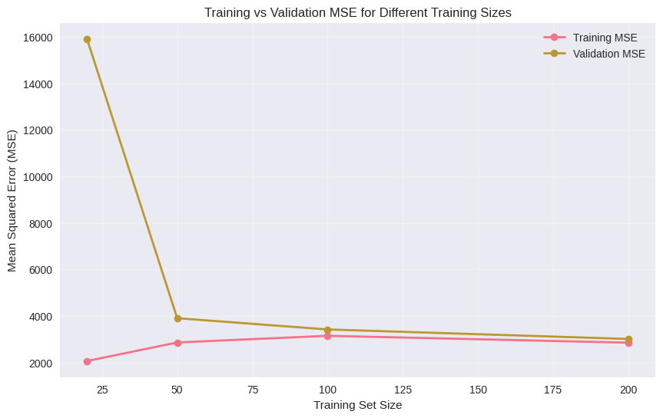
Visualization:
Learning Curve Analysis

Slide 15
XGBoost Implementation
Objective
To Evaluate Whether A More Sophisticated Ensemble Method (Xgboost) Can Outperform Our Linear Regression Models In Predicting Diabetes Progression.
Xgboost Advantages:
Handles Complex Non-linear Relationships And Feature Interactions
Built-in Regularization To Prevent Overfitting
Automatic Feature Importance Scoring
Robust To Outliers And Different Data Distributions

Slide 16
Performance Results
Single Feature Analysis (BMI)
Linear Regression:
• MSE: 3890.46
XGBoost Results:
• MSE: 2983.45
Feature Pair Analysis (BMI + S5)
Linear Regression:
• MSE: 3205.19
XGBoost Results:
• MSE: 1592.37
All Features Performance
Linear Regression:
• MSE: 2859.70
XGBoost Results:
• MSE: 72.76
Training Size | Model Type | Training MSE | Validation MSE | Difference
20 | Linear Regression | 2,066.51 | 15,905.60 | +13,839.09
 | XGBoost | 0.08 | 5,090.44 | +5,090.36
50 | Linear Regression | 2,863.62 | 3,907.02 | +1,043.40
 | XGBoost | 1.37 | 4,496.23 | +4,494.85
100 | Linear Regression | 3,150.51 | 3,423.45 | +272.93
 | XGBoost | 38.37 | 3,819.43 | +3,781.06
200 | Linear Regression | 2,854.95 | 3,014.92 | +159.97
 | XGBoost | 133.92 | 3,814.48 | +3,680.56

Slide 17
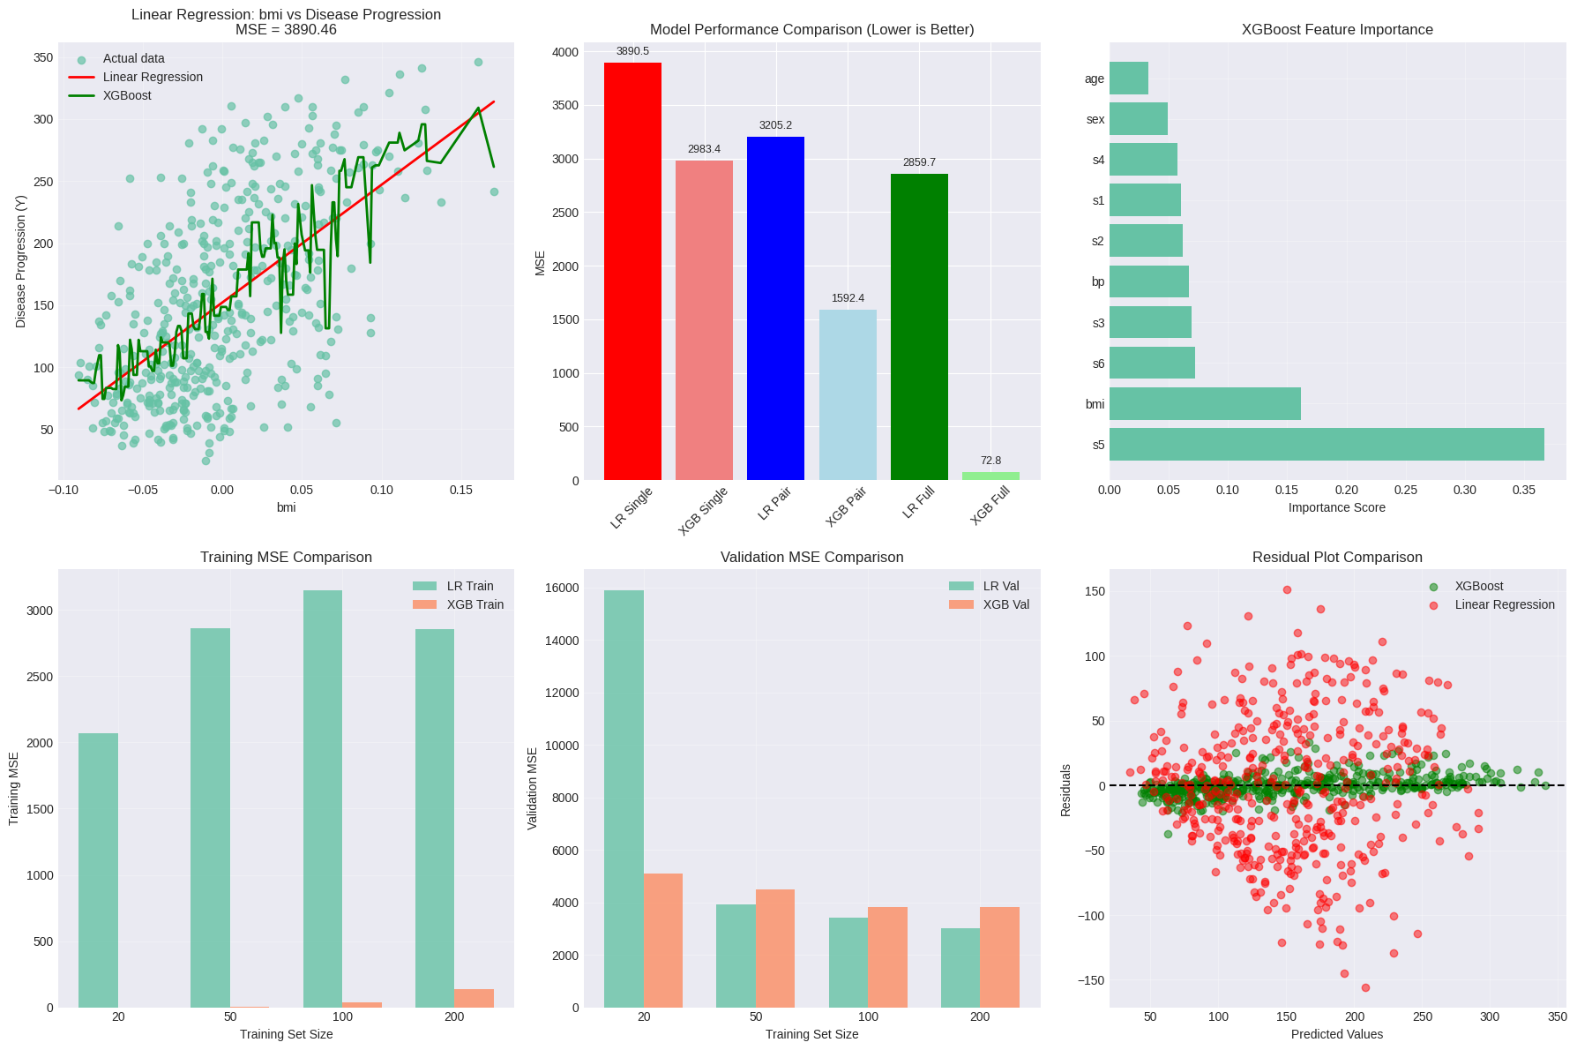
Visualization:

Slide 18
Conclusion
Performance Summary
Xgboost Significantly Outperforms Linear Regression Across All Scenarios
Scenario | Linear Regression | XGBoost | Improvement
Single Feature | 3890 MSE | 2983 MSE | 23%
Feature Pair | 3205 MSE | 1592 MSE | 50%
All Features | 2859 MSE | 73 MSE | 97%

