Slide 1
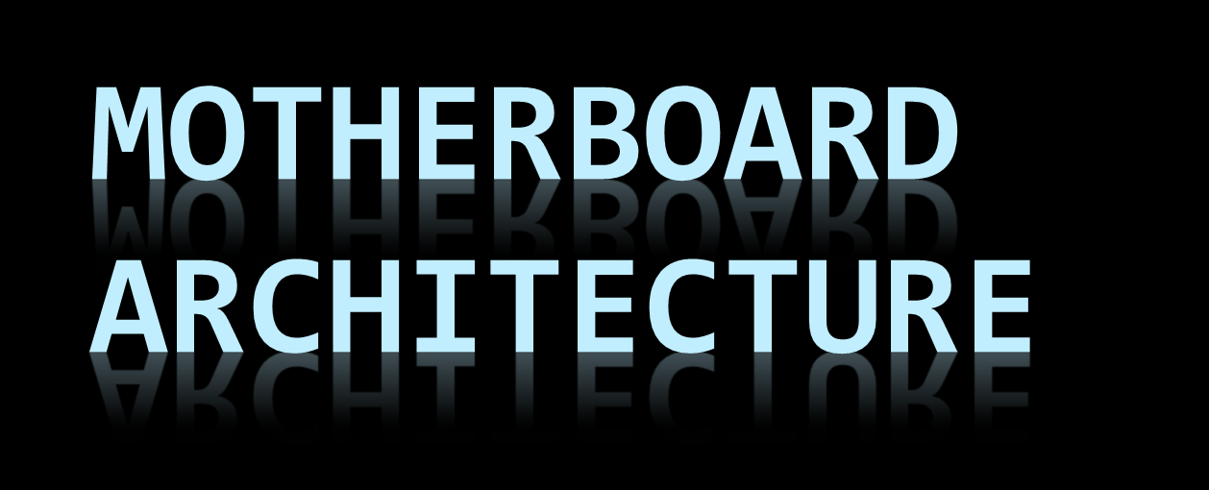

Slide 2
Objectives
Explain the function of a motherboard
Explain traces and busses
List the common bus types in a computer
Define Chipset
Explain the function of the Northbridge and Southbridge
List 5 factors to consider when purchasing a motherboard
Explain 1 way to troubleshoot a motherboard

Slide 3
MOTHERBOARD
the mainboard, system board, planar board or logic board.
a printed circuit board (PCB) found in all modern computers which holds many of the crucial components of the system, such as the central processing unit (CPU) and memory, and provides connectors for other peripherals.
the foundation of a computer

Slide 4
Motherboard is/has
Multi-layered printed circuit board
Copper circuit paths called traces carry signals and voltages across the motherboard
Some layers carry data for input/output while other layers carry voltage and ground returns

Slide 5
Motherboards
Motherboards connect all devices in a computer
Motherboards handle communications (the electrical signals) between the devices, ports, and slots
Comprised of many individual circuit traces grouped together to form busses.

Slide 6
Think of a Motherboard as:
Futuristic City with many modular plug-in buildings, using power from a common electrical system.
Multiple-lane highways of various widths transporting data between buildings.
Data and power infrastructure for the entire computer.

Slide 7
Motherboard
Holds The Processor
Memory
Expansion Slots
Connects Directly or Indirectly to Every Part of The PC

Slide 8
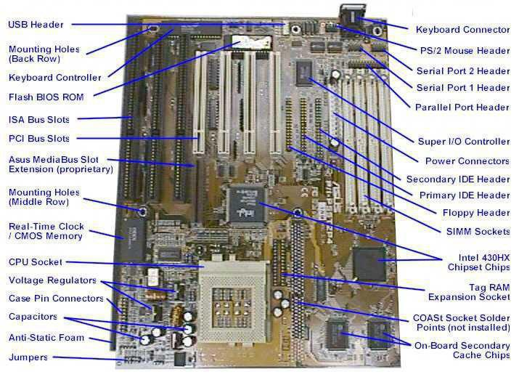
The Motherboard

Slide 9
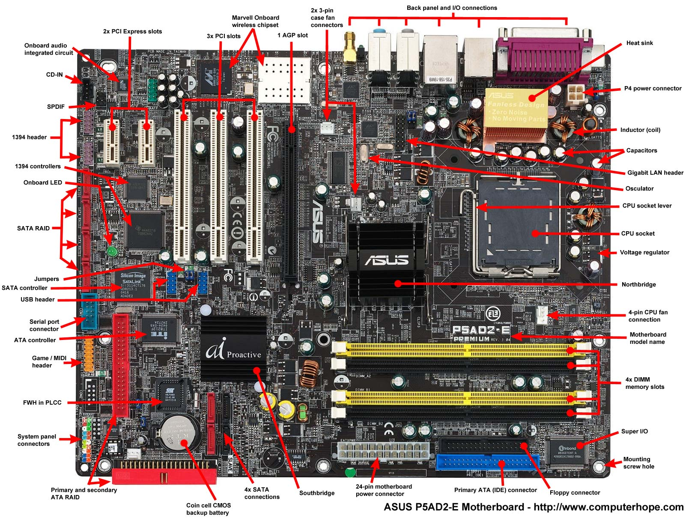

Slide 10
Motherboard Made Up Of:
A Chipset (known as the “glue logic”)
Some Code in ROM
Various Interconnections or Buses
“Glue logic - A simple logic circuit that is used to connect complex logic circuits together.”

Slide 11
Mobo Design
Provides the electrical connections by which the other components of the system communicate.
Devices may be attached to the motherboard as plug-in cards or via cables.
Integration or embedding some of the peripherals into the motherboard itself.

Slide 12
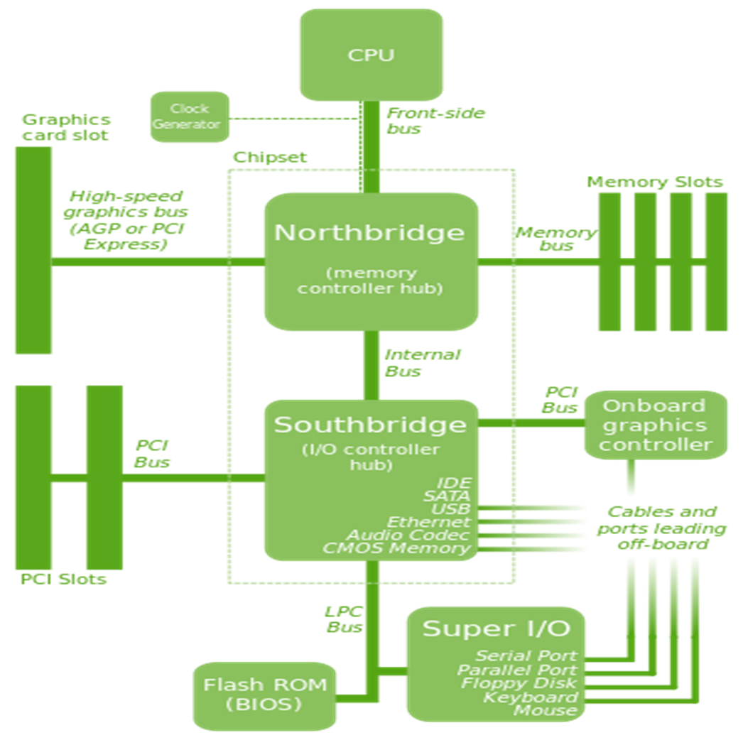

Slide 13
Motherboard Determines:
CPU type and speed
Chipset
Secondary cache type
Types of slots
Number of slots
Type of memory
Number of memory sockets and maximum memory
Type of case
ROM
Plug & Play compatibility
Type of keyboard

Slide 14
Expansion slots (PCI Express, PCI, and AGP) 3-pin case fan connectors Back pane connectors
Heatsink 4-Pin (P4) power connector Inductor
Capacitor CPU Socket Northbridge
Screw hole Memory slot Super I/O
Floppy connection ATA (IDE) disk drive primary connection
24-pin ATX power Supply connector Serial ATA connections
Coin cell battery (CMOS backup battery) RAID System panel connectors
FWH(FirmWare Hub) Southbridge Serial port connector
USB headers Jumpers Integrated circuit 1394 headers
SPDIF(Sony and Phillips Digital Interconnect Format) CD-IN BIOS
Cache memory Chipset Diode
Dip switches Electrolytic Fuse
Game port and MIDI header Internal speaker LCC(Leadless Chip Carrier)
Network header Obsolete expansion slots (AMR, CNR, EISA, ISA, VESA)
Obsolete memory slots (SIMM) Onboard LED Parallel port header
PS/2 header Resistor Serial port header
Screw hole aka mounting hole SCSI Solenoid
Voltage regulator Voltage regulator module (VRM)
Notes:
Extended Industry Standard Architecture
VESA (Video Electronics Standards Association) Local Bus worked alongside the ISA bus; it acted as a high-speed conduit for memory-mapped I/O and DMA, while the ISA bus handled interrupts and port-mapped I/O.
A solenoid can be a thin wire looped, or wrapped, around a metallic object. When electricity is passed through the wire, a magnetic field is generated. A solenoid can also be a transducer that converts energy in linear motion. It can be used as a switch to turn something on or off.
Computer motherboards contain solenoids and perform various functions. One important function is to help regulate the power coming from the power supply, in order to minimize the chance of voltage spikes and motherboard damage.

Slide 15
15 important items on a motherboard:
Support for processor
PCI slots
The AGP
The ISA slots
The parallel port
The serial port
The PS2 port
USB port
The chipset
The power connector
The memory slots
The floppy drive connector
IDE connectors
CMOS battery
BIOS

Slide 16
Form Factors
Form factor means the size and shape of the actual motherboard
3 most common Form Factor classifications:
  Baby AT
  ATX
  Slimline NLX

Slide 17
MOTHERBOARD FORM FACTORS
Width Length
Style (inches) (inches) Design Case Type
IBM PC 8.5 13 Mainboard IBM PC
IBM PC XT 8.5 13 Mainboard IBM PC XT
IBM PC AT 12 11–13 Mainboard Desktop or tower
Baby AT 8.5 10–13 Mainboard Desktop or tower
LPX 9 11–13 Backplane Desktop
Micro-AT 8.5 8.5 Mainboard Desktop or tower
ATX 12 9.6 Mainboard Desktop or tower
Mini-ATX 11.2 8.2 Mainboard Desktop
Mini-LPX 8–9 10–11 Backplane Desktop
Micro-ATX 9.6 9.6 Mainboard Desktop
NLX 8–9 10–13.6 Backplane Desktop
Flex-ATX 9 7.5 Mainboard Desktop or tower

Slide 18
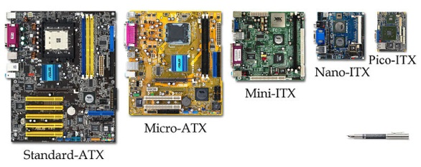

Slide 19
Temperature and reliability of MOBO
MOBO’s are generally air cooled with heat sinks often mounted on larger chips.
Insufficient or improper cooling can cause damage to the internal components of the computer and cause it to crash.
Passive cooling, or a single fan mounted on the power supply.
Newer motherboards have integrated temperature sensors to detect motherboard and CPU temperatures.

Slide 20
MOBO Boostrapping
the process of loading and executing bootstrap software by the computer during the boot process.
a chain of events that starts with execution of hardware-based procedures and may then hand-off to firmware and software which is loaded into main memory.
involves processes such as performing self-tests, loading configuration settings, loading a BIOS, resident monitors, a hypervisor, an operating system, or utility software.

Slide 21
Power-On Self Test (POST) Testing
Video adapter
Cards inserted into slots, such as conventional PCI
Floppy drive
Thermistors, voltages, and fan speeds for hardware monitoring
CMOS used to store BIOS setup configuration
keyboard and mouse
network controller
Optical drives: CD-ROM or DVD-ROM
SCSI hard drive
IDE, EIDE, or SATA hard disk
Security devices, such as a fingerprint reader or the state of a latch switch to detect intrusion
USB devices, such as a memory storage device

Slide 22
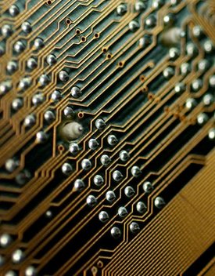
What are Traces?
TRACES –
  Thin conductors or circuits on the motherboard that work together for a specific purpose.
  Transmit electrical signals to and from CPU, RAM, and Devices

Slide 23
What is a Bus
A group of circuit traces that work together to move current or data between components on a motherboard.

Slide 24
Types of Buses on a Motherboard
Data
  moves data between components
Control
  delivers commands from the CPU to devices
Memory
  connects CPU to memory
I/O
  connects CPU to expansion slots
Power
  sends electrical power to devices such as speakers, lights, and switches

Slide 25
System Bus
The bus that connects the CPU to main memory on the motherboard is called the system bus.
    The system bus is also called the front side bus (FSB), local bus, or host bus.
    FSB is a major selling point for motherboards in the market today
      The higher the FSB, the faster the machine

Slide 26
Current Bus Architecture
  Local Bus
      32 or 64 bit bus
      800, 1066, 2000 MHz speeds
      Speeds are too high to communicate with I/O devices through slower expansion slots
        less PCI slots, more USB, 1394, PCIe
  North Bridge/ South Bridge - Chipsets
      Chips that separate the Local and I/O Buses that allow for data at 2 different speeds to be passed through

Slide 27
What is a Chipset
The combination of the North and Southbridge in a computer is called the chipset.
  They act as traffic signals on the motherboard to regulate high and low speed communications to avoid data crashes.
    Northbridge handles high speed communications between CPU, RAM, and some video slots - AGP
    Southbridge handles slow speed communications between ports and slots – USB, IDE, Parallel, Serial, keyboard, and old ISA slots.

Slide 28
Older ATX Motherboard
Bus Speed Diagram
FASTER COMMUNICATIONS
RAM
FSB 100 MHz
66 MHz
CPU
North
Bridge
AGP
33 MHz
PCI Bus
PCI Slots
USB
South
Bridge
IDE 1 - HD
IDE 2 - CD
8 MHz
Not used today!
ISA Bus
ISA Slots
Keyboard
Disk Drive
I/O Chip
LPT
Parallel Port
SLOWER
COMMUNICATIONS
SERIAL PORTS

Slide 29
Buying a Motherboard
Considerations
  Form Factor
      Will it fit in my case and work with the Power Supply I have selected?
  FSB Speed
      Faster is better
  Chipset
      Who makes the Northbridge and SouthBridge
  CPU Socket Type
      Will my CPU fit into the board, did I select the correct CPU type for my board?
  Ram Type
      Will my existing RAM type work? Did I select the correct RAM type?
  Expansion
      Are there enough extra ports and slots to add additional components later?

Slide 30
Troubleshooting Motherboards
Motherboards are FRU’s – Field Replaceable Units
Motherboards are hard to diagnose as bad
  Typically a bad board will fail immediately otherwise electrical shock via lightning stike, power surge, or short is the main reason a board will fail.
Must isolate the motherboard for testing
  Must have another board like the suspect board to swap with

Slide 31
Assignment
PART 1
Copy the Bus Speed Diagram from slide 10 for your notes.
Copy the Buying a Motherboard Considerations list to the back of the diagram. Keep it for your notes – you will use it in an upcoming lesson.
PART 2
Use the Internet and create a list of symptoms of a bad motherboard. Must use 2 different sources for information and Document the web address for each source used. Type your list into a word document.
Use the Internet and create a list of steps for safely uninstalling and reinstalling a motherboard. Must use 2 sources for information and document the web address of both sources. Type your list into the same word document, print, and turn in.

