Slide 1

Embedded system
2008/7/16 莊宜勳

Slide 2



Outline
What is Embedded System
  Embedded System
  Booting Process
Setup Host/Target Development
  Host / Target Development Setups
  Develop Tool
  Building OS
Application Porting
  Install an application
  Optimizing Application Issues
Homework

Slide 3
What is Embedded System

Slide 4

Embedded System ?
What
  Embedded System is a special-purpose computer system designed to specific functions.
Where
  It can be found everywhere
    MP3 player, air condition, vehicle control system, and so on.
How
  “We” often use linux-based operate system

Slide 5


The Scale of Embedded System
Small-scale
  Low-power
  About 2 MB ROM, 4 MB RAM
Medium-scale
  About 32MB ROM, 64MB RAM
  Perhaps with storage device
  EX: PDA, MP3 player
Large-scale
  Power-full or multi-core
  Usually no resource constrain
Notes:
在small-scale雖然linux可以跑,但不使用linux反而更好

Slide 6
System Layer
Application
Application
Operating System
Operating System
Firmware
Firmware
Firmware
Hardware
Hardware
Hardware
Desktop computer
Complex embedded
computer
Simple embedded
computer

Slide 7
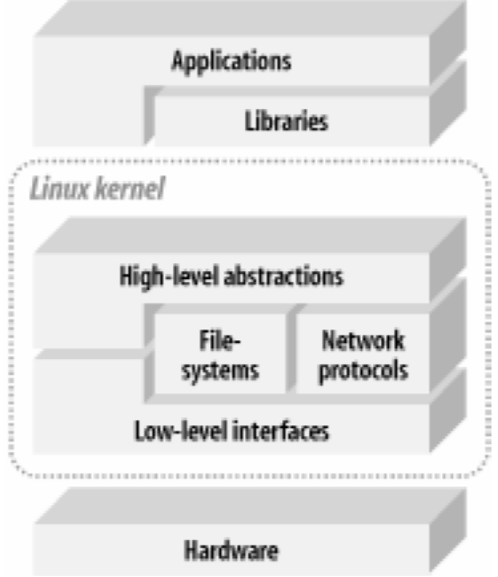
Architecture of
Embedded Linux System
Notes:
High-level abstraction => 系統內部的管理軟體(如automount)
Low-level interface => driver

Slide 8
Hardware
CPUs
  ARM (arm7tdmi, arm9, strongARM, Xscale, …etc.)
  MIPS
  X86, 8086
  SH
  PowerPC…
Memory Technology Device
  ROM
  Flash
  RAM
  HD or CF card or USB storage

Slide 9
Hardware (cont.)
Peripherals
  keypad
  USB device
  RS232 (UART)
  Network
  IrDA
  CF card others memory cards

Slide 10
Embedded OS
DOS
Palm OS
WinCE
Symbian
Linux
  uCLinux - without MMU
  RTLinux - for real-time system
  Android – Java and linux-based OS by google
  OpenMoko
  Etc.

Slide 11
Library
GNU C Library – glibc
  Standard
  Include several libraries, ex: libm, libc, and so on.
  Too large for embedded system
uC-libc
  Original designed for uClinux
  For No MMU system
  Support m68000, ColdFire and ARM
  Most APIs are compatible to Glibc, but not all
uClibc
  Also support MMU
  More compatible to glibc, but still not all
  Support m68000, ColdFire, ARM, MIPS, x86, SuperH, PowerPC
  Support share library

Slide 12
Booting Process

Slide 13
What the hell is the black box doing?
Power on
BIOS
  Load the hardware configuration
  Find the booting device
MBR of booting device
  MBR (master boot record) is in the first sector of booting device
  Boot loader is stored in the MBR of booting device
  When booting, it will read the booting information of boot loader in MBR.
Notes:
Boot loader需支援某些filesystem,像 lilo和grub支援linux和windows的filesystem,所以兩者都可以支援開機
但windows的loader不支援linux的filesystem,所以無法開linux kernel

Slide 14
It’s time to prepare for working
Loading Kernel
  Boot loader knows where the kernel is stored.
  De-compress the compressed kernel image and start to drive the hardware device.
Init
  The first executed process is init.
  It reads the file “/etc/inittab”
Run-level
  run some application of /etc/rc.d/rcx.d
Login
  /bin/login
Notes:
Boot loader除了kernel之外亦會將initrd一起load進memory
Initrd可以看成一個虛擬的root filesystem,裡面有需要用的modules

Slide 15

Root Filesystem
Root filesystem contains the set of applications, libraries, and related files needed to run the system
  According to the requirement of the system, the architecture of Root filesystem is different.
  Generally, the most useful directories of root filesystem are
    bin
    dev
    etc
    lib
    sbin
    usr
    proc*

Slide 16
MBR
address | Description | Size (byte)
0 | Code area | 440 (max 446)
440 | Optional Disk signature | 4
444 | Usually Nulls; 0x0000 | 2
446 | Table of primary partitions | 64
510 | MBR signature | 2
Total：512 bytes

Slide 17
What is boot loader ?
Definition of Boot Loader
  The first section of code to be executed after the embedded system is powered on.
Boot Loader in x86 PC consists of two parts
  BIOS (Basic Input/Output System)
  OS Loader (located in MBR of Hard Disk)
    Ex. LILO and GRUB
In some embedded systems the role of the boot loader is more complicated
  Since these systems may not have a BIOS to initial system configuration

Slide 18
Boot loader
Boot Loader is varied from CPU to CPU, from board to board
  Since Boot Loader is very close to hardware
  Hardware manufacturer may provide corresponding boot loader.
Examples:
LILO、GRUB
  x86 compatible boot loader
PPCBOOT
  Boot loader for PowerPC based embedded Linux systems

Slide 19
Boot loader (cont.)
PMON
  For MIPS architecture
Das U-Boot
  “Universal Boot loader“
  For PowerPC, ARM, XScale, MIPS, Coldfire, NIOS, x86, etc.

Slide 20
BTW
Because of the boot loader functionality, the boot loader we use have to depend on our OS
  The boot loader have to “know” the kernel file-system.
  LILO and GRUB support Windows and Linux, but the windows boot loader does not.

Slide 21
GRUB
grub.conf
  default 0
  timeout 5
  title Fedora Core
  root (hd0,0)
  kernel /vmlinuz-2.6.18-1 root=/dev/sda1
  initrd /initrd-2.6.18-1.img
  title=Windows XP
  root (hd0,5)
  makeactive
  chainloader +1

Slide 22
Setup Host/Target Development

Slide 23
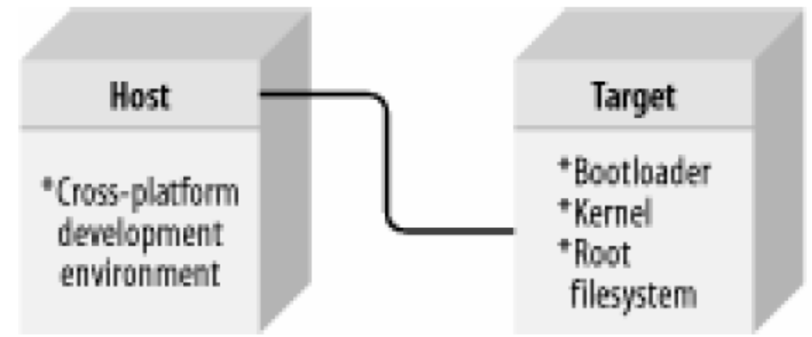
First type of Host/Target Development Setups
Linked Setup
  Host contains the cross-platform development environment
  Target contains an appropriate bootloader, kernel, and root filesystem
  Kernel could be available via TFTP
  Root filesystem could be NFS

Slide 24
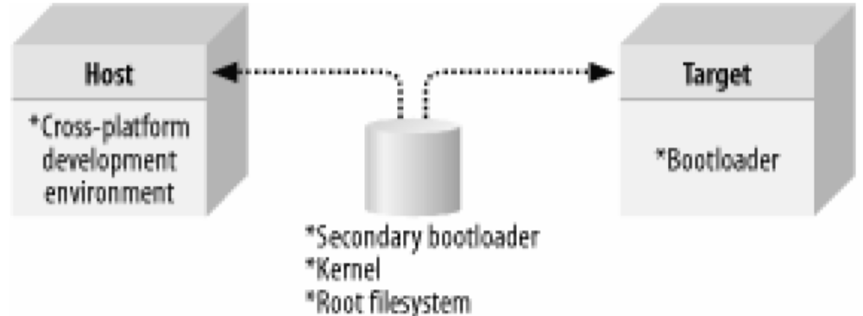
Second type of Host/Target Development Setups
Removable Storage Setup
  OS is written into storage by the host, and then is transferred to the target, and is used to boot the target device
  Host contains the cross-platform development environment
  Target contains bootloader
  The rest of the components are stored on a removable storage media

Slide 25
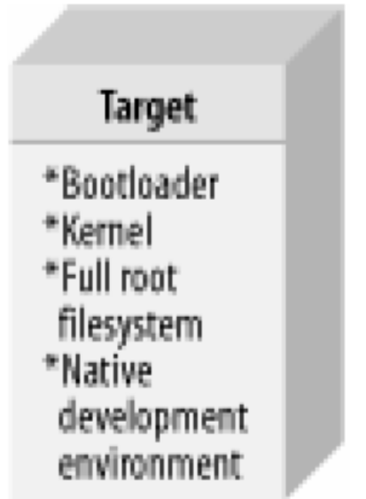
Third type of Host/Target Development Setups
Standalone Setup
  Target is a self-contained development system and includes all the required software to boot, operate, and develop additional software

Slide 26
Heterogeneous Environment

Slide 27
Cross-Compiler Toolchain
Toolchain means not only compiler
  But also Library, Linker (ld), assembler (as), other binutils, etc.
For two reasons we need the Toolchain
  Different architecture (ex: X86 & arm)
  Different Library
Usually Toolchain is downloaded from Internet and just use it
  If you have to setup Toolchain by yourself, you will get into big trouble

Slide 28
Setup Cross-Compiler Toolchain
Components
  gcc
  binutils
    as, ld, nm, etc
  Library
    glibc or uClibc
  Patch
    Fix bug
    Add some functions

Slide 29
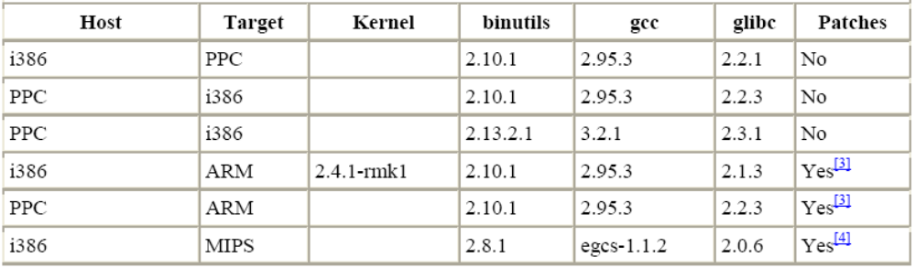
Setup Cross Compiler Toolchain
Versions are very important
  not all versions of one tool will build properly when combined with different versions of the others
  “New” doesn’t mean “Suitable”
  The only way to find the appropriate tool set is just “Try” or Google it

Slide 30
Setup Cross Compiler Toolchain
Five main steps
1. Kernel headers setup
2. Binary utilities setup
3. Bootstrap compiler setup
  Some languages supported by gcc, such as C++, require C library support
  Only support C language here
4. C library setup
  Compile library used in target system
5. Full compiler setup
  Build full compiler with C library

Slide 31
Develop Tool

Slide 32
Make and Makefile
Development problems
  It is hard to manage the relationship of files in large project.
  Every change requires long compilation
Motivation
  To manage the project well and automatically in the case of
    Many lines of code
    Multiple components
    More than one programmer

Slide 33
Make and Makefile (cont.)
A Makefile is a file (script) containing
  Project structure (files, dependencies)
  Instructions for files creation
The “make” command reads a Makefile, understands the project structure and makes up the executable
Note that the Makefile mechanism is not limited to C programs

Slide 34
Makefile
Rule syntax
main.o: main.c sum.h
gcc –c main.c
Rule
tab
action
dependency

Slide 35
Makefile
Example
  Program contains 3 files
  main.c., sum.c, sum.h
  sum.h included in both .c files
  Executable should be the file summary
summary
main.o
sum.o
main.c
sum.h
sum.c
sum.h

Slide 36
Makefile (cont.)
summary: main.o sum.o
gcc –o summary main.o sum.o
main.o: main.c sum.h
gcc –c main.c
sum.o: sum.c sum.h
gcc –c sum.c

Slide 37
Building your OS

Slide 38
Building uClinux
uClinux-dist
  http://www.uclinux.org/pub/uClinux/dist/
  Full source package
    including kernel, libraries and application

Slide 39
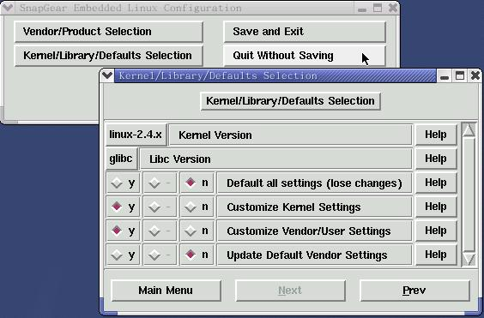
Platform Config
make menuconfig/ make xconfig
  Select your platform & kernel version

Slide 40
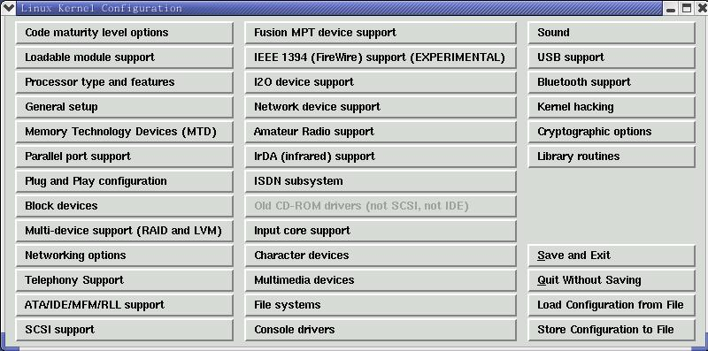
Kernel Config
Kernel setting

Slide 41
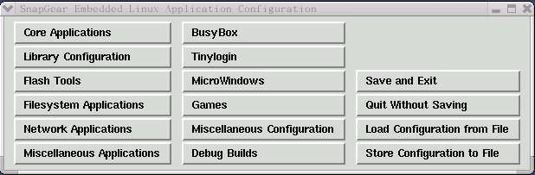
Application Config
Application setting

Slide 42
Start to compile uClinux
Compile
  make dep
    Check the dependence of files
  make
    make ➔ Errors occur ➔ solve it (Google it) ➔
    make again

Slide 43
Make for each components
Make linux_only
  Used to make kernel
Make user_only
  Used to make application
Make lib_only
  Used to make necessary library
Make romfs
  將編譯好的用戶程式產生Romfs檔系統（romfs目錄）。
Make image
  根據romfs目錄產生檔系統映射檔，然後編譯核心，產生核心映射檔。

Slide 44
Final output
Finally, there are two files generated：
  zImage
    uClinux kernel 2.4.x compress image
  romfs.img
    Rom file-system
Write files into corresponding location
  bootloader.bin
  zImage
  romfs.img

Slide 45
Application Porting

Slide 46
Install an application
Configure
  configure –h
    for information about parameters
  Some times the Makefile is generated by configure
  configure --parameters
    Ex: configure --enable-release --enable-optimizations
Compile
  make
    make ➔ Errors occur ➔ solve it (Google it) ➔ make again
  make install
    Install application or lib into specific location

Slide 47
Example: VLC
Environment
  Fedora Core 4 / Fedora Core 8
  Kernel: 2.6.11-1 / 2.6.14
vlc-0.8.6b.tar.bz2
  configure --enable-dvb
  make; make install

Slide 48
When installing
Add the path of Toolchain to PATH
  export PATH=/example/toolchain/path:$PATH
--prefix=PREFIX
  Indicate where to install application
--target=TARGET
  configure for building compilers for TARGET [HOST]

Slide 49
Optimizing Application Issues

Slide 50
Down Size
Remove unused part of application
  configure --disable-(something)
Reduce binary code size
  strip
    One of binutils tool
    Strip symbols and debug messages from object files
  uClinux
    ELF -> FLAT
  Optimum size in compile time
    gcc -Os
Cut down library
  Ace in the hole
Notes:
Ace xxx 最後王牌,最後的手段

Slide 51
Efficiency
Dynamic linking -> Static
Use more efficient function in program
  Ex: memcpy vs mmap
  Even use assembly language to rewrite critical part
Optimum in configure
  configure --enable-release --enable-optimizations
Turn up gcc optimum level
  gcc -O0 ~ -O3
Notes:
Mmap =>將file or device into memory
Memcpy在小檔案比較快, mmap在檔案越大越有效率

Slide 52
ETC.
Low response time
Minimal memory usage
Power saving

Slide 53
Homework

Slide 54
VLC
Fulfill install process of VLC by page 35
  Report configure parameters, encountering problems, the result and what you has learned from this

Slide 55
Reference
Building Embedded Linux Systems, Karim Yaghmour, O’Reilly, 2003
uClinux, http://www.uclinux.org
VideoLAN developers, http://www.videolan.org/developers/vlc.html

Slide 56
This slider was originally written by lijw in 2006
revised by erdatsai in 2007
revised by JACKY in 2008

