Slide 1

Linux Booting Steps
Presented By-
Anando Kumar Paul

Slide 2

Introduction
Overview
System startup
Stage 1 boot loader
Stage 2 boot loader
Kernel
Init

Slide 3
Overview
Processor executes code at a well known location i.e. Basic Input / Output System (BIOS).
BIOS stored in Flash memory on the mother board.
CPU invokes the reset vector to start a program at a known address in flash/ROM.
BIOS determines candidates for boot.
First Stage Boot Loader is loaded into RAM and executed when a boot device is found.
Continue…

Slide 4
Overview
First stage Boot Loader is less than 512 bytes in length (single sector), and loads the second-stage boot loader.
A splash screen is commonly displayed at the time of when the second-stage boot loader is in RAM.
Linux and initial RAM disk (temporary file system) are loaded into memory.
After completing image loading, the second-stage boot loader passes control to the kernel image.
Now kernel is decompressed and initialized.
Continue…

Slide 5
Overview
After initialization second-stage boot loader
  checks the system hardware
  enumerates the attached hardware devices
  Then mounts the root device
  loads the necessary kernel modules
When complete, the first user-space program (init) starts, and high level system initialization is performed.

Slide 6
System Startup
Depends on the Linux hardware.
A bootstrap environment is used when the system is powered on or reset. e.g. U-Boot, RedBoot and MicroMonitor from Lucent.
Embedded platforms are commonly shipped with a boot monitor, which resides in special region on flash memory on the target hardware.
Download Linux kernel image into flash memory and subsequently execute it.
Have the ability to store and boot a Linux image and cover both the first and second stage boot loader.

Slide 7
System Startup
Linux booting begins in the BIOS at address 0xFFFF0.
STEP 1 :
  Power-on self test (POST).
  To perform a check of the hardware.
STEP 2 :
  Local device enumeration and initialization.
Uses of BIOS functions :
  First parts:
    POST code
  Second part
    Runtime services
After completion of POST, it is flushed from memory but the BIOS runtime services remain and are available to the target operation system.

Slide 8
System Startup
BIOS runtime searches for devices that are both active and bootable in the order of preference defined by the complementary metal ozide semiconductore (CMOS) settings.
Boot devices
  Floppy Disk
  CD-ROM
  A partition on a Hard disk
  A device on the network
  USB flash memory stick
Linux is booted using boot loader which resides in Master Boot Record (MBR), located in the first sector on the disk (sector 1 of cylinder 0 head 0)‏
After MBR loaded into RAM, BIOS yields control to it.

Slide 9
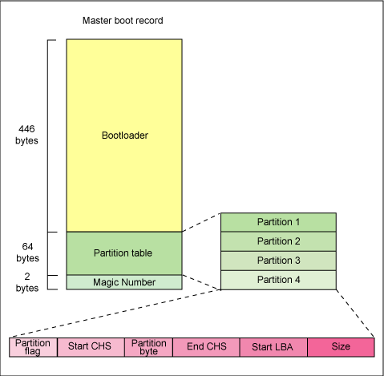
Stage – 1 Boot Loader
The primary boot loader which resides in MBR.
512-byte image containing both program code and small partition table.

Slide 10
Stage – 1 Boot Loader
First 446 bytes are the primary boot loader contains both executable code and error message text.
Next 64 bytes are the partition table contains a record for each of four partitions (1b bytes each).
MBR ends with 2 bytes that are defined as magic number (0xAA55).
Magic number serves as a validation check of MBR.
Uses :
  Find and load the secondary boot loader (stage 2).
  It does this by looking through the partition table for an active partition.
  It scans remaining partitions to ensure that they are all inactive when it finds an active operation.
  The active partition’s boot record is read from the device into RAM and executed, when this is verified.

Slide 11
Stage 2 Boot Loader
Also known as kernel loader.
To load the Linux kernel and optional initial RAM disk.
The first stage and second stage boot loaders combined are called LInux Loader (LILO) or Grand Unified Bootloader (GRUB).
LILO has some disadvantages that were corrected in GRUB.
GRUB features
  Linux file system knowledge.
  Can load a Linux kernel from an ext2 or ext3 file system instead of using raw sectors on the disk as LILO.
  Converts two stage boot loader to three stage boot loader.
  Stage 1 : (MBR) boots a stage 1.5 boot loader that understands the particular file system containing the Linux kernel image.

Slide 12
Stage 2 Boot Loader
GRUB features
  Converts two stage boot loader to three stage boot loader.
  Stage 1 :
    (MBR) boots a stage 1.5 boot loader that understands the particular file system containing the Linux kernel image.
    “Reiserfs_stagel_5” to load from reiser journaling file system or “e2fs_stagel_5” to load from an ext2 or ext3 file system.
    When the stage 1.5 boot loader is loaded and running then the stage 2 boot loader can be loaded.
  Stage 2 :
    GRUB can display a list of available kernels( defined in /etc/grub.conf. wit the soft links from /etc/grub/menu.lst and /etc/grub.cons).
    Can select a kernel and amend it with additional kernel parameters.
    Can use command line shell for greater manual control over the boot process.
    This stage can consult with the file system and the default kernel image and initrd image are loaded into memory.
    With this images ready boot loader invokes the kernel image.

Slide 13
Kernel
Kernel stage begins with the kernel image in the memory and control given from stage 2 boot loader.
It’s a compressed kernel image. E.g. zImage (<512KB), bzImage(>512KB).
A routine does some minimal amount of hardware setup and then decompresses the kernel contained within the kernel image and place it into high memory.
The routine moves it into memory and notes for later use if an initial RAM disk is present.
Calls the kernel and the kernel boot begins.
bzImage is invoked and begin at ./arch/i386/boot/head.S in the start assembly routine.
Does hardware support and invokes the startup_32 routine in ./arch/i386/boot/compressed/head.S.
This routine sets up a basic environment (stack, etc.) and clears the Block Started by Symbol (BSS).
Kernel then decompressed through a call to a C function called decompressed_kernel ( located in ./arch/i386/boot/compresed/misc.c ).
Another startup_32 function is called which is in ./arch/i386/kernel/head.S.

Slide 14
Kernel
Startup_32 function (also called the swapper or process 0), the page tables are initialized and memory paging is enabled.
CPU type is detected along with optional floating-point unit (FPU) and stored away for later use.
start_kernel function invoked (init/main.c), which takes to the non-architecture specific Linux kernel.
start_kernel, in essence, the main function for the Linux kernel.

Slide 15
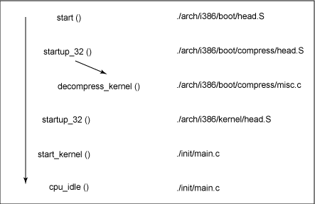
Kernel
Program flow

Slide 16
Kernel
“start_kernel” function
  List of initialization functions are called to set up interrupts
  Performs further memory configuration.
  Load the initial RAM disk.
“kernel_thread” function (in arch/i386/kernel/process.c)‏
  Start init function, which is the first user space process.
Finally, the idle task is started and the scheduler can now take control(after the call to cpu_idle).
The pre-emptive scheduler periodically takes control to provide multitasking with interrupts enabled.

Slide 17
Kernel
Kernel booting
  The initial RAM disk (initrd) is copied into RAM and mounted.
  Initrd serves as a temporary root file system in RAM and allows the kernel to fully boot without having to mount any physical disks.
  Necessary modules can be part of the initrd.
  Kernel can be very small, but still support a large number of possible hardware configurations.
  After the kernel is booted, the root file system is pivoted (via pivot_root).
  Then the initrd root file system is unmounted and the real root file system is mounted.

Slide 18
Kernel
Initrd function allows to create a small Linux kernel drivers compiled as loadable modules.
These loadable modules allows kernel
  To access disks and the file system
  To access the drivers
Root file system is a file system on a disk.
Initrd function provides bootstrapping to gain access to the disk and mount the real root file system.
If we target without a hard disk, the initrd can be the final root file system, or the final root file system can be mounted via the Network File System (NFS).

Slide 19
Init
After the kernel is booted and initialized, the kernel starts the first user space application.
Init is the first program invoked that is compiled with the standard C library.
Before this stage, no standard C application have been executed.
In a desktop Linux system, the first application started is commonly /sbin/init. But it need not be.
Sometimes embedded systems require the extensive initialization provided by init (as configured through /etc/inittab).
We can invoke simple shell script that starts the necessary embedded applications.

Slide 20
Lower level booting steps
The Motherboard BIOS Triggers the Video Display Card BIOS Initialization
Motherboard BIOS Initializes Itself
SCSI Controller BIOS Initializes
Hardware Summary
OS/2 BootManager Menu
Lilo is started
The Linux Kernel Initializes
  Processor, Console, and Memory Initialization
  PCI Bus Initialization
  Network Initialization
  The Kernel Idle Thread (Process 0) is Started
  Device Driver Initialization
    Generic Parallel Port Initialization
    Character Device Initializations
    Block Device Initializations
    SCSI Bus Initialization
  Initialization of Kernel Support for Point-to-Point Protocol
  Examination of Fixed Disk Arrangement
Init Program (Process 1) Startup
The Bash Shell is Started

Slide 21

Summary
Linux boot process is highly flexible
Supports a huge number of processors and hardware platforms.
Before, the loadlin (Linux boot loader that runs under DOS or Microsoft Windows) provided a simple way to boot Linux without any frills.
The LILO boot loader expanded the boot capabilities, but lacked any file system awareness.
The latest generation boot loader ( GRUB) permits Linux to boot from a range of file systems.

