Slide 1
Linux Processes and Threads
Chapter 10.3
cs431-cotter
Notes:
cs431-cotter

Slide 2
Processes vs. Tasks
Linux views all work as a series of tasks imposed on the OS. Processes and threads are essentially viewed in the same way, except that resources allocated are different
CS431-cotter
cs431-cotter
Notes:
cs431-cotter
cs431-cotter

Slide 3
Processes vs. Tasks
Linux views all work as a series of tasks imposed on the OS. Processes and threads are essentially viewed in the same way, except that resources allocated are different
Process 1
Process 2
Process 3
Outside OS
Inside OS
Task 1
Task 2
Task3
cs431-cotter
Notes:
cs431-cotter
cs431-cotter

Slide 4
Implementation of Processes and Threads
Categories of information in the process descriptor:
Scheduling parameters
Memory image
Signals
Machine registers
System call state
File descriptor table
Accounting
Kernel stack
Miscellaneous
cs431-cotter
Tanenbaum, Modern Operating Systems 3 e, (c) 2008 Prentice-Hall, Inc. All rights reserved. 0-13-6006639
Notes:
cs431-cotter

Slide 5
Process Descriptor - task_struct -(see /usr/include/linux/sched.h)
Individual variables:
  state
  priority
  flags
  signal
Pointers to queues, structs, etc.
  fs_struct
  mm_struct
  task Lists
  “family”
cs431-cotter
Notes:
cs431-cotter
cs431-cotter

Slide 6
Process States
TASK_RUNNING
TASK_INTERRUPTIBLE
TASK_UNINTERRUPTIBLE
TASK_STOPPED
TASK_ZOMBIE
cs431-cotter
Notes:
cs431-cotter
cs431-cotter

Slide 7
Process Relationships
p_cptr
parent
p_pptr
p_pptr
p_pptr
p_osptr
p_osptr
youngest
child
child
oldest
child
p_ysptr
p_ysptr
pid_t getpid(void);
pid_t getppid(void);
cs431-cotter
Notes:
cs431-cotter
cs431-cotter

Slide 8
The Process List
Tasks managed through a doubly linked list. Each task_struct includes:
  struct task_struct *next_task;
  struct task_struct *prev_task;
  List terminated at global variable init_task
cs431-cotter
Notes:
cs431-cotter
cs431-cotter
The kernel manages all processes through doubly linked lists. Each task_struct contains

Slide 9
Process and thread creation
Process Creation
  fork ( )
  execve( )
  clone( )
Thread Creation
  clone( )
  pthread_create( )
cs431-cotter
Notes:
cs431-cotter
cs431-cotter

Slide 10
Creating Processes - fork( )
pid_t fork(void);
Creates a child process that differs from the process only in its PID and PPID, and in the fact that resource utilizations are set to 0. Linux uses a copy-on-write procedure.
Child process returns PID = 0;
Parent process returns child PID
cs431-cotter
Notes:
cs431-cotter
cs431-cotter
The fork( ) command has been around as long as UNIX (or Linux) has been around. It was the

Slide 11
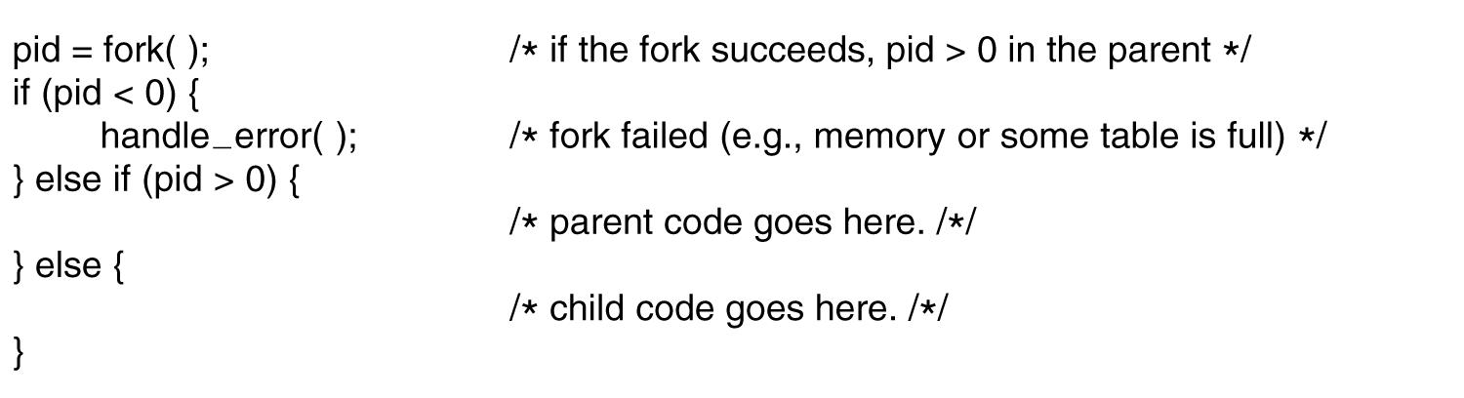
Processes in Linux
Figure 10-4. Process creation in Linux.
cs431-cotter
Tanenbaum, Modern Operating Systems 3 e, (c) 2008 Prentice-Hall, Inc. All rights reserved. 0-13-6006639
Notes:
cs431-cotter

Slide 12
Process Fork example
#include <stdio.h>
#include <sys/time.h>
#include <sys/types.h>
#define LB_SIZE 128
int main ()
{
time_t now;
char lineBuf[LB_SIZE];
pid_t pid;
void work (char *name);
time (&now);
printf ("Fork test at %s\n", ctime(&now));
cs431-cotter
Notes:
cs431-cotter
cs431-cotter

Slide 13
Process Fork example
if ((pid = fork() ) < 0) {
printf("Couldn't fork process!\n");
exit(1);
}
else if (pid == 0) { // child process
work ("child");
return 0;
}
work("main");
printf ("Closing main program...\n");
return 0;
}
void work(char * name) {
printf("This is the %s work cycle\n",name);
sleep (1);
}
cs431-cotter
Notes:
cs431-cotter
cs431-cotter

Slide 14
Process Fork example (Output)
[root]@bobs-RHLINUX cs431_linux]# gcc -o proc_fork proctest.c
[root]@bobs-RHLINUX cs431_linux]# ./proc_fork
Fork test at Wed Jan 10 14:57:53 2001
This is the main work cycle
Closing main program...
This is the child work cycle
cs431-cotter
Notes:
cs431-cotter
cs431-cotter

Slide 15
Creating New Processes - execve( )
int execve (
  const char *filename,
  char *const argv[ ],
  char *const envp[ ]);
filename: name of executable file (or script) to be executed
argv[]: list of arguments to be passed to executable file
(an array of strings. May use NULL)
envp[]: list of environment variables to be used
(an array of strings. May use NULL)
No return on success. -1 on failure
cs431-cotter
Notes:
cs431-cotter
cs431-cotter

Slide 16
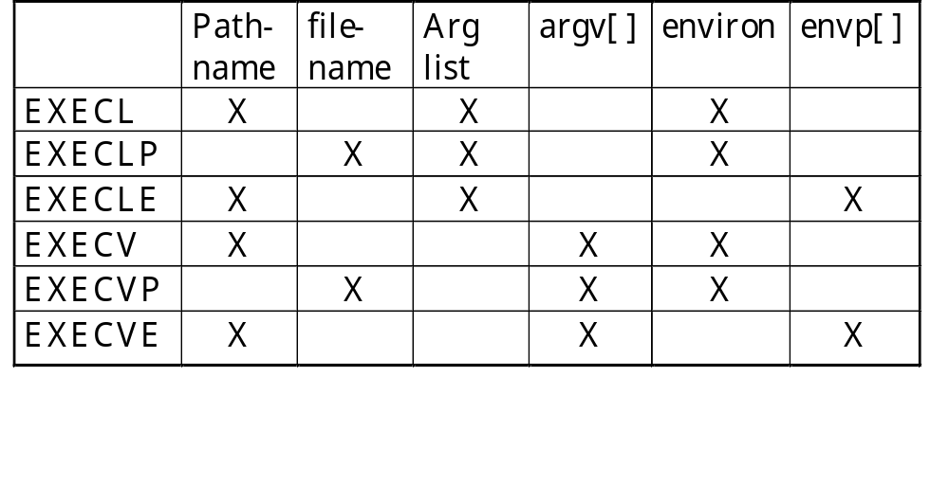
Creating Processes - Execve
Used to call an executable program from a child process. 6 varieties available, depending on options needed:
cs431-cotter
Notes:
cs431-cotter
cs431-cotter

Slide 17
New Process Example (exec.cpp)
#include <iostream>
#include <unistd.h>
#include <sys/types.h>
#include <string.h>
#include <errno.h>
extern char **environ;
extern int errno;
pid_t pid;
using namespace std;
int main (int argc, char* argv[]) {
FILE *fin;
char lineBuf[128];
char *progname= argv[1];
char myname[15] = "Bob";
char mynum[5] = "5";
static int result;
char *args[4];
cs431-cotter
Notes:
cs431-cotter
cs431-cotter

Slide 18
New Process Example
if (argc == 2)
strcpy (progname, argv[1]);
else {
cout << "Usage: " << argv[0] << " progname" << endl;
exit(1);
}
pid = fork();
if (pid==0) { //We are in the child process
args[0] = progname;
args[1] = (char *) &myname;
args[2] = (char *) &mynum;
args[3] = (char *) 0; // array must be null terminated
if ( execv (progname, args) == -1) {
cout << "ERROR IN EXECVE " << endl;
perror("execve");
}
}
cs431-cotter
Notes:
cs431-cotter
cs431-cotter

Slide 19
New Process Example
else //We are in the parent process
{
cout << “Created new process with process ID " << pid << endl;
sleep(1);
}
return 0;
}//main
cs431-cotter
Notes:
cs431-cotter
cs431-cotter

Slide 20
Child Process (hello.cpp)
#include <iostream>
using namespace std;
int main(int argc, char * argv[])
{
int i, mynum;
if (argc != 3) {
cout << "Usage: : " << argv[0] << " NAME NUMBER" << endl;
return 0; }
cout << "Hello, World!" << endl;
cout << “Passed in " << argc << " arguments" << endl;
cout << "They are: " << endl;
mynum = atoi(argv[2]);
cout << "Program name is " << argv[0] << endl;
cout << "Name argument is " << argv[1] << endl;
cout << "The number is " << mynum << endl;
return 0;
}

Slide 21
New Process Example (Output)
[rcotter@kc-sce-450p2 cs431]$ g++ -o exec exec.cpp
[rcotter@kc-sce-450p2 cs431]$ g++ -o hello hello.cpp
[rcotter@kc-sce-450p2 cs431]$ ./exec hello
Created new process with process ID 2795
Hello, World!
Passed in 3 arguments
They are:
Program name is hello
Name argument is Bob
The number is 5
[rcotter@kc-sce-450p2 cs431]$
cs431-cotter
Notes:
cs431-cotter
cs431-cotter

Slide 22
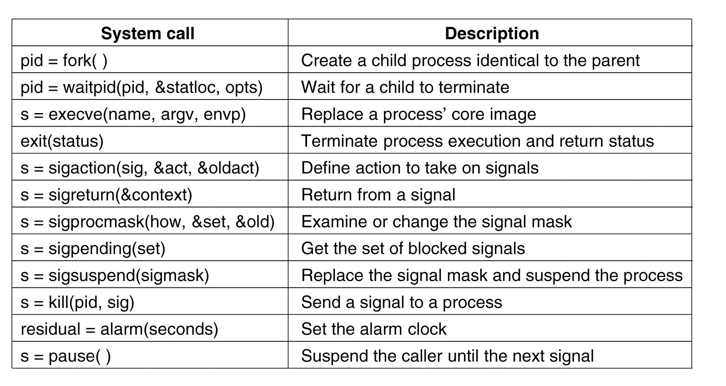
Process Management
System Calls in Linux
Figure 10-6. Some system calls relating to processes.
cs431-cotter
Tanenbaum, Modern Operating Systems 3 e, (c) 2008 Prentice-Hall, Inc. All rights reserved. 0-13-6006639
Notes:
cs431-cotter

Slide 23
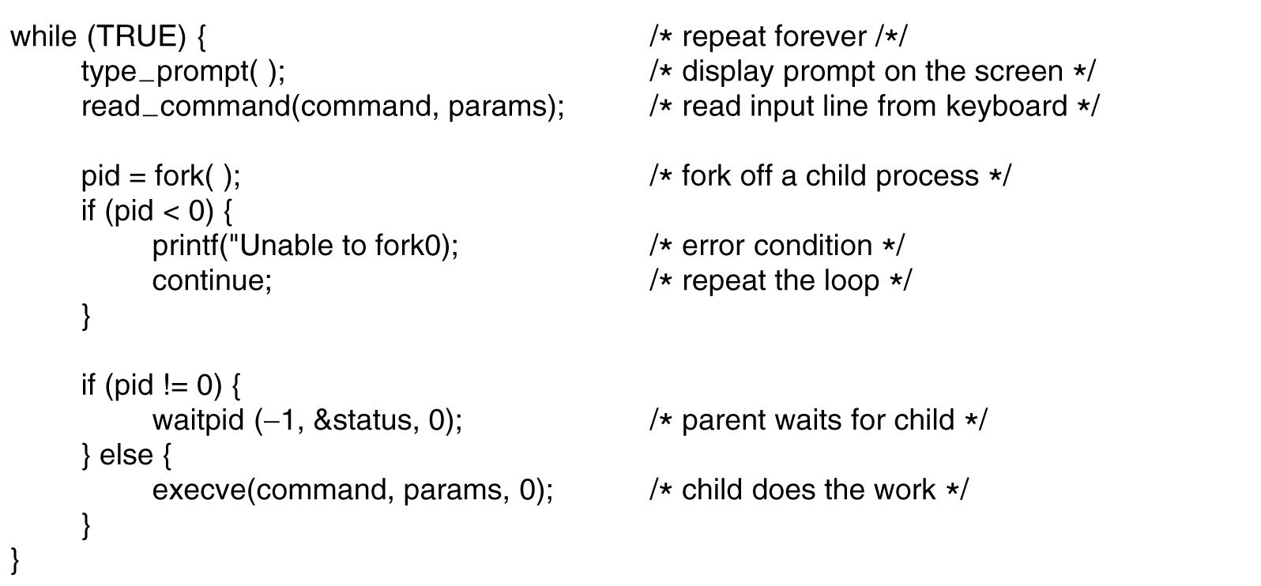
A Simple Linux Shell
Figure 10-7. A highly simplified shell.
cs431-cotter
Tanenbaum, Modern Operating Systems 3 e, (c) 2008 Prentice-Hall, Inc. All rights reserved. 0-13-6006639
Notes:
cs431-cotter

Slide 24
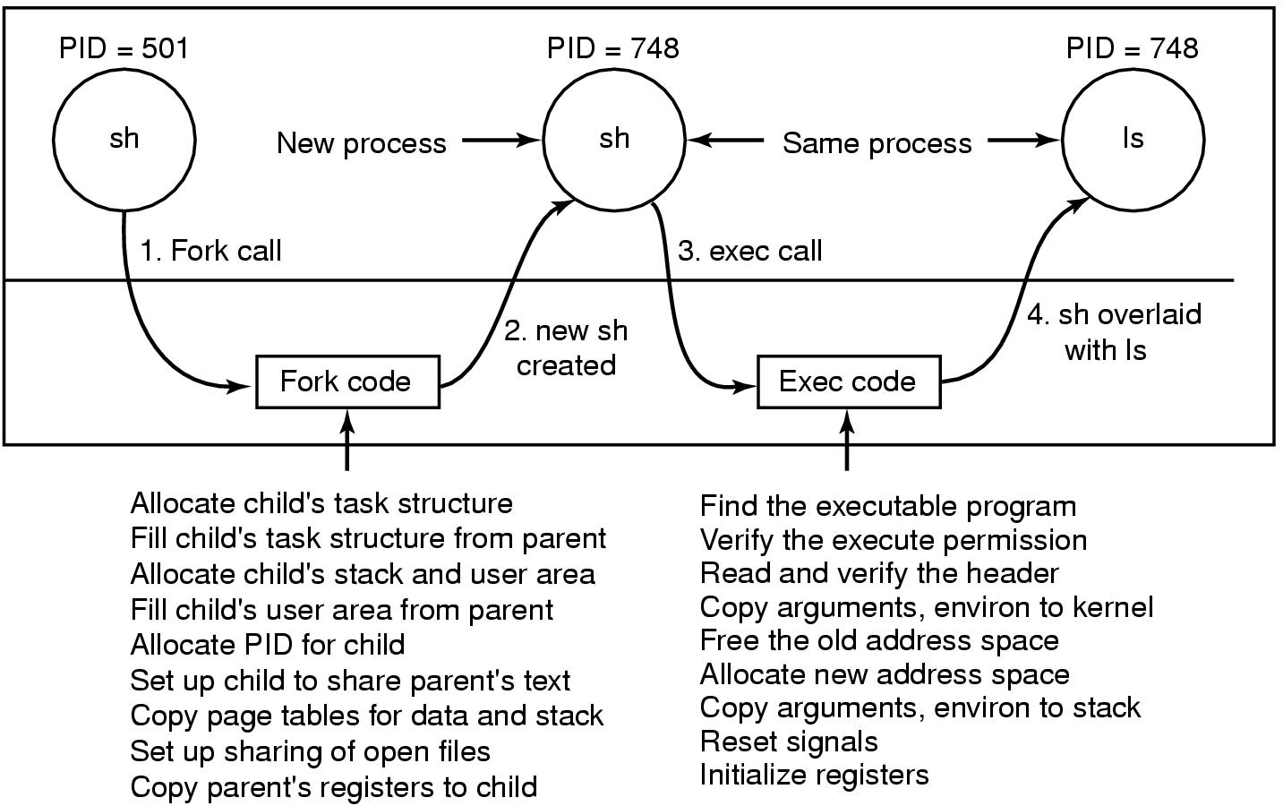
Implementation of Exec
Figure 10-8. The steps in executing the command
ls typed to the shell.
cs431-cotter
Tanenbaum, Modern Operating Systems 3 e, (c) 2008 Prentice-Hall, Inc. All rights reserved. 0-13-6006639
Notes:
cs431-cotter

Slide 25
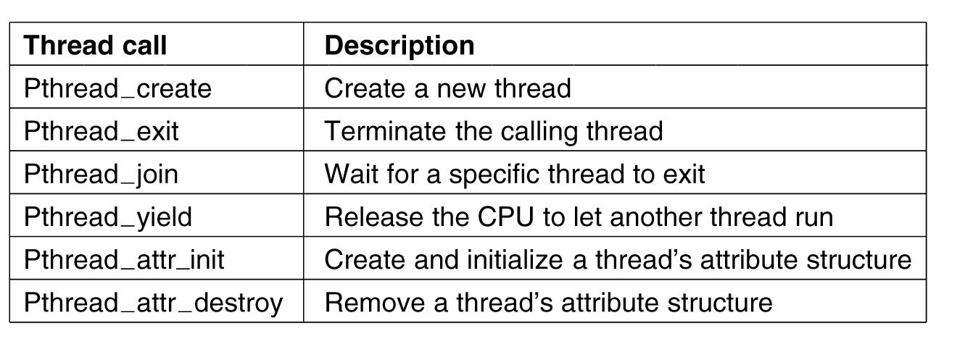
POSIX Threads (1)
Figure 2-14. Some of the Pthreads function calls.
cs431-cotter
Tanenbaum, Modern Operating Systems 3 e, (c) 2008 Prentice-Hall, Inc. All rights reserved. 0-13-6006639
Notes:
cs431-cotter

Slide 26
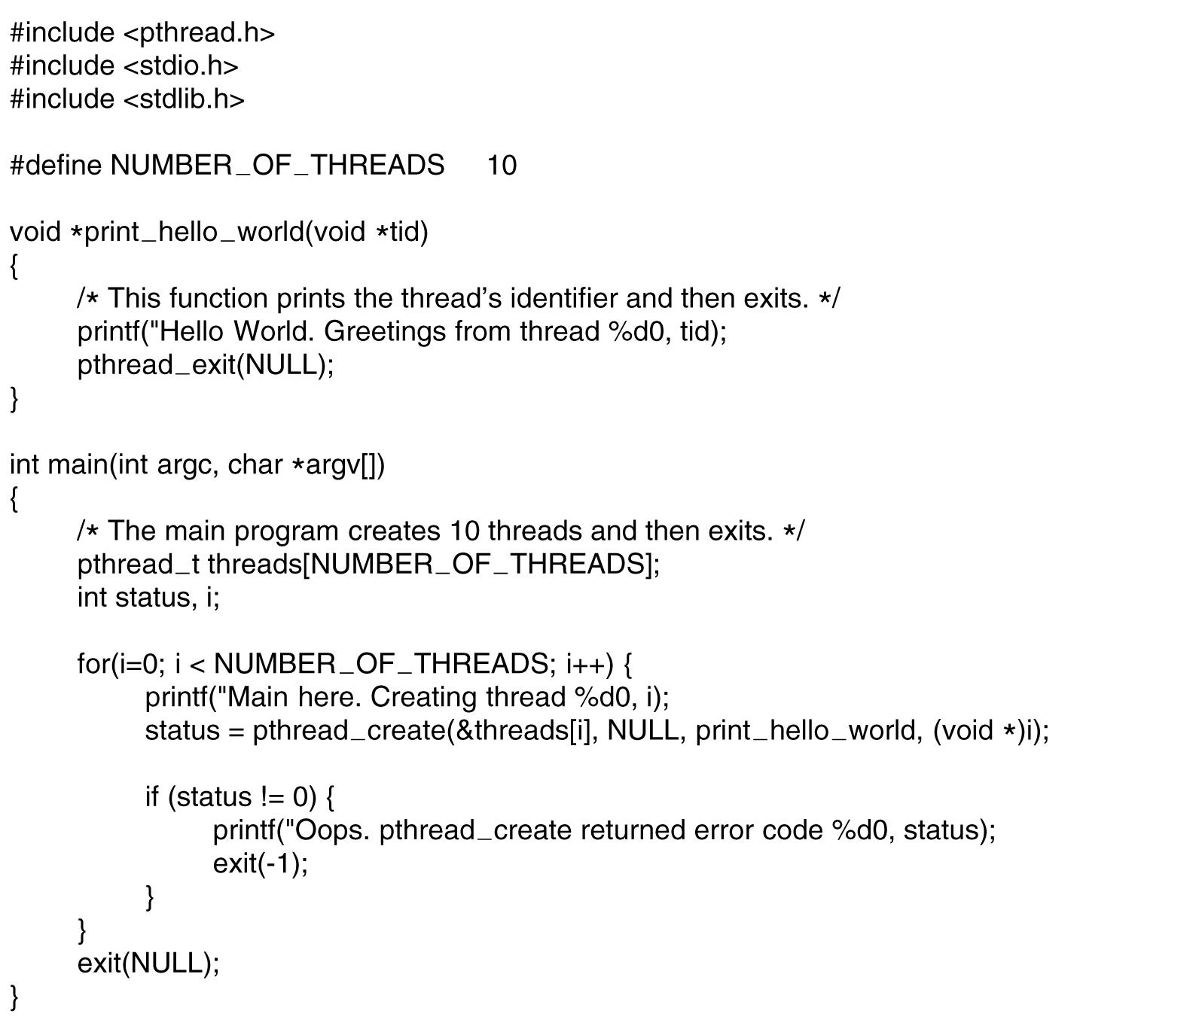
POSIX Threads (2)
. . .
Figure 2-15. An example program using threads.
cs431-cotter
Tanenbaum, Modern Operating Systems 3 e, (c) 2008 Prentice-Hall, Inc. All rights reserved. 0-13-6006639
Notes:
cs431-cotter

Slide 27
Creating Threads - _pthread_create()
#include <pthread.h>
int pthread_create (
  pthread_t *thread, //variable to store returned thread ID
  pthread_attr_t *attr, // thread attributes
  void * (*start_routine)(void *), //function to run
  void * arg); //args to pass to new thread
cs431-cotter
Notes:
cs431-cotter
cs431-cotter

Slide 28
_pthread_create( ) attributes
May be set to NULL to use default attributes
detachstate //control whether the thread is created in the joinable state (default) or not.
schedpolicy //select scheduling policy (default is regular, non-realtime scheduling)
schedparam //set scheduling priority (default is 0)
inheritsched //is sched policy to be inherited by child processes or threads? (default is no)
cs431-cotter
Notes:
cs431-cotter
cs431-cotter

Slide 29
POSIX Thread example
#include <stdio.h>,<sys/time.h>, <sys/types.h>, <pthread.h>
#define LB_SIZE 128
int flag;
int main (int argc, char * argv[]) {
FILE *fin;
time_t now;
char lineBuf[LB_SIZE];
pthread_t tid; //structure that holds thread number
int childno, childcount = 3, mainnum = 0;
void work (void * childnum); //function prototype
cs431-cotter
Notes:
cs431-cotter
cs431-cotter

Slide 30
POSIX Thread example
time (&now);
printf ("Thread test at %s\n", ctime(&now));
childno = 1;
while (childno <= childcount) {
flag = 0;
if ((pthread_create (&tid, NULL, (void *)&work,
(void *)&childno))>0) {
printf("Couldn't create new thread!\n");
exit(1);
} else //we're in main {
while (flag == 0) ;
printf("Just created thread %d\n", tid);
childno++;
}
}
cs431-cotter
Notes:
cs431-cotter
cs431-cotter

Slide 31
POSIX Thread example
work(&mainnum);
printf ("Terminating Main program......\n");
return 0;
} //end of main
void work(void * arg) {
int i,j, childnum;
flag = 1;
childnum = *(int *) arg;
for (i = 0; i < 3; i++) {
printf("Loop %d of thread %d work cycle\n", i, childnum);
sleep (1);
}
}
cs431-cotter
Notes:
cs431-cotter
cs431-cotter

Slide 32
POSIX Thread example (Output)
[root]@bobs-RHLINUX cs431_linux]# gcc -o thread_test proctest_v4a.c -lpthread
[root]@bobs-RHLINUX cs431_linux]# ./thread_test
Thread test at Fri Jan 12 14:49:52 2001
Loop 0 of thread 1 work cycle
Just created thread 1026
Loop 0 of thread 2 work cycle
Just created thread 2051
Loop 0 of thread 3 work cycle
Just created thread 3076
Loop 0 of thread 0 work cycle
:
:
Loop 2 of thread 2 work cycle
Loop 2 of thread 3 work cycle
Loop 2 of thread 0 work cycle
Terminating Main program......
cs431-cotter
Notes:
cs431-cotter
cs431-cotter

Slide 33
POSIX Thread example (v2)
#include <iostream>,<stdlib.h>,<pthread.h>
#define LB_SIZE 128
using namespace std;
void * work (void * arg); // function prototype
int main (int argc, char * argv[]) {
time_t now;
pthread_t tid[3];
int childno, childcount = 3; index, i, childid[3];
void * ptReturn; // a pointer to the return value from a thread
cs431-cotter

Slide 34
POSIX Thread example (v2)
time (&now);
cout << "Thread Test at " << ctime(&now) << endl;
for (index = 0; index < childcount; index++) {
childid[index] = index;
if (( pthread_create(&tid[index], NULL, &work, (void *)&childid[index] )) > 0)
{
cout << "Couldn't create new thread!" << endl;
exit(1);
} else //we're in main {
cout << "Thread " << index << " has tid " << tid[index] << endl;
childno++;
}
}
cs431-cotter

Slide 35
POSIX Thread example (v2)
cout << "Now, wait for threads to finish ..." << endl;
for (i = 0; i < childcount; i++)
{
pthread_join (tid[i], &ptReturn);
cout << "Return value for " << tid[i] << " is: " << (long) ptReturn << endl;
}
cout << "Terminating Main program ......." << endl;
return 0;
}
cs431-cotter

Slide 36
POSIX Thread example (v2)
void * work(void * arg)
{
int i, childnum; childnum = *(int *) arg; //recast as int pointer, then deref.
for (i = 0; i < 3; i++)
{
cout<< "Loop "<< i << " of thread "<< childnum<<" work cycle"<< endl;
sleep (1);
}
//pthread_exit ((void *) childnum);
return ((void *)childnum);
}
cs431-cotter

Slide 37
[rcotter@kc-sce-450p2 cs431]$ g++ -o pthread2 pthread_v2.cpp -lpthread
[rcotter@kc-sce-450p2 cs431]$ ./pthread2
Thread Test at Fri Oct 15 10:02:12 2010
Thread Loop 00 has tid of thread 0 work cycle
3077553008
Thread 1 has tid 3067063152
Loop 0 of thread 1 work cycle
Thread 2 has tid 3056573296
Now, wait for threads to finish ...
Loop 0 of thread 2 work cycle
Loop 1 of thread 0 work cycle
Loop 1 of thread 1 work cycle
Loop 1 of thread 2 work cycle
Loop 2 of thread 0 work cycle
Loop 2 of thread 1 work cycle
Loop 2 of thread 2 work cycle
Return value for 3077553008 is: 0
Return value for 3067063152 is: 1
Return value for 3056573296 is: 2
Terminating Main program .......
[rcotter@kc-sce-450p2 cs431]$
Output for pthread V2
cs431-cotter

Slide 38
UNIX / Linux library inclusion
Only basic libraries included by default.
Other libraries (math, pthread, etc.) must be explicitly linked.
Libraries included in /usr/lib
File name format is “libxxx.a” where xxx is library name
  Math library: libm.a use “-lm”
  POSIX threads library: libpthread.a use “-lpthread”
cs431-cotter
Notes:
cs431-cotter
cs431-cotter

Slide 39
Creating “Native Threads” clone( )
#include <sched.h>
pid = __clone(
int (*fn) (void *arg), //pointer to function
void *child_stack, //pointer to a new stack
int flags, //various flags (see next slide)
void *arg) //argument passed to function
A new stack must be created for the cloned task (process or thread).
cs431-cotter
Notes:
cs431-cotter
cs431-cotter

Slide 40
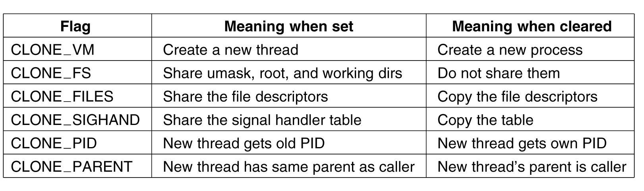
The Clone System Call
Figure 10-9. Bits in the sharing_flags bitmap.
cs431-cotter
Tanenbaum, Modern Operating Systems 3 e, (c) 2008 Prentice-Hall, Inc. All rights reserved. 0-13-6006639
Notes:
cs431-cotter

Slide 41
Clone Example
#include <stdio.h>, <math.h>, <sys/time.h>, <sys/types.h>, <sched.h>
#define LB_SIZE 128
int flag;
extern int errno;
int main (int argc, char * argv[])
{
time_t now;
char lineBuf[LB_SIZE];
pid_t pid;
int childno = 1, mainnum = 0;
void *csp, *tcsp;
void test (void *childnum); //function prototype
cs431-cotter
Notes:
cs431-cotter
cs431-cotter

Slide 42
Clone Example
csp=(int *)malloc(8192*8); //create a new stack
if(csp)
tcsp=csp+8192*8; //move pointer to the end of the stack
else
exit(errno);
time (&now);
printf ("Clone Test run on %s\n\n", ctime(&now));
flag = 0;
childno = 1;
if (( pid = __clone( (void *)&test, tcsp, CLONE_VM,
(void *)&childno )) < 0)
{
printf("Couldn't create new thread!\n");
exit(1);
}
cs431-cotter
Notes:
cs431-cotter
cs431-cotter

Slide 43
Clone Example
else { //we're in main
while (flag == 0) ;
printf("Just created thread %d\n", pid);
}
test(&mainnum);
printf ("Main program is now shutting down\n\n");
return 0;
}
void* test(void * arg) {
int childnum;
flag = 1;
childnum = *(int *) arg;
printf("Thread %d work cycle\n",childnum);
sleep (3);
}
cs431-cotter
Notes:
cs431-cotter
cs431-cotter

Slide 44
Clone Example (Output)
[root]@bobs-RHLINUX cs431_linux]# gcc -o clone_test proctest_v6.c
[root]@bobs-RHLINUX cs431_linux]# ./clone_test
Clone Test run on Fri Jan 12 14:49:30 2001
Thread 1 work cycle
Just created thread 430
Thread 0 work cycle
Main program is now shutting down
cs431-cotter
Notes:
cs431-cotter
cs431-cotter

Slide 45
Summary
Linux schedules threads for execution.
Linux supports creation of new processes and threads
  Fork(): create a duplicate process
  Exec*(): create a new process
  Pthread_create(): create a POSIX thread
  Clone(): Create a Linux native thread
cs431-cotter

Slide 46
Questions
How does a native thread differ from a POSIX thread?
What happens when a Linux program executes a "fork( )" command?
Following a fork( ), how do the resulting processes identify which is the parent and which is the child?
What special compiler/linker flag is needed to create an executable program that creates POSIX threads (pthreads)?
How can a process identify its parent process PID? (what command)
In the book figure 2-15, what problems may arise from the way that the main program passes the thread ID to the “hello_world” function?
cs431-cotter

