Slide 1
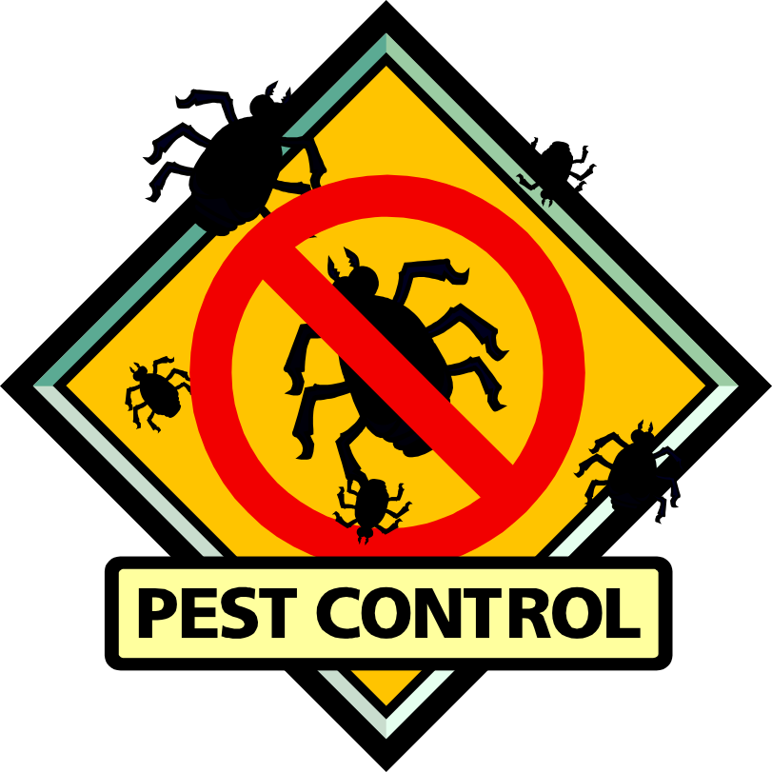
A DDD Tutorial
Elena Jakubiak & Larissa Winey

Slide 2
What is DDD
DDD stands for Data Display Debugger
DDD is a visual interface to the command-line GDB debugger

Slide 3
Why DDD?
It’s intuitive
It’s fast
“I just use print() statements”
  That’s like sewing clothes using a needle and thread instead of a sewing machine

Slide 4
Getting Started
Copy the sample programs to your directory
  % cp /r/uxpdworkshop/DebugLab/* .
Compile your program using the –g flag
  % g++ -g factorial.cpp –o factorial
Run your program, right now, we’ll start with factorial (any easy program to start with)
  % factorial

Slide 5
So You Have a Bug
What did you expect the program to do?
  It should take the factorial of a number
  i.e. 6! = 6 * 5 * 4 * 3 * 2 * 1 = 720 (1! = 1)
Any ideas what went wrong?
  You didn’t write this code
  You could read the code and then try to understand a bunch of it and then put in print() statements
  You could walk through it in the debugger (Hint: Choose the debugger)

Slide 6
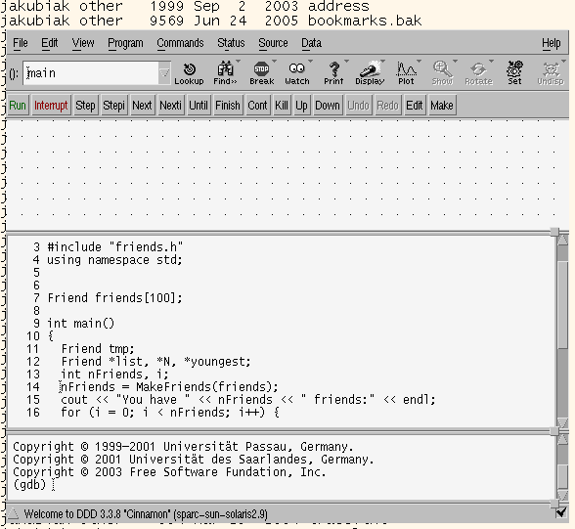
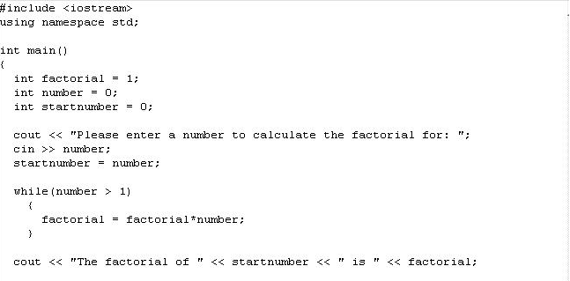
Starting DDD
Open your executable program in DDD (DDD knows what source code to use because you compiled with the –g flag)
  % ddd factorial &

Slide 7
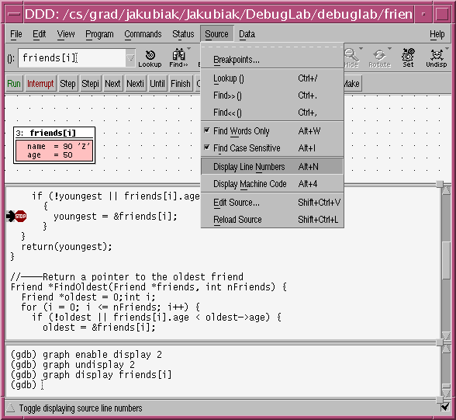
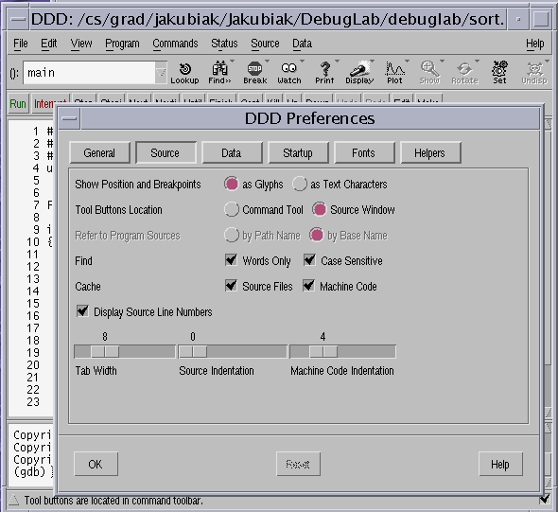
Customizing DDD
Line numbers: Source → Display Line Numbers
Docking toolbars: Edit → Preferences

Slide 8
Setting Breakpoints
If the program is stuck in an infinite loop, then we want to set a breakpoint in the while loop
  Right-click on the line number of the while(number < 1)
  Select Set Breakpoint
  There should now be a stop-sign at that line

Slide 9
Start the Program
At the top of the screen, select “Run” to start your program
  This can also be found in the ‘program’ menu
  If DDD asks for arguments to your program, just leave it blank
The program will halt and prompt you for input in the bottom of the window
  Enter a small number: something that should finish in less than a second.
It should stop again at the breakpoint.
  (The black arrow indicates the next line to be executed)

Slide 10
Next, Hover, and Step
Use Next to move through the program one line at a time
After each Next you can hold your cursor over each variable to see the value
  This is called hovering
  Use this to watch the values in factorial, number and startnumber
  This always displays the variable’s value at the current line of execution
Note
  Step will move down the program, one line at a time. It will also step into function calls if there are any.
  Next would also move down one line at a time, but would skip function calls.

Slide 11
Fixing the Bug
So, what’s going wrong?
Leave DDD open
Open the code in your favorite editor (factorial.cpp)
  Fix the code
Recompile the code
Run the code (on the command line)
If you wanted to run it again in DDD, you would need to reload the code in DDD

Slide 12
Now, a Harder Example
Compile your program, again using the –g flag
  % g++ -g myFriends.cpp –o myFriends
Run myFriends

Slide 13
So You Have Another Bug
What did you expect the program to do?
Any ideas what went wrong?

Slide 14
Starting DDD
Open your executable program in DDD (DDD knows what source code to use because you compiled with the –g flag)
  % ddd myFriends &

Slide 15
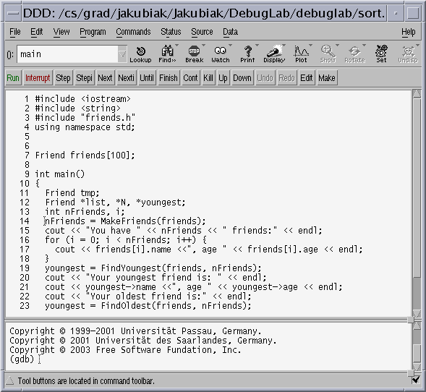
Using DDD
What do we know about where this bug occurred?
  Our youngest friend was wrong
  Be strategic! Where should we look first?

Slide 16
Using DDD
What do we know about where this bug occurred?
  Our youngest friend was wrong
  Be strategic! Where should we look first?

Slide 17
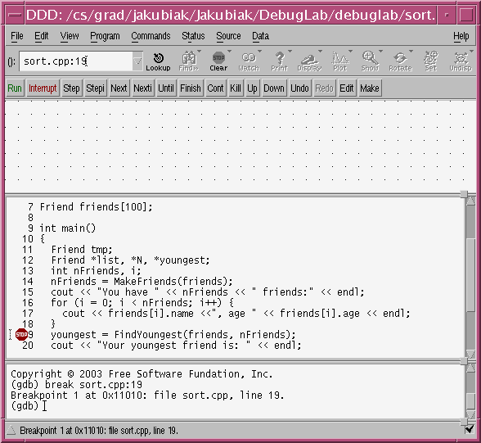
Setting Breakpoints
We want to watch the program at the call to FindYoungest()
  Set a breakpoint at:
  youngest = FindYoungest(friends, nFriends);

Slide 18
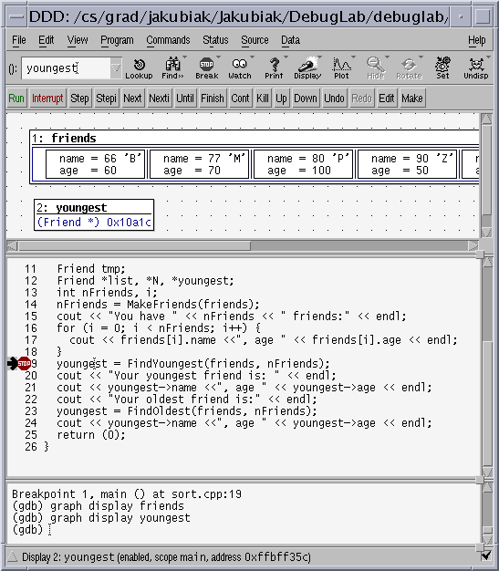
Inspecting the Data
Right-click on friends and choose Display friends
  The data display editor opens
Right-click on youngest and choose
Display *youngest
(notice the *)
  You can also hover over a variable to see its value
  Try hovering over the variable yougest

Slide 19
Inspecting Your Data
Does the data look correct?
  Yes. Click Next to step to the next line of code
Now, does the data look correct?
  No. Where did it go wrong?
  We now want to step into FindYoungest()

Slide 20
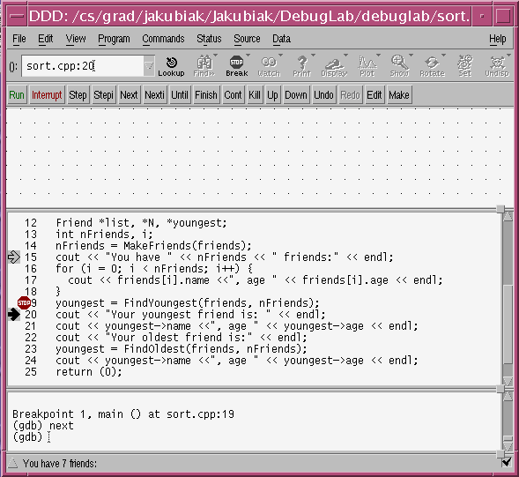
Going Backwards
To get back to the break point..
  Click and drag the arrow up a to the line
  youngest = FindYoungest(friends, nFriends);

Slide 21
Inspecting Your Data
At the breakpoint, click Step in the command tool to step inside FindYoungest()
    Next: steps one line at time, stepping over function calls
    Step: steps one line at time, stepping into function calls
Should we step through or set another breakpoint?
  Stepping is temping but what if there are 10,000 items in your array and a lot of code inside your loop?
  What should we do?

Slide 22
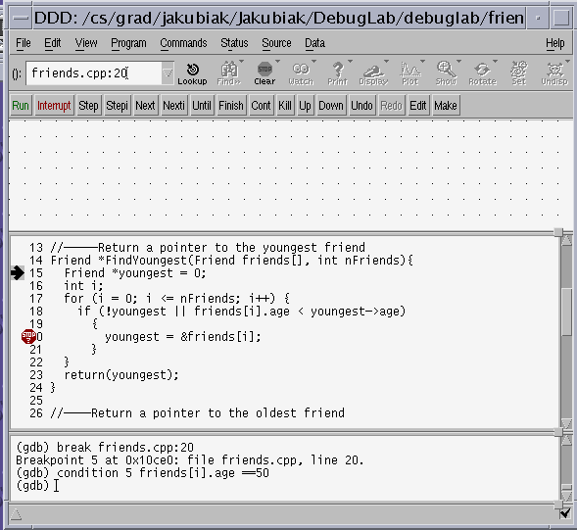
Finding the Bug
Put a breakpoint at
youngest = &friends[i];
Put a breakpoint on the line
return(youngest)
This prevents exiting the function after the loop

Slide 23
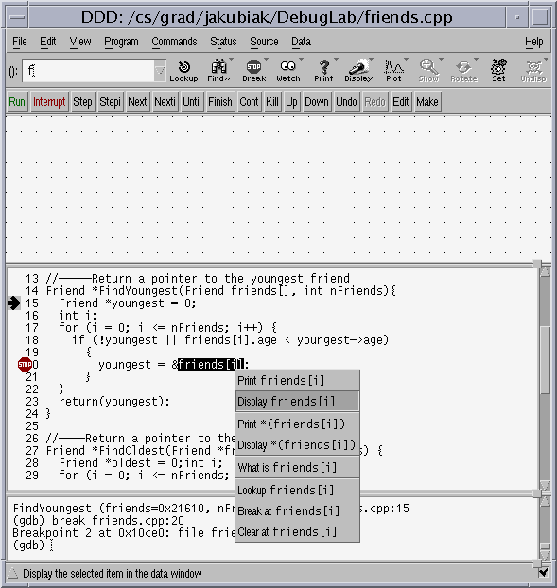
Finding the Bug
Click Continue to run the program to the next breakpoint
Check the data
  Right-click on youngest and choose
  Display *youngest (Note the *)
  Highlight friends[i], right click on the selection, and choose Display friends[i]

Slide 24
Finding the Bug
Watch the program
  Click Continue to run to the next time youngest is updated
  Check your data
  Is youngest ever set correctly?
  Repeat…
When you reach the breakpoint at return(youngest), ask
  Was youngest ever set correctly?
  What is its value now?
So, what is the bug?
  Drag the arrow up and restart running through the loop
  Determine exactly when did the data become incorrect?

Slide 25
Discovering the Bug
The infamous Array out-of-bounds!

Slide 26
Fixing the Bug
Again, leave DDD open
Open the code in your favorite editor (friends.cpp)
  Fix the code
Recompile the code
Run the code

Slide 27

It’s still broken

Slide 28
Fixing the NEXT Bug
Reload the code in DDD
  In the Source menu, choose Source → Reload
Where do we put the break-point this time?
  What is the last line of code that we know was executed?
  Set a breakpoint
  Next…
  Next…
  Step…

Slide 29
Some Debugging Theory
Most programs are too big to step through
You have to use breakpoints strategically
Suppose you have 10,000 lines of code with no output and a segmentation fault. Where do you put your breakpoint?

Slide 30
Some Debugging Theory
Most programs are too big to step through
You have to use breakpoints strategically
Suppose you have 10,000 lines of code with no output and a segmentation fault. Where do you put your breakpoint?
The Binary Search Principle of debugging
  You don’t look up a word in the dictionary by starting at the first letter ‘A’ page and turning hundreds of pages until you find your word (especially if your word is zebra).
  Like searching the dictionary, put a breakpoint in the middle of your program and look at the values there. Is your bug before or after that point?

Slide 31
Bells & Whistles
DDD is very powerful!
Each time you think, “I wish DDD could ….”, check the manual because it probably can!
There are too many features to teach so we will go over only a few of the most useful

Slide 32
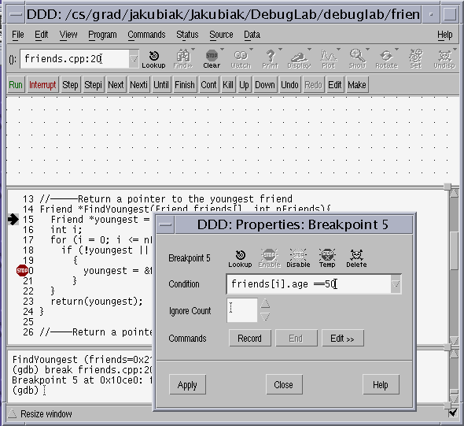
Conditional Breakpoints
What if you had 10,000 friends? It would take a long to check each assignment.
Instead, first make sure that the loop reaches the youngest friend.
Use a conditional breakpoint
  Insert a breakpoint
  Right-click the break point and choose properties
  Enter the condition (in C code) when, if true, the code should pause.

Slide 33
Watchpoints
Often you have a program and, at some point, an important value gets set incorrectly
  e.g., using (x = 0) instead of (x == 0)
  Suppose you know that
    A line 6, x is set to 7
    At line 9,234 x = 0 (but x should still be 7).
  How can you quickly find the line where x was incorrectly set.
    A watchpoint allows you to watch for a variable to change

Slide 34

REMEMBER…
Be systematic & strategic
  Where should I look next?
    Remember the Binary Search Principle
  What should I look at next?
    Use the data display
    Use breakpoints & watchpoints

