Slide 1

Writing char device driver
Goals
  Anatomy of character device driver
  User interface to driver
    Device files
  Kernel interface to device driver
    File operations structure
    Major and minor number
  Registering/De-registering char device driver

Slide 2
Anatomy of device driver
A device driver has three sides
  One side talks to the rest of the kernel
  One talks to the hardware and
  One talks to the user
        Device
        File
User
Kernel
Device Driver
Hardware

Slide 3
User interface to the device driver
A very important Unix design decision was to represent most of the “system objects” as “files”
It allows applications to manipulate all “system objects” with the normal file API (open, read, write, close, etc.)
So, devices had to be represented as “files” to the applications
This is done through a special artefact called a device file
It a special type of file, that associates a file name visible to user space applications to the triplet (type, major, minor) that the kernel understands All device files are by convention stored in the /dev directory

Slide 4
Device file example
Device files examples
$ ls -l /dev/ttyS0 /dev/sda1
brw-rw---- 1 root disk 8, 1 2012-11-08 19:52 /dev/sda1
crw-rw---- 1 root dialout 4, 64 2012-11-08 19:52 /dev/ttyS0
Example C code that uses the usual file API to write data to a serial port
int main() {
int fd;
fd = open(“/dev/ttyS0”, O_RDWR);
write(fd, “Hello”, 5);
close(fd);
}

Slide 5
Device files
In Linux kernel, most of the devices are presented to the user space applications through two different abstractions
  Character device
  Block device
Internally the kernel identifies each device by a triplet of information
  Type (character or block)
  Major number (typically the category of devices)
  Minor number (typically the identifier of the device)

Slide 6
Types of devices
Block devices
  A device composed of fixed-sized blocks, that can be read and write to store data.
  Used for hard disks, SD cards etc.
Character devices
  An infinite stream of bytes, with no beginning, no end, no size. For e.g. serial port.
  Used for serial ports, terminals etc.
  Most of the devices that are not block devices are represented by linux kernel as character device.

Slide 7
Creating device files
On a basic Linux system, the device files can be created manually using the mknod command
  mknod /dev/<device> [c|b] major minor
  Needs root privileges
  Coherency between device files and devices handled by the kernel is left to the system developer
On more elaborate Linux systems, mechanisms can be added to create/remove them automatically when devices appear and
disappear
  devtmpfs virtual filesystem, since kernel 2.6.32
  udev daemon, solution used by desktop and server Linux systems
  mdev program, a lighter solution than udev

Slide 8
Kernel interface to the device driver
In order to talk to the kernel, the driver registers with subsystems to respond to events. Such an event might be the opening of a file, closing a file, a page fault, the plugging in of a new USB device, etc.
Kernel
Event List
File open File close
Interrupt page
fault
X
X
X
X
Device Driver

Slide 9
Character drivers
User-space needs
  The name of a device file in /dev to interact with the device driver through regular file operations (open, read, write, close...)
The kernel needs
  To know which driver is in charge of device files with a given major / minor number pair
  For a given driver, to have handlers (“file operations”) to execute when user- space opens, reads, writes or closes the device file.
User Space
Read buffer
Write string
/dev/foo
Kernel space
Major/Minor
Read handler
Write handler

Slide 10
Implementing a character driver
Four major steps
  Implement operations corresponding to the system calls an application can apply to a file: file operations.
  Define a “file_operations” structure containing function pointers to system call functions in your driver.
  Reserve a set of major and minors for your driver
  Tell the kernel to associate the reserved major and minor to your file operations
This is a very common design scheme in the Linux kernel
  A common kernel infrastructure defines a set of operations to be implemented by a driver and functions to register your driver
  Your driver only needs to implement this set of well-defined operations

Slide 11
File operations
Before registering character devices, you have to define file_operations (called fops) for the device files.
The file_operations structure is generic to all files handled by the Linux kernel.
Here are the most important operations for a character driver. All of them are optional. (include/linux/fs.h)
  struct file_operations {
  ssize_t (*read) (struct file *, char __user *, size_t, loff_t *);
  ssize_t (*write) (struct file *, const char __user *, size_t, loff_t *);
  long (*unlocked_ioctl) (struct file *, unsigned int, unsigned long);
  int (*open) (struct inode *, struct file *);
  int (*release) (struct inode *, struct file *);
  [...]
  };

Slide 12
File operation definition example
#include <linux/fs.h>
static const struct file_operations sample_device_fops = {
.owner = THIS_MODULE,
.open = sample_device_open,
.release = sample_device_release,
.unlocked_ioctl = sample_device_ioctl,
};
You need to fill the fops with function your device needs to be supported.

Slide 13
open: for opening the device(allocating resources)
release: for closing the device (releasing resources)
write: for writing data to the device
read : for reading data from the device
ioctl: for query the device statistics and passing configuration parameters to device
mmap: for potentially faster but more complex direct access to the device

Slide 14
Open() and release()
int open(struct inode *i, struct file *f)
  Called when user-space opens the device file.
  inode is a structure that uniquely represent a file in the system.
  file is a structure created every time a file is opened. Several file structures can point to the same inode structure.
    Contains info like the current position, the opening mode, etc.
    Has a void *private_data pointer to store driver specific data
  The open method is provided by the driver to do any initialization in preparation to later operations such as allocating memory resources.
int release(struct inode *i, struct file *f)
  Called when user-space closes the file.
  The role of release is reverse of open(). It performs all the operation to undo the tasks done in open() such as de-allocating the memory resources allocated at time of open().

Slide 15
read() function
ssize_t read (struct file *file, __user char *buf, size_t size, loff_t *off)
  Called when user-space uses the read() system call on the device.
  Must read data from the device,
  write at most ‘size’ bytes in the user-space buffer buf, and
  update the current position in the file off.
  “file “ is a pointer to the same file structure that was passed in the open() operation
  Must return the number of bytes read.
  On UNIX/Linux, read() operations typically block when there isn't enough data to read from the device

Slide 16
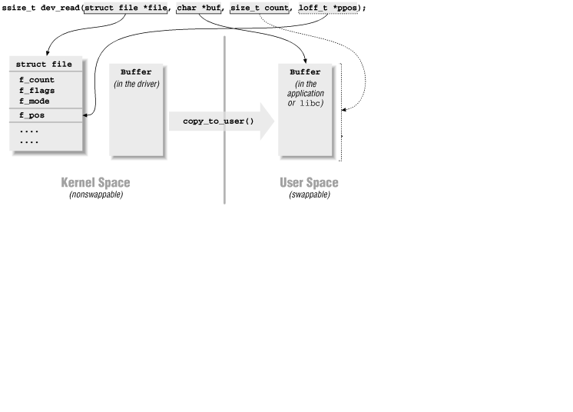
read() function example

Slide 17
Write()
ssize_t foo_write(struct file *file, __user const char *buf, size_t size ,loff_t *off)
  Called when user-space uses the write() system call on the device
  The opposite of read, must read at most ‘size’ bytes from buf,
  write it to the device,
  update off and
  return the number of bytes written.

Slide 18
ioctl
static long ioctl(struct file *file, unsigned int cmd, unsigned long arg)
  Associated with the ioctl system call.
  Allows to extend drivers capabilities beyond read/write API.
  Example:
    changing the speed of a serial port,
    setting video output format,
    querying a device serial number.
  cmd is a number identifying the operation to perform
  arg is the optional argument passed as third argument of the ioctl() system call. Can be an integer, an address, etc.
  The semantic of cmd and arg is driver-specific.

Slide 19
dev_t data types
The kernel data type dev_t represent a malor/ minor number pair
  Also called a device number.
  Defined in <linux/kdev_t.h>
  Linux 2.6: 32 bit size (major: 12 bits, minor: 20 bits)
  Macro to compose the device number:
  MKDEV(int major, int minor);
  Macro to extract the minor and major numbers:
  MAJOR(dev_t dev);
  MINOR(dev_t dev);

Slide 20
Registering device numbers
#include <linux/fs.h>
int register_chrdev_region(
dev_t from, /* Starting device number */
unsigned count, /* Number of device numbers */
const char *name); /* Registered name */
Returns 0 if the allocation was successful.
If you don't have fixed device numbers assigned to your driver
  Better not to choose arbitrary ones. There could be conflicts with other drivers.
  The kernel API offers an alloc_chrdev_region function to have the kernel allocate free ones for you. You can find the allocated major number in /proc/devices.

Slide 21
Information of registered devices
Registered devices are visible in /proc/devices:
Character devices:
  1 mem
  4 /dev/vc/0
  4 tty
  4 ttyS
  5 /dev/tty
  5 /dev/console
  5 /dev/ptmx
  6 lp
Block devices:
  1 ramdisk
  259 blkext
  7 loop
  8 sd
  9 md
  11 sr
  65 sd
  66 sd
        Major number Registered name

Slide 22
Character device registration
The kernel represents character drivers with a cdev structure
Declare this structure globally (within your module):
  #include <linux/cdev.h>
  static struct cdev char_cdev;
In the init function, initialize the structure
  void cdev_init(struct cdev *cdev, struct file_operations *fops);
  cdev_init(&char_cdev, &fops);

Slide 23
Character device registration
Then, now that your structure is ready, add it to the system:
  int cdev_add(
  struct cdev *p, /* Character device structure */
  dev_t dev, /* Starting device major / minor number */
  unsigned count); /* Number of devices */
  If (cdev_add(&char_cdev, dev_no, device_count))
  printk(“Char device registration failed\n”);
After this function call, the kernel knows the association between the major/minor numbers and the file operations. Your device is ready to be used!.

Slide 24
Character device unregistration
First delete your character device:
  void cdev_del(struct cdev *p);
Then, and only then, free the device number:
void unregister_chrdev_region(dev_t from, unsigned count);
Example :
  cdev_del(&char_cdev);
  unregister_chrdev_region(char_dev, count);

Slide 25
Char driver example from kernel sources
Read operation example
  Drivers/char/lp.c
Ioctl operation example
  drivers/char/lp.c
Write operation example
  Drivers/char/lp.c

Slide 26
Linux error code
The kernel convention for error management is
  Return 0 on success
  return 0;
  Return a negative error code on failure
  return -EFAULT;
Error codes
  include/asm-generic/errno-base.h
  include/asm-generic/errno.h

Slide 27
Misc Drivers
Misc (or miscellaneous) drivers are simple char drivers that share certain common characteristics.
The kernel abstracts these commonalities into an API (implemented in drivers/char/misc.c),
This simplifies the way these drivers are initialized.
All misc devices are assigned a major number of 10, but each can choose a single minor number.
Consider the sequence of initialization steps that a char driver performs:
  Allocates major/minor numbers via alloc_chrdev_region() and friends
  Creates /dev and /sys nodes using class_device_create()
  Registers itself as a char driver using cdev_init() and cdev_add()
A misc driver accomplishes all this with a single call to misc_register()

Slide 28
#include <linux/miscdevice.h>
struct miscdevice sample_misc_device = {
.minor = MISC_DYNAMIC_MINOR,
.name = “sample_device",
.fops = &sample_device_fops,
};
Registration
misc_register(&sample_misc_device);

Slide 29
Character driver summary
Character driver writer - Define the file operations callbacks for the device file: read, write, ioctl... - In the module init function, reserve major and minor numbers with register_chrdev() - In the module exit function, call unregister_chrdev() and | Kernel
System administration - Load the character driver module - Create device files with matching major and minor numbers if needed The device file is ready to use! | User space
System user - Open the device file, read, write, or send ioctl's to it. | User space
Kernel - Executes the corresponding file operations | Kernel

Slide 30
Practical lab
Writing a simple character driver implementing the basic calls open, release, read, write
Write simple charater driver with open, release, read, write, using misc driver interface.
Write the test application to open, close, read and write

