Slide 1

Introduction to System calls
Objectives
  Understanding system calls
  System calls and library functions
  Interfacing functions between user space and kernel space
  Types of system calls
    File management
    Process management
    Device management
    Information and maintenance
    Process communication
  Programs implementing system calls

Slide 2
System calls
All operating systems provides some mechanism to request services from the kernel.
This service request points are called “system calls”
In Linux system, there is an interface layer between the user space and kernel space. This layer consists of library made up of functions that communicate between normal user applications and the Kernel.
This implementation of C library is called libc/glibc. This provides wrapper functions for the system calls.
System calls are implemented using software interrupt or trap.
System call transfer control to the operating system. It sets the system call number, the C arguments into the general registers and then executes some machine instruction that generates a software interrupt in the kernel.

Slide 3
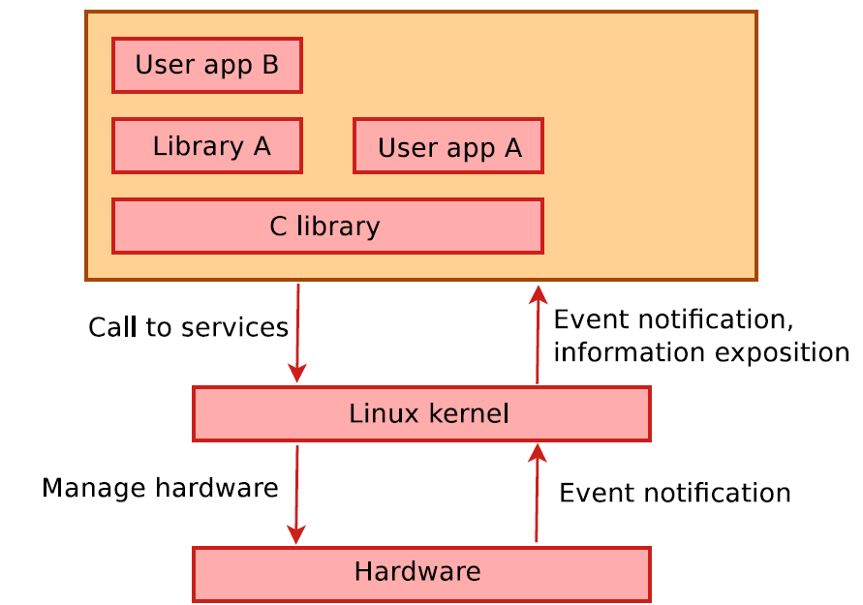
Interfacing between user and kernel space

Slide 4
Library functions
Library functions are the general purpose functions defined in Section 3 of “Linux/Unix programmers Manual”
$ man <section_no> <command_name>
These functions are not entry points into the kernel although they may invoke one or more of the kernel functions.
For example, ‘printf’ may invoke the ‘write’ system call to perform the output .
‘strcpy’ and ‘atoi’ doesn’t invoke the kernel service at all. They are library functions

Slide 5
<Section_no>
1. executable programs or shell commands
2. system calls
3. library routines
4. special files (i.e., devices in the /dev directory)
5. file formats
6. games
7. macro packages
8. system administration commands
9. kernel routines
n. Tcl/Tk (a programming language)

Slide 6
system call and library function
Examples of systems calls
  Read() / write ()
  Fork()/ exec ()
Example of library functions
  Date/time
  Strcpy/atoi/printf
User Space
Application code
C library functions
System calls

Slide 7
Header Files
The Application programming interface (API) of the C standard library is declared in a number of header files. Each header files contains one or more function declarations, data types definitions and macros.
Header files are located at /usr/include
Name | Description
<errno.h> | Testing error code reported by library functions.
<stdarg.h> | For accessing varying number of arguments passed to functions
<stdatomic.h> | For atomic operations on data shared between threads
<stddef.h> | Defines several types and macros
<stdio.h> | Defines core input/output APIS
<stdlib.h> | Defines memory allocation/process control
<string.h> | Defines string manipulations APIs.
<threads.h> | Thread handling APIs
<time.h> | Date/Time handling APIs

Slide 8
System call categories
System calls can be roughly grouped into five major categories:
  Process management
  File management
  Device management
  Information/Maintenance
  Communication
Process management
  create process the process
  Terminate process
  Load the process
  Execute the process
  get/set process attributes
  wait for time, wait event, signal event

Slide 9
System call categories..contd…
File management.
  create file, delete file
  open, close
  read, write, reposition
  get/set file attributes
Device Management.
  request device, release device
  read, write, reposition
  get/set device attributes
  logically attach or detach devices
Information Maintenance.
  get/set time or date
  get/set system data
  get/set process, file, or device attributes
Communication.
  create, delete communication connection
  send, receive messages
  transfer status information
  attach or detach remote devices

Slide 10
File management
We will start our study with the functions available for the file I/O operations such as open a file, read & write a file, close a file and so on.
Most file IO operations are performed with the open, read, write, lseek and close system calls.
File descriptors
  File descriptor is a non-negative integer representing the file opened in the kernel.
  When file is opened or newly created, the kernel returns a file descriptor to the process.
  During read/write, the file is identified by the file descriptor that was returned by open()

Slide 11
FILE DESCRIPTOR
Integer value(Fd) Name
0 Standard input (stdin)
1 Standard output (stdout)
2 Standard error (stderr)

Slide 12
Open function
Open and possibly create a file or device
#include <sys/types.h>
#include <sys/stat.h>
#include <fcntl.h>
int open(const char *pathname, int flags);
int open(const char *pathname, int flags, mode_t mode);
int creat(const char *pathname, mode_t mode);
DESCRIPTION
Given a pathname for a file, open() returns a file descriptor, a small, nonnegative integer for use in subsequent system calls (read, write, lseek, fcntl, etc.).
Flags : One of the access modes: O_RDONLY, O_WRONLY, or O_RDWR. These request opening the file read-only, write-only, or read/write, respectively.
RETURN VALUE
open() and creat() return the new file descriptor, or -1 if an error occurred (in which case, errno is set appropriately).

Slide 13
Close function
Close a file descriptor
SYNOPSIS
#include <unistd.h>
int close(int fd);
DESCRIPTION
close() closes a file descriptor, so that it no longer refers to any file and may be reused.
RETURN VALUE
close() returns zero on success. On error, -1 is returned, and errno is set appropriately.

Slide 14
Read function
Read from a file descriptor
SYNOPSIS
#include <unistd.h>
ssize_t read(int fd, void *buf, size_t count);
DESCRIPTION
read() attempts to read up to count bytes from file descriptor fd into the buffer starting at buf.
If count is zero, read() returns zero and has no other results. If count is greater than SSIZE_MAX, the result is
unspecified.
RETURN VALUE
On success, the number of bytes read is returned (zero indicates end of file), and the file position is advanced by this number. On error, -1 is returned, and errno is set appropriately.

Slide 15
Write function
Write to a file descriptor
SYNOPSIS
#include <unistd.h>
ssize_t write(int fd, const void *buf, size_t count);
DESCRIPTION
write() writes up to count bytes from the buffer pointed buf to the file referred to by the file descriptor fd.
RETURN VALUE
On success, the number of bytes written is returned (zero indicates nothing was written). On error, -1 is returned, and errno is set appropriately.

Slide 16
Open, close, read and write calls
#include <sys/types.h>
#include <sys/stat.h>
#include <fcntl.h>
#include <unistd.h>
#include <stdio.h>
#include <string.h>
int main (){
int fd, read_bytes;
char buff[256];
fd = open("./test_file_op", O_RDWR);
if (fd < 0)
printf("Error opening file\n");
printf("FD (%d)\n", fd);
read_bytes = read(fd, buff, 15);
if (read_bytes < 0)
printf("Read Error\n");
printf("File contents\n");
printf("%s\n", buff);
strcpy(buff, "testing_write_system_call");
read_bytes = write(fd, buff, 20);
close(fd);
}

Slide 17
lseek function
lseek - reposition read/write file offset
SYNOPSIS
#include <sys/types.h>
#include <unistd.h>
off_t lseek(int fd, off_t offset, int whence);
DESCRIPTION
The lseek() function repositions the offset of the open file associated with the file descriptor fd to the argument offset according to the eective whence as follows:
  SEEK_SET - The offset is set to offset bytes.
  SEEK_CUR - The offset is set to its current location plus offset bytes.
  SEEK_END – The offset is set to the size of the file plus offset bytes
RETURN VALUE
Upon successful completion, lseek() returns the resulting offset location as measured in bytes from the beginning of the file. Otherwise, a value of (off_t) -1 is returned and errno is set to indicate the error.

Slide 18
access
Testing file permissions
SYNOPSIS
  Access (const char *pathname, permission_flags)
  Permission flags - R_OK, W_OK, X_OK for read, write and execute permissions.
DESCRIPTION
The access system call determines whether the calling process has access permission to a file.
  It can check any combination of read (r), write (w) and execute (x) permission.
  It can also check whether file exists or not.
RETURN VALUE
On success return value is 0, if process has all specified permissions,
If the file exists and process does not have the specified permissions, access returns -1 and errno is set to EACCESS.

Slide 19
System call | File Operation
open | open a file or device fs/open.c
creat | create a file or device
close | close a file descriptor
dup2 | duplicate a file descriptor
dup | duplicate an open file descriptor
mmap | map files into memory (Only the PROT_READ protection flag is supported.)
munmap | unmap files from memory
pread | read from a file descriptor at a given offset
pwrite | write to a file descriptor at a given offset
read | read from a file descriptor
readv | read data from multiple buffers
write | write to a file descriptor
writev | write data from multiple buffers
lseek | reposition read/write file offset
llseek | move extended read/write file pointer
lstat | get file status
truncate | set a file to a specified length
ftruncate | set a file to a specified length
unlink | delete a name and possibly the file it refers to

Slide 20
System call | Directory Operation
chdir | change working directory
chroot | change root directory
fchdir | change working directory
rmdir | remove a directory
rename | change the name or location of a file
getdents | read directory entries
mkdir | create a directory
System call | Permission Operation
chmod | change permissions of a file
chown | change ownership of a file
fchmod | change access permission mode of file
fchown | change owner and group of a file
System call | Sync Operation
sync | update the super block
fsync | synchronize the complete in-core state of a file with that on disk
System call | Statistics and status Operation
fstatfs | get file system statistics
fstat | get file status
statfs | get file system statistics
stat | get file status

Slide 21
Getrlimit and setrlimit: resource limit
The getrlimit and setrlimit system calls allow a process to read and set limits on the system resources that it can consume.
For each resource, there are two limits
  Hard limit
  Soft limit
Both getrlimit and setrlimit take as arguments a code specifying the resource limit type and a pointer to a structrlimit variable.
The getrlimit call fills the fields of this structure, while the setrlimit call changes the limit based on its contents.
The rlimit structure has two fields: rlim_cur is the soft limit, and rlim_max is the hard limit.

Slide 22
Most useful resource limits that may be changed are listed here, with their codes:
RLIMIT_CPU
  The maximum CPU time, in seconds, used by a program. This is the amount of time that the program is actually executing on the CPU, which is not necessarily the same as wall-clock time.
  If the program exceeds this time limit, it is terminated with a SIGXCPU signal.
RLIMIT_DATA
  The maximum amount of memory that a program can allocate for its data. Additional allocation beyond this limit will fail.
RLIMIT_NPROC
  The maximum number of child processes that can be running for this user. If the process calls fork and too many processes belonging to this user are running on the system, fork fails.
RLIMIT_NOFILE
  The maximum number of file descriptors that the process may have open at one time.

Slide 23
CPU-Time limit demonstration
The program illustrates setting the limit on CPU time consumed by a program.
It sets a 1-second CPU time limit and then spins in an infinite loop. Linux kills the process soon afterward, when it exceeds 1 second of CPU time.
When the program is terminated by SIGXCPU, the shell helpfully prints out a message interpreting the signal:
$ ./limit_cpu
CPU time limit exceeded
#include <sys/resource.h>
#include <sys/time.h>
#include <unistd.h>
int main () {
struct rlimit rl;
/* Obtain the current limits. */
getrlimit (RLIMIT_CPU, &rl);
/* Set a CPU limit of 1 second. */
rl.rlim_cur = 1;
setrlimit (RLIMIT_CPU, &rl);
/* Do busy work. */
while (1);
return 0;
}

Slide 24
Getrusage- Process statistics
The getrusage system call retrieves process statistics from the kernel.
Syntax : man getrusage
It can be used to obtain statistics either for the current process by passing RUSAGE_SELF as the first argument, or for all terminated child processes that were forked by this process and its children by passing RUSAGE_CHILDREN.
The second argument to rusage is a pointer to a struct rusage variable, which is filled with the statistics.
A few of the more interesting fields in struct rusage are listed here:
  ru_utime—A struct timeval field containing the amount of user time, in seconds, that the process has used. User time is CPU time spent executing the user program, rather than in kernel system calls.
  ru_stime—A struct timeval field containing the amount of system time, in seconds, that the process has used. System time is the CPU time spent executing system calls on behalf of the process.
  ru_maxrss—The largest amount of physical memory occupied by the process’s data at one time over the course of its execution.

Slide 25
Display Process user and system time
A few of the more interesting fields in struct rusage are listed here:
ru_utime—A struct timeval field containing the amount of user time, in seconds, that the process has used. User time is CPU time spent executing the user program, rather than in kernel system calls.
ru_stime—A struct timeval field containing the amount of system time, in seconds, that the process has used. System time is the CPU time spent executing system calls on behalf of the process.
ru_maxrss—The largest amount of physical memory occupied by the process’s data at one time over the course of its execution.
#include <stdio.h>
#include <sys/resource.h>
#include <sys/time.h>
#include <unistd.h>
void main () {
struct rusage usage;
getrusage (RUSAGE_SELF, &usage);
printf (“CPU time: %ld.%06ld sec user, %ld.%06ld sec system\n”,
usage.ru_utime.tv_sec, usage.ru_utime.tv_usec,
usage.ru_stime.tv_sec, usage.ru_stime.tv_usec);
return 0;
}

Slide 26
Sysinfo: Obtaining system statistics
The sysinfo system call fills a structure with system statistics. Its only argument is a pointer to a struct sysinfo.
Syntax : man sysinfo
Some of the more interesting fields of struct sysinfo that are filled include these:
uptime—Time elapsed since the system booted, in seconds
totalram—Total available physical RAM
freeram—Free physical RAM
procs—Number of processes on the system

Slide 27
Print system statistics
  #include <linux/kernel.h>
  #include <linux/sys.h>
  #include <stdio.h>
  #include <sys/sysinfo.h>
  int main () {
  /* Conversion constants. */
  const long minute = 60;
  const long hour = minute * 60;
  const long day = hour * 24;
  const double megabyte = 1024 * 1024;
  /* Obtain system statistics. */
  struct sysinfo si;
  sysinfo (&si);
  /* Summarize interesting values. */
  printf (“system uptime : %ld days, %ld:%02ld:%02ld\n”,
  si.uptime / day, (si.uptime % day) / hour, (si.uptime % hour) / minute, si.uptime % minute);
  printf (“total RAM : %5.1f MB\n”, si.totalram / megabyte);
  printf (“free RAM : %5.1f MB\n”, si.freeram / megabyte);
  printf (“process count : %d\n”, si.procs);
  Return 0
}

Slide 28
Uname system
The uname system call fills a structure with various system information, including the computer’s network name and domain name, and the operating system version it’s running.
Syntax : man uname
A single argument, a pointer to a struct utsname object.
The call to uname fills in these fields:
  sysname—The name of the operating system (such as Linux).
  release, version—The Linux kernel release number and version level.
  machine—Some information about the hardware platform running Linux. For x86 Linux, this is i386 or i686, depending on the processor.
  node—The computer’s unqualified hostname.
  __domain—The computer’s domain name.
Each of these fields is a character string.

Slide 29
Print linux verion number and hardware information
#include <stdio.h>
#include <sys/utsname.h>
int main ()
{
struct utsname u;
uname (&u);
printf (“%s release %s (version %s) on %s\n”, u.sysname, u.release,
u.version, u.machine);
return 0;
}

Slide 30
Basic I/O
Implement cp src_file.txt dst_file.txt
Implement cat src_file.txt, read and display file contents
Implement cp src1.txt src2.txt src3.txt dst.txt
Implement a program to display the contents of file from the starting and from given offset.
Implement program for creating dir, change dir, create a file, write data in to a file, copy file to another file and display contents of both the files.
Implement a program to create a file read permission, Perform write on it then change file permissions to make writable, display file contents
Implement a program to read the file stats and statistics.
Open the file in read-only mode and print it out, block by block.
Truncate the file to its original size after the first close.
Read the file again and print it out.
Close the file

Slide 31
Write programs to
  Set the unmask to read-write permission for the user, read-only permission for everyone else.
  Ask the user for a file name.
  Verify that the name is valid.(file name length , path length etc will be system dependent )
  Check if a file of that name already exits without attempting to open the file.
  If it does, determine if the user has right access over the file.
    If the user does not have write access, ask for another file & repeat this process.
    If the user has write access, open the file for writing, & truncate it.
  If the file does not exist, create it & open it for writing.
  Write the file name out to the file & close it.
  Open the file in append mode
  Print out the current byte position of the file pointer & remember it for later use.

Slide 32
Process statistics
Write a program to
  Print system dependency and limits
  Print out maximum number of open file permissible
  Print out the maximum length of a file
  Print out the length of the maximum possible file that can be created by this process.
Modify this file size limit to 512 bytes.
Open a temporary file (use the C library to get the name) & keep writing to it until the write fails or the process get killed.

Slide 33
Few refences
Linux system call quick reference :
  http://www.digilife.be/quickreferences/qrc/linux%20system%20call%20quick%20reference.pdf
Linux system call table:
  http://docs.cs.up.ac.za/programming/asm/derick_tut/syscalls.html

