Slide 1
Introduction to toolchain
Goals:
Introduction to cross-compilation, host machine, target machine
Components of cross-compilation toolchain
Types of toolchain build procedures
Understanding of building of toolchain
Using pre-compiled toolchain
Toolchain contents

Slide 2
Toolchain
The usual development tools available on Linux systems are native toolchain
This toolchain runs on your desktop/laptop and generates codes for your desktop/laptop, usually x86
For embedded systems development, following similar procedure is inconvenient and inefficient to use native toolchain
  The target is too restricted in terms of storage and/or memory
  The target is slow in processing as compared to the workstation (Desktop/Laptop)
  You might not want to install all development tools on your target machines
Therefore, cross-compiling toolchains are generally used.
They run on your workstation and generate code for your target machines.

Slide 3
Host Vs. Target environment
In embedded development, there is always a spilt between
  The Host, the development workstation, which is typically a powerful PC
  The target, which is the embedded system under development.
  They are connected by various means, almost always a serial line for debugging, frequently an ethernet connection and sometimes JTAG for low level debugging
      Serial
      Ethernet
Host
X86 or X86-64 PC
Target
ARM,
PowerPC, MIPS

Slide 4
Cross-compiling Toolchain
The usual tool chain available on Linux workstation is a native toolchain.
This toolchain runs on your desktop/workstation and generates code for your workstation, usually x86
A cross-compiled toolchain is required for target. They run on the workstation but generate code for your target.
X86 compilation machine
Execution machine
Source code
Native
toolchain
Cross-compilation
toolchain
X86 Binary
ARM binary

Slide 5
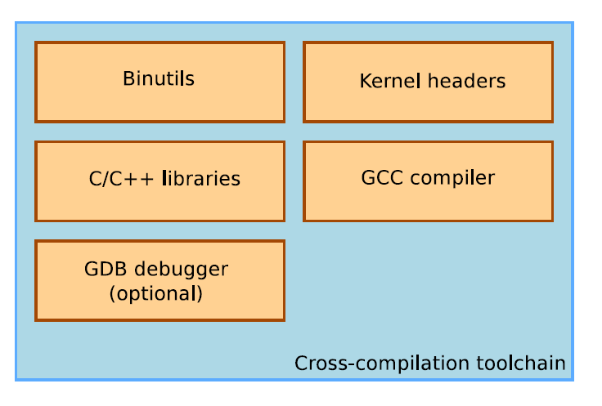
Components

Slide 6
Cross-compilation toolchain components
Binutils
  Binutils are set of programs necessary for compilation, linking, assembling and other debugging operations
    as - the assembler, that generates binary code from assembler source code
    Ld, the linker
    As, ranlib to .a archives used for libraries
    Objdump, readelf, nm, strings to inspect binaries
    Strip, to strip useless part of binaries in order to reduce their size
    http://www.gnu.org/software/binutils/

Slide 7
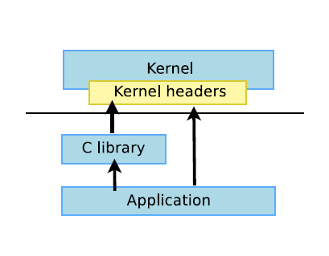
Kernel headers
The C library and compiled programs needs to interact with the kernel for
  Supported system calls and their system call numbers
  Constant definitions
  Data structures
Therefore, compiling C library required kernel headers.
Its available in include/linux and include/asm directories corresponding to the include/linux dir in kernel sources

Slide 8
System call numbers in /usr/include/asm/unistd.h
#define __NR_restart_syscall 0
#define __NR_exit 1
#define __NR_fork 2
#define __NR_read 3
#define __NR_write 4
Constant definitions in /usr/include/asm-generic/fcntl.h, as used in open system call
#define O_RDONLY 00000000
#define O_WRONLY 00000001
#define O_RDWR 00000002

Slide 9
Data structures in /usr/include/asm/stat.h as used by stat system call
struct stat {
unsigned long st_dev;
unsigned long st_ino;
unsigned short st_mode;
unsigned short st_nlink;
unsigned short st_uid;
….
};

Slide 10
GNU C compiler
    The basic C compiler used for generating object code (both kernel and applications)
Can compile C, C++, Ada, Fortran, Java, Objective-C, Objective-C++, and generate code for a large number of CPU architectures, including ARM, AVR, Blackn, CRIS, FRV, M32, MIPS, MN10300, PowerPC, SH, v850, i386, x86 64, IA64, Xtensa, etc.
http://gcc.gnu.org/
Available under the GPL license, libraries under the LGPL.

Slide 11
C library
The C library is an essential component of a Linux system
Interface between the applications and the kernel
Provides the well-known standard C API to ease application development
Several C libraries are available:
  glibc, uClibc, eglibc, dietlibc, newlib, etc.
The choice of the C library must be made at the time of the cross-compiling toolchain generation, as the GCC compiler is compiled against a specific C library.

Slide 12
Machines in build procedures
Three machines must be distinguished when discussing toolchain creation
  The build machine, where the toolchain is built.
  The host machine, where the toolchain will be executed.
  The target machine, where the binaries created by the toolchain are executed.
Four common build types are possible for toolchains

Slide 13
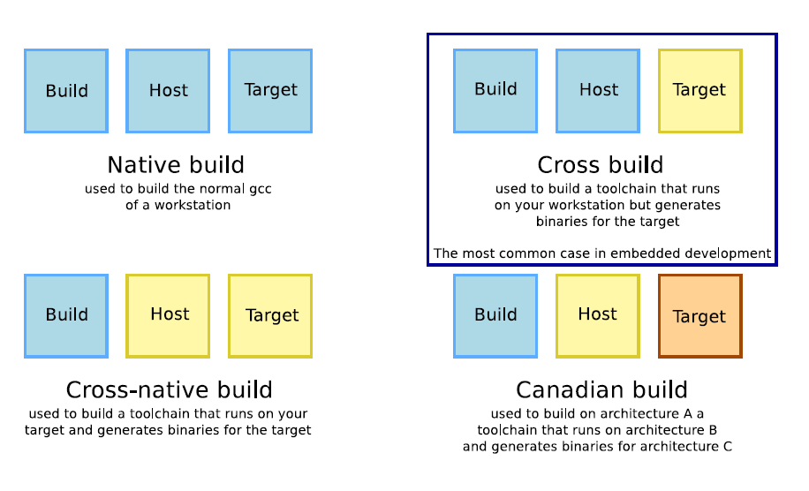
Different tool chain build procedures

Slide 14
Application binary interface (ABI)
ABI – Application binary interface, defines the system call calling conventions i.e.
  how function arguments are passed,
  How the return value is passed
  How system calls are made
  The organization of the structures (alignments etc)
All binaries must be compiled with the same ABI
When building a toolchain, the ABI used to generate the binaries needs to be defined.
Reference : http://en.wikipedia.org/wiki/Application_Binary_Interface

Slide 15
Building tool chain manually
Building a cross-compilation tool chain by yourself is a difficult and painful task. I can take days or weeks or months
Lot of details to learn: Many components to build, complicated configuration
Lot of decision to make (such as C library version, ABI, component versions)
Need kernel headers and C library sources
Need to be familiar with current gcc issues.

Slide 16
Pre-compiled toolchain
To select the precompiled tool-chain determine what you need:
  CPU, processor support
  C library
  ABI
  Various other software component’s version
  Check whether the available tool-chains match your requirements
Choices for pre-compiled tool-chains
  Sourcery code bench tool-chains
    They have support for ARM, MIPS, PowerPC, x86
  Linaro tool-chains

Slide 17
Installing the code sourcery tool chain
Download the code sourcery tool chain and/or contact Adarsh/Bhargav for using the downloaded toolchain
Install the tool chain file
  “arm-2011.03-41-arm-none-linux-gnueabi cross compiler.bin”
During installation, it prompts for few options,
  Select the folder where to place the tool chain, mostly home directory
  Select rest of default options
On successful installation, the tool chain is present in your specified directory for e.g. home directory
$~/CodeSourcery/Sourcery_G++_Lite
All Bin utils are present in bin/ directory
  $ls ~/CodeSourcery/Sourcery_G++_Lite/bin

Slide 18
Using pre-compiled tool-chain
Steps
  Usually, you just need to extract the tarball in a directory
  Add the path to the tool-chain directory where the binaries are present using the command ‘export PATH=/path_to_tool_chain/bin’:$PATH
  Compile your application using the command,
  PREFIX-gcc –o testing_toolchain testing_toolchain.c
  The PREFIX depends on the toolchain configuration, and allows to distinguish cross-compilation tools from native compilation utilities

Slide 19
Using arm-none-linux-gnueabi- toolchain
Add the path to use the tool chain
  export PATH=/home/vsalve/CodeSourcery/Sourcery_G++_Lite/bin/:$PATH
  echo $PATH
  $arm-none-linux-gnueabi-gcc
Write the C program
  $vim /tmp/test_toolchain.c //sample program
Use arm-none-linux-gnueabi-gcc to compile the program
  $arm-none-linux-gnueabi-gcc /tmp/test_toolchain.c -o /tmp/test_toolchain
Check the file type of output file generated from this compilation
  $file /tmp/test_toolchain
  /tmp/test_toolchain: ELF 32-bit LSB executable, ARM, version 1 (SYSV), dynamically linked (uses shared libs), for GNU/Linux 2.6.16, not stripped
This shows the output file “/tmp/test_toolchain” is ARM version executable

Slide 20
Using native toolchain, gcc
Now compile same C program using Native toolchain, gcc
  gcc /tmp/test_toolchain.c -o /tmp/native_test_toolchain
Check the file type of output file generated from this compilation
  file /tmp/native_test_toolchain
  /tmp/native_test_toolchain: ELF 64-bit LSB executable, x86-64, version 1 (SYSV), dynamically linked (uses shared libs), for GNU/Linux 2.6.15, not stripped
This shows the output file “/tmp/native_test_toolchain” is x86-64 version executable file

Slide 21
Toolchain contents
The cross compilation tool binaries, in bin/ directory
One or several sysroot, each containing
  The C library and related libraries, compiled for the target
  The C library headers and kernel headers
There is one sysroot for each variant
  Toolchains can be multilib if they have several copies of the C library for different configurations (for ARMv4T, ARMv5T, etc)
  CodeSourcery ARM toolchain are multilib, the sysroots are in
    arm-none-linux-gnueabi/libc
    arm-none-linux-gnueabi/libc/armv4t
    arm-none-linux-gnueabi/libc/thumb2

Slide 22
References
http://www.mentor.com/embedded-software/sourcery-tools/sourcery-codebench/overview
https://wiki.linaro.org/WorkingGroups/ToolChain
http://en.wikipedia.org/wiki/GNU_Debugger
http://www.gnu.org/software/gdb/
http://en.wikipedia.org/wiki/Application_Binary_Interface

Slide 23
Study and experiments with the following tools
  Variuous options for gcc, ld, as
  Various options for objdump, nm, strings
  File command
Install and experiments with Code Sourcery tool chain
  Compiling application programs using this tool chain

