Slide 1

Introduction to Embedded systems
Objectives
  What is an Embedded system
  Types of embedded systems
  Architecture of Linux embedded systems
    Components of an embedded systems.
  Role of Linux kernel in Embedded systems
    Linux kernel Architecture
    Linux kernel subsystems
  Understanding address spacess
    user space and kernel space
  understanding modes
    user mode and kernel mode

Slide 2
In day-to-day life we come across a wide variety of consumer electronics products such as TV remote controllers, Mobile phones, fax & xerox machines etc.
These are class of “Embedded systems”.
An Embedded system is a special purpose system designed to perform specific control functions often with the some computing constraints.
It is usually “Embedded” as a part of complete device including hardware and software components as compared to a general purpose computer such as PC, which is designed to be flexible and to meet a wide range of end-user needs.

Slide 3
Examples of Embedded system
Embedded systems controls many of the common devices in use today
Mobiles/smart phones
Digital watches
Traffic lights
Printers
Medical equipments
MP3 players, digital cameras
Routers, telephone switches
Automotives, Navigation devices

Slide 4
Embedded systems components
  Hardware
    Processor, interrupt controllers, I/O devices, Memories etc.
  Software
    Series of software tasks of controlling the hardware.

Slide 5
System on Chip (SOC)
System-on-chip (SOC) is an integrated circuit that integrates all components of a computer or other electronic system into a single chip
It may contain digital, analog, mixed-signal and often radio frequency functions – all on one chip.
In any embedded system application, functional blocks can be
  Level I: External discrete hardware components on board
  Level II: Hardware integrated with CPU on chip(SoC)
  Level III: Done by software running on CPU
Keyboard
controller
USB interface
CPU
LCD
controller
Memories
Customized
hardware
Audio/Video
Engine

Slide 6
Embedded system hardware
Power supply &
Reset circuit
Input Device interfacing
System
App
Specific
Circuits
Processor
Memory &
Storage
Timers
I/O Ports
&
I/O Buses
Interrupt controller
Networking module
Output Device interfacing

Slide 7
Processors
The central processing unit is the most important components in the embedded systems.
Depending on the type of applications the processors are broadly classified into 3 categories
    General purpose microprocessors
    Microcontrollers
    Digital signal processors
  General purpose microprocessors
    This microprocessor is designed to solve problems in a large variety of applications as diverse as communications, automotives and industrial embedded systems.
    The prime of microprocessor is to read data, perform extensive calculations on that data and store the results in mass storage device or display the results.

Slide 8
Processors contd..
  Microcontrollers
    A microcontroller is a small computer on a single integrate circuits containing a processor, memory and I/O peripherals.
    The prime use of microcontroller is to use to control the operations of the machine using a fixed program that is stored in ROM and does not change over the lifetime of the system.
  Digital signal processors
    These processors are designed for handling signal processing algorithms.
    One of the common operations required in such applications is array manipulations which required lot of multiplication/addition operations.

Slide 9
Other hardware components
Memory
  RAM, a very basic Linux system can work within 8MB of ram, but a more realistic system will require at least 32MB RAM
Storage
  Flash storage with NAND and NOR Flash
  Block storage with SD/MMC cards
Input Output device and interfaces
  Input output interfaces are necessary to interact with the external world.
  The input output devices keyboard, the display screen, the antenna, microphone, speaker etc.
Networking, Ethernet, WiFi, bluetooth etc.
Communications, SPI, I2C, SDIO, USB, UART.

Slide 10
Embedded Linux system architecture
Development
Host
PC
Embedded Systems
Application
Application
Tools
Compiler
Debugger
….
Library
Library
Library
C library
Linux Kernel
Bootloader

Slide 11
Software components
Cross-compilation tool chain
  Compilers that runs on the development machines but generates code for the target machine
Boot loader
  Started by the hardware, responsible for basic hardware initialization, loading and executing the kernel
Operation system
  Contains the process and memory management, network stack, device drivers and services to user space
C Library
  The interface between the kernel and user space applications
Libraries and applications
  All user space components, open source, 3rd party or in-house

Slide 12
Boot loaders
Boot loader is a piece of code which performs
  Basic hardware initialization
  Loading of an application binary, usually OS kernel, from the flash storage, from the network or from another type of non-volatile storage
  Possibly decompression of application binary
  Execution of the application
Most boot loaders also provides command line interface with various commands implementing different operations.
Examples
  Linux Desktop : GRUB
  Embedded systems : commonly used U-Boot

Slide 13
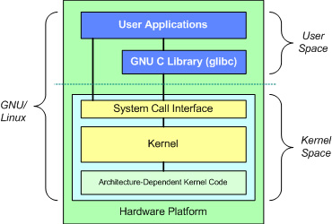
Introduction to Linux kernel
Fundamental architecture of Linux operating system
User/Application space, where applications are executed.
Kernel Space, where the kernel exist
GNU C library, this provides the system call interface, a mechanism to communicate between user space application and kernel

Slide 14
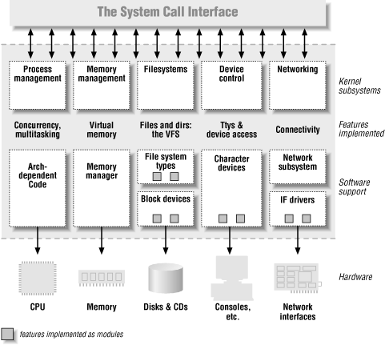
Kernel subsystem
Kernel subsystem

Slide 15
Linux kernel subsystem components
Process Management
  Kernel in-charge of process creation and termination.
  Communication among different processes (signals, IPC primitives)
  Process scheduling, how processes share the CPU and how they are scheduled to execute and blocked (put in waiting state) whenever they need any other resources.
  Process management handles process execution which belongs to user space and couple of other process which executes only in kernel space(they are called as kernel threads)
  The linux provides set of functions, which can also be used by kernel modules whenever needed.

Slide 16
Linux kernel subsystem components..contd…
Memory management
  The kernel builds up the virtual address space for all the processes.
  Keep tracks of the allocation and free of memory when the processes are created and exited.
  Keeps tracks of sufficient memory available for proper functioning of the system and take appropriate action whenever such unwanted situation arises.
  It also handles the device memory mapping

Slide 17
Linux kernel subsystem components..contd…
File systems
  File systems are used to organize and store the data and files on the secondary storage devices such as hard disks, SD cards and flash.
  This system defines various ways to store and retrieve the data. This is define by implementing different types of file systems. Linux supports multiple file systems types.
  Examples:
    Windows OS: NTFS, DOS
    Linux OS : Ext2, ext3, ext4 etc
  Virtual File system(VFS) provides a common interface abstraction for the various file systems supported by the kernel.
  Linux is heavily based on file system concepts; almost everything is treated as file.

Slide 18
Linux kernel subsystem components..contd…
Networking
  The networking sub-system defines the ways different machines communicate with each other
  The networking sub-system contains the complete network stack (mapped to OSI layers) as part of the kernel.
  It is in charge of delivering data packets across applications and network interfaces.
  All routing and address resolution issues are implemented within the kernel.
  Examples of network stacks
    TCP/IP
    Bluetooth
    WiFi

Slide 19
Linux kernel subsystem components..contd…
Device control
  This sub-system defines ways handle the various hardware devices connected to the CPU.
  It defines set of functions to read and write to device ports
  It defines set of functions to read and write to device memory
  It defines how the device memory should be mapped into virtual address space and how is visible to the kernel and CPU and other devices.
  It also defines how the CPU and the device should communicate with each other. For example, handle the interrupts.
  Most of the system operations eventually maps to the physical device.
  All device control operations are performed by piece of software code, called as Device Driver.
  Device drivers are implemented using kernel modules.

Slide 20
Linux kernel subsystem components..contd…
IPC
  This sub-system defines the various ways in which the processes can communicate with each other.
  It defines the set of functions for each type of mechanism.
  The inter process communication on Linux includes
    signals
    pipes and FIFO
    sockets
    shared memory and message queues.

Slide 21
Linux kernel subsystem components..contd…
System call interface
  This layer provides the means for user process to communicate with the kernel for any specific requirement which cannot be performed in user space.
  Whenever the user process comes with this requirement it makes a special call, called as “system call” to the kernel.
  This system call interface helps to route the system call to the kernel.
  The kernel executes the system call in the kernel space .
  Once the specific task is complete, the system call interface helps to return back the control to user space process.
  The system call interface defines set of various system calls for process management, file system management, device management etc.

Slide 22
Kernel Space & kernel mode
Kernel Space
  All the kernel sub-system components reside in kernel space.
  Kernel space is high privileged area where only kernel can execute.
  The user applications/processes execute in user space.
Kernel Mode
  When the execution is happening in kernel space, the process is said to be in kernel mode
  This is highly privileged mode, only kernel sub-system components can be in kernel mode.

Slide 23
User space & User mode
User space on linux is based on the following concepts
  Program: This is the image of an application, resides on a filesystem. When an application needs to be run, the image is loaded into memory and run.
  Virtual memory: allows each process to have its own address space including memory map for code, global data and dynamic data, stack etc
  System calls: These are entry points into the kernel so that the kernel can execute services on behalf of the application.
User mode
  When the application is executing in user space, it is said to be in user mode.

Slide 24
