Slide 1

ABCD of Library
By
Harikrushna Sheth

Slide 2
Topics To Be Covered
What is Library?
Types Of Library
For all types of library…..
  How it Works?
  Light-side/Dark-Side
  How to write it?
  How to build it?
  How to use it?
By Harikrushna Sheth,

Slide 3




What is library ?
By Harikrushna Sheth,

Slide 4



What is library?
(Computer Programming)
Provides services to other library or executable
Pre-Compiled File containing code+data
Examples
  Math Function library
  Network Library
  Thread Library
  File operation library
  Graphics Library
By Harikrushna Sheth,

Slide 5
What is library?
(Libraries are precompiled for several reasons)
libraries rarely change
  So pre-compilation save time .
To Protect intellectual property(IP)
  precompiled objects are in machine language, it prevents people from accessing or changing the source code, which is important to hide source code of implementation
By Harikrushna Sheth,

Slide 6
What is library ?
(Advantages of Library)
Modularize code
Faster recompile of application
Make easy to upgrade deployed application
reusing chunks of program code
  So Reduce Development time
Save memory on RAM
Save space on storage
By Harikrushna Sheth,

Slide 7
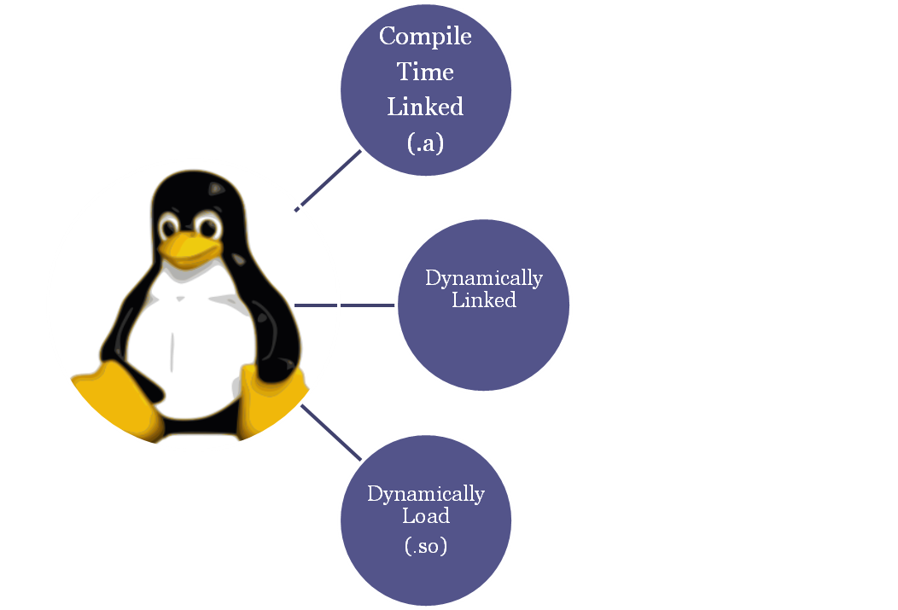
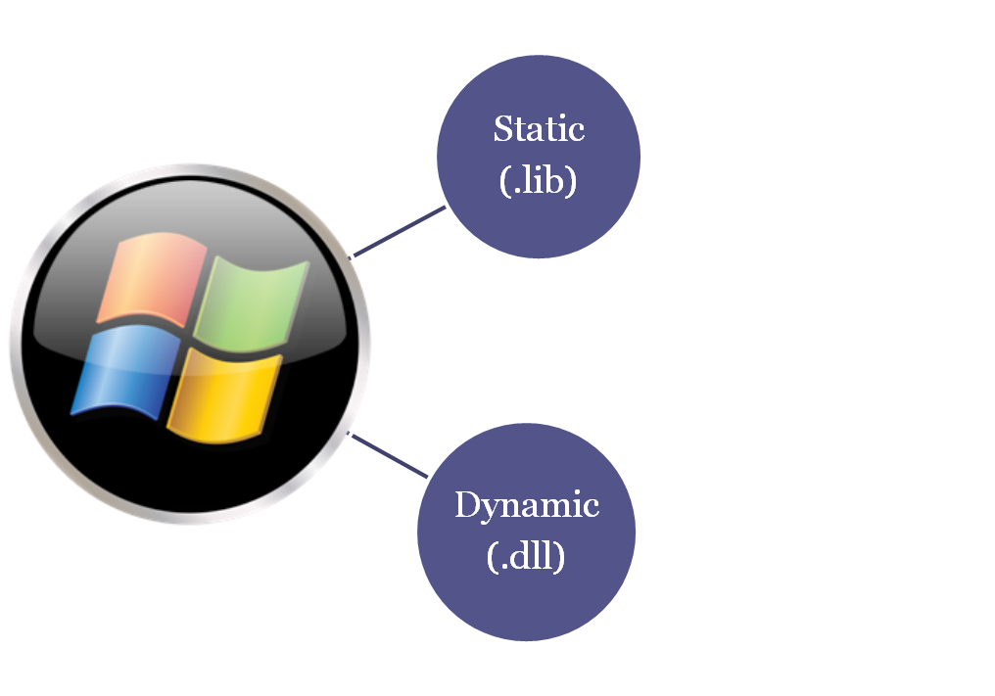
Classification of Library
By Harikrushna Sheth,

Slide 8




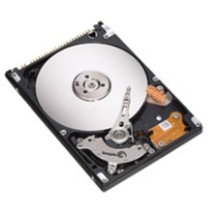

C Compilation Model
Source File
hello.c or hello.cpp
Load code into
Process Address Space
“C” Pre-processor
Preprocessed code file – hello.i
Relocation Info
“C” Compiler
Object File
“C” Loader
Assembly code file hello.s
Library File
“C” Assembler
Object code file hello.o
Executable code hello / hello.exe
Store in secondary storage
“C” Linker/ Link Editor
By Harikrushna Sheth,

Slide 9
Static library (Archive Files)
[Compilation Time Linked]
Single/Collection of ordinary object files
Consists of a set of routines which are copied into a target application by the linker.
By Harikrushna Sheth,

Slide 10
Static Library (C Compilation Model)
Source File
hello.c or hello.cpp
Load code into
Process Address Space
“C” Pre-processor
Preprocessed code file – hello.i
Relocation Info
“C” Compiler
Object File
“C” Loader
Assembly code file hello.s
Library File
“C” Assembler
Object code file hello.o
Executable code hello / hello.exe
Store in secondary storage
“C” Linker/ Link Editor
By Harikrushna Sheth,

Slide 11
Static library: Advantages
(Compare to Other type of libraries)
Allow the application to be contained in a single executable file
  simplifying distribution
  simplifying installation.
Sometimes increase performance as everything inside executable before it load into memory
  When library function usage ratio of executable is very high
By Harikrushna Sheth,

Slide 12
Static library: Disadvantages
(Compare to Other type of libraries)
Lot of wastage of storage
  As every executable have same library code inside
Lot of wastage of Memory (RAM)
  In case multiple application using same library and running state
In case of application upgrade whole executables needs to be changed even there is a small change in one library
Can’t upgrade library while application is running
By Harikrushna Sheth,

Slide 13

Prepare static library of Math Operation and use it in application
By Harikrushna Sheth,

Slide 14
Static library:
(How to build it?)
To create object file
  gcc -c <sourcefile.c> -o <SourceObjectFile.o>
    -c : just do compilation, don’t do linking (object file)
    -o : Specify name of output file
  ar rc <libArchiveFile.a> <SourceObjectFile.o>
    c : create archive. (Omit if it is already exist)
    r : insert “object file” into archive (If “object file” already available then replace it)
By Harikrushna Sheth,

Slide 15
Static library:
(How to use it? )
Generate executable
  gcc <ExecutableSourceFile.c> -L”<achieve path>" –l<ArchiveFile>
    -l : specify archive file
      Don’t mention prefix “lib”
      Don’t mention extension “.a”
      Don’t leave space between “-l” and “archive name”
Execute Executable
  ./a.out
By Harikrushna Sheth,

Slide 16
Dynamically Linked Library
Special mechanism incorporate to link library dynamically before program starts
Copy of library available to every application while application load into memory
It is not used in general purpose programming
It is implemented in special purpose OS
Here we just understand concept
By Harikrushna Sheth,

Slide 17
Dynamically Linked Library
(C Compilation Model)
Source File
hello.c or hello.cpp
Load code into
Process Address Space
“C” Pre-processor
Preprocessed code file – hello.i
“C” Compiler
“C” Loader
Assembly code file hello.s
Linker Stub
“C” Assembler
Object code file hello.o
Executable code hello / hello.exe
Store in secondary storage
“C” Linker/ Link Editor
By Harikrushna Sheth,

Slide 18




Dynamically Linked Library
(C Compilation Model) Continue…
Execute main()
function
“C” Loader
Complete
Dynamic Linking
Load code into
Process Address Space
Stub Will load
Dynamic Linker
Kernel Will Run
Dynamic Linker
By Harikrushna Sheth,

Slide 19
Dynamically Linked Library: Advantages
(Compare to Other type of libraries)
Save space on disk(secondary storage)
  As only one copy of library available on HDD
Easily upgrade software
By Harikrushna Sheth,

Slide 20
Dynamically Linked Library: Disadvantages
(Compare to Other type of libraries)
OS must need special support for dynamic linker
Memory wastage as all application using same library has copy of library in memory
By Harikrushna Sheth,

Slide 21
Dynamically Loaded Library
Load-time dynamic linking
  The load time loader finds all necessary external symbols and alters all references to each symbol (all previously zeroed) to memory references relative to the beginning of the program.
Run-time dynamic linking
  During load time the first access of an invalid, unresolved, reference results in a software trap. The run-time dynamic linker determines why this trap occurred and seeks the necessary external symbol.
By Harikrushna Sheth,

Slide 22
Dynamic Loaded Library
(C Compilation Model)
Source File
hello.c or hello.cpp
“C” Pre-processor
Preprocessed code file – hello.i
Load code into
Process Address Space when required
“C” Compiler
“C” Loader
Assembly code file hello.s
Library File
“C” Assembler
Object code file hello.o
Executable code hello / hello.exe
Store in secondary storage
“C” Linker/ Link Editor
By Harikrushna Sheth,

Slide 23
Dynamically Loaded Library: Advantages
(Compare to Other type of libraries)
Save space on disk(secondary storage)
  As only one copy of library available on HDD
Save space on Memory(primary storage)
  As only one copy of library available in RAM and shared by all application running
Easily upgrade software
Decide which library will be used at run time
  No need to know it’s name in advance
Decide which function of library will be used at run time
  No need to know it’s name in advance
By Harikrushna Sheth,

Slide 24
Dynamically Loaded Library: Disadvantages
(Compare to Other type of libraries)
Complexity may reduce performance for real time application
Distribution and setup will become complex
Chances of application crash if library is not available (deleted/modified/corrupted/renamed)
By Harikrushna Sheth,

Slide 25
Prepare dynamic library of Math Operations and use it inside application
By Harikrushna Sheth,

Slide 26
Dynamically Loaded Library
(How to build?)
To create object file
  gcc -c –fpic <SourceFile.c>
    -fpic: Position independent code, needed for shared libraries (PIC is machine instruction code that executes properly regardless of where in memory it resides)
To create Shared Object file
  gcc -o Operation.so Operation.o –shared
    -shared: Produce a shared object which can then be linked with other objects to form an executable
By Harikrushna Sheth,

Slide 27
Dynamically Loaded Library
(How to use?)
To generate executable
  gcc <SourceFile.c> -L <path of .so file> -ldl
    -ldl: It specify dynamic linking
Execute Exe
  ./a.out
By Harikrushna Sheth,

Slide 28

Question Answer
Harikrushna.sheth@.com

