Slide 1

Genomic analysis of abc proteins in archaea and bacteria
BTP Presentation phase-ii
Supervised By: Dr. S. P. Kanaujia
Presented By: Mehul Garg
10010621
IIT Guwahati

Slide 2
OVERVIEW
ABC PROTEINS – INTRODUCTION
DOMAINS OF ABC PROTEINS
IDENTIFICATION OF DOMAINS
TOOLS FOR IDENTIFICATION
PATTERN SEARCH ALGORITHM
RESULTS AND DISCUSSIONS

Slide 3
ABC PROTEINS:
The ATP-binding cassette (ABC) genes represent the largest family of transmembrane (TM) proteins.
These proteins bind ATP and use the energy to drive the transport of various molecules across all cell membranes.

Slide 4
Structure :
Proteins are classified as ABC transporters based on the sequence and organization of their ATP-binding domain(s), also known as nucleotide-binding folds (NBDs), transmembrane domain(TMDs) and substrate binding domain(SBPs).
The NBDs contain characteristic motifs (Walker A and B), separated by approximately 90–120 amino acids, found in all ATP-binding proteins., the signature (C) motif, located just upstream of the Walker B site.
The TMDs contain 6–11 membrane-spanning α-helices.
The SBPs are present in bacteria and archaea which help in substrate uptake in transporters.

Slide 5
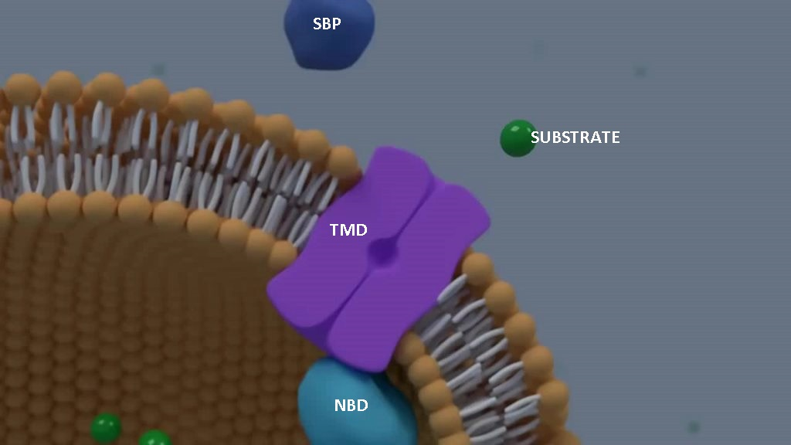
ABC Transporter
This animation display the domains present in ABC Transporter.
SBP binds with substrate and initiate the transport. The TMD helps in transport of substrate through membrane. The NBD helps by providing energy through ATP hydrolysis.

Slide 6
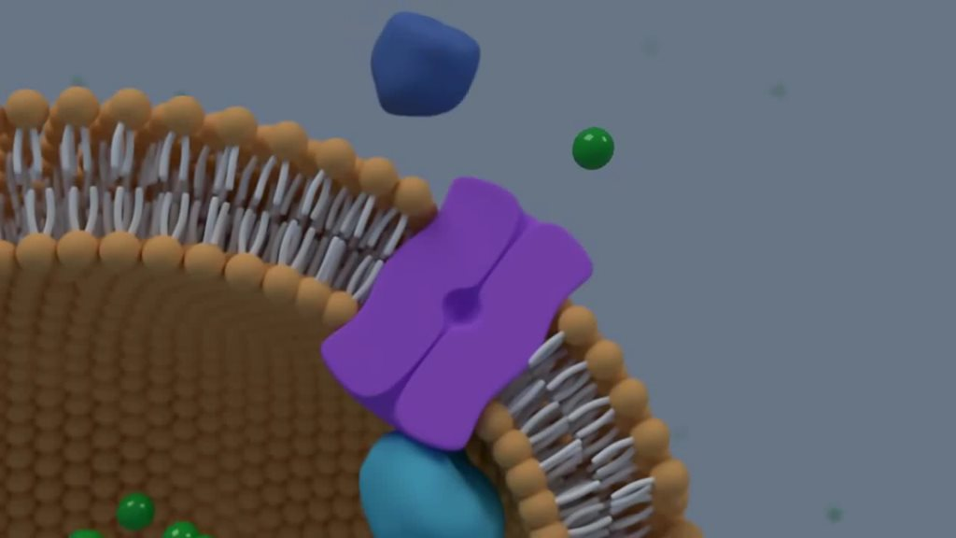
ABC Transporter
This animation display the domains present in ABC Transporter.
SBP binds with substrate and initiate the transport. The TMD helps in transport of substrate through membrane. The NBD helps by providing energy through ATP hydrolysis.

Slide 7
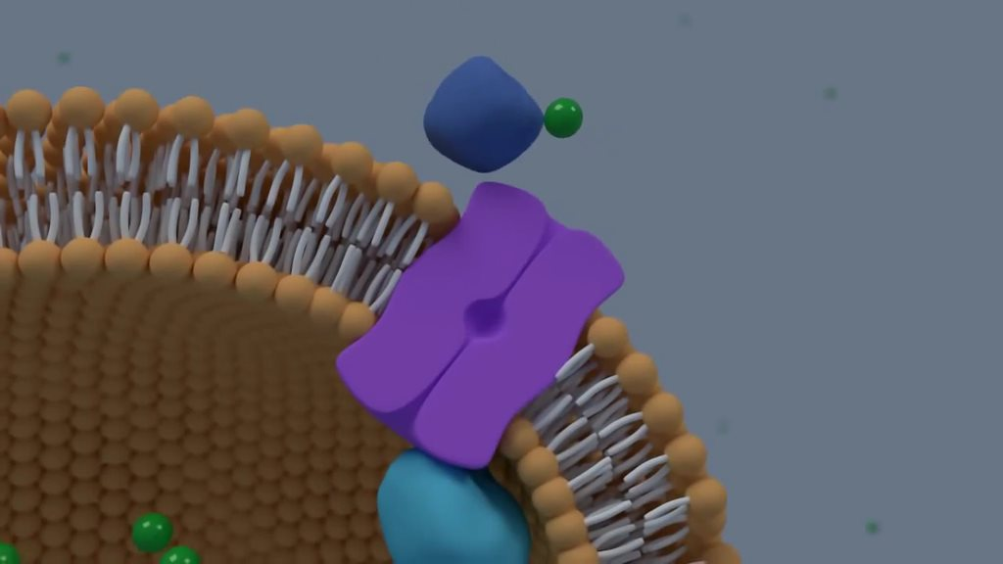
ABC Transporter
This animation display the domains present in ABC Transporter.
SBP binds with substrate and initiate the transport. The TMD helps in transport of substrate through membrane. The NBD helps by providing energy through ATP hydrolysis.

Slide 8
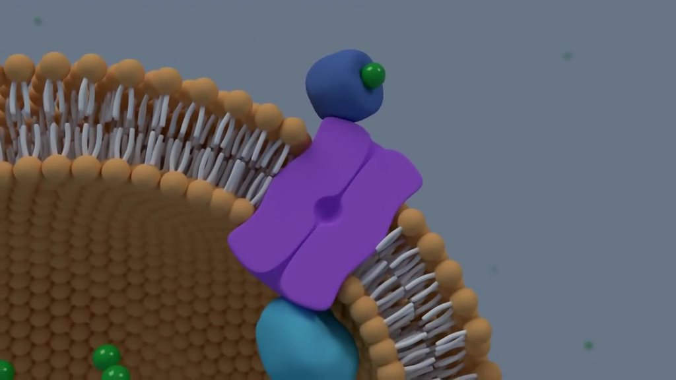
ABC Transporter
This animation display the domains present in ABC Transporter.
SBP binds with substrate and initiate the transport. The TMD helps in transport of substrate through membrane. The NBD helps by providing energy through ATP hydrolysis.

Slide 9
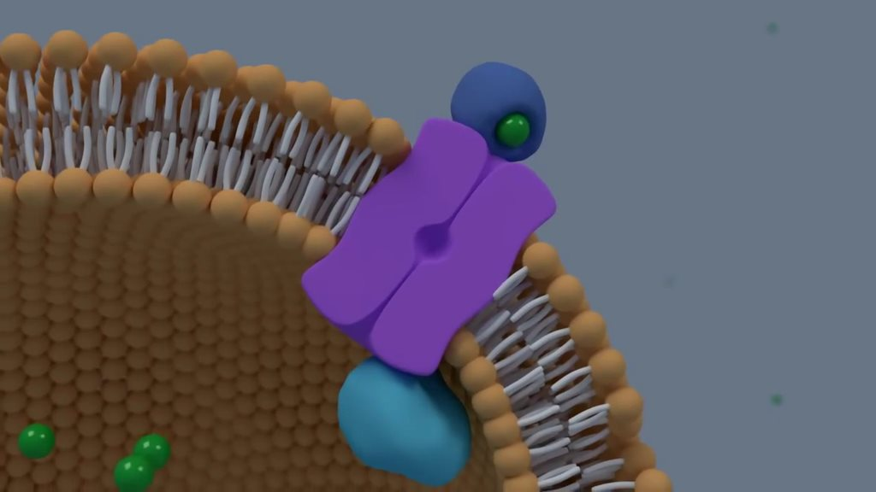
ABC Transporter
This animation display the domains present in ABC Transporter.
SBP binds with substrate and initiate the transport. The TMD helps in transport of substrate through membrane. The NBD helps by providing energy through ATP hydrolysis.

Slide 10
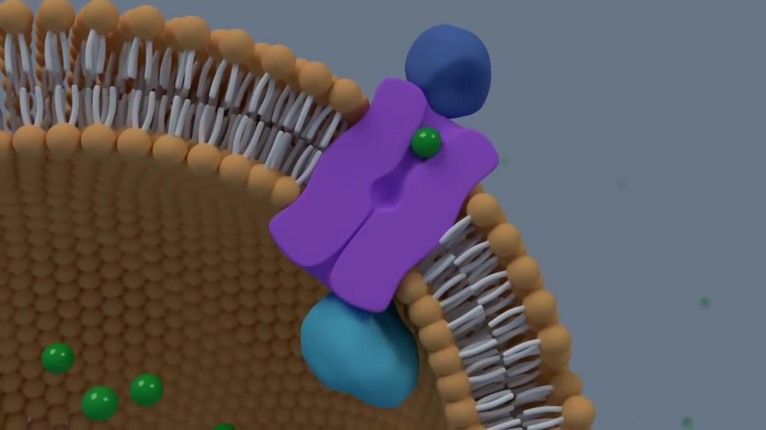
ABC Transporter
This animation display the domains present in ABC Transporter.
SBP binds with substrate and initiate the transport. The TMD helps in transport of substrate through membrane. The NBD helps by providing energy through ATP hydrolysis.

Slide 11
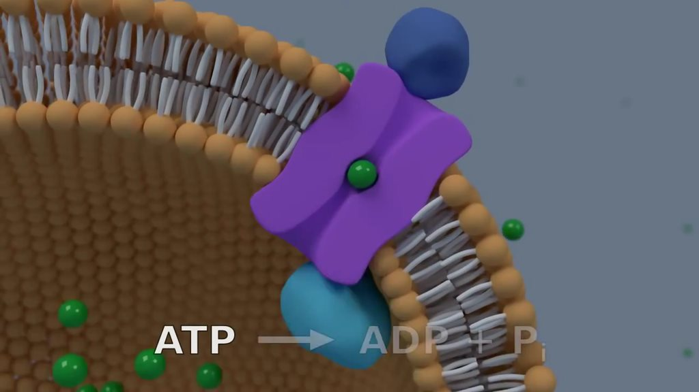
ABC Transporter
This animation display the domains present in ABC Transporter.
SBP binds with substrate and initiate the transport. The TMD helps in transport of substrate through membrane. The NBD helps by providing energy through ATP hydrolysis.

Slide 12
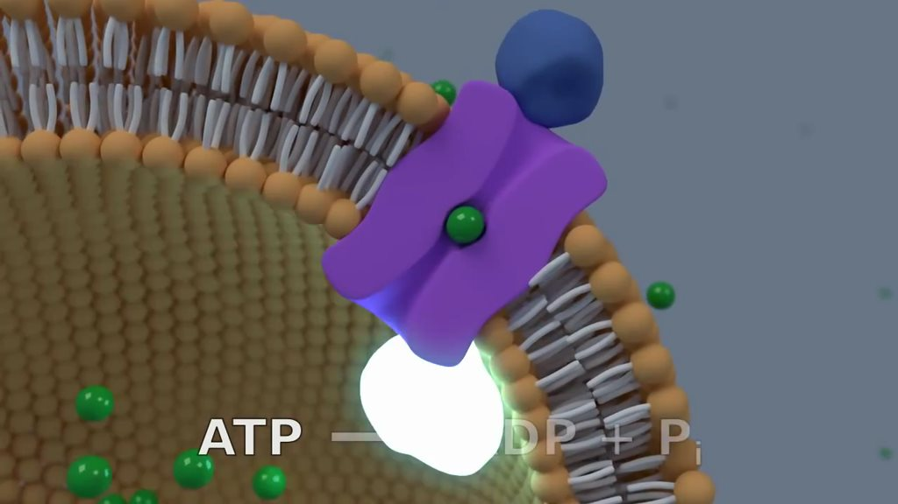
ABC Transporter
This animation display the domains present in ABC Transporter.
SBP binds with substrate and initiate the transport. The TMD helps in transport of substrate through membrane. The NBD helps by providing energy through ATP hydrolysis.

Slide 13
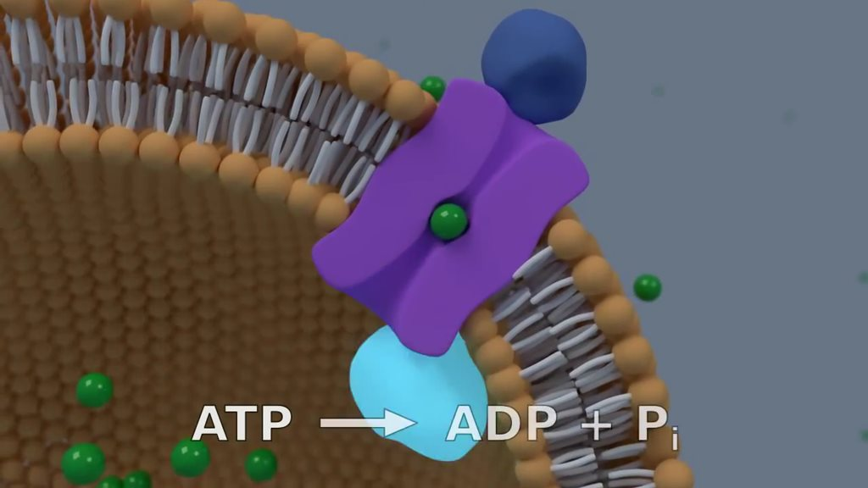
ABC Transporter
This animation display the domains present in ABC Transporter.
SBP binds with substrate and initiate the transport. The TMD helps in transport of substrate through membrane. The NBD helps by providing energy through ATP hydrolysis.

Slide 14
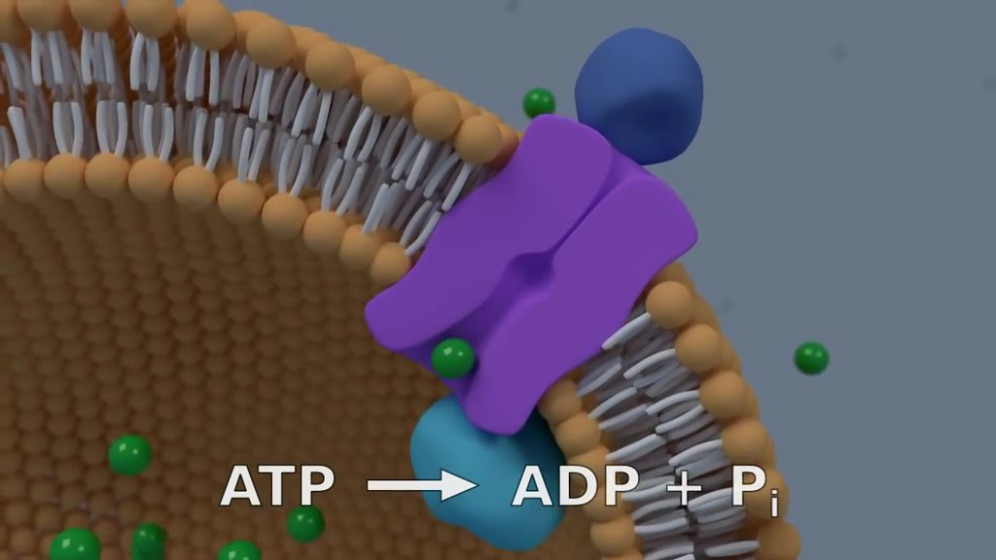
ABC Transporter
This animation display the domains present in ABC Transporter.
SBP binds with substrate and initiate the transport. The TMD helps in transport of substrate through membrane. The NBD helps by providing energy through ATP hydrolysis.

Slide 15
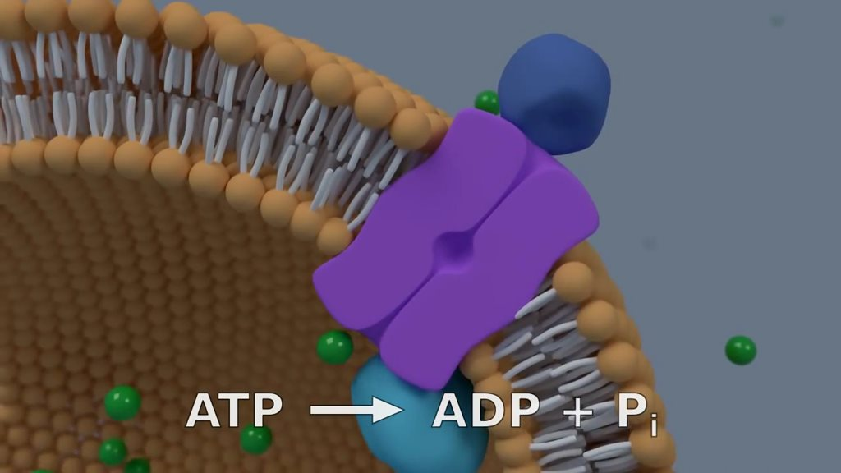
ABC Transporter
This animation display the domains present in ABC Transporter.
SBP binds with substrate and initiate the transport. The TMD helps in transport of substrate through membrane. The NBD helps by providing energy through ATP hydrolysis.

Slide 16
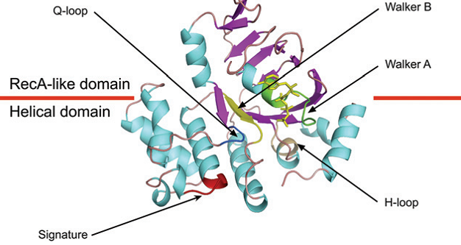
NBDs :
(reproduced from wikipedia.org)
CONSERVED DOMAINS :
WalkerA : [AG]-x(4)-G-K-[ST]
WalkerB : D-E-x(5)-D
Signature Sequence:
[LIVMFYC]-[SA]-[SAPGLVFYKQH]-G-[DENQMW]-[KRQASPCLIMFW]-[KRNQSTAVM]-[KRACLVM]-[LIVMFYPAN]-{PHY}-[LIVMFW]-[SAGCLIVP]-{FYWHP}-{KRHP}-[LIVMFYWSTA]
[] : any one amino acid, {} : none of the amino acid, X : any amino acid

Slide 17
IDENTIFICATION OF NBDs:
Scanned all the proteins for their content of the WalkerA, the WalkerB and the ABC transporter family signature motifs.
In NBDs, the ABC transporter family signature motif is always located between the two Walker A and B motifs (about 100 residues downstream of the WalkerA motif and 10 residues upstream of the WalkerB motif), we checked if the identified proteins contain each of these three motifs at a correct relative positions.
We searched for the conserved domains in NBDs using web server : Genolist

Slide 18
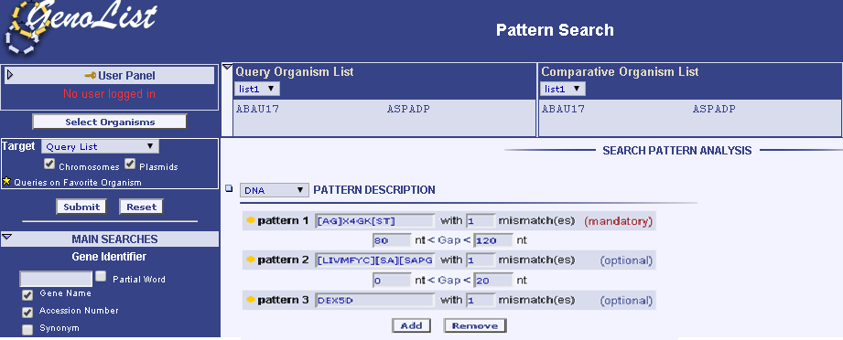
SERVER USED FOR SEARCHING PATTERN: GENOLIST
Genolist is a server provided by : Pasterur Institute France. One can analyze 700 genomes that are provided by the server.
For Pattern Search following syntax is used :
[] : Any Protein in the brackets allowed.
[^] : None of the Protein in the brackets allowed.
X : Any Protein allowed

Slide 19
PATTERN SEARCH :
Used Regular Expression, Python tool.
Advantages :
Having Code helps user know what program is doing
Only 700 genomes are listed in Genolist, for which one can perform pattern search. Other available pattern search doesn’t allow multiple pattern search.
Only upto 100 genomes can be selected in Genolist, whereas you can search among any number of genome using code.

Slide 20
CODE:
Different Parts :
The program asks user for number of patterns.
The user is asked for the pattern and the number of mismatches allowed.
The programs then asks user for the lower and upper bound of amino acids in between patterns.
The program find all possible combinations of mismatches allowed and compute regular expression.
The expression is searched in input file that user provides and the results are written to temporary file according to the mismatches.
The temporary files are combined and results are written into a common output file based on total sum of mismatches.

Slide 21
IDENTIFICATION OF TMDs :
Signature motifs are only found in some sub-families of TMDs.
All TMDs are integral transmembrane proteins are composed of four to eight alpha-helices and their encoding genes are usually organized in an operon with those encoding NBDs.
We searched for nearby proteins for transmembrane domain using web server : TMHMM

Slide 22
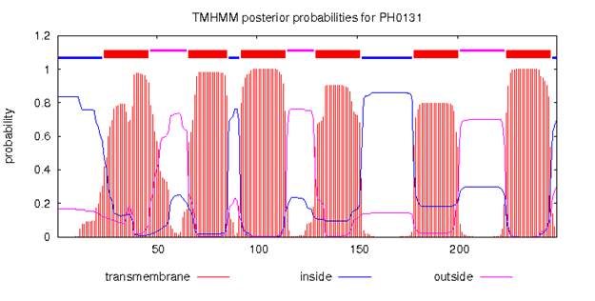
SERVER FOR TRANSMEMBRANE DOMAIN: TMHMM
TMHMM is a server provided by : Technical University of Denmark. One can analyze upto 4000 proteins one time for presence of transmembrane domain.

Slide 23
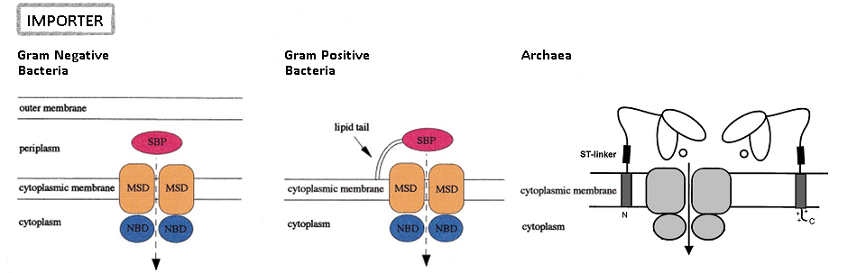
SBPs :
(reproduced from Braibant et al. (2000))
In Gram Positive Bacteria and Archaea the SBP is attached to the membrane whereas in Gram Negative Bacteria it is in between outer and inner membrane.

Slide 24
IDENTIFICATION OF SBPs :
Archaea and Gram Positive Bacteria:
Gram Negative Bacteria:
Our strategy for finding the SBPs of the importers was based on the facts that:
In Gram-positive bacteria, SBPs are lipoproteins containing a prokaryotic membrane lipoprotein lipid attachment site.
The genes encoding the SBPs are usually organized in an operon with those encoding NBDs and TMDs.
Our strategy for finding the SBPs of the importers was based on the facts that:
In Gram-negative bacteria, SBPs are proteins containing a signal peptide.
The genes encoding the SBPs are usually organized in an operon with those encoding NBDs and TMDs.

Slide 25
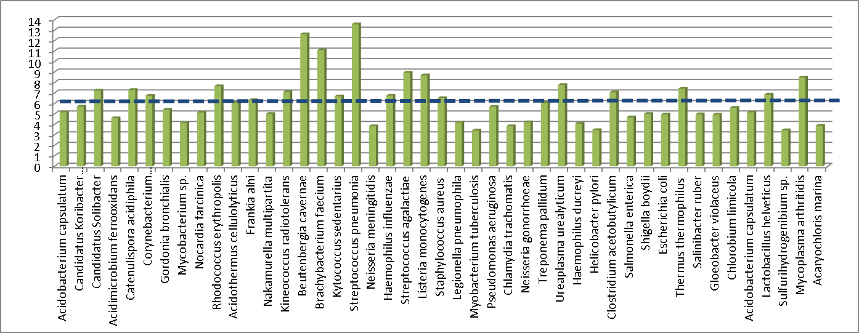
RESULTS:
BACTERIA
µ+2σ
µ
µ-2σ
Streptococcus pneumoniae and Beutenbergia cavernae were found to have high content of ABC assemblies as compared to other genomes.

Slide 26
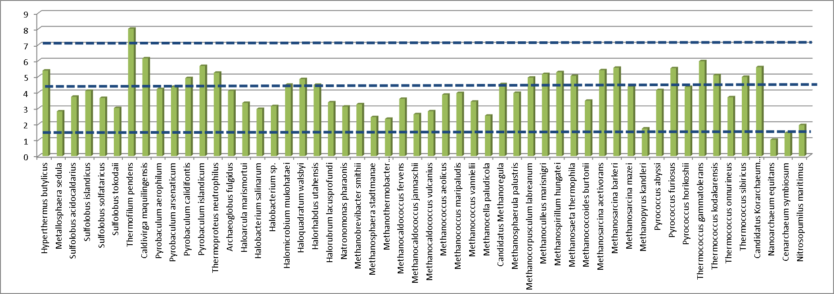
RESULTS:
ARCHAEA
µ+2σ
µ
µ-2σ
Thermofilum pendes has a very high content of ABC systems: may be due to fact that it can sustain life in extreme environments, making it a thermoacidophile, thus requirement of transporters in extreme conditions might be responsible. Nanoarchaeum equitans has only 2 assembly: due to the fact that it cannot synthesize most nucleotides, amino acids, lipids and cofactors as the cell most likely obtains these biomolecules from Ignicoccus.

Slide 27
ABC Assembly VS Number of Genes:
Archaea
Bacteria
As the size of the genome increases, the number of transporters of all categories is approximately proportional to genomic size.

Slide 28
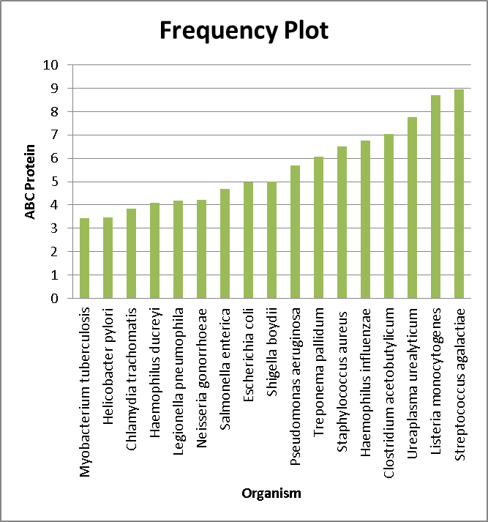
PATHOGENIC BACTERIA:
Mean Normalized Score : 1.86%, less than overall Bacteria ABC Assembly percentage. Myobacterium tuberculosis has the lowest number of ABC proteins.

Slide 29
CONCLUSION:
Bacteria : 45 genomes
Archaea : 60 genomes
Normalized percentage of ABC proteins found (1.97*3) ~5.93 %
Most of the bacteria used are intracellular parasites. Such bacteria are able to grow inside cells, or the availability of a metabolite can lead to gene inessentiality and to subsequent disruption or deletion of the gene. M. tuberculosis has only 38 ABC assemblies which is lower than E. coli where 90 ABC assemblies are found.
Normalized percentage of ABC assemblies found (1.37*3) ~4.12 %
Thermofilum pendes was found to have a very high content of ABC systems compared with that of species of similar genome size.
Nanoarchaeum equitans was found to have only 2 ABC assemblies.
Normalized percentage of ABC protein can be found by multiplying by average three(NBD,TMD and SBP).
Normalized Score = Number of ABC Assembly/Number of Genes in genome.

Slide 30
REFERENCES:
Martine Braibant, Philippe Gilot, Jean Content, The ATP binding cassette (ABC) transport systems of Mycobacterium tuberculosis, FEMS Microbiology Reviews, 2000, 24 449-467.
Sonja-Verena Albers, Sonja M. Koning, Wil N. Konings & Arnold J. M. Driessen, Insights Into ABC Transport in Archaea, Journal of Bioenergetics and Biomembranes, 2004, Vol. 36, No. 1.
Pierre Lechat, Laurence Hummel, Sandrine Rousseau & Ivan Moszer. GenoList: an integrated environment for comparative analysis of microbial genomes, PubMed, 2008, D469-74. DOI:10.1093.
Jannick Dyrliv, Bendtsen, Henrik Nielsen, Gunnar von Heijne, Soren & Brunak. Improved prediction of signal peptides | SignalP, 3.0.J. Mol. Biol., 2004, 23-1.
Combet, C., Blanchet, C., Geourjon, C. & Deleage, G. Trends Biochem. Sci., 2000, 25-147

