Slide 1
Age, Gender & Ethnicity Detection
CS 583 – Deep Learning Project
Prof: Abdul Rafae Khan
Team Members:
Mehul Sudhakar Ingale
Ujwala Kamineni

Slide 2
Brief Overview:
The human face serves as a rich source of demographic and biometric information, divulging details about identity, age, gender, and ethnicity.
The facial attributes with significant influence on communication, namely age, ethnicity, and gender, are intertwined with cultural values, shaping how individuals express themselves and interpret interactions.
The applications of age, gender, and ethnicity prediction are diverse, spanning law enforcement, security control, and human-computer interaction.
Human-computer interaction can leverage predictions to customize recommendations based on users' age, gender, and ethnicity, influencing content and product suggestions in platforms like e-commerce.

Slide 3
Details of the datasets used:
we used the UTKFace dataset consisting of over 23k face image pixels with annotations of age, gender, and ethnicity in CSV format. It has a total of 27305 samples. The pixels of images cover large variations in facial expression, illumination, pose, resolution, and occlusion. We chose this dataset because of its relatively more uniform distributions, and the diversity it has in image characteristics such as brightness, occlusion, and position.
Some sample images generated from pixels from the UTKFace dataset can be seen in below figure

Slide 4
Details of Tools and Technologies used:
Here's a list of tools and technologies used
Programming Language:
Python
Libraries and Frameworks:
NumPy: Used for numerical operations and array handling in Python.
pandas: Used for data manipulation and analysis, particularly for creating and working with data frames.
Matplotlib: Used for creating visualizations and plots.
seaborn: Built on Matplotlib, seaborn is used for statistical data visualization.
scikit-learn: Provides tools for machine learning tasks such as data preprocessing, model evaluation, and classification reports.
TensorFlow (via Keras): Used for building and training deep learning models, including the CNN architecture

Slide 5
Details of the experiment:
In this project we have used three models:
CNN :
In the project code, Convolutional Neural Networks (CNNs) were implemented to predict age, gender, and ethnicity from facial images stored in pixel format within a CSV file.
For gender prediction, the CNN architecture featured convolutional layers with batch normalization and dropout, utilizing Stochastic Gradient Descent (SGD) as the optimizer.
The model was trained for 25 epochs with a stopping criterion of validation loss < 0.2700. For ethnicity prediction, the model employed convolutional and fully connected layers, using RMSprop as the optimizer and training until achieving a validation accuracy > 79%.
Age prediction involved a sophisticated CNN architecture with convolutional layers, batch normalization, and dropout, utilizing the Adam optimizer.
Notably, the age prediction model exhibited exceptional accuracy. The training histories were visualized using Matplotlib and Plotly to monitor accuracy and loss over epochs.

Slide 6
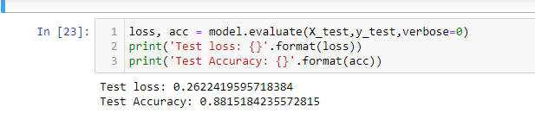
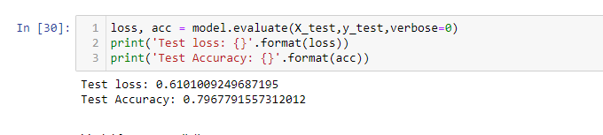
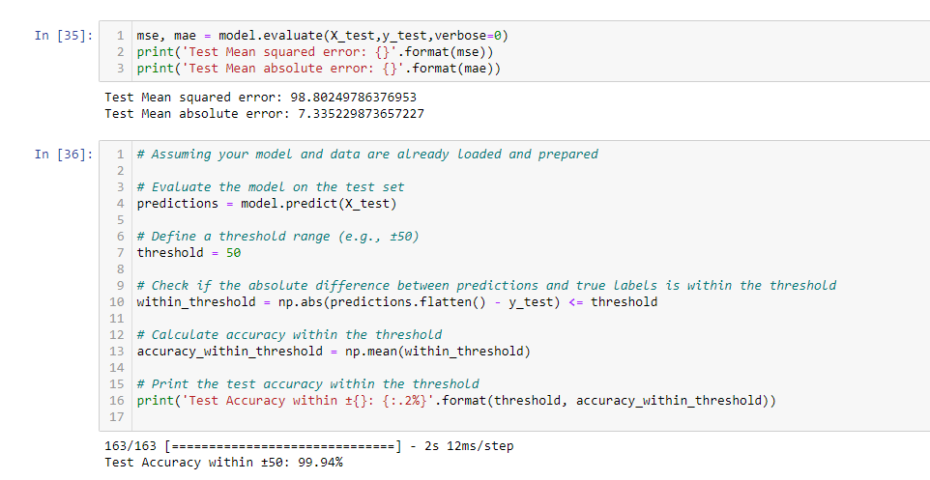
Outputs:
Age
Ethnicity
Ethnicity
Gender

Slide 7
#Pre-trained Model
2) VGG 16:
In the project, I implemented Convolutional Neural Networks (CNNs) for age, gender, and ethnicity prediction using a customized architecture, achieving notable accuracies.
Subsequently, I experimented with the VGG16 model for comparison.
However, the VGG16 model yielded lower accuracy than the custom CNN.
The VGG16 implementation involved loading the pre-trained VGG16 model from Keras applications, modifying the output layer for the specific tasks, and fine-tuning the model on the dataset.
Despite VGG16 being a powerful model, the custom CNN outperformed it in this particular project.

Slide 8
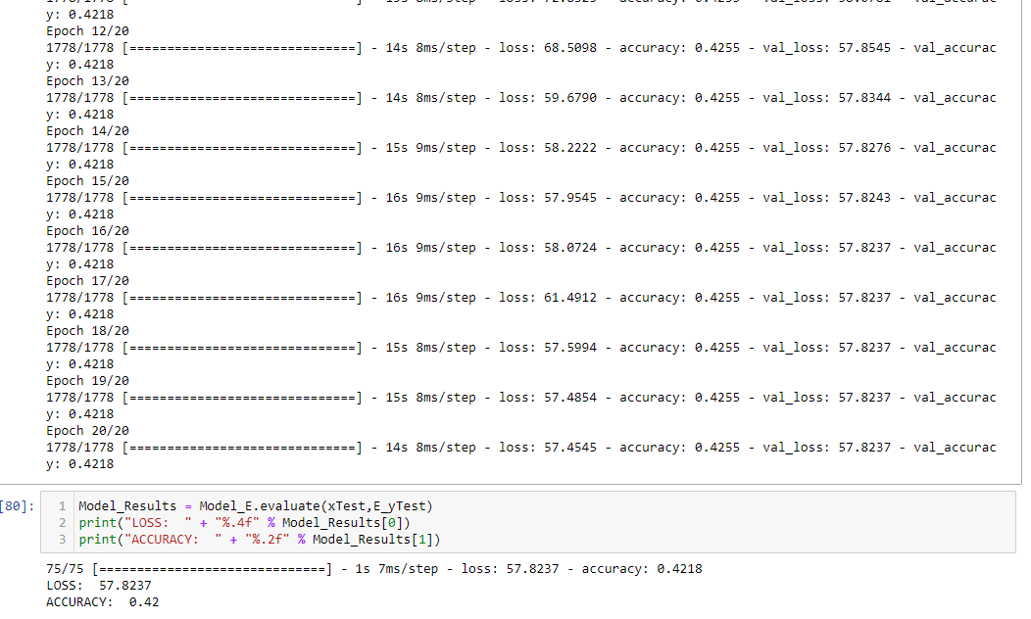
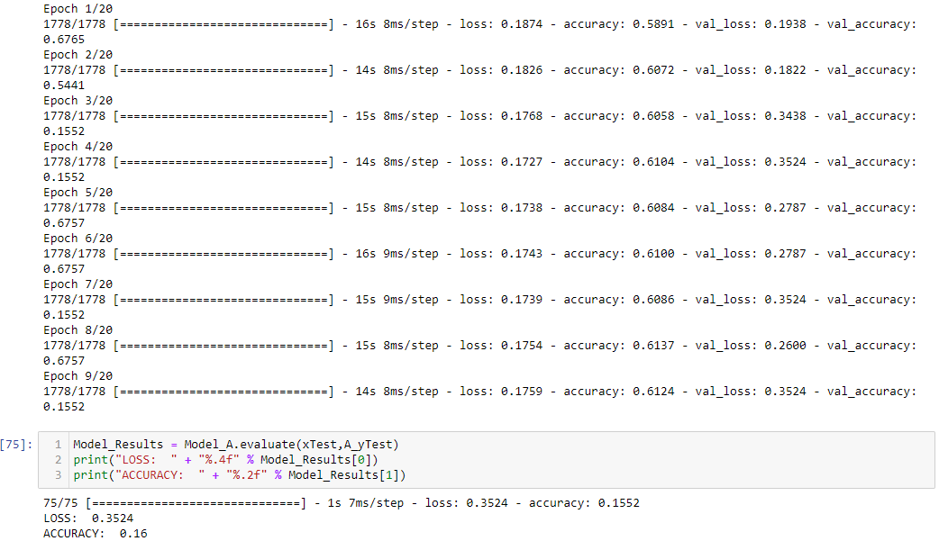
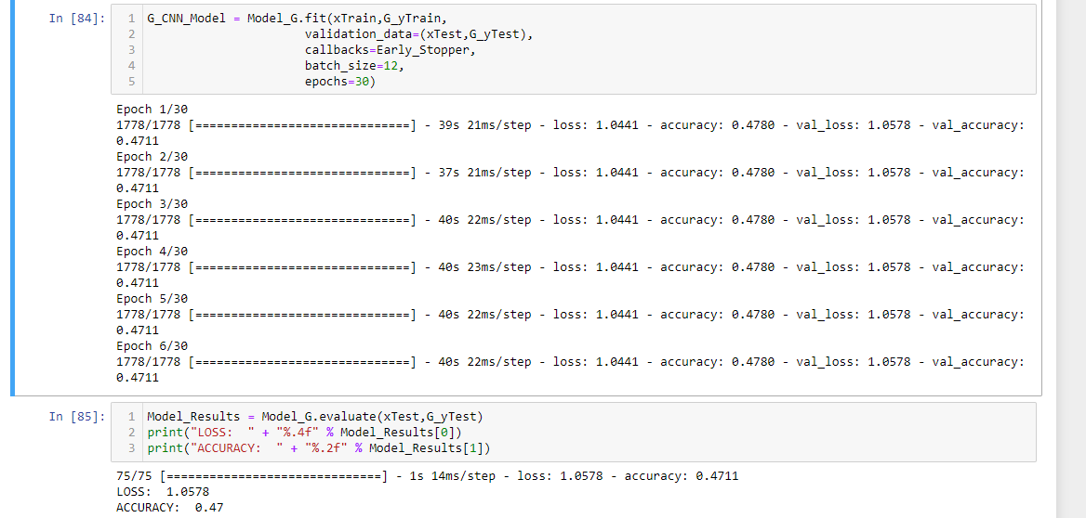
Results:
Age
Ethnicity
Gender

Slide 9
#Pre-trained Model
3) MobileNetV2:
Implemented MobileNetV2 for age, gender, and ethnicity prediction using pre-trained models.
For gender classification, achieved an accuracy of 51.69%, indicating comparable performance to VGG16.
Age regression, however, showcased improved accuracy with a mean squared error of 0.8393 and mean absolute error of 0.4957, surpassing VGG16. Ethnicity classification with MobileNetV2 resulted in an accuracy of 42.39%, demonstrating a similar performance as VGG16.
In the code, MobileNetV2 was employed with transfer learning by utilizing a pre-trained base model.
Input data preprocessing involved applying the MobileNetV2-specific preprocessing function.
Model architectures were built on top of the MobileNetV2 base, incorporating additional layers for task-specific predictions.
Training involved fine-tuning the top layers while freezing the pre-trained base layers.
The evaluation showcased varying performances across gender, age, and ethnicity tasks, emphasizing the nuanced impact of the chosen pre-trained model.

Slide 10
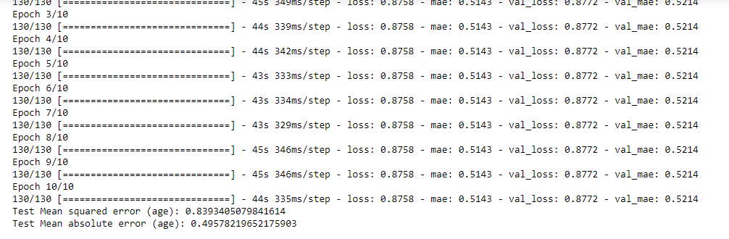
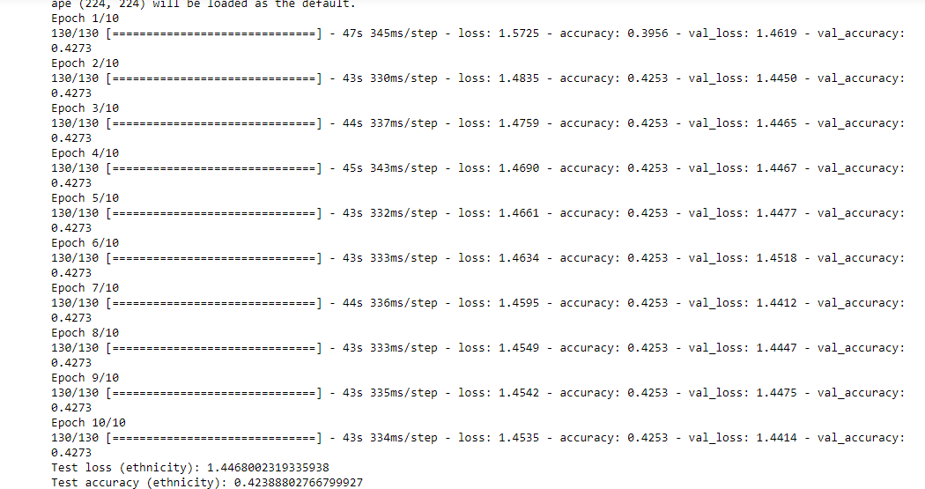
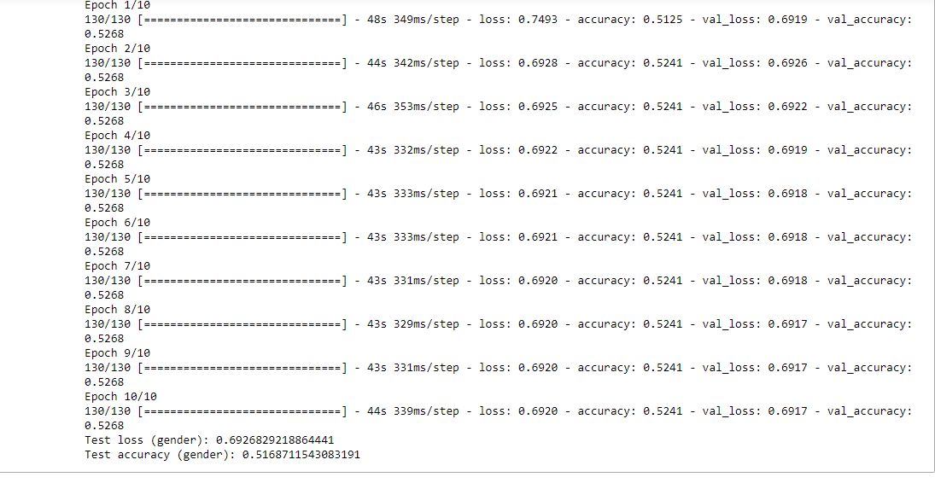
Results:
Age
Ethnicity
Gender

Slide 11
Conclusion
In conclusion, this project explored the effectiveness of custom CNNs and pre-trained models, namely VGG16 and MobileNetV2, for age, gender, and ethnicity prediction from facial images.
While VGG16 exhibited competitive results, MobileNetV2, despite achieving superior accuracy in age regression, demonstrated comparable performance for gender and ethnicity classification.
The project underscores the significance of task-specific model design, where custom architectures can outperform more complex pre-trained models in certain contexts.
Future directions may involve further fine-tuning, exploring alternative architectures, and expanding the dataset for enhanced model robustness.
Overall, this study provides valuable insights into the nuanced interplay between model architectures and task specific requirements in facial image prediction.

Slide 12
Questions

Slide 13
Thank you

