Slide 1

Pipelining and hazards
Unit - iv

Slide 2
Content
Introduction of Pipelining
Instruction Pipelining
Arithmetic Pipelining
Pipelining Hazards
Numerical on Pipelining

Slide 3
1. Introduction of Pipelining

Slide 4
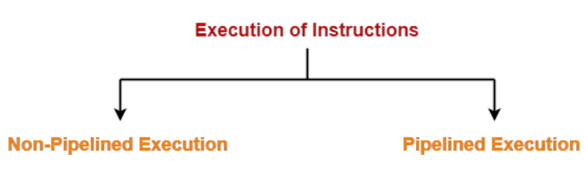
Introduction
A program consists of several number of instructions. These instructions may be executed in the following two-way:
The primary goal of computer architecture is to enhance the performance and speed of the computer. This can be achieved by:
  Improving the hardware
  Arranging the hardware so that multiple operations can be performed simultaneously.

Slide 5
Introduction
In non-pipelined (sequential) architecture, all the instructions of a program are executed sequentially one after the other
Pipelining is referred as
  A technique in which a given task is divided into a number of subtasks that need to be performed in sequence.
  One of the processes of arranging the hardware so that simultaneous execution of multiple instructions takes place, thus, improving the overall performance.
The main advantage of pipelining is the simultaneous execution of various subtasks, which improves the system's throughput.

Slide 6
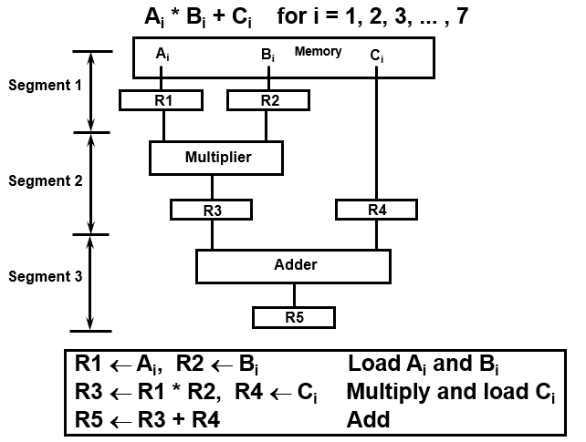
Pipelining
A technique of decomposing a sequential process into suboperations, with each subprocess being executed in a partially dedicated segment that operates concurrently with all other segments.
Example:

Slide 7
Instruction Cycle
There are several stages of processing an instruction. A pipeline can be of three, four, five, or six stages.
3-stage
4-stage
5-stage
6-stage
Fetch
Decode
Execute
Fetching the instruction
Decoding the instruction
Executing the instruction
Write Back
Fetching the instruction
Decoding the instruction
Memory Access for operands
Executing the instruction
Write Back
Fetching the instruction
Decoding the instruction
Calculate the effective address of the operand
Memory Access for operands
Executing the instruction
Write Back

Slide 8
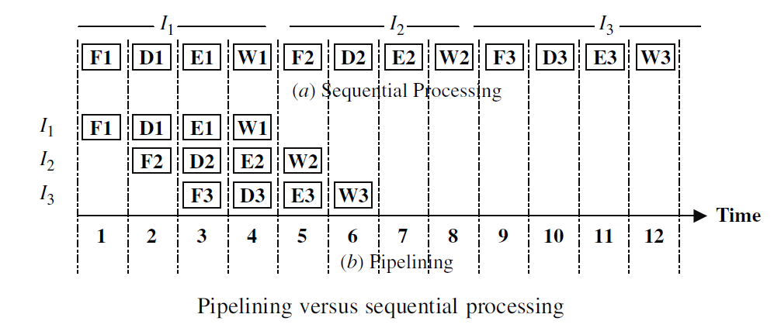
Sequential vs. Pipelined Execution of Instructions
Consider that there are three instructions- I1, I2, and I3 and there are 4 stages of execution – Fetch (F), Decode (D), Execute (E), and Write back (W).
It takes 12 machine cycles to execute these three instructions in sequential processing and only 6 machine cycles in pipelining.
4-stage pipelining

Slide 9
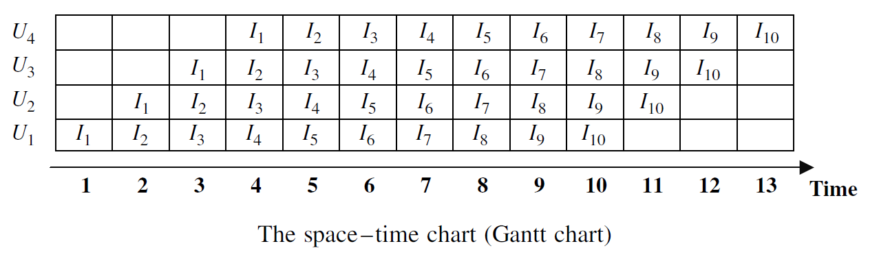
performance measures for the goodness of a pipeline
In order to formulate the performance measures for the goodness of a pipeline in processing a series of instructions
  A space-time chart (called the Gantt’s chart) is used.
  In this chart, the vertical axis represents the subunits (stages) (four in this case) and the horizontal axis represents time (the time (T) taken by each subunit to perform its task is the same, therefore, known as unit time)
13 time units are required to execute 10 instructions using 4-stage pipelining

Slide 10
performance measures for the goodness of a pipeline
There are three performance measures for the goodness of a pipeline.
Speed-up S(n)
Throughput U(n)
Efficiency E(n)

Slide 11
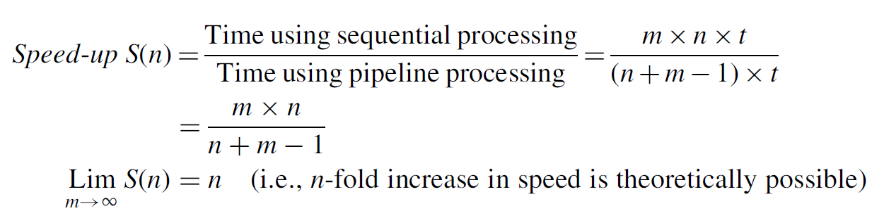
Speed-up S(n)
Consider the execution of m instructions using the n-stages (units) pipeline. The time units required to complete the m instructions in:
Sequential (non-pipelined) execution is m * n
Pipelined execution is n + m – 1
In pipelined execution, the first instruction will take T clock cycles to process, but the other instructions will take just 1 more clock cycle.
The speedup can be calculated as:
Speedup = Cycles of non-pipelined processor/ cycle of pipelined processor

Slide 12
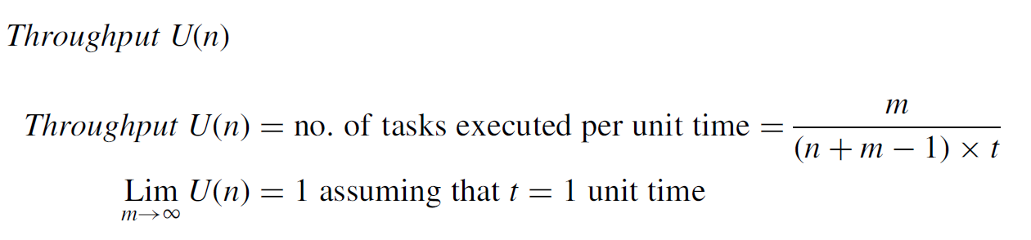
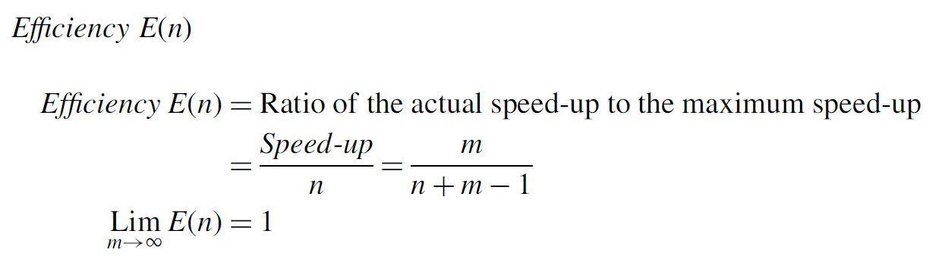
Throughput U(n) & Efficiency E(n)

Slide 13
Mainly two types of pipelining
1. Instruction Pipelining
2. Arithmetic Pipelining

Slide 14
2. Instruction Pipelining

Slide 15
Instruction Pipelining
Instruction pipelines are used to divide the task of executing a stream of instructions into subtasks to be executed in different pipeline segments to improve the throughput of the computer system.
For example, if we have a stream of instructions, then one segment of the pipeline can read the instructions while another segment can decode the previous instruction. In this way, more than one instruction will be handled simultaneously by the computer system which will improve its throughput. The instruction pipeline will be more efficient if the instructions are divided into equal-duration segments.
A typical example of an instruction pipeline used by computer systems consists of the following segments:
  Segment 1: This segment will fetch the instruction from the memory
  Segment 2: This segment will decode the instruction and find out the effective address
  Segment 3: This segment will fetch the operands from the memory
  Segment 4: This segment will execute the instruction

Slide 16
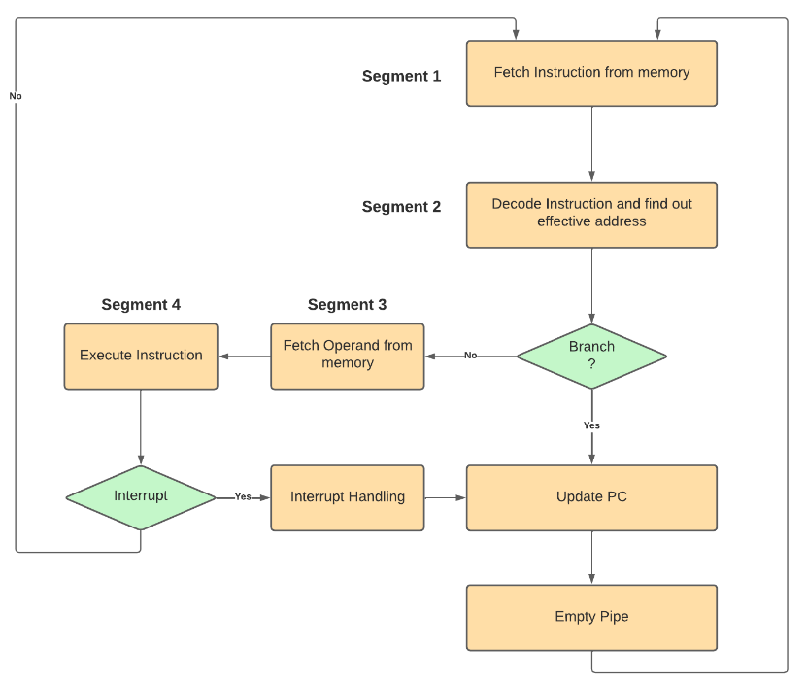
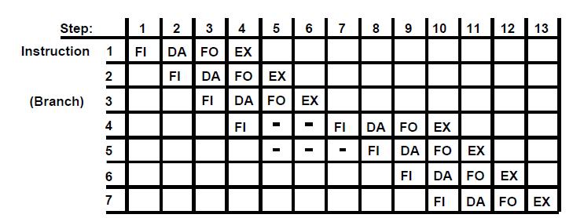
Instruction Pipelining

Slide 17
3. Arithmetic Pipeline

Slide 18
Arithmetic Pipelining
Arithmetic pipelines are used to divide an arithmetic task into subtasks to be executed in different pipeline segments.
The main purpose is to speed up the arithmetic operations
Pipeline arithmetic units are usually found in very high-speed computers. They are used to implement floating-point operations, multiplication of fixed-point numbers, and similar computations encountered in scientific problems.
  Floating-point operations are easily decomposed into suboperations.
  A pipeline multiplier is essentially an array multiplier, with special adders designed to minimize the carry propagation time through the partial products.

Slide 19
Arithmetic Pipelining: Floating Point Adder
We know that two floating point numbers are represented in their normalized form using mantissa and exponents. Mantissa represents the precision of the number and the exponent represents the range.
Let us consider two floating point numbers X and Y.
Exponents
Mantissas
a
b
A
B
R
R
Segment 1:
Compare
Difference
exponents
by subtraction
R
X = A x 2ª
Y = B x 2^{b}
Segment 2:
Choose exponent
Align mantissa
A and B are two fractions that represent the mantissa and a and b are the exponents.
R
Segment 3:
Add or subtract
Compare the exponents
Align the mantissa
Add/sub the mantissa
Normalize the result
In the arithmetic pipeline, these four steps are performed in four different segments to improve the speed and throughput of the system
mantissas
R
R
Segment 4:
Adjust
Normalize
exponent
result
R
R

Slide 20
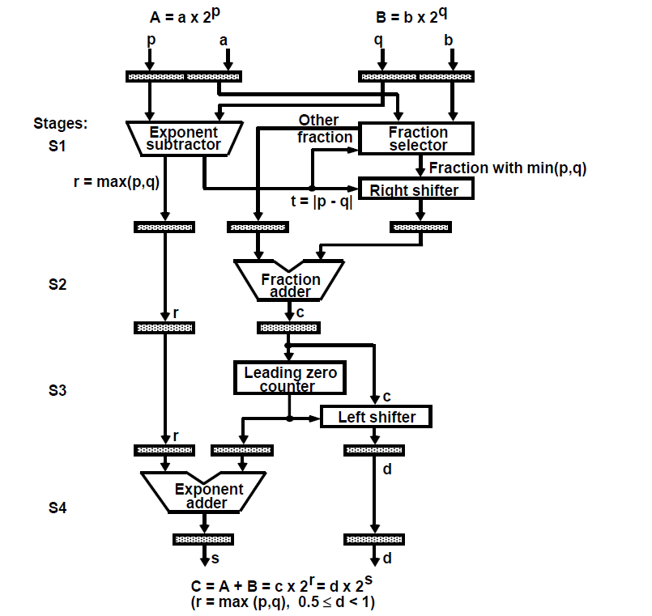
Arithmetic Pipelining: Floating Point Adder

Slide 21


Example: Floating Point Adder
The following numerical example may clarify the suboperations performed in each segment. For simplicity, we use decimal numbers, although Figure refers to binary numbers.
Consider the two normalized floating-point numbers:
The two exponents are subtracted in the first segment to obtain 3 - 2 = 1. The larger exponent 3 is chosen as the exponent of the result.
The next segment shifts the mantissa of Y to the right to obtain

Slide 22
Example: Floating Point Adder
This aligns the two mantissa under the same exponent. The addition of the two mantissa in segment 3 produces the sum Z = 1 .0324 * 10³.
The sum is adjusted by normalizing the result so that it has a fraction with a nonzero first digit. This is done by shifting the mantissa once to the right and incrementing the exponent by one to obtain the normalized sum.
Z = 0.10324 * 10⁴.
The comparator, shifter, adder-subtractor, incrementer, and decrementer in the floating-point pipeline are implemented with combinational circuits. Suppose that the time delays of the four segments are t₁ = 60 ns, t₂ = 70 ns, t₃ = 100 ns, t₄ = 80 ns, and the interface registers have a delay of t_{r} = 10 ns.
The clock cycle is chosen to be t_{p} = t₃ + t_{r} = 110 ns.
An equivalent non-pipeline floating point adder-subtractor will have a delay time t_{n} = t₁ + t₂ + t₃ + t₄ + t_{r} = 320 ns.
In this case the pipelined adder has a speedup of 320/110 = 2.9 over the nonpipelined adder.

Slide 23
4. Pipelining Hazards

Slide 24
Pipelining Hazards
Pipeline hazards are situations that prevent the next instruction in the instruction stream from executing during its designated clock cycles.
Any condition that causes a stall in the pipeline operations can be called a hazard.
There are primarily three types of hazards:
  Data Hazards
  Control Hazards or instruction Hazards
  Structural Hazards.

Slide 25
1. Data Hazards
A data hazard is any condition in which either the source or the destination operands of an instruction are not available at the time expected in the pipeline. As a result, some operation has to be delayed, and the pipeline stalls.
When the execution of an instruction is dependent on the results of a prior instruction that’s still being processed in a pipeline, data hazards occur. If the execution is done in a pipelined processor, it is highly likely that the interleaving of these two instructions can lead to incorrect results due to data dependency between the instructions. Thus the pipeline needs to be stalled as and when necessary to avoid errors.

Slide 26
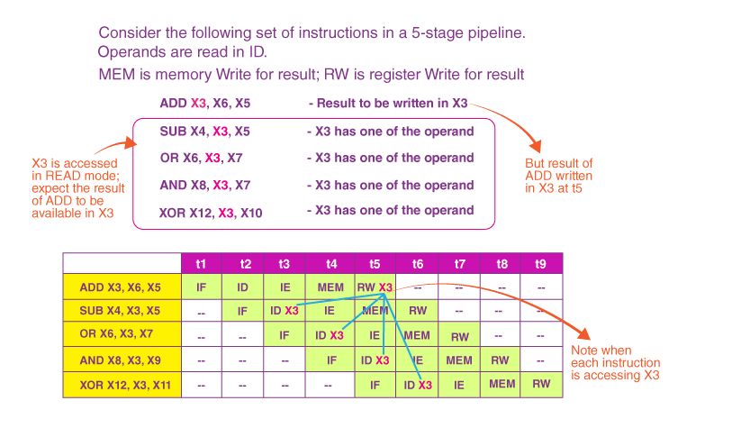
1. Data Hazards
Consider the following scenario.

Slide 27
Data Hazards Classification
Data hazards are divided into three types according to the order in which READ or WRITE operations are performed on the register:
Flow/True Data Dependency [RAW (or Read after Write)]:
  This is when one instruction makes use of data from a previous instruction.
  Example,
    ADD X0, X1, X2
    SUB X4, X3, X0

Slide 28
Data Hazards Classification
Anti-Data Dependency [WAR (or Write after Read)]
  When the second instruction is written to a register before the first instruction is read, this is known as a race condition. In the case of a simple structure of a pipeline, this is uncommon. WAR, on the other hand, can occur in some machines having complex and specific instructions.
  Example,
  ADD X2, X1, X0
  SUB X0, X3, X4
Output data dependency [WAW (or Write after Write)]
  This is a situation where two simultaneous instructions must write the same register in the same sequence they were issued.
  Example,
  ADD X0, X1, X2
  SUB X0, X4, X5

Slide 29
Data Hazards Classification
Important Note:
  WAW and WAR hazards can only occur when instructions are executed in parallel or out of order. These occur because the same register numbers have been allotted by the compiler although avoidable.
  This situation is fixed by renaming one of the registers by the compiler or by delaying the updating of a register until the appropriate value has been produced.
  Modern CPUs not only have incorporated Parallel execution with multiple ALUs but also out of order issues and execution of instructions along with many stages of pipelines.

Slide 30
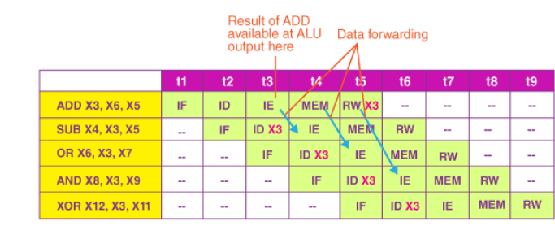
1. Data Hazards
Solution 1: At the IF stage of the SUB instruction, add three bubbles. This will make it easier for SUB – ID (Instruction Decoder) to work at t6. As a result, all subsequent instructions in the pipe are similarly delayed.
Solution 2: Forwarding of Data – Data forwarding is the process of sending a result straight to that functional unit that needs it: a result is transferred from one unit’s output to another’s input. The goal is to have the solution ready for the next instruction as soon as possible.

Slide 31
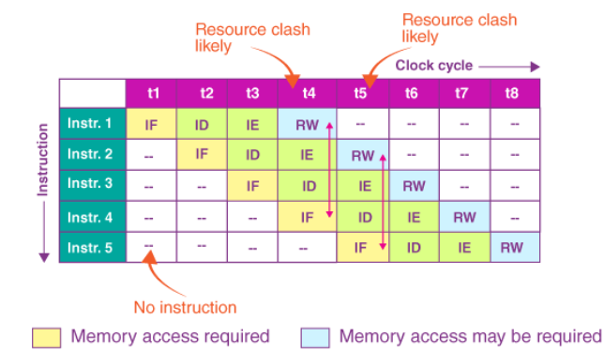
2. Structural Hazards
Hardware resource conflicts among the instructions in the pipeline cause structural hazards. Memory, a GPR Register, or an ALU might all be used as resources here.
When more than one instruction in the pipe requires access to the very same resource in the same clock cycle, a resource conflict is said to arise.
In an overlapping pipelined execution, this is a situation where the hardware cannot handle all potential combinations.

Slide 32
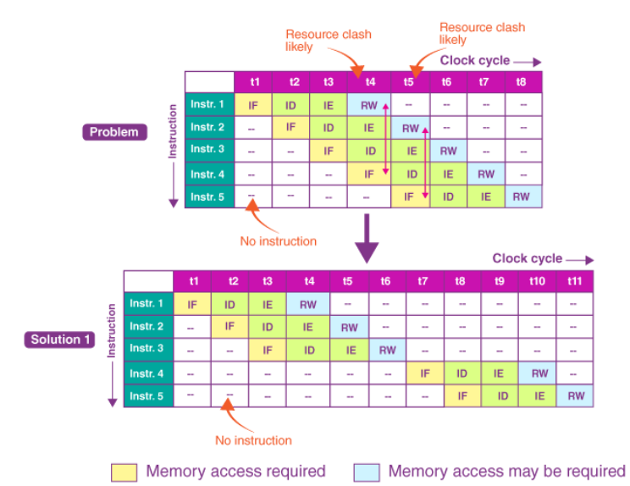
2. Structural Hazards
Solution: For a portion of the pipeline, instructions must be performed in series rather than parallel.

Slide 33
3. Control hazards
Control hazards are called Branch hazards and are caused by Branch Instructions. Branch instructions control the flow of program/ instructions execution. Recall that we use conditional statements in the higher-level language either for iterative loops or with conditions checking (correlate with for, while, if, and case statements). These are transformed into one of the variants of BRANCH instructions. It is necessary to know the value of the condition being checked to get the program flow.
Thus a Conditional hazard occurs when the decision to execute an instruction is based on the result of another instruction like a conditional branch, which checks the condition’s resultant value.
The branch and jump instructions decide the program flow by loading the appropriate location in the Program Counter(PC). The PC has the value of the next instruction to be fetched and executed by CPU. Consider the following sequence of instructions.

Slide 34
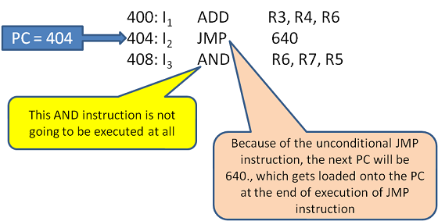
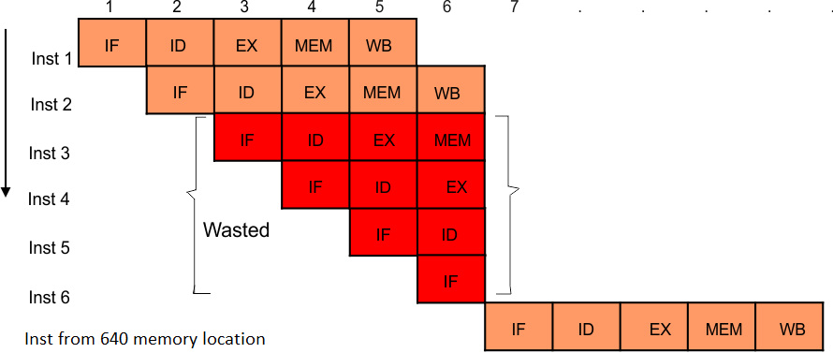
3. Control hazards

Slide 35
Solution for Control hazards
Stall:
  Stall the given pipeline as soon as any branch instructions are decoded. Just don’t allow IF anymore. Stalling reduces throughput as it always does. According to statistics, at least 30% of the instructions in a program are BRANCH. With Stalling, the pipeline is effectively operating at 50% capacity.
Prediction:
  Consider a for or a while loop that is repeated 100 times. We know the program would run 100 times without the given branch condition being met. The program only exits the loop for the 101st time. As a result, it’s better to let the pipeline run its course and then flush/undo when the branch condition is met. This has less of an impact on the pipeline’s throttle and stalling.

Slide 36
Solution for Control hazards
Dynamic Branch Prediction :
  A history record is maintained with the help of Branch Table Buffer (BTB). The BTB is a kind of cache, which has a set of entries, with the PC address of the Branch Instruction and the corresponding effective branch address. This is maintained for every branch instruction that occurs.
Branch Instruction Address | Target Branch Address taken
Reordering Instructions:
  Delayed branching entails reordering the instructions to move the branch instruction later in the sequence, allowing safe and beneficial instructions that are unaffected by the result of a branch to be brought in earlier in the sequence, delaying the fetch of the branch instruction. If such instructions are not available, NOP is used. The Compiler is used to implement this delayed branch.

Slide 37
5. Numerical on Pipelining

Slide 38
Question 1
In certain scientific computations it is necessary to perform the arithmetic operation (A_{i} + B_{i})(C_{i} + D_{i}) with a stream of numbers. Specify a pipeline configuration to carry out this task. Use the contents of all registers in the pipeline for i = 1 through 6.

Slide 39
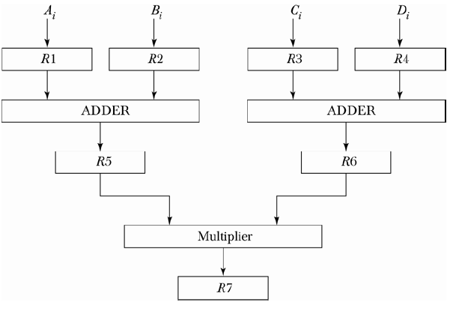
Question 1
In certain scientific computations it is necessary to perform the arithmetic operation (A_{i} + B_{i})(C_{i} + D_{i}) with a stream of numbers. Specify a pipeline configuration to carry out this task. Use the contents of all registers in the pipeline for i = 1 through 6.
Solution:

Slide 40
Question 2
Determine the number of clock cycles that it takes to process 200 tasks in a six-segment pipeline

Slide 41
Question 2
Determine the number of clock cycles that it takes to process 200 tasks in a six-segment pipeline
Solution: Pipelined execution is = n + m – 1
        n = 6 segments
        m = 200 tasks
        (n + m – 1) = 6 + 200 – 1 = 205 cycles

Slide 42
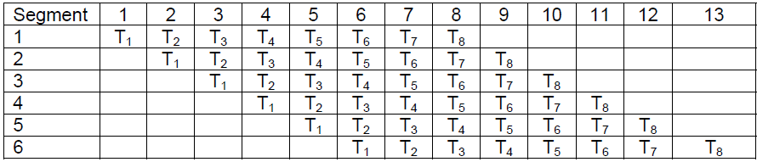
Question 3
Draw a space-time diagram for a six-segment pipeline showing the time it takes to process eight tasks.
Solution:
(n + m – 1) = 6 + 8 – 1 = 13 cycles

Slide 43
Question 4
A non-pipeline system takes 50 ns to process a task. The same task can be processed in a six-segment pipeline with a clock cycle of 10 ns. Determine the speedup ratio of the pipeline for 100 tasks. What is the maximum speedup that can be achieved?

Slide 44
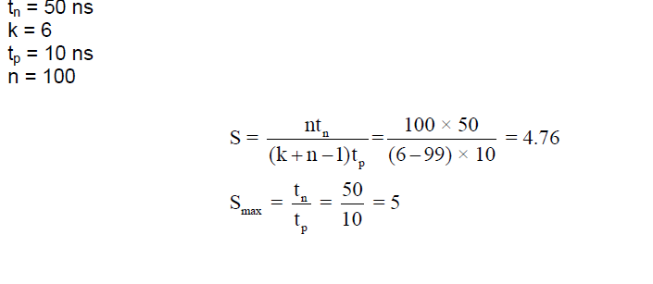
Question 4
A non-pipeline system takes 50 ns to process a task. The same task can be processed in a six-segment pipeline with a clock cycle of 10 ns. Determine the speedup ratio of the pipeline for 100 tasks. What is the maximum speedup that can be achieved?
Solution:

Slide 45
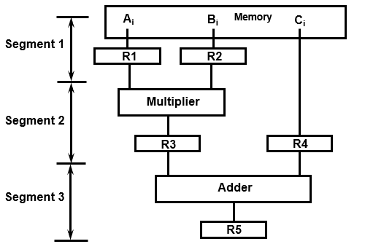
Question 5
The pipeline of Fig has the following propagation times: 40 ns for the operands to be read from memory into registers R1 and R2, 45 ns for the signal to propagate through the multiplier, 5 ns for the transfer into R3, and 15 ns to add the two numbers into R5.
What is the minimum clock cycle time that can be used?
A non-pipeline system can perform the same operation by removing R3 and R4. How long will it take to multiply and add the operands without using the pipeline?
Calculate the speedup of the pipeline for 10 tasks and again for 100 tasks.
What Is the maximum speedup that can be achieved?

Slide 46
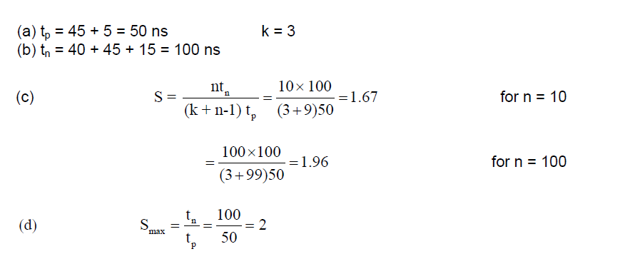
Question 5
Solution:

Slide 47
Question 6
To perform a task a non-pipeline system takes 50 nsec. The same task can be performed in a pipeline system with 6 segments and a pipeline cycle time of 10 nsec. In the pipeline system, 20% of tasks incur 3 stall cycles. The speed-up of the pipeline is _______.

Slide 48
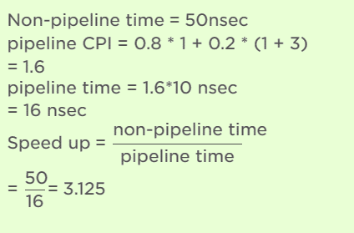
Question 6
To perform a task a non-pipeline system takes 50 nsec. The same task can be performed in a pipeline system with 6 segments and a pipeline cycle time of 10 nsec. In the pipeline system, 20% of tasks incur 3 stall cycles. The speed-up of the pipeline is _______.
Solution:

Slide 49
Question 7
Consider a pipeline having 4 phases with duration 60, 50, 90 and 80 ns. Given latch delay is 10 ns. Calculate: -
  Pipeline cycle time
  Non-pipeline execution time
  Speed up ratio
  Pipeline time for 1000 tasks
  Sequential time for 1000 tasks
  Throughput

Slide 50
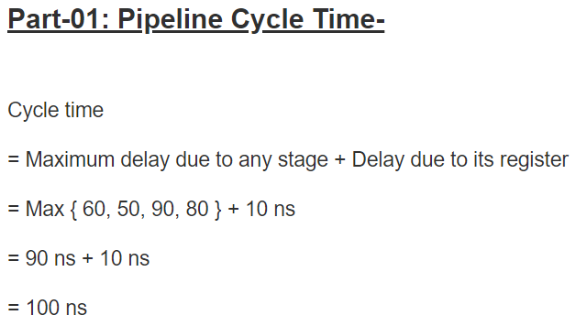
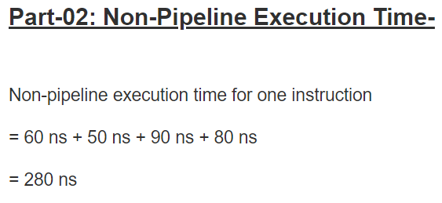
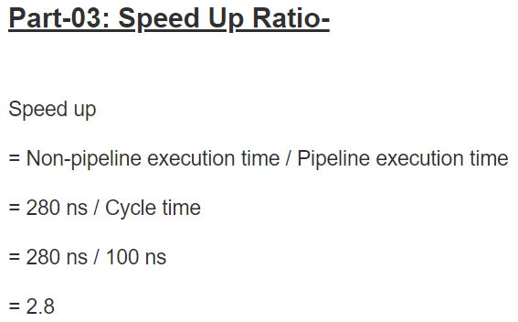
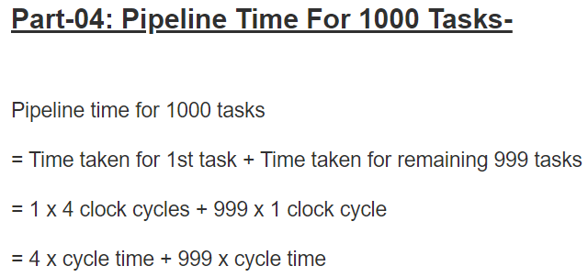
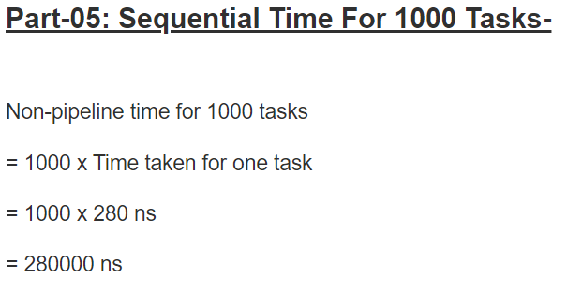


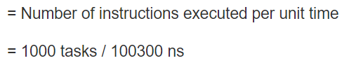
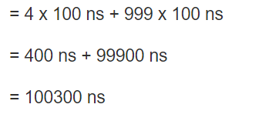
Question 7 - Solution

