Slide 1
Switching Techniques

Slide 2
Topics of Discussion
Introduction
    Need of switching
    Types of Switching methods
    Switching and layers of the TCP/IP protocol suite.
Circuit-switched network
    Three phases in these types of networks: Set-up phase, data transfer phase and tear down phase.
    Efficiency and delay of these networks.
Packet switching
    Datagram networks.
    Virtual circuit networks, addressing, VCI.
    Efficiency and delay of these networks.

Slide 3
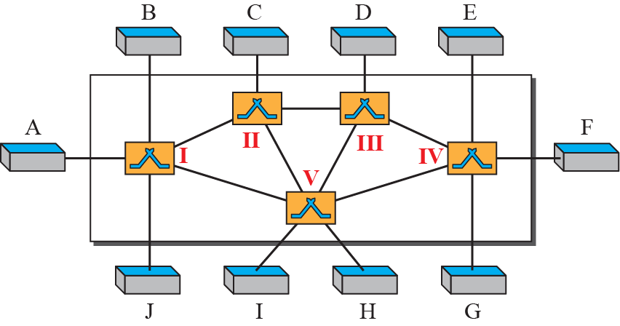
Introduction
Whenever we have multiple devices, we have the problem of how to connect them to make one-to-one communication possible.
Mesh and star topology are impractical in large networks.
Bus topology is ruled out because of distance between devices.
The solution is switching and consists of a series of interlinked nodes, called switches.

Slide 4
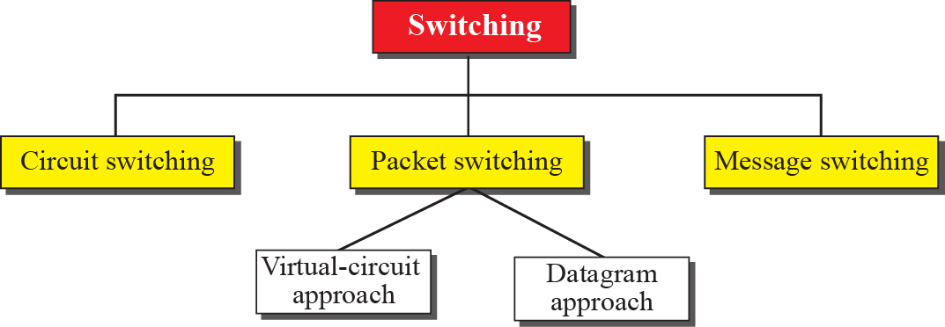
Methods of Switching: Three Methods of Switching
The first two are commonly used today.
The third has been phased out in general communications but still has applications.
Switching and TCP/IP Layers
Switching can happen at several layers of the TCP/IP protocol suite: at the physical layer, at the data-link layer, and at the network layer.
Physical layer:
Circuit switching
Data Link layer:
Virtual-circuit switching
Network layer:
Datagram approach
Virtual-circuit switching
Application layer:
Message switching
Figure-2: Taxonomy of switched networks

Slide 5
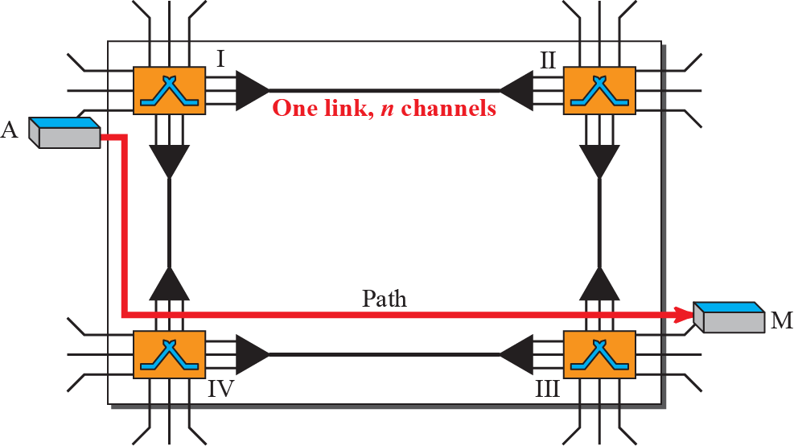
    CIRCUIT-SWITCHED NETWORKS
A circuit-switched network consists of a set of switches connected by physical links.
A connection between two stations is a dedicated path made of one or more links.
However, each connection uses only one dedicated channel on each link.
Each link is normally divided into n channels by using FDM or TDM, as discussed in Multiplexing.

Slide 6
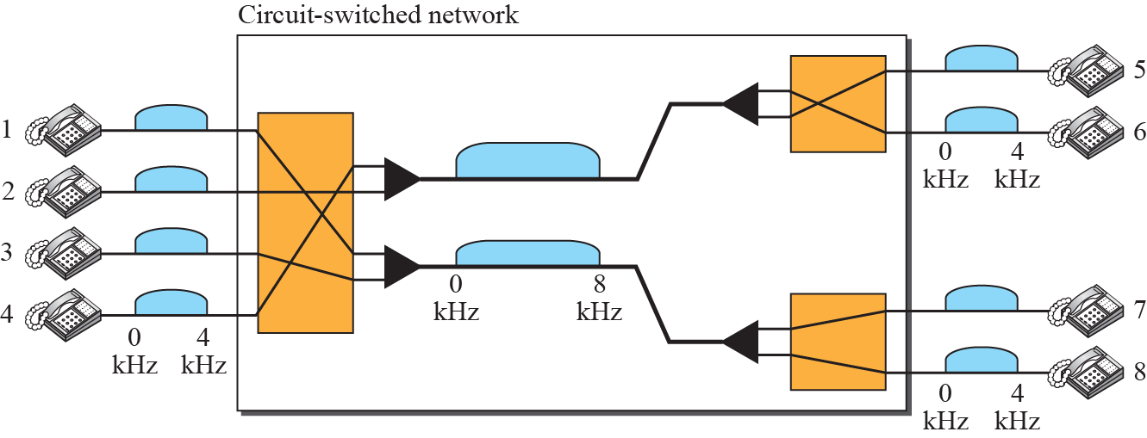
Example 1
As a trivial example, let us use a circuit-switched network to connect eight telephones in a small area. Communication is through 4-kHz voice channels. We assume that each link uses FDM to connect a maximum of two voice channels. The bandwidth of each link is then 8 kHz. Figure shows the situation. Telephone 1 is connected to telephone 7; 2 to 5; 3 to 8; and 4 to 6. Of course the situation may change when new connections are made. The switch controls the connections.

Slide 7
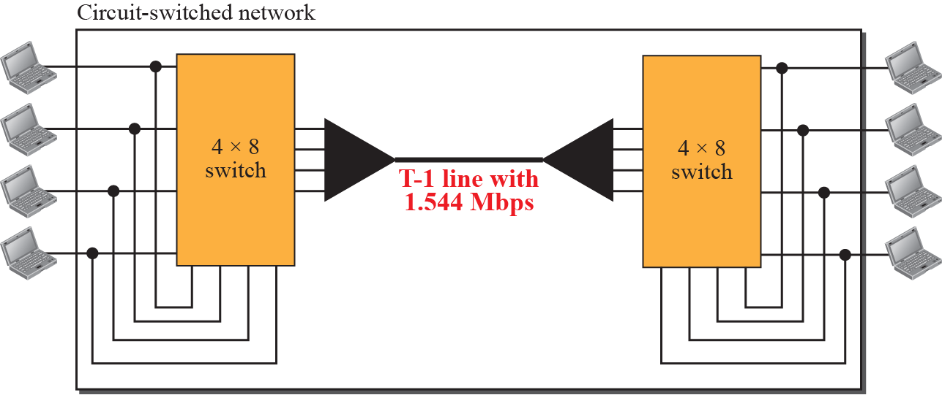
Example 2
As another example, consider a circuit-switched network that connects computers in two remote offices of a private company. The offices are connected using a T-1 line leased from a communication service provider. There are two 4 × 8 (4 inputs and 8 outputs) switches in this network. For each switch, four output ports are folded into the input ports to allow communication between computers in the same office. Four other output ports allow communication between the two offices. Figure shows the situation.

Slide 8
Three Phases in Circuit-switched network
The actual communication in a circuit-switched network requires three phases:
connection setup,
data transfer, and
connection teardown.

Slide 9
Efficiency and Delay in Circuit-switched network
Efficiency:
It can be argued that circuit-switched networks are not as efficient as the other two types of networks because resources are allocated during the entire duration of the connection.
These resources are unavailable to other connections.
In a telephone network, people normally terminate the communication when they have finished their conversation.
Delay:
Although a circuit-switched network normally has low efficiency, the delay in this type of network is minimal.
During data transfer the data are not delayed at each switch; the resources are allocated for the duration of the connection.
Figure 6 shows the idea of delay in a circuit-switched network when only two switches are involved.

Slide 10
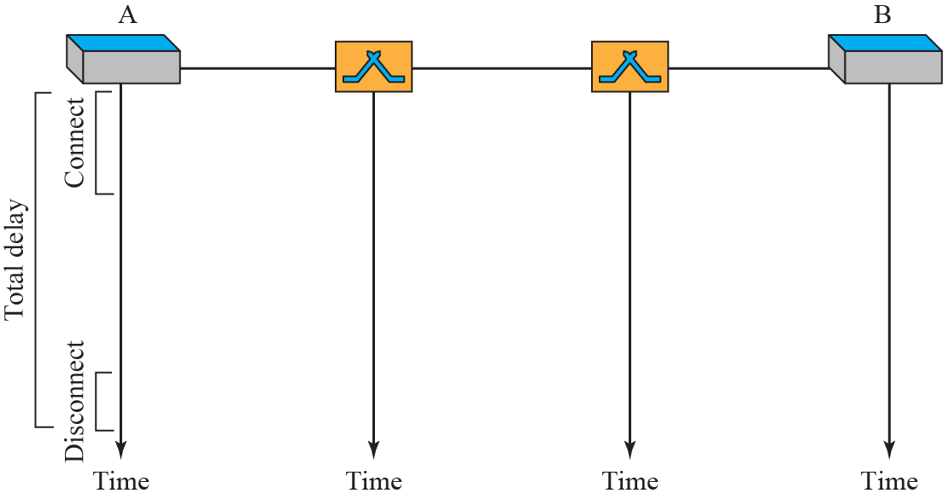
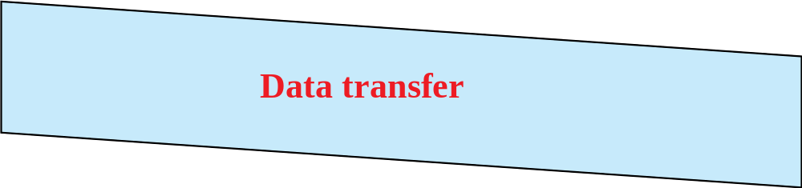
Delay in Circuit-switched Network
Total delay= set up delay +
data transfer delay +
teardown delay

Slide 11
PACKET SWITCHING
In data communications, we need to send messages from one end system to another.
If the message is going to pass through a packet-switched network, it needs to be divided into packets of fixed or variable size.
The size of the packet is determined by the network and the governing protocol.
Categories:
    1. Datagram approach
    2. Virtual-circuit approach

Slide 12
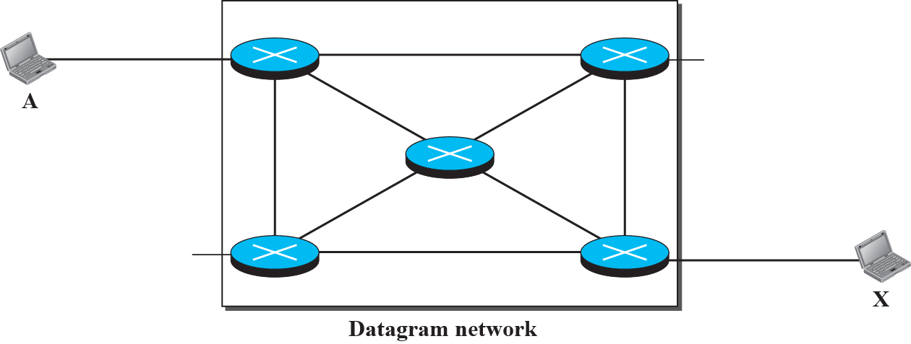






Datagram Networks
In a datagram network, each packet is treated independently of all others.
Even if a packet is part of a multipacket transmission, the network treats it as though it existed alone.
Packets in this approach are referred to as datagrams.
Connectionless networks
Note: No setup and teardown phase

Slide 13
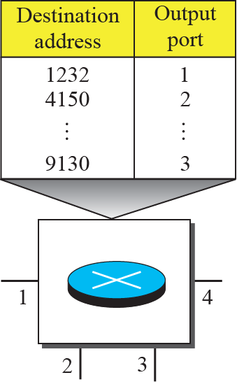
Routing Table in Datagram Networks
No setup phase.
How packets are routed to destinations?

Slide 14
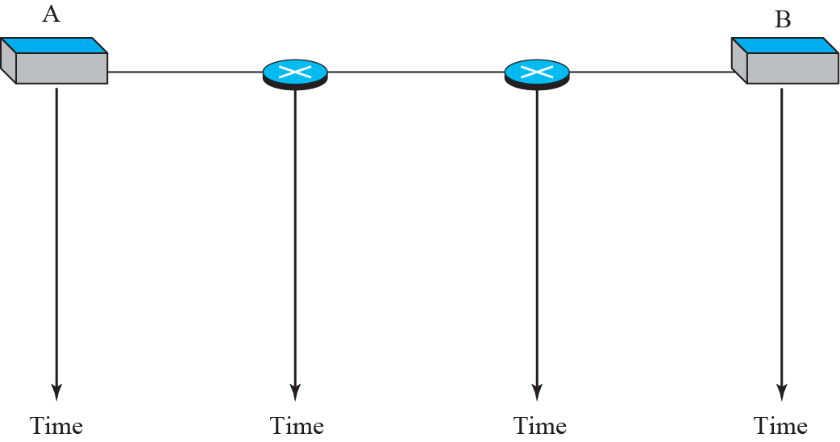




Efficiency & Delay in Datagram Networks
Efficiency is better than circuit-switched networks
Greater delay, waiting time at switch before forwarding, packets may travel through different switches

Slide 15
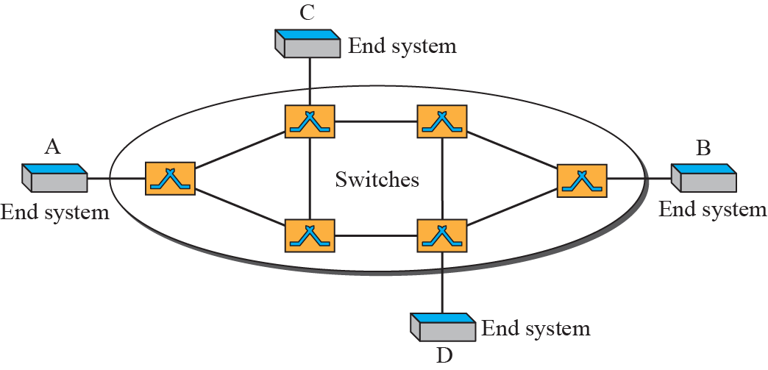
Virtual-Circuit Networks
A virtual-circuit network is a cross between a circuit-switched network and a datagram network.
It has some characteristics of both.
1. Three phases
2. Resource allocation
3. Packetizing
4. Packets follows the same path
5. Implemented in the data link layer

Slide 16
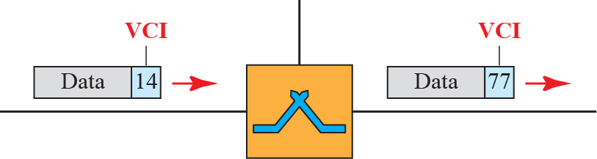
Virtual-Circuit Identifier (VCI)
Addressing: Global and Local (Virtual-circuit identifier)
The identifier that is actually used for data transfer is called the virtual-circuit identifier

Slide 17
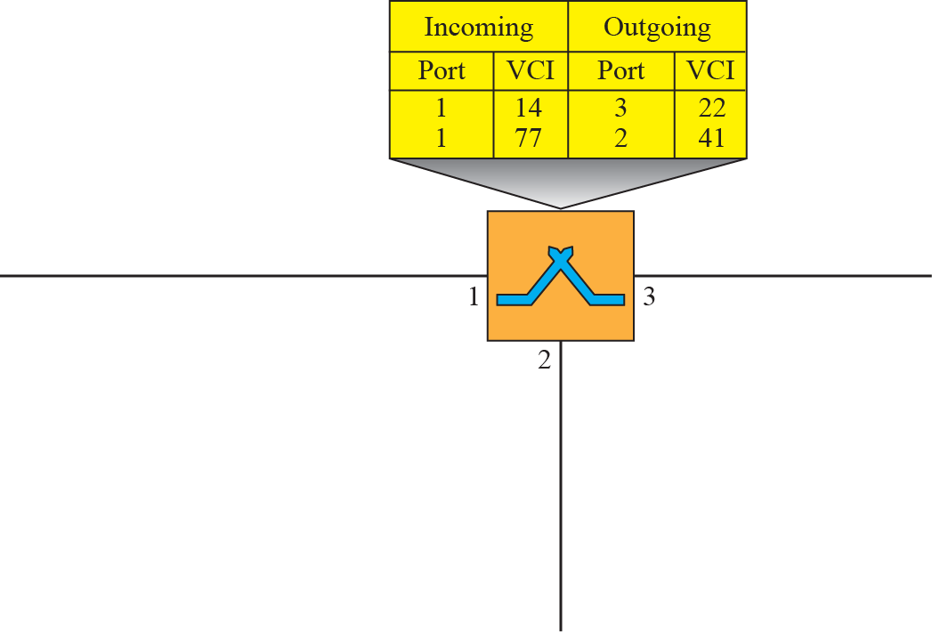



Switch and Table for Virtual-Circuit Network
Three Phases:
Data Transfer Phase
Setup phase: setup request and acknowledgement
Teardown phase

Slide 18
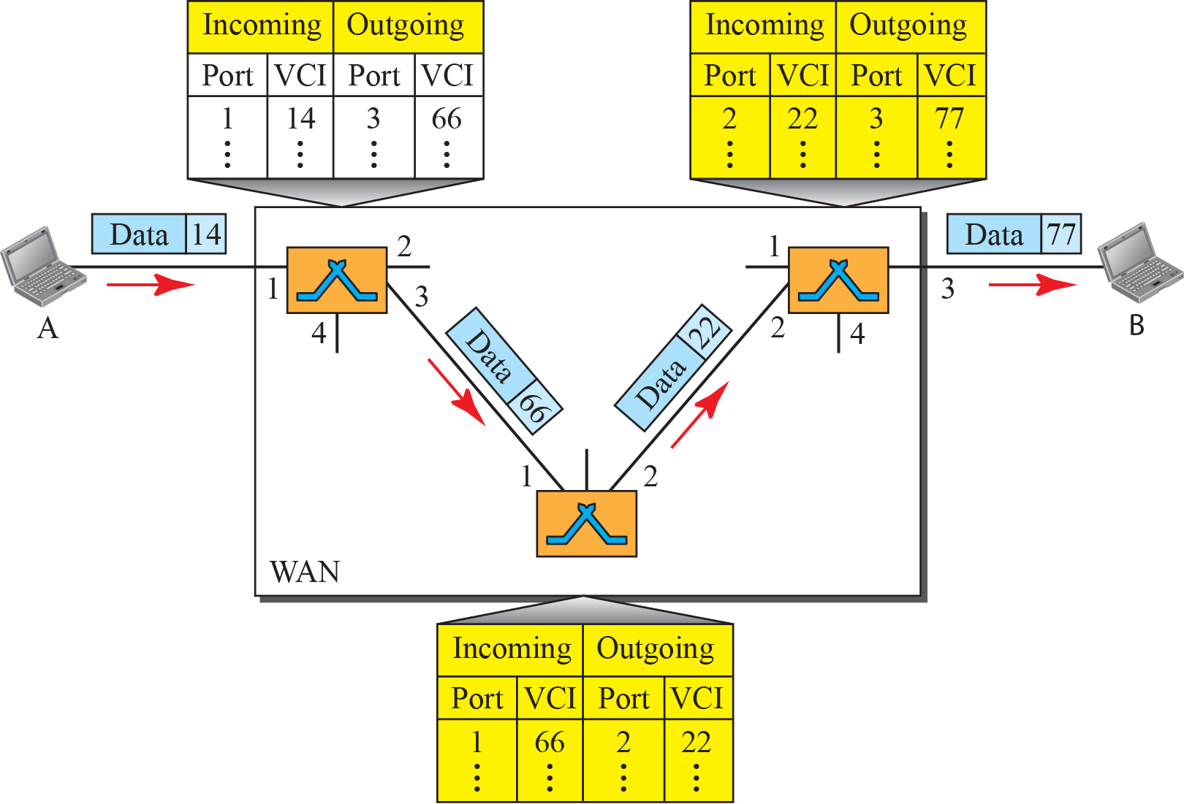
Source to Destination data transfer in virtual-circuit Network

Slide 19
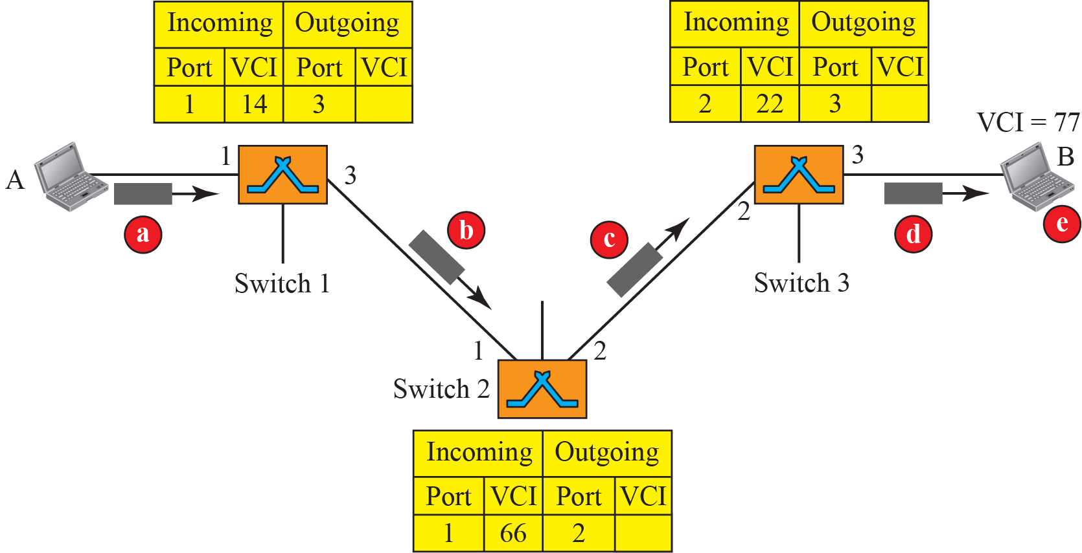
Setup request in Virtual-Circuit Network

Slide 20
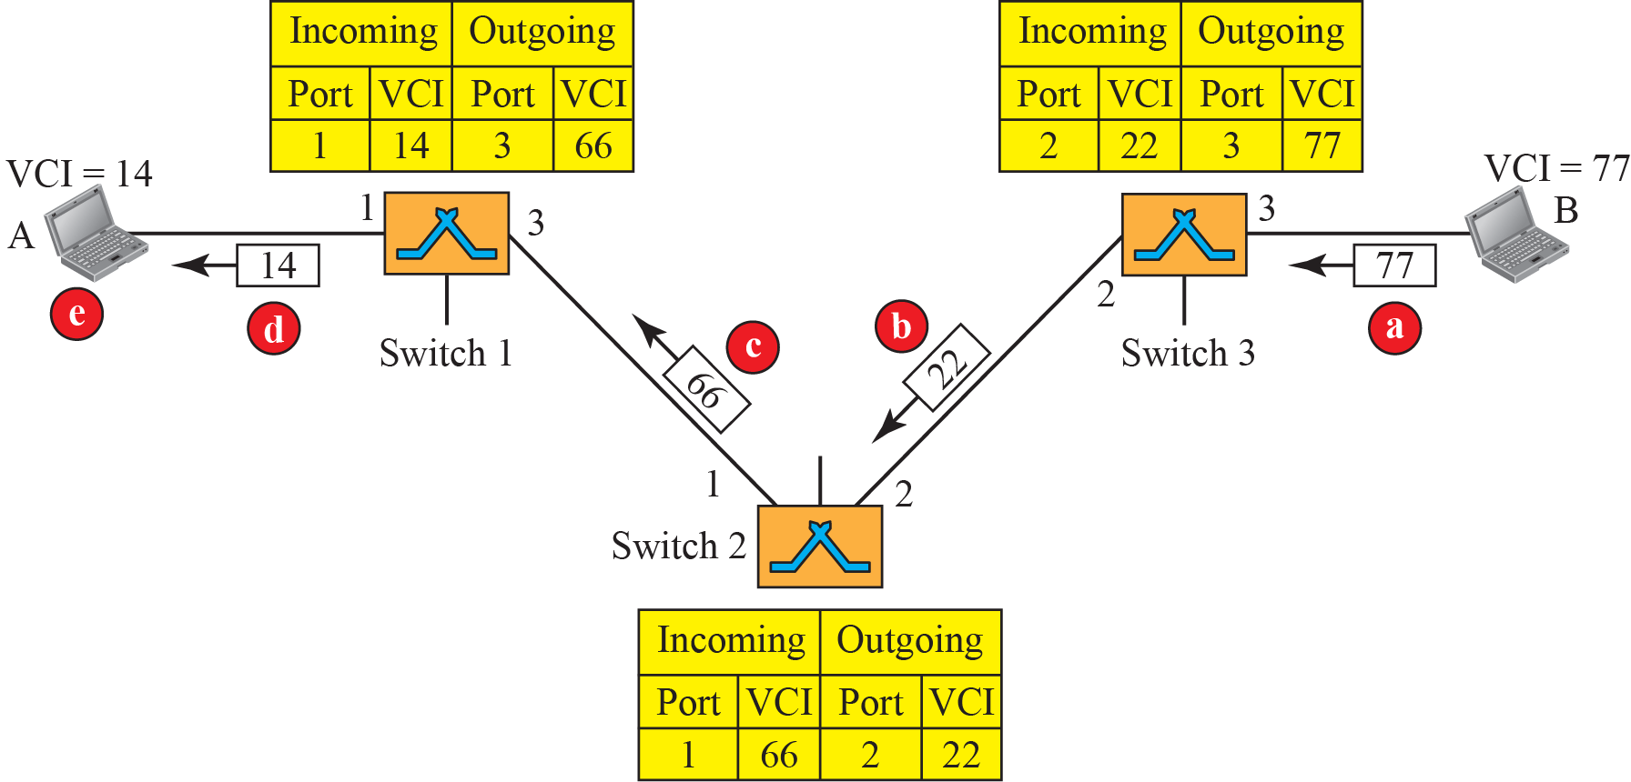
Setup acknowledgement in Virtual-Circuit Network

Slide 21
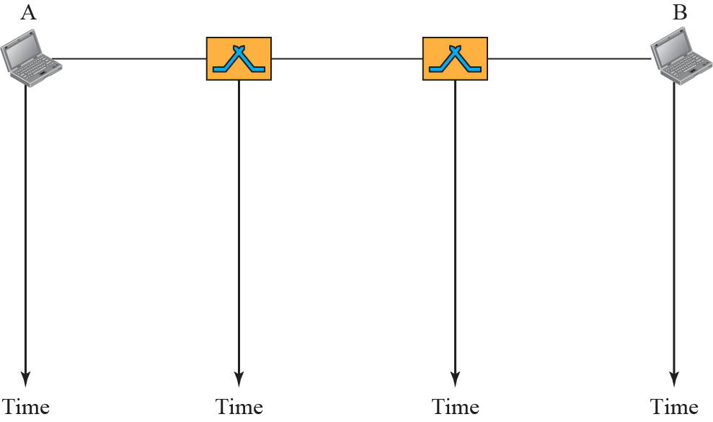


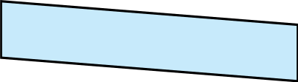

Delay in Virtual-Circuit Network
Resource reservation during setup. Resource allocation is on demand during data transfer.
All packets belonging to the same source and destination travel the same path, but the packets may arrive at the destination with different delays if resource allocation is on demand.
1.<number>

Slide 22
Summary
In this section we have discussed the following:
Concept of Switching
Switching techniques as Circuit, Packet and Message Switching
Notes:
1.#

Slide 23

Notes:
1.#

