Slide 1
Data Mining Course Project
Spring 2015 TA: Bing Li bingli5@asu.edu
Notes:
I will briefly introduce the data mining course project in this presentation

Slide 2
Topic: Classification
You’ve learnt several classification approaches. Now it’s time to use them.
2 datasets: training set and testing set
2 label sets: training label and testing label
2 classes: 1 and 2
You will have the freedom to choose your own tools and algorithms
You can work on your own or form a group. But each group will have AT MOST 2 people from the same session.
Hidden
Predict
Your own
class label

Slide 3
Form your group
If you are working in a group, the size of the group is limited to 2 student;
Working alone and working in group are treated equally;
The deadline for forming a group is March 13th;
You are NOT allowed to form a group with a student from the other session;
By forming a group, you need to make sure you have sent an email to the TA by 11:59PM on March 13th. Any email received later than that will be disregarded and you will work on your own.

Slide 4
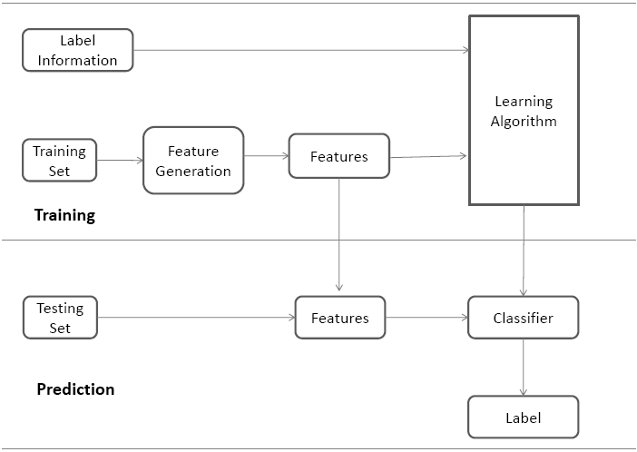
Classification
The prediction is essentially a classification problem
A tricky part is how to do model selection?

Slide 5
Details about the data provided
Provided data
- The training set and its label information
- The testing set
Hidden data
- The label information of the testing data
- The data will be used for the purpose of evaluation

Slide 6
Details about the data provided
Training Set
Training Label
Training Stage
Model
Hidden Info
Testing Set
Testing Stage
Prediction
Testing Label

Slide 7

Data Format
We view a sample / an instance as a row vector
Each entry corresponds to a feature
Corresponds to an instance

Slide 8
Model Challenge from Model Selection
There are so many classifiers
- Which one is better?
Compared to the sample size, the dimension is quite large.
- Will dimension reduction helps improve the prediction? (Dimension Reduction)
There may be parameters in classifiers
- How to determine the optimal values? (Model Selection)

Slide 9
Evaluation
We will use balanced accuracy (BAC) to evaluate the quality of your prediction
- Comparing the hidden labels with your predicted labels
- BAC = 0.5*(TP/P + TN/N)
TP is the number of correct predictions for class 1
P is the actual number of instances of class 1 in the test data set.
TN is the number of correct predictions for class 2
N is the actual number of instances of class 2 in the test data set.

Slide 10
Evaluation
Your final grades will strongly depend on the rankings of the quality of the predicted labels you provide
- Your prediction performance takes 15%
- Your reports take 5%

Slide 11
Submission Deadlines
You can submit your results three times
- March 20th (optional)
- April 3rd (optional)
- April 17th (the final deadline for both prediction labels and reports)
We will give you the feedback within 3 days
- The balanced accuracy
- The current best accuracy

Slide 12
Final Representation
We will invite 5 groups to represent their work at the end of the course (TBD)
- Two groups which make the biggest progress among all submissions
- Three groups which have the highest performance
The statistics of prediction will also be published

Slide 13
Submitted Results
The predicted labels for the testing data
- It is named with LastName-ASUID.txt
- It should have the same format as TrainingLabel.txt
- If you are working in groups, you only need to submit it once
We only accept the results with correct format

Slide 14
Other Information
We do not limit the techniques you use
- You can apply whatever techniques you learnt from data mining course or other courses
I encourage you to submit the results at the optional time
- You can choose better models, parameters, or strategies
- If you do not submit the results, we will not report any results to you
- Our previous experience

Slide 15
Cheating Prevention
You are not allowed to work together with other groups at all!!! No collaborations between groups are allowed.
Can I collaborate with groups from the other session? No!!!
If we see two groups submitting the same result, we will start our investigation process with inspection to your reports and data;
Considering the size of the dataset and the vast choices of models, data pre-processing approaches, and parameter selection combinations for each model, exact same results are highly likely produced from collaborations;
Once the investigation confirms collaboration happening, you will take full responsibility for cheating!!!

