Slide 1

CUSTOMER CHURN PREDICTION

Slide 2
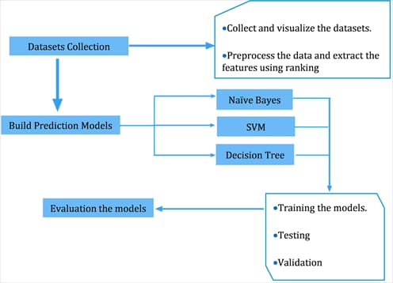

Slide 3

INNOVATION ABOUT THE CUSTOMER RETAIN AND GAINING:-
The main idealogy of the customers to not get left out from the company , we would recognise the insights and outsights functioning of our customers.
We would make the product as well as developed so the customers would’nt get reduced.
The plans and the offers we would suggest to the customers and effectively the company will gain the profit.

Slide 4

MODEL OF DESIGN :-
The objective and the analysis of the customers and the data of them to be collected and analysis upon it.
The visualization strategy belong to creation of dashboard of customers.
As we discussed earlier in phase-1 about the designing of the model on the basis of congos.
The algorithm is made and then the solution we have given for retaining the customers is innovated by the idealogy of profits and understanding the needs of the customers.

Slide 5

Thank you

