Slide 1

PHASE -3 CUSTOMER CHURN PREDICTION
PREPROCESSING AND LOADING THE DATA THROUGH THE HELP OF IBM COGNOS.

Slide 2

Pre Processing

Slide 3

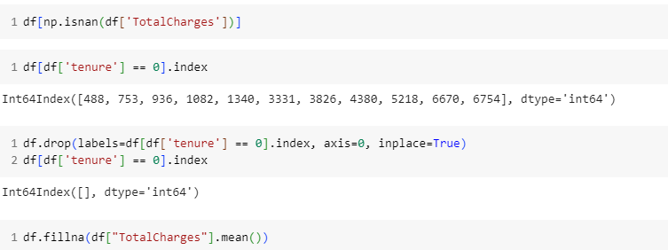
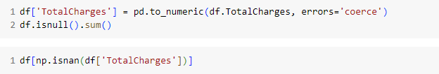
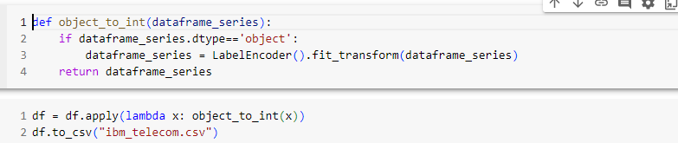
Drop the Customer ID as it is not required
Covert TotalCharges from string to numeric
Drop rows where Tenure is equal to zero
Convert 0 and 1 to Yes and No in Senior Citizen
Label Encode all the required column for the further process

Slide 4

Visualization

Slide 5
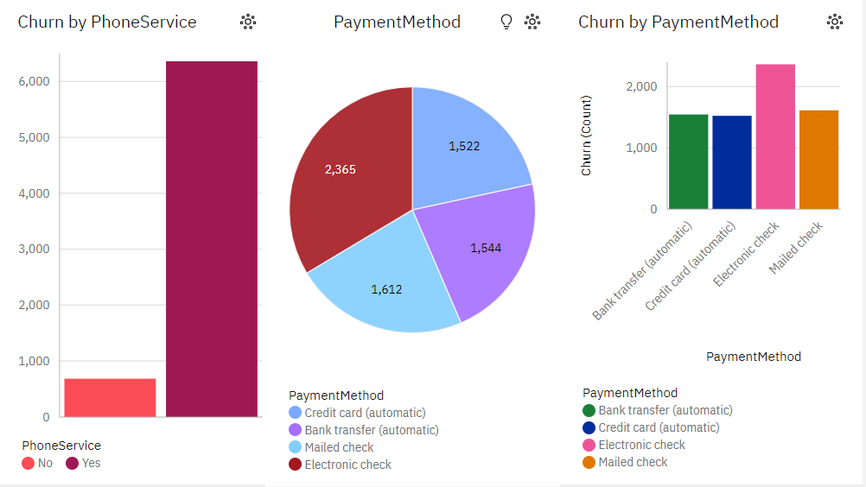
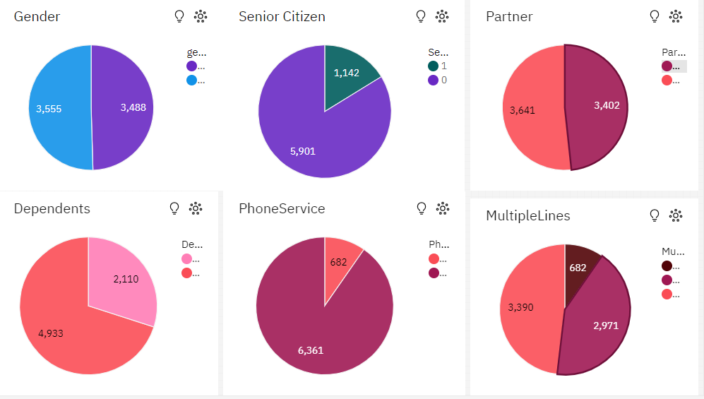

Slide 6
Visualization
Pie Charts
Bar Graphs
Distribution of Customers based on various features
Gender
Senior Citizen
Partner
Dependents
It shows the count of customers in each category
Effect of various features on the churn rate
The most important feature affecting the Churn are “Payment methods” and “Phone Service”.

Slide 7
The phase-3 includes us the concept of pre-processing and cleaning of the data. The analysis of the Telecom company dataset provided. It is done with the help of “IBM –COGNOS” and through the data set which is provided
CONCLUSION

Slide 8
T.H.A.N.K.Y.O.U

