Slide 1
JioCloud Governance
Jan 24, 2020

Slide 2
MOM of Previous Governance Meeting
Action item updates on Microsoft Planner: https://tasks.office.com/ril.com/en-US/Home/Planner/#/plantaskboard?groupId=5c3003f4-b646-4fed-b4b5-2d16bfb827d0&planId=YSG5N-6BzEqZdZXKrQYWEckABAlR

Slide 3
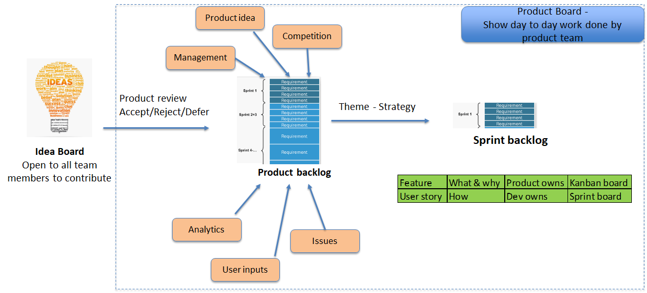
How product feature will be identified & planned

Slide 4
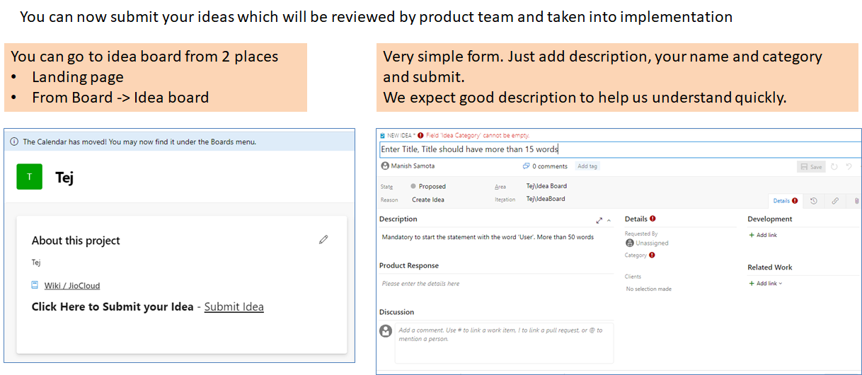
Submit your ideas for JioCloud

Slide 5
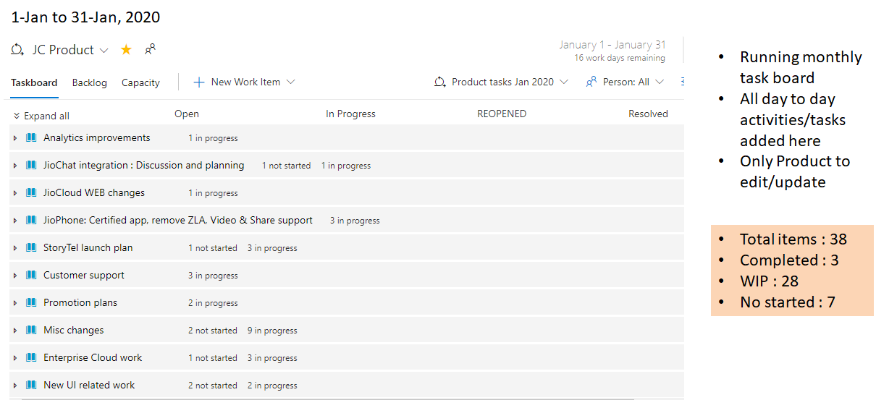
Product task board : what are we doing

Slide 6
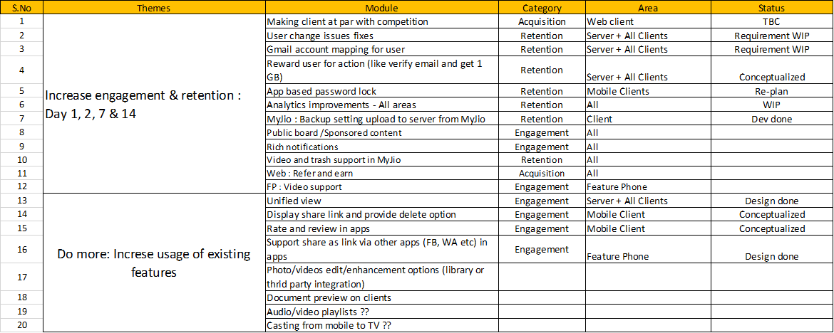
Theme and roadmap

Slide 7
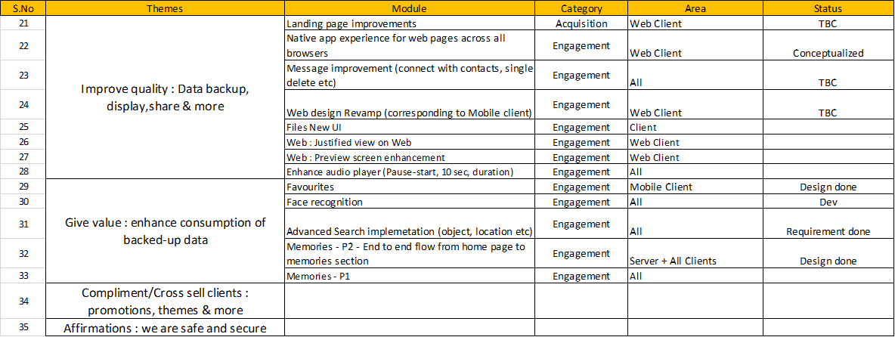
Theme and roadmap

Slide 8
New UI [Files Module] (Azure Epic:56082 )
Feature |  | Grooming (w success criteria & Analytics) | Design | DEV |  |  |  | SIT [Verification] |  |  | PRE-PROD |  | PROD
 |  |  |  | QA Test Scenarios | Milestone 1 | Milestone 2 | Milestone 3 | Milestone 1 | Milestone 2 | Milestone 3 | Regression | Go live Plan | Deploy+ Sanity
New UI Dependencies New UISDK, Partial Swiftification. UDF + Feature SDK implementation Integration with Jio*SDKs. Remaining RnD Items. Stabilization, First Screen-up | iOS | N/A | Dec 6 | N/A | Nov 22 | Dec 6 | Later | 2WK from Build Delivery | N/A | N/A | 1WK from SIT Cert. | N/A | N/A
 | Android | N/A | Dec 6 | N/A | Dec 11 13 | Jan 3 | Later | 2WK from Build Delivery | N/A | N/A | 1WK from SIT Cert. | N/A | N/A
UI + functional Development [Files subsystem] Including Unified View UI 4-5 Engg+ 1 Automation | iOS | Pending | Dec 6 | Dec 23 Dec 27 | Dec 9-13 | Dec 16 to 27* Jan 3 Jan 13 | Jan 6 -17* Jan 14 (kickoff) | Dec 16-20 Dec 26-Jan 3 N/A | Jan 3 Jan 13 – 21 | 2WK from Build | 1WK from SIT Cert.
 | iOS Auto | N/A | N/A | Dec 27 | Jan 6 – Jan 24[New] |  | TBC | Jan 27 –Feb 7 [Existing script update]
 | Android | Pending | Jan 3 | Dec 27 | Jan 14 (kickoff) | Jan 14 (kickoff) | TBC | 2WK from Build Delivery |  |  | 1WK from SIT Cert.
Unified View Core Dev/Update Data source verification and update. . [2 Engg + 1 Automation] | iOS | Done | Dec 20 | Jan 3 | Jan 20-24 | NA | NA | Feb 8 2WK from Build | NA | NA | 1WK from SIT Cert.
 | Android | Done | Nov 27 | Jan 3 | Nov 25-Dec 13 20 25 31 | NA | NA | Dec 27 NA 2WK fr Build | NA | NA | 1WK from SIT Cert.
JSON/ScreenCards API Readiness +Automation |  | Nov 15 | Dec 9 (Dev Ownership) | Dec 20 | Dec 13 Dec 18 | Dec 20 25 30 | Jan 10 | Dec 20 27 Jan 7 One click deploy TBC |  | Jan 17
CICD setup and readiness |  | Oct 25 | Dec 10 | N/A | N/A | N/A | TBC | Dec 06 12 UAT Dec 20 | Dec 20 30 Jan 7 | Testflight Jan 28 | NA | NA | NA
Notes:
Dec N/A
N/A
N/A
N

Slide 9
Contd. New UI [Files Module] (Azure Epic:56082 )
Update since last week:
iOS Milestone 2 build will be delivered for product review by Monday 13th EOD
Android First screen demo with new UI done
CI/CD milestone 2 delivered with automation test case integration.
Done or Started
Automation Test cases for iOS Milestones 1-2 started.
Android Estimations for milestone-1/2 is in progress.
IOS Estimations for milestone-3 is in progress
QA tests cases for iOS and android delivered to dev, team is reviewing in parallel.
Decisions/Open Items:
Analytics, Localization ​[planned in Jan 2nd week]
(yet to receive details from product)
Animations
Catalogue [Dev team will maintain their own.
When ready UX team will share]
UI Layout, Styles [New- Discussion pending]

Slide 10
New UI - Scope & Release Plan (Android & iOS)
Decision Taken on 6th Jan
First release for New UI (for Android & iOS)-ETA - 2nd week of March (9th March-14th March)
Scope for First Release
Live with Files UI only + existing (+)Button
New Tab bar +(+ button)
Contacts +2 + more
With unified view +Home screen (colour+ rounded) + Board only rename to Album
Favourites & share
Pending Tasks (Blocker to give an Estimation for above scope)
Product needs to give dates for analytics & Localization dates @Manish Samota ETA –20th Jan 7th Feb For localization & 24th Jan 7th Feb for Analytics.
Need to give UI for -Intermediate new UI for Home-screen, TAB Bar –Done 9/1 Contact, Album, Settings and More settings –in Progress ETA –7th Feb @Amit Bhopi
There should not be much gap between the release (not more than 4 weeks)
Second release scope includes
Home screen with all changes
Board

Slide 11
Sprint 38 Android & myJio Integrated Plan
Feature | Grooming | Design | Dev |  |  |  | SIT(Verification) |  |  | PRE-PROD |  | PROD
 |  |  | QA Test Scenario | Milestone1 (original scope of sprint 38) | Milestone2 | Milestone3 | Milestone1 | Milestone2 | Milestone3 | QA Regression | Go Live plan & checklist | Deploy & Sanity
Android Sprint 38 -Migration to work Manager, Defect fix, Unified view data creation task | 27-Nov | NA | 28-Nov | 06-Dec 9th Dec Hold (13/12-19/12) 31st Dec (merged with Hotfix) | NA | NA | 16th Dec. 10^{h} Jan | NA |  | 16th Jan | NA (Its tech Task ) | 17th Jan Beta Release on 21st Jan
MyJio Video player +Trash changes ,Device content & upload auto-back up setting | Done | Done | Done | Build to myjio 28-11 | myjio to Jiocloud (only with video player) 29-11 | Build to QA -13th Dec 16th Dec Build to myjio -19^{h} Dec 31st Dec | NA | NA | QA-18th Dec (internal Testing) | Build from Myjio 23rd Dec,31st Dec.. Tested, verified to 2nd Jan | ETA -10th Jan 21st Jan(Beta) | Done
Android Sprint 39 (Scope Yet to freeze) | Pending | Pending | TBD | TBD |  |  | TBD |  |  | TBD |  | TBD
Notes:
Android Sprint –Sprint 38 –Submitted the Build to Infosec on 16th Jan. Awaiting approval.
Myjio Android –Video Player & Trash changes(including web changes) –live for Beta users on 21st Jan
Android Sprint 39 –Account flow grooming done (21st Jan),Public Board grooming pending, Dev team estimating account flow ticket.
Complete | At Risk | On Track

Slide 12
Lead & Cycle time for WEB promotions Cycle time should go down to 2-3 days after Promotion templates are in place
Lead Time
X’mas Promotion (Grooming session to Production)
16 working days
Groom: 29 Nov Prod: 23 Dec
Cycle Time
X’mas Promotion (Dev to Production)
15 working days
Dev: 3 Dec Prod: 23 Dec
Lead Time Xmas
Cycle Time Xmas
Lead Time
New Year Promotion (Grooming session to Production)
21 working days
Groom: 2 Dec Prod: 31 Dec
Cycle Time
New Year Promotion (Dev to Production)
8 working days
Dev: 20 Dec Prod: 31 Dec
Lead Time NY
Cycle Time NY
*Considering - holiday week, parallel QA activity
Notes:
Dec N/A
N/A
N/A
N

Slide 13
WEB Sprint 35
Integrated Plan
Feature | Grooming (w success criteria & Analytics) | Design | DEV |  |  |  | SIT |  |  | PRE-PROD |  | PROD
 |  |  | QA Test Scenarios | Frontend/Client | Backend | Infra | Infra | QA Func. Cert. | 1-click deploy, tests | QA Regression | Go live plan & checklist | Deploy & Sanity
Audio Player Enhancement (Azure feature ID: 56764) Dev: Vishal, Ajay & Pooja | Pre Diwali | Pre Diwali | Dec 25 Jan 6 | Dec 17* Jan 8 Jan 10 | NA | NA | NA | Jan 1 Jan 15 Jan 17 | NA | Jan 10 Jan 24 Jan 28 | Jan 10 Jan 27 Jan 29 | Jan 13 Jan 27 Jan 29
Complete | At Risk | On Track
Update since last week (updates in blue):
Vishal was busy with Trash changes for MyJio in 2nd week of dec and due to SIT unavailobity of SIT for 1.5 day
Due to technical challenges, there is further slippage
Decisions/Open Items:
Final Grooming session done for share suggestion which Pratap had suggested. Sachin to come up with UI estimates by EOD today, 3 Jan
Dependencies/Blockers:
SIT & PP dates are subject to open defects

Slide 14
iOS MyJio Integrated Plan
Feature | Grooming | Design | Dev |  |  |  | SIT(Verification) |  |  | PRE-PROD |  | PROD
 |  |  | QA Test Scenario | Milestone1 | Milestone2 | Milestone3 | Milestone1 | Milestone2 | Milestone3 | QA Regression | Go Live plan & checklist | Deploy & Sanity
MyJio Trash changes | Done | Done | Done | NA | NA | Dec 13 |  |  |  | Dec 16 We have shared the build with Myjio & awating integrated build |  | TBD with MyJio
Update :
iOS Myjio: Trash changes are done and delivered from our side to MyJio team and they have shared integrated build and our testing is also done
Complete | At Risk | On Track

Slide 15
MicroServices – Sprint 43
Major Themes & Deliveries Planned
Sprint 43 Deliverables Planned:
Progress on User Login Issue.
Zero DB Downtime working on SIT.
Board, K8 batch & Promotion performance enhancements.
Face Detection Go live with Web client for internal users.
ScreenCards JSON API additional config options for New UI (localization, themes etc.).
Enterprise Share Functionality, Share enhancement for Web.
Integration & Unit tests, All deployments with automated testing till SIT.
Advanced Search API with Object Tag support (car, dog etc.) available to use by Clients.
Sprint Duration : Jan 13 – Jan 31
Sprint Planning : Jan 09
Sprint Kick Off : Jan 13
Zero DB SIT Certification : Jan 15
SIT Certification : Jan 16
SIT Certification : Jan 20
SIT Certification : Jan 28
PP Deployment : Jan 30
PP Certification : TBD

Slide 16
MicroServices – Sprint 43
Integrated Plan
Complete | At Risk | On Track
Deliverables | Grooming (w success criteria & Analytics) Planning | Design | DEV |  |  | SIT |  |  | PRE-PROD |  | PROD
 |  |  | QA Test Scenarios | Frontend/Client | Backend | Infra | QA Func. Cert. | 1-click deploy, tests | QA Regression | Go live plan & checklist | Deploy & Sanity
Zero DB downtime – Module changes based on User experience | Jan 9 | Jan 6 | Jan 10 |  | Jan 10 | N/A | Jan 15 Jan 20 |  | N/A | N/A | N/A
Performance change for promotion Board migration support | Jan 9 |  |  |  | Jan 24 |  | Jan 28 |  | Jan 30
KT of Streaming MS Transcoding – InfoSec Memory – Analytics improvement, Consumer implementation, MEM DB change | Jan 9 |  |  |  | Jan 10 Jan 24 |  | Jan 13 Jan 16 Jan 28 |  | Jan 17 Jan 24 |  | Jan 22
Board – Height, Width, Orientation batch Jacoco Unit Test Case Framework NMS | Jan 9 |  |  |  | Jan 24 |  | Jan 28 |  | TBD
Login via email OTP User login issue Token validation API – Open for Date Test cases for PBS/USM | Jan 9 | Jan 15 |  |  | Jan 24 Jan 31 |  | Jan 28 TBD |  | Jan 30
Face Detection – Launch readiness, Feedback API, Unit testing | Jan 9 |  |  |  | Jan 24 | TBD | Jan 28 |  | TDB*

Slide 17
MicroServices – Sprint 43
Integrated Plan
Complete | At Risk | On Track
Deliverables | Grooming (w success criteria & Analytics) | Design | DEV |  |  | SIT |  |  | PRE-PROD |  | PROD
 |  |  | QA Test Scenarios | Frontend/Client | Backend | Infra | QA Func. Cert. | 1-click deploy, tests | QA Regression | Go live plan & checklist | Deploy & Sanity
ScreensCard API enhancements unit test case and integration test Valut POC | Jan 9 |  | TBC |  | Jan 24 |  | TBD |  | TBD
Enterprise Share Share enhancements for WEB, auth Enterprise SDK bugfixes | Jan 9 |  | TBC |  | Jan 24 Jan 31 |  | TBD TBD |  | TBD*
NOT – ES Index Promotion batch to update quota Email template check | Jan 9 |  | TBC |  | Jan 24 |  | Jan 28 |  | Jan 30
Enterprise SIT DWN | Jan 9 |  | TBC |  | Jan 24 |  | TBD |  | TBD*
OTG improvement Amiko data cleanup | Jan 9 |  | TBC |  | Jan 10 Jan 17 |  | Jan 13 TBD |  | TBD* |  | Jan 22
p.s. Dates marked * needs another round of discussion and confirmation

Slide 18
JioCloud | One Click Deployment
Phase | Task | Dependency | Completion Date | Status
I | Auto Regression Testing of service end to end. | Devops – To configure CI|CD pipeline Developer – To build test suite and maintain them | Nov 20 29 | DEV and SIT C|/CD with auto test configured and working
 | Quick movement to production for server side impact changes
II | CI/CD based DB patch deployment to handle database level changes | Devops – To configure CI/CD pipeline for DB To configure CI/CD for service group Developers – Make changes to implement read-write services | Dec 20 30 15th Jan | Zero DB Downtime technical changes were successfully done on 24th Dec but live flow was disrupted due to certain api’s being write instead of read.
 | Zero downtime DB deployment with read-only service availability during deployment period
 | Install or rollback of micro service as service group to handle module dependencies
III | Implement single business unit (code + DB patch) for a micro service | Devops – Single pipeline for DB and source deployment DB Eng .– Segregate procedures and function | 10-Jan
IV | Accomplish running of new and existing code in production in parallel without impacting production users Allow alpha, beta testing in production environment without impacting live traffic Live Switch over to new set of API’s. | Devops – Implement A/B testing Production to be on K8s | 7-Feb
V | Implement Canary deployment for new module releases with both new and old code running in parallel in serving live user traffic. | Devops – Implement canary deployment | 10-Mar
Update since last week (updates in blue):
On 13th Jan we will test updated Build with live flow being seamless
Decisions/Open Items:
Will not take service grouping to handle microservice dependencies as part of current phase
Create Test Execution pipeline for PP and Prod so that automation test cases can be executed in PP and Prod
Complete | At Risk | On Track
Dependencies/Blockers:

Slide 19
JioCloud | Performance – K8
Phase | Task | Dependency | Completion Date | Status
I | Run a mixed load test with 1/6 of prod load (per shard per sec load) (UPL + NMS + ABK + DWN + USM) | Devops | 6-Dec | completed
II | One-third of prod load on 2 shards (500 m data set and other new) | None | Dec 13 27 10 17 24 Jan | 1/3rd Endurance Test successfully run for 5 hrs. Test for 8 hrs endurance failed. Frequent DB connection issues. Work in progress.
III | Upgrade java on pods to open jdk Endurance test with system working with 6 hr’s on one-sixth load | None | Dec 08 13 27 17 24 Jan | Sanity completed.
IV | Endurance test with 24 hrs run with PROD ARCHITECTURE with 1/12 of prod load. | Devops | 10 31 Jan 7 14 Feb | Jkass environment for LT has been setup. Sanity checked for microservice completed. OpenJDK java update completed.
V | Endurance test with health check ON | Devops | 17th Jan 7 14 21Feb
VI | One - half of prod load on 3 shard | Devops DB team for shard creation | 31 Jan 7 14 Feb
Update since last week (updates in blue):
1/3rd Endurance failed for 8 hrs.
Observations:
Frequent drop of DB connections.
Decisions/Open Items:
Latest code deployment
Complete | At Risk | On Track
Dependencies/Blockers:

Slide 20
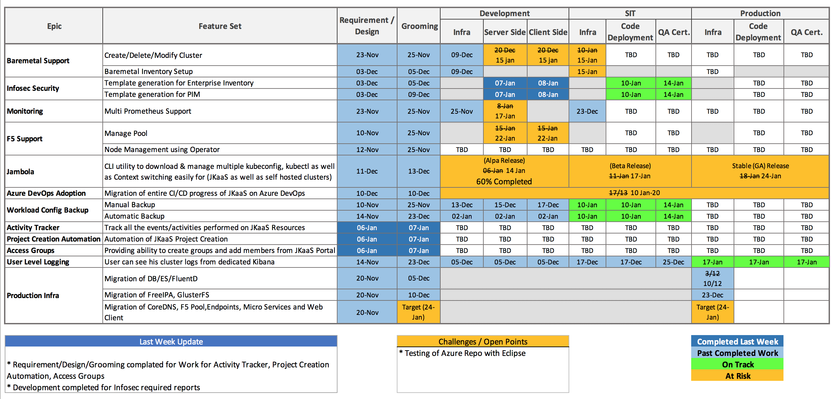
JKaaS

Slide 21
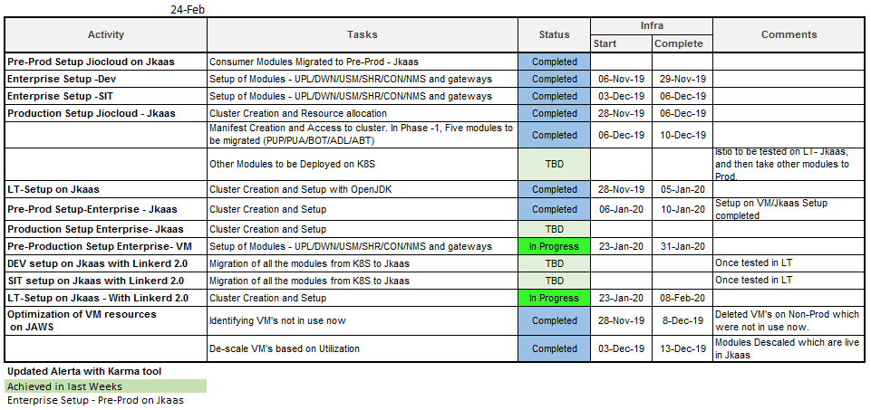
Jiocloud-Infra

Slide 22
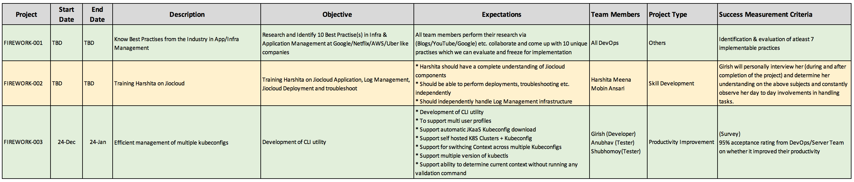
Firework
Kickoff Meeting Planned : 14-Jan
Kickoff Projects Identified

Slide 23
UX
Task Type | Requestor | Owner | Request Date | Status | Delivery Date | Platform
Temp Home screen | Pratap | Laxman | 06/01/2020 | Complete | 09/01/2020 | Mobile
Temp Tab Bar | Pratap | Amit | 06/01/2020 | TBD Product |  | Mobile
Mobile Share Screen | Anuroop | Amit | 2 weeks ago | To do a Tech review |  | Mobile web
Web Share | Anuroop | Amit | 2 weeks ago | WIP |  | Web
Facetag | Manish | Laxman | 31/12/2019 | Complete | 02/02/2020 | Web
Facetag | Manish | Laxman | 02/01/2020 | WIP |  | Mobile web
Animation JSON | DEV | Laxman | 09/01/2020 | Complete | 09/01/2020 | Mobile
MyJio | Anuroop | Amit | 08/01/2020 | Complete | 08/01/2020 | Mobile
Public Board (Storytel) | Dilip | Amit | 09/01/2020 | Complete | 09/01/2020 | Mobile
New Login | Dilip | NA | 09/01/2020 | Not started |  | Mobile / Mobile Web

