Slide 1

SMART INDIA HACKATHON 2026
Problem Statement ID – SIH26021
Problem Statement Title- A block chain-based system for honey traceability and smart beekeeping management.
Theme-Agriculture,Food Tech & Rural Development
PS Category- Software
Team ID- 121588
Team Name – NETHER STACK

Slide 2
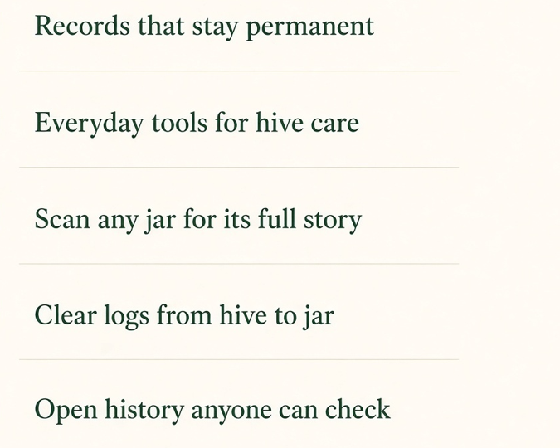
HiveMesh-IDEA
NETHER
STACK
PROPOSED SOLUTION
HoneyChain is a blockchain-based platform that creates a digital traceable record for every honey batch, from:
Hive → Harvest → Processing → Packaging → Distribution → Consumer
IT COMBINES
Blockchain-based traceability
Smart beekeeping management
QR-based batch tracking
Hive & production records
Transparent supply-chain history
INNOVATION
“Every honey batch gets a verifiable digital journey fro hive to consumer”

Slide 3
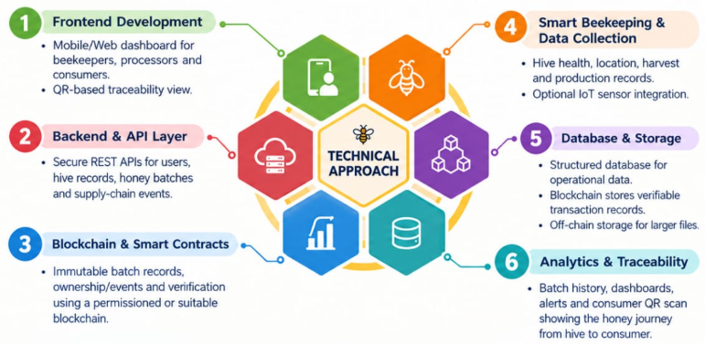
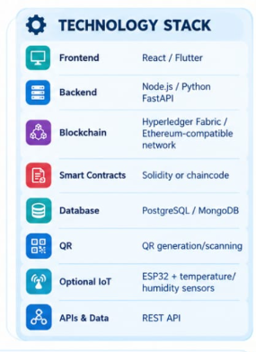
TECHNICAL APPROACH
NETHER
STACK

Slide 4
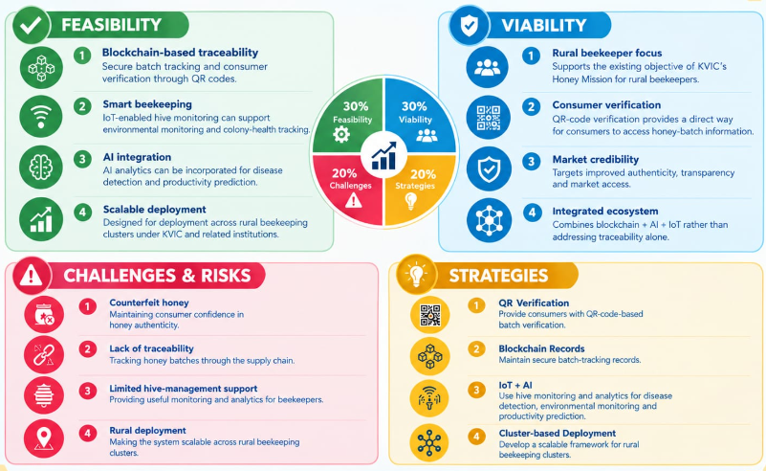
FEASIBILITY AND VIABILITY
NETHER
STACK

Slide 5
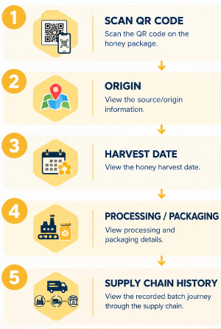
IMPACT AND BENEFITS
NETHER
STACK
Targeted For Beekeepers
Digital hive & harvest records
Better production management Improved visibility of honey batches
Easier record keeping.
For Processors / Distributors Batch-level traceability
Easier supply-chain verification
Reduced dependency on paper records Improved accountability.
For Regulators
Transparent supply-chain records
Easier auditingFaster verification of batch history

Slide 6
RESEARCH AND REFERENCES
NETHER
STACK
KVIC – Honey Mission:
Provides beekeeping training, bee colonies/boxes, toolkits and handholding support to beekeepers.
Blockchain & Food Traceability
KVIC Honey Mission – Government Document⁠
Blockchain-Based Frameworks for Food Traceability: A Systematic Review Foods / MDPI, 2023
Research reviews blockchain, QR codes, IoT and other technologies for food-supply-chain traceability.
Blockchain-Based Frameworks for Food Traceability – MDPI⁠
https://www.mdpi.com/2304-8158/12/16/3026
Smart Beekeeping / IoT:
Intelligent Beehive Monitoring System Based on IoT and Colony State Analysis
Smart Agricultural Technology, 2024 Demonstrates sensor-based hive/environment monitoring and bee-colony analysis.
Intelligent Beehive Monitoring using IoT – ScienceDirect
https://www.sciencedirect.com/science/article/pii/S2772375524001898
Honey Authentication Research:
The Molecular Identity of Honey: Toward Reliable Biochemical Authentication
Trends in Food Science & Technology, 2025
Discusses honey authentication using biochemical techniques, AI and digital traceability technologies.
Molecular Identity of Honey & Authentication – ScienceDirect
https://www.sciencedirect.com/science/article/pii/S0924224425004674

