Slide 1
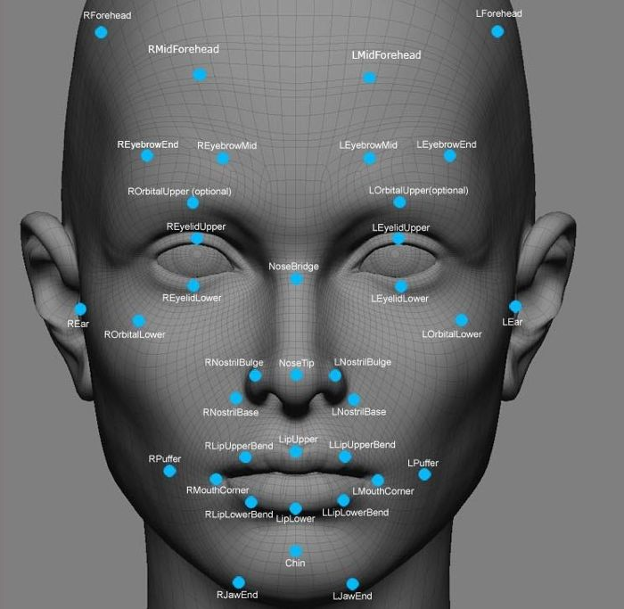

Face Recognition Based Attendance System
Developed by: Mehul Makwana, Vasu Mori, Darshan Maraviya Guided by: Mr. Shrey Shah (Internal) & Dr. Prakash Gujrati (External) Department of Master of Computer Application
April 19, 2025

Slide 2
Project Overview
An innovative approach to attendance management

Slide 3
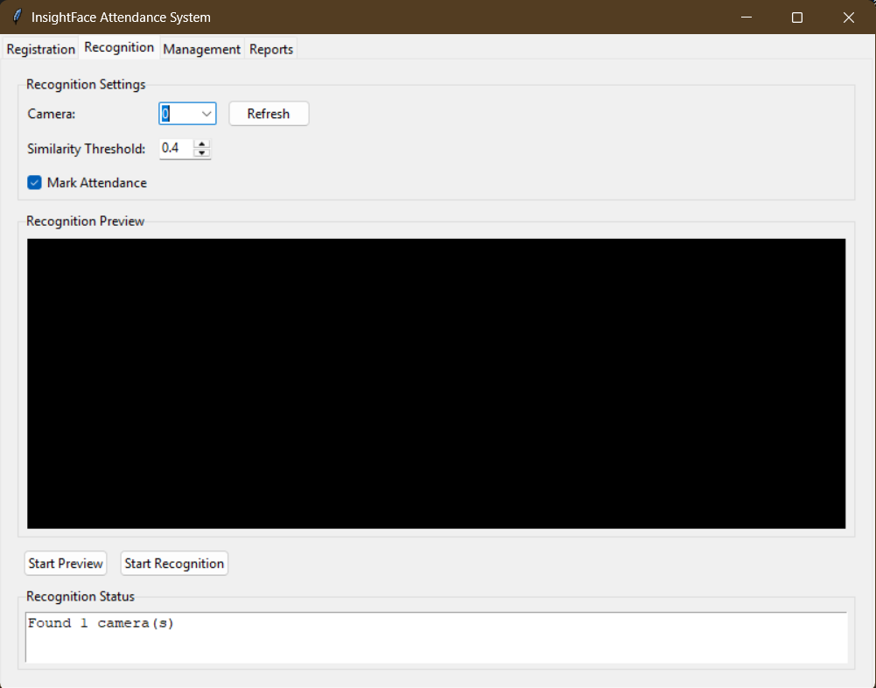
Project Introduction
• An automated attendance system powered by facial recognition technology
• Eliminates manual attendance marking and reduces administrative overhead
• Provides contactless, efficient, and accurate attendance tracking
• Prevents proxy attendance through biometric verification
• Features real-time recognition with comprehensive reporting
• Built on state-of-the-art computer vision and machine learning techniques

Slide 4
Project Objectives
• Automate attendance marking with minimal human intervention
• Implement robust facial recognition for reliable identification
• Ensure physical presence verification to prevent proxy attendance
• Reduce time spent on attendance management processes
• Provide analytics for attendance pattern monitoring
• Create intuitive interfaces for administrators and users
• Design a scalable system to accommodate growing user bases

Slide 5
Technology Stack
Powered by cutting-edge technologies

Slide 6
Technology Stack
Core Technologies
Supporting Technologies
• Python 3.8+ (Core Language)
• InsightFace (Face Recognition)
• Milvus (Vector Database)
• OpenCV (Computer Vision)
• Tkinter (GUI Framework)
• Docker (Containerization)
• NumPy (Numerical Processing)
• PIL (Image Handling)
• CSV (Data Storage)
• Threading (Concurrency)

Slide 7
InsightFace: State-of-the-Art Recognition
• Implementation of advanced deep learning models for face processing
• SCRFD algorithm delivers accurate and efficient face detection
• ArcFace produces high-quality 512-dimensional facial embeddings
• Achieves >99% accuracy on standard benchmarks
• Robust against variations in pose, lighting, and facial expression
• Delivers real-time performance on standard hardware
• Actively maintained open-source project with regular updates

Slide 8
Milvus: Vector Database for Facial Recognition
• Purpose-built for embedding vectors storage and retrieval
• Optimized for approximate nearest neighbor (ANN) search
• Supports multiple index types for performance optimization
• Horizontally scalable for large user databases
• Achieves millisecond-level query responses even at scale
• Efficiently handles the 512D face embedding vectors
• Perfect solution for facial recognition's similarity matching

Slide 9
System Architecture
Designed for efficiency and scalability

Slide 10
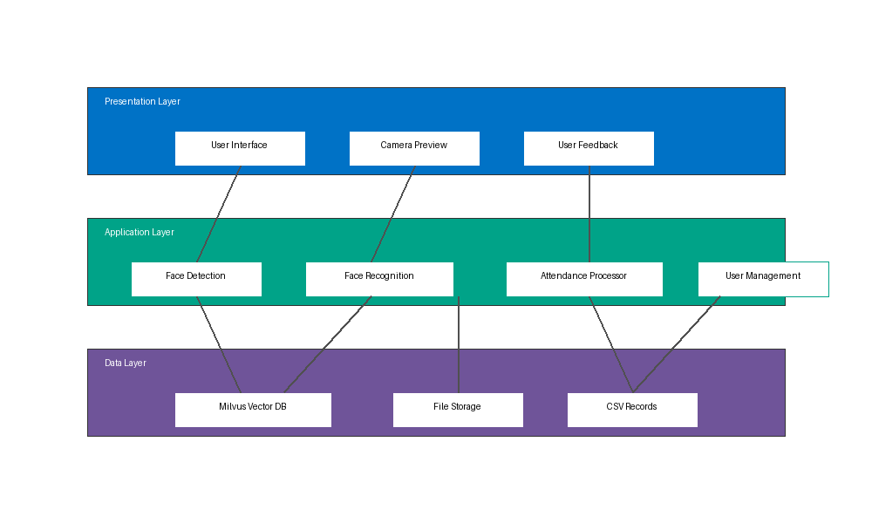
Three-Tier Architecture

Slide 11
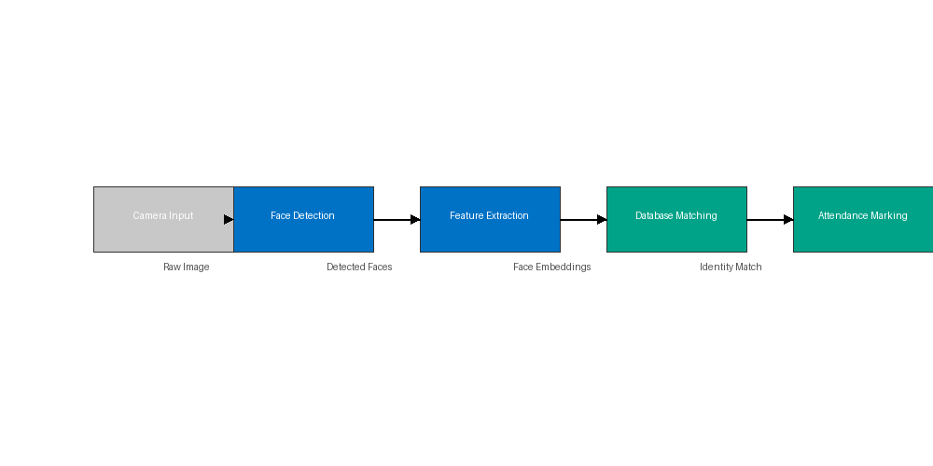
Recognition Process Flow

Slide 12
Database Design
• Vector Database (Milvus)
- Collection: face_datastore
- Fields: id, embedding (512D vector), registration_number, full_name, etc.
- Index: IVF_FLAT with cosine similarity metric
• Attendance Records
- CSV format for compatibility and ease of export
- Daily files with timestamp information
- Fields: ID, Name, Time, Status

Slide 13
Key Features
What makes our system stand out

Slide 14
Core System Features
• Multi-face detection and simultaneous recognition
• Real-time attendance marking with immediate feedback
• User-friendly registration with guided face sampling
• High recognition accuracy (>95% under normal conditions)
• Comprehensive attendance reporting with statistics
• Protection against duplicate attendance entries
• Intuitive user and administration interfaces

Slide 15
User Interface Design
• Tab-based navigation for different functions
• Clean, intuitive control layout for ease of use
• Real-time camera preview with detection feedback
• Visual confirmation of successful recognition
• Status messages with clear action guidance
• Comprehensive attendance reports and analytics
• User management dashboard for administrators

Slide 16
System Performance
Metrics and evaluations

Slide 17
Response time vs. number of registered users
System Scalability

Slide 18
Challenges and Solutions
Challenges Faced
Our Solutions
• Variable lighting conditions affecting recognition
• Multiple faces creating processing bottlenecks
• Database scalability issues with larger datasets
• Privacy concerns with facial data storage
• User acceptance of biometric technology
• Implemented image enhancement algorithms
• Optimized with multi-threading approach
• Adopted vector database architecture
• Store embeddings instead of actual images
• Created intuitive, transparent interfaces

Slide 19
Future Roadmap
Where we go from here

Slide 20
Planned Enhancements
• Mobile application for remote attendance management
• Cloud-based storage for distributed deployment
• Advanced analytics for attendance pattern insights
• Multi-factor authentication options
• API development for third-party integration
• Algorithm optimization for larger user bases
• Mask detection and recognition capabilities
• Multi-language support and accessibility improvements

Slide 21
Conclusion
• Successfully developed a functional face recognition attendance system
• Implemented advanced technologies for optimal performance
• Achieved high accuracy and reliability in recognition tasks
• Created an intuitive and user-friendly interface
• Addressed key challenges in automated attendance tracking
• System is ready for deployment in educational settings
• Established foundation for future improvements

Slide 22
Thank You
Developed by: Mehul Makwana, Vasu Mori, Darshan Maraviya
Under the guidance of: Mr. Shrey Shah & Dr. Prakash Gujrati Head of Department: Dr. Divyesh Gohel Department of Master of Computer Application

