Slide 1
Cash Flow Generation and Valuation of Fixed Income Products
Team Members:
Marco Santana Cruz
Anshumaan Gandhi Sid Joardar
Mehul Mehta
Abhijay Shukla
Zongxin Tian
Yimeng Zhao
Mentored By:
Dr. Wei Chen
Joshua Johnstone
Special Thanks:
Dr. Tao Pang
Dr. John Collison
August 6, 2021
Notes:
Hello all and thank you everyone for joining us today. We will presenting today on the topic of Cash Flow Generation and Valuation of Fixed Income Products. We as a group have covered the pricing of certain Fixed income assets and additionally did some research areas on the applications related to same. Before we begin we would like to give a special thanks to Dr. Wei Chen and Joshua Johnstone for mentoring and guiding us through the project and for their invaluable insights. So without further ado, let’s get into it.

Slide 2
Outline
Overview of Fixed Income Products
Pricing Framework and Valuation of Products
In-depth assessment on TIPS
Research on Inflation Modeling Techniques
Stress Testing of TIPS
Analysis of Breakeven
Conclusion
Further Research
Notes:
So we have divided our project into 2 core aspects. The first part was to build pricing and valuation modules of different fixed income products for SAS analytics that could be integrated with the SAS Asset Liability and Management architecture. In the second part of the project, we have looked into an asset class which has been gathering a lot of interest since the pandemic - Inflation protected securities or TIPS. We tried to look into inflation modelling techniques, stress analysis of TIPS price with respect to interest rates, and breakeven analysis of TIPS yields. “

Slide 3
Pricing Fixed Income Products
Bond Futures
Bond Convertibles
Treasury Inflation Protected Securities (TIPS)
Implementing different day count conventions for each product as user-input.
Implementing adaptive cash flow schedule to account for holidays as user-input.
Implementing different cash flow frequencies and settlement type according to user-input.
Generating economic scenarios as input - for example: forecasting inflation curve.
Generating Cash Flows
Discounting to Present value
Calculating Final Price
Notes:
a major component of our project was to build pricing modules to help value different fixed income products for SAS. We have covered three types of products here. Bond Futures, Bond Convertibles and TIPS. Since these pricing modules are to be embedded within the SAS Asset Liability Management architecture, our objective was to build Cash Flow Generators which would generate cash flows for a given position in a given economic scenario. Thus allowing us to calculate present value of all cash flows during the lifetime of a bond and thereby allowing us to price the product. Additionally our objective was to build the pricing modules as dynamic as possible. As a result we implemented various characteristics of a bond as part of the user input. This allows the user to customize pricing. Such features include - selection of different day-count conventions for accrued interest calculations, cash flow schedule alteration for holidays, selection of different cash flow frequency. Additionally, some features implemented are specific to different fixed income products. I’d like to pass it to Zongxin to explain them in greater detail.

Slide 4
Pricing Frameworks and Their Features
Asset Type | Specific Functionalities | Common Functionalities
TIPS | Forecasting CPI for inflation component of bond | Bond Parameters (coupon, maturity, coupon frequency, etc.) Yield Curve Interpolation methods (i.e. linear, cubic spline) Day-count conventions (ACT/ACT, ACT/360, etc.) Calendar Adjustments to cash flow schedule to account for holidays.
Bond Futures | Settlement Type: Cash/ Physical Bond Basket for selecting CTD bond
Bond Convertibles | Binomial Tree for Convertible Pricing Conversion Calendar
Notes:
As a part of each pricing framework, we had some common functionalities across all fixed income products and some specific functions that had to be input for some specific products. Let’s go over the common features first. Here, we have our basic bond parameters such as coupon rate, coupon frequency, maturity, issue date, etc. We also need allow for the user to input their yield curve and select type of interpolation to calculate discounting rate. Additionally, for calculating accrued interest on payments and settlement dates we allow for the user to select from different commonly used day count conventions. And last but not the least, we account for calendar adjustments on cash flow legs to incorporate holidays. As for the specific functionalities, we implemented a binomial tree for pricing convertibles as well as a conversion calendar allowing user to account for specific callable dates. For bond futures, the user inputs a series of different bond i.e. a basket of bond off which our pricing framework will determine a Cheapest-to-deliver bond and calculate it’s futures quote. For pricing TIPS, inflation is a major component of bond so we need to generate a forecast for consumer price index which provide the user a functionality of the pricing framework itself. For the second aspect of our project we dived into some important questions concerning an asset class which has been recently garnering increasing interest.

Slide 5
Applications of Pricing TIPS
Portfolio Management
Perspective
Varying Economic
Conditions
Managing Inflation Risk
Valuation standpoint: Assets marked to market
Price performance of TIPS w.r.t:
Change in Inflation;
Stressed Interest C rates
Analysis of break- even inflation rate
Notes:
We have looked into some discussions that we thought are of great interest in the present economic scenario and also are an application to the use of our pricing module designed for valuation of TIPS. Before we get into the finer details I’d like to summarise areas of our analysis. An obvious application to building a pricing module is the benefit it provides from a valuation standpoint to a portfolio manager. Pricing allows to efficiently mark your assets and can be further extended into calculating important information about a bond such as it’s duration and convexity. We tried to take an approach to this by assessing price performance of TIPS using our valuation framework to see how TIPS prices change with different inflation rates and different interest rates as well. Specifically, we try to simulate interest rates for the next year and try to come up with a modest analysis to the price performance of TIPS in stressed markets. Lastly we will cap off our discussion with breakeven rate analysis which we believe is an interesting discussion in the present time and an important piece of information for a fixed income investor. I’d like to now pass it to Yimeng to give you an overview of TIPS as a fixed income product and walk you through our pricing methodology.

Slide 6
TIPS: Characteristics
Particulars | Treasury Inflation Protected Securities (TIPS)
Principal Payment | The principal adjust with inflation/deflation.
Coupon Payment | Applied to the adjusted principal with semi-annual payments.
Convexity | Less convex than Treasury bonds.
Inflation | Impacted by real inflation.
Liquidity | Less liquid than Treasury bonds.
NOTE:
1. TIPS yield tends to be lower because the principal values of TIPS adjust with the level of inflation.
2. TIPS market is significantly smaller than Treasury market, so the prices are sensitive to supply and demand dynamics.
Notes:
So as the name suggests TIPS are designed to provide an investor protection against inflation. They do so by adjusting the principal on the bond with respect to inflation. They pay coupons in the same fashion as treasury bonds, i.e. semi-annually. To account for the inflation component we make use of of the CPI index. The principal in the bond adjusts with respect to the changes in the CPI index. Inherently, TIPS are less convex than treasuries since the volatilities associated with interest rates are higher than the volatilities associated with TIPS rates. Also treasury markets are larger in size than TIPS markets hence there is a liquidity risk associated with TIPS as well which is higher than that of nominal treasuries. Now, that we have the a comprehensive overview of TIPS lets look at the pricing framework for TIPS in greater detail.

Slide 7
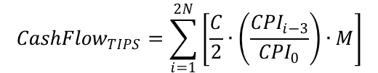



TIPS Pricing Framework
Cash Flow from Coupons:
Pricing equation
Pricing equation
Pricing equations
Pricing equations
Pricing equation
Input variables
Accrued interest:
Output variables
Given Values:
Coupon rate,
Bond price,
Quantity,
Interest rate,
Derived yield
Values: CPI index
Cash flow
Bond price
Payment at maturity:
Price at Settlement:
Note: All Cash Flows are undiscounted here.
Notes:
In case of TIPS pricing we have essentially 3 components - Cash flow from coupons, cash flow from balloon payments at maturity, and accrued interest. For coupon payments we already saw that they occur generally on a semi-annual frequency. What is key to note here is that coupon is paid on adjusted principal. We adjust the principal by taking the CPI ratio. TIPS generally work on a lagged CPI value and we calculate CPI ratio by taking the 3 month prior index value and it’s ratio to the CPI value at time of bond issue. Accrued interest is simply with respect to calculating interest accrued to bond holder between two coupon dates until the time of settlement and hence we subtract it from the cashflow sum when calculating final price. For balloon payment at maturity, we need to take the maximum value from original principle and principal cash flow. As we can see from this a big part of pricing here is the CPI index which will be a forecast as we have to get CPI values for future dates as well. While the industry standard is to use a fixed rate of inflation based on historical data, we as a group have also worked on some inflation modelling tool to better explain it’s behavior and get some predictive insights. I’d like to pass it to Mehul to take us further with that.

Slide 8
Inflation Modeling: SARIMA
Seasonal Auto Regressive Integrated Moving Average (SARIMA)
Seasonal P and p stands for Auto Regressive
Terms Used
p: Trend autoregression order
P: Seasonal autoregressive order
d: Trend difference order
D: Seasonal difference order
q: Trend moving average order
Q: Seasonal moving average order
AR uses the relationship between Observation & Lagged Observations
Seasonal D and d stands for Integrated
I is called differencing that converts non stationary data into stationary
Seasonal Q and q stands for Moving Average
MA uses the dependency between Observation & Residual Error
Notes:
Thank you Yimeng. Now I will talk about Consumer Price Index which is one of the most important component that goes into TIPS Pricing. So to give you a brief, The Consumer Price Index is a measure of the average monthly change in the price for goods and services paid by urban consumers between any two time periods. To predict the Consumer Price Index, we used 3 different models i.e., SARIMA Model, Vector Autoregressive Model and Geometric Brownian Motion. To give you a brief of the 1st model, SARIMA models is nothing but an ARIMA models with a seasonal component. The model ‘explains’ a given time series based on its own lagged values and the lagged forecast errors. SARIMA has 3 components to it i.e.,p and seasonal P which indicate number of autoregressive terms; d and seasonal D that shows the differencing that must be done to stationarize the time series; q and seasonal Q tell about the number of moving average terms.

Slide 9
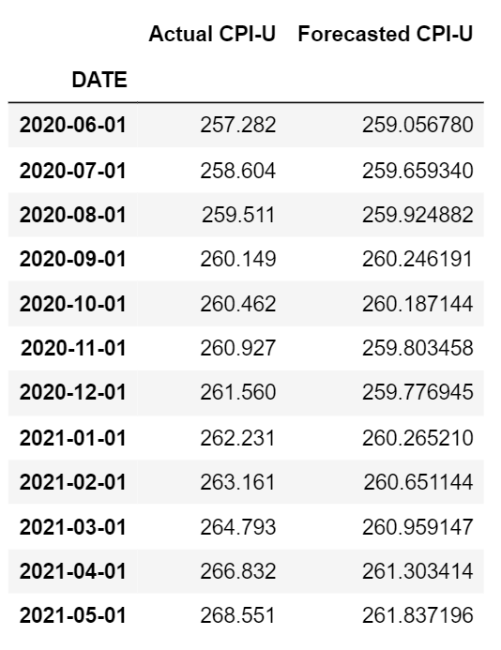
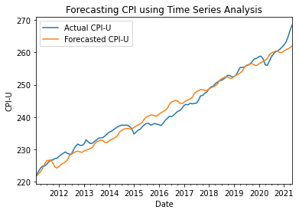
SARIMA Results
SARIMA(2, 1, 0) x (4, 1, 0, 12)
Error Metrics | Value
Mean Error | -0.21
Mean Absolute Error | 1.72
Root Mean Squared Error | 2.10
Notes:
We tried and tested different AR and MA components in the SARIMA Model and selected the best model based on AIC and BIC values. So, we trained the model from 1971 to 2010, and then used the trained model to forecast the values from the year 2011 to 2021. In the figure, it can be seen that the SARIMA model did a good job in predicting the inflation. To check the accuracy, we used different parameters such as Mean Error, Root mean square error. The low value of rmse signifies that the model did a good job in predicting the CPI values. Now, I will pass it to Abhijay to discuss about the Vector Auto Regressive Model.

Slide 10
Inflation Modelling : Multivariate Approach
Factors Affecting CPI
Proposed Model
(Multivariate)
Macroeconomic Factors:
Linear Regression
Time Series (VAR)
Money supply
Disposable income
Interest rate
Oil price (WTI)
Production price index
Unemployment rate
Pros:
Dependency of CPI on multiple factors.
Cons:
Difficult to predict the independent variables
Non-linear relationship between dependent & independent variables
Pros:
Interdependence within the variables.
Simple to predict future values based on past values.
Captures trends/ seasonality in the data.
Notes:
As Mehul has shown that how the CPI can be forecasted through time-series (ARIMA) modelling, but here I am presenting a slightly different methodology to forecast CPI index.
We all know that CPI is nothing but the wide range of goods and services purchased by consumers. While overall demand for all these products is not likely to fluctuate wildly—although the specific products that consumers purchase can vary significantly under different economic conditions: In dynamic economy there is no single cause of inflation. Here to capture some of the economic conditions considering that might impact the CPI inflation in some or the other way.
We checked Multivariate linear regression model but the we faced difficulty to predict each of the dependent variables.
Further, our team has discovered about the VAR model, The VAR model has proven to be especially useful for describing the dynamic behavior of economy and to forecast the CPI.
As my colleague Mehul has already given you all the brief about the working of time series, so here in VaR model,
There were 2 major Add Ons:
1: it incorporates multiple factors (same as multivariable regression),
2. the target variable is dependent on the lagged values of other variables in a linear form, same as Linear regression.
On the next slide

Slide 11
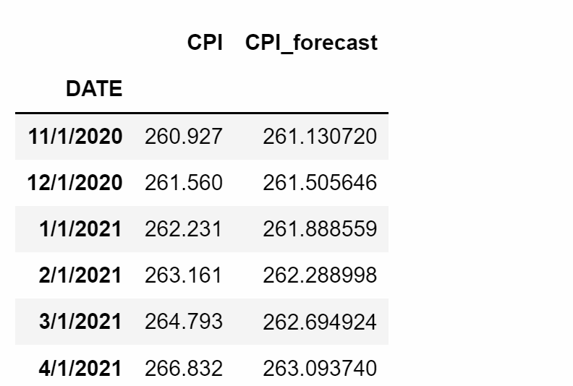
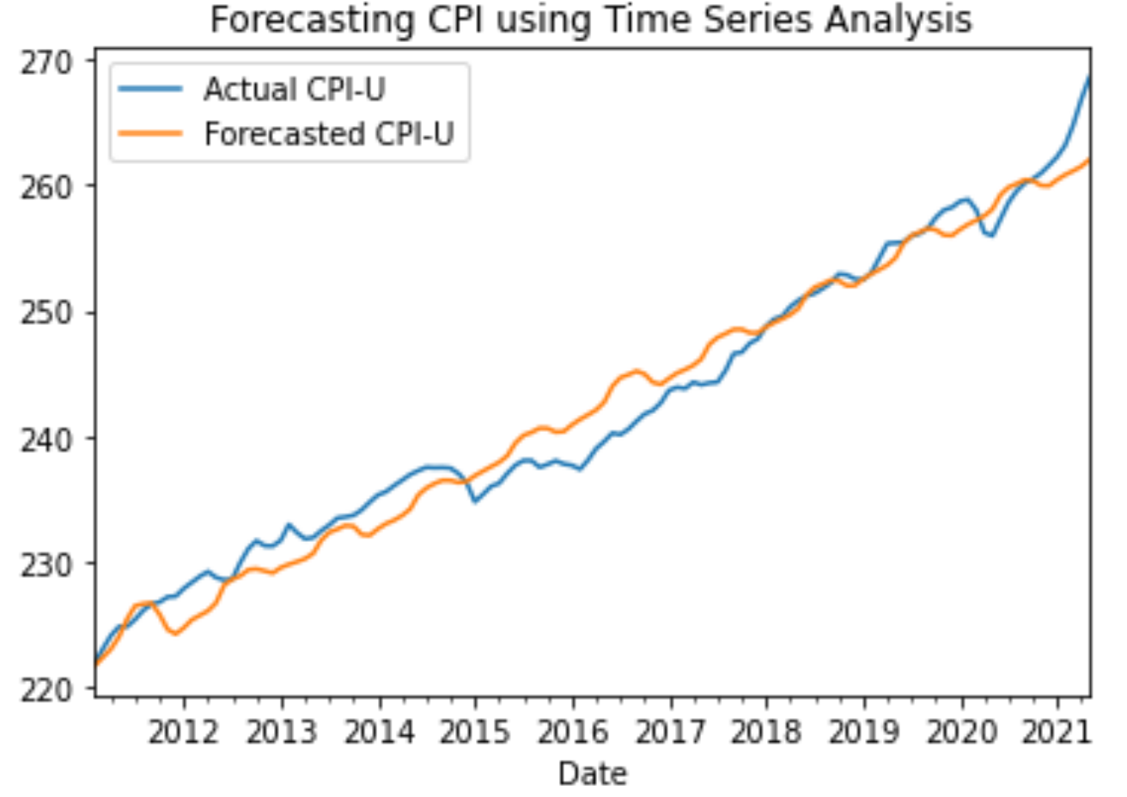
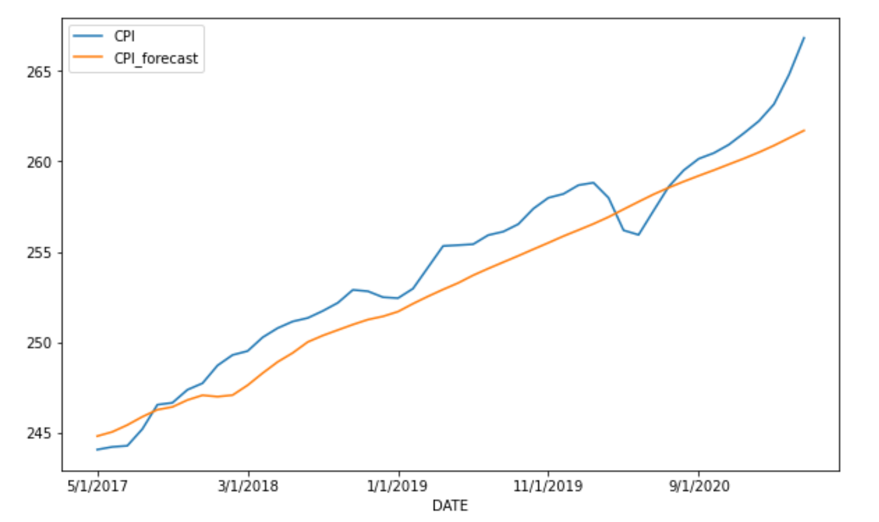
VAR Model Results
Error Metrics | Value
Mean Error | -1.24
Mean Absolute Error | 1.55
Root Mean Squared Error | 1.77
Notes:
Here on the left side, the graph shows the forecasting values on the test datasets and original values for the same data. The values are very close for the complete periods but only it didn’t perform well during the COVID times. The reason is that the model is not well prepared for these shocks and there were some unexpected changes in macroeconomic factors. But overall the model performs well with MAE 1.55%. Now I’ll pass on to Sid, to show impact of CPI on TIPS.

Slide 12

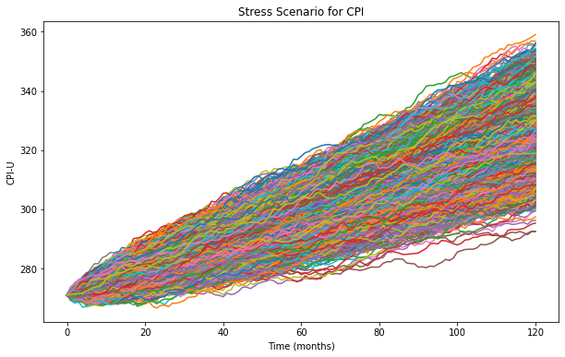
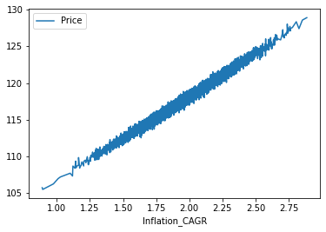
Inflation Modeling: Geometric Brownian Motion
GBM :
Simulated Scenarios of CPI
Effect of CPI on Bond Price

Slide 13

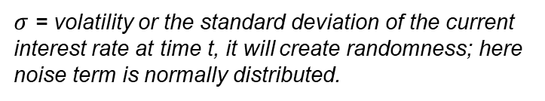
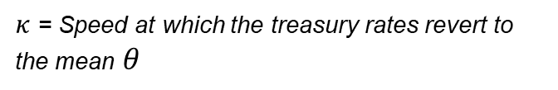



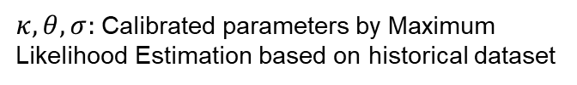
Interest Rate Modeling: Vasicek Model
Equation:

Slide 14
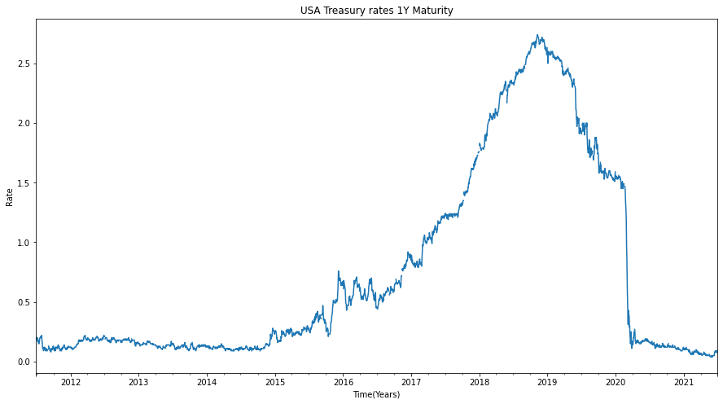
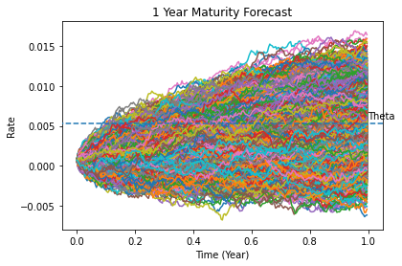
Vasicek Model Results
US Treasury historical Rate (1Y Maturity)
Simulated Interest Rate Paths

Slide 15
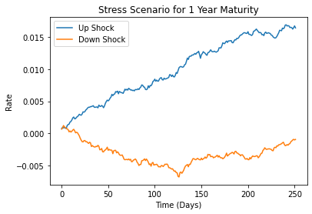
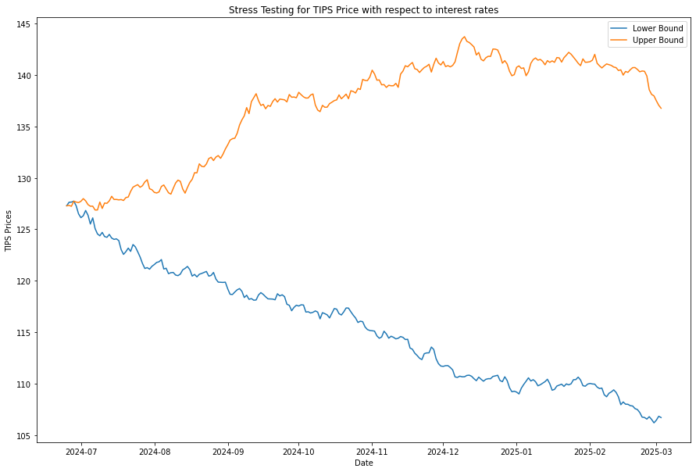
Stress Testing Of TIPS
Selecting Extreme Scenarios
Effect of Extreme Scenarios on Price

Slide 16
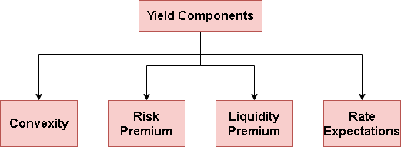
Analysis of Breakevens
Breakeven rates are a crude measure to gauge inflation expectations.
It is calculated by the difference between the yield for nominal treasuries and real yield of TIPS.
Inflation rate less than a breakeven rate generally denotes real inflation to be less than market expectations and vice versa.
Extremely useful from a portfolio management/ investor standpoint.
Breakeven Rate = Yield (Nominal) - Yield (TIPS)
Notes:
Breakeven rates are a crude measure to gauge inflation expectations. We have calculated breakeven rate by calculating the real yield on TIPS and subtracting it from the nominal treasury yields. These breakeven rates show the expected path of inflation and is observed by market participants. In general sense, if the inflation rate in reality is higher than the breakeven rate, then TIPS would outperform in such a scenario as expected inflation would be underwhelmed by the reality in that case. On the other hand, if the real inflation comes out ot be less than the breakeven rate, then TIPS in this scenario would underperform the nominal treasuries. What our breakeven analysis lacks is it calculates directly from yields of the bonds but we do not consider the liquidity premium or risk premium associated with these assets. In general though however crude, breakeven rates are a useful tool to assess expectation of inflation on the market and gauge the trend of expected inflation. This helps us as an investor to better the decide the allocation between TIPS and treasuries on a bond portfolio.

Slide 17
Conclusion & Further Research
Conclusions:
Assessing price performance in varied economic conditions.
Assessing value and price of individual assets in a fixed income portfolio.
Aid in risk management and portfolio management decision making.
Further Work:
Vasicek simulations are computationally expensive. Alternative - PCA.
Quantify other factors which affect yield calculations in breakeven rates.

Slide 18
Questions

Slide 19
Appendix

Slide 20
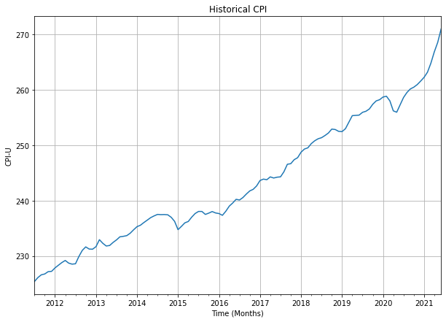
CPI MODELING: GEOMETRIC BROWNIAN MOTION
Assumptions:
1. CPI follows GBM.
Input Parameters:
Mu: Last 10 years
Sigma: Last 10 years
St: CPI as of 6/2021

Slide 21
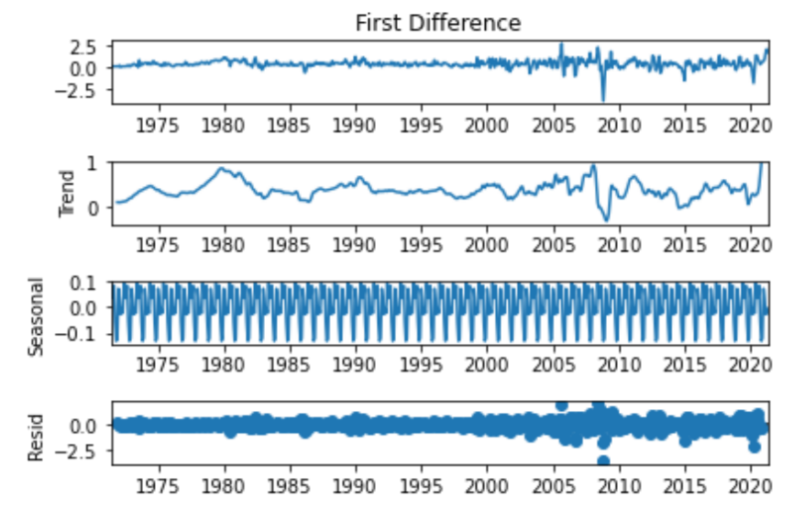
SARIMA Results

Slide 22
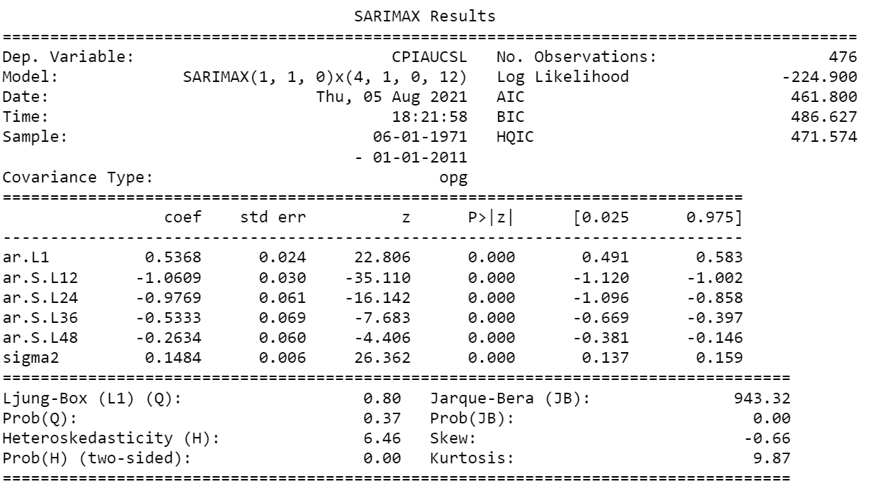
SARIMA Results

Slide 23
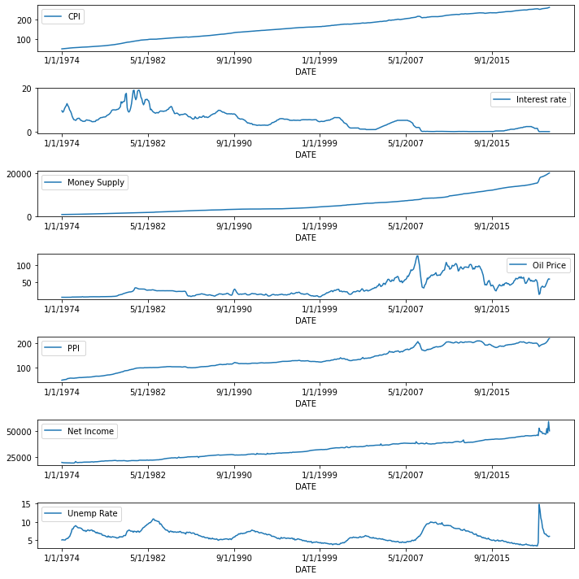
Economic Parameters

