Slide 1
SCOA Mini-Project Air Conditioner Controller using MATLAB Fuzzy Logic Toolbox
By :
Mehul Solanki ( BECOB260 )
Vikrant Wyawhare (BECOB271)

Slide 2
Air Conditioner
Intelligent air condition system using fuzzy logic that it maintains the temperature and humidity so that it is comfortable at all times.
No need to change the temperature manually.
Efficient and saves power.

Slide 3
Non-Fuzzy Approach
If temp = 30 and Humidity = Medium then temp = 26
If temp>30 then then temp = 24
If temp = 22 and Humidity = Low, then temp = 28

Slide 4
Fuzzy Approach
If (Temperature is low) and (Humidity is low) then (output is warmer)
If (Temperature is high) and (Humidity is high) then (output is cooler)
If (Temperature is medium) and (Humidity is high) then (output is same)

Slide 5
Input Parameters
Parameter | Status | Unit
Target temperature | Very Cold, Cold, Warm, Hot, Very Hot | 16 to 32 degree Celsius
Actual room temperature | Very Cold, Cold, Warm, Hot, Very Hot | 16 to 32 degree Celsius
Humidity | Dry, Refreshing, Comfortable, Humid | 10% to 70%

Slide 6
Output Parameters
Parameter | Status | Unit
Fan speed | Minimum, Slow, Medium, Fast, Maximum | 16 to 32 degree Celsius
Compressor speed | Minimum, Slow, Medium, Fast, Maximum | 16 to 32 degree Celsius
Fin direction | Away, Towards | 10° (towards user) 80° (away from user)
Operation | Air Condition (AC), Dehumidifier | -

Slide 7
Membership Function Used
Triangular Membership Function
Gaussian Membership Function
Trapezoidal Membership Function

Slide 8
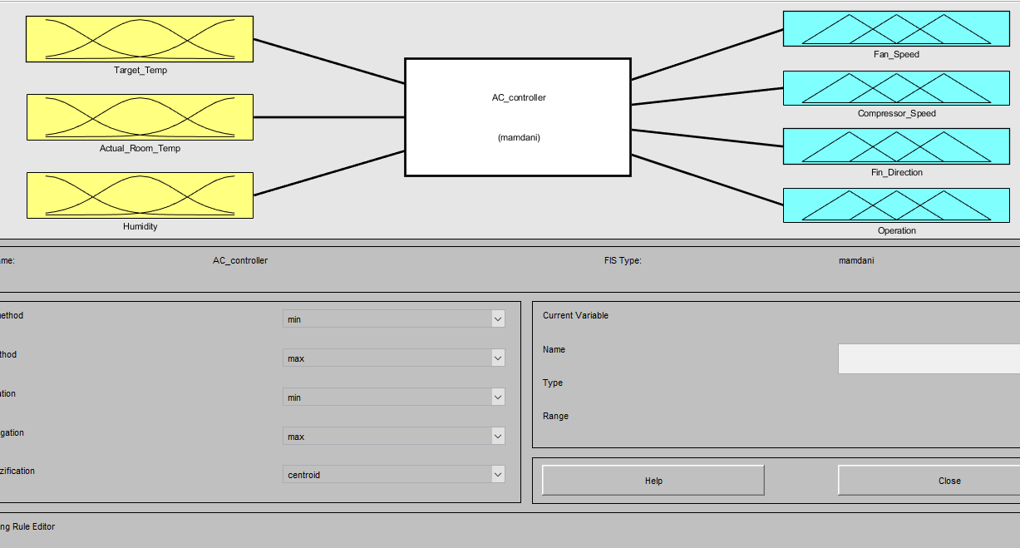
1. Fuzzy Logic Designer

Slide 9
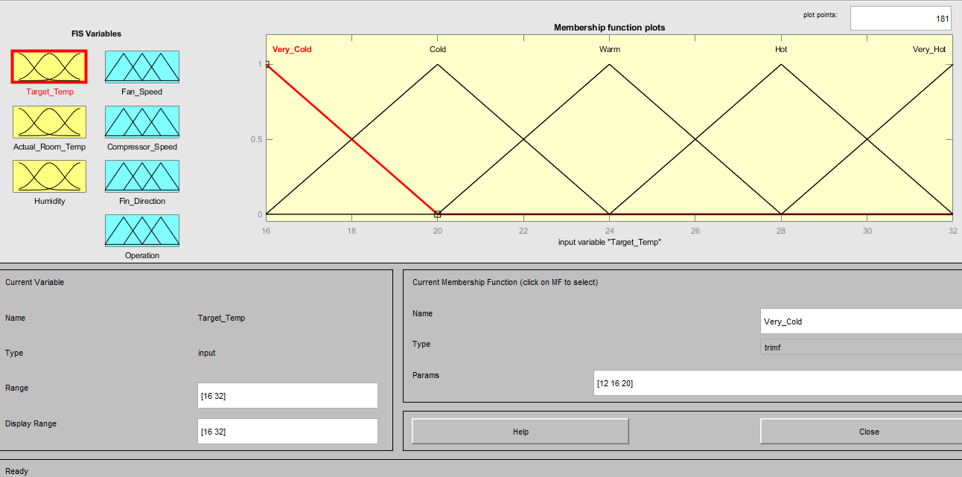
2. Membership Functions

Slide 10
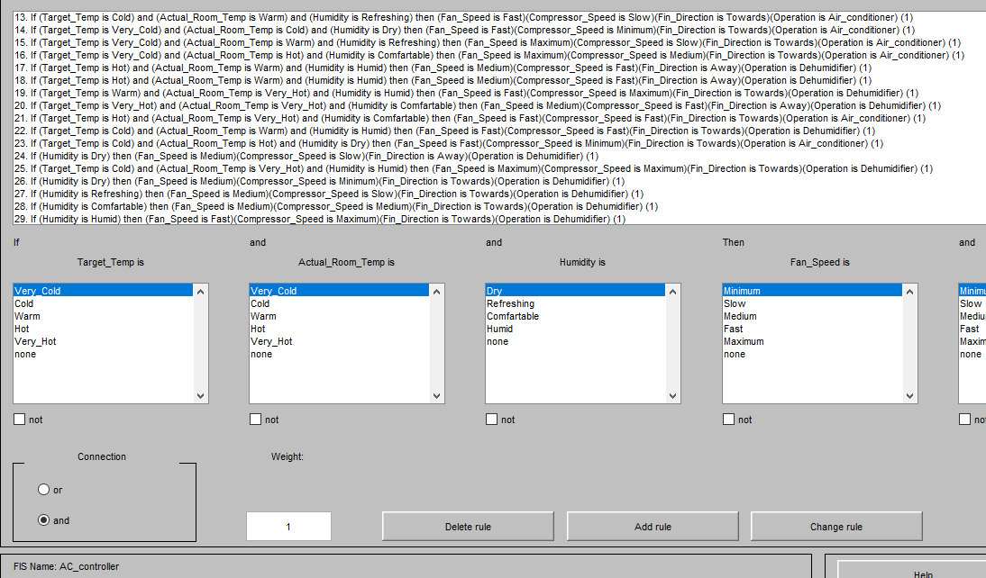
3. Fuzzy Rule Editor

Slide 11
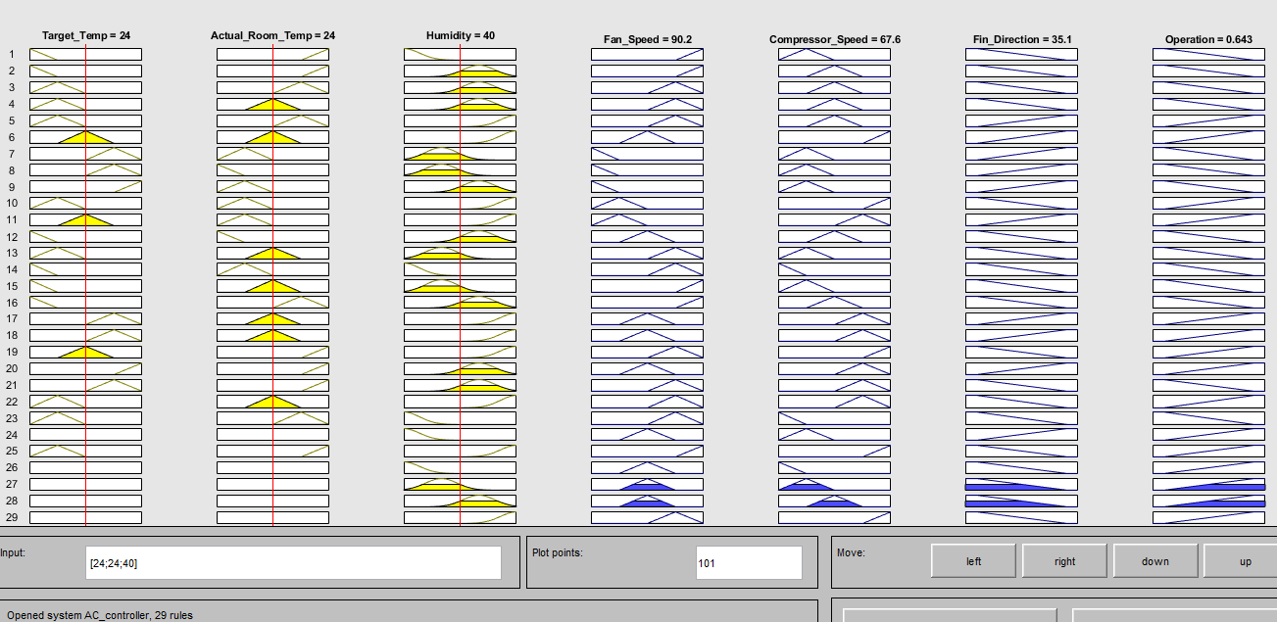
4. Fuzzy Rule Viewer

Slide 12
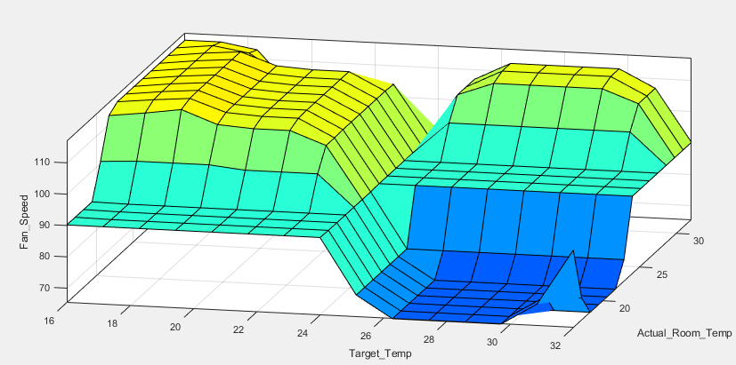
5. Surface Viewer

Slide 13
Fuzzy Rules
1. If (Target_Temp is Very_Cold) and (Actual_Room_Temp is Very_Hot) and (Humidity is Dry) then (Fan_Speed is Maximum)(Compressor_Speed is Slow)(Fin_Direction is Towards)(Operation is Air_conditioner)
2. If (Target_Temp is Very_Cold) and (Actual_Room_Temp is Very_Hot) and (Humidity is Comfartable) then (Fan_Speed is Maximum)(Compressor_Speed is Medium)(Fin_Direction is Towards)(Operation is Air_conditioner)
3. If (Target_Temp is Cold) and (Actual_Room_Temp is Hot) and (Humidity is Comfartable) then (Fan_Speed is Fast)(Compressor_Speed is Medium)(Fin_Direction is Towards)(Operation is Air_conditioner)
4. If (Target_Temp is Cold) and (Actual_Room_Temp is Warm) and (Humidity is Comfartable) then (Fan_Speed is Fast)(Compressor_Speed is Medium)(Fin_Direction is Towards)(Operation is Air_conditioner)
5. If (Target_Temp is Cold) and (Actual_Room_Temp is Hot) and (Humidity is Humid) then (Fan_Speed is Fast)(Compressor_Speed is Medium)(Fin_Direction is Away)(Operation is Dehumidifier)
6. If (Target_Temp is Warm) and (Actual_Room_Temp is Warm) and (Humidity is Humid) then (Fan_Speed is Medium)(Compressor_Speed is Maximum)(Fin_Direction is Away)(Operation is Dehumidifier)
7. If (Target_Temp is Hot) and (Actual_Room_Temp is Cold) and (Humidity is Refreshing) then (Fan_Speed is Minimum)(Compressor_Speed is Slow)(Fin_Direction is Away)(Operation is Air_conditioner)

Slide 14
8. If (Target_Temp is Hot) and (Actual_Room_Temp is Very_Cold) and (Humidity is Refreshing) then (Fan_Speed is Minimum)(Compressor_Speed is Slow)(Fin_Direction is Away)(Operation is Air_conditioner)
9. If (Target_Temp is Very_Hot) and (Actual_Room_Temp is Cold) and (Humidity is Comfartable) then (Fan_Speed is Minimum)(Compressor_Speed is Slow)(Fin_Direction is Away)(Operation is Air_conditioner)
10. If (Target_Temp is Cold) and (Actual_Room_Temp is Cold) and (Humidity is Humid) then (Fan_Speed is Slow)(Compressor_Speed is Maximum)(Fin_Direction is Towards)(Operation is Dehumidifier)
11. If (Target_Temp is Warm) and (Actual_Room_Temp is Cold) and (Humidity is Humid) then (Fan_Speed is Slow)(Compressor_Speed is Fast)(Fin_Direction is Away)(Operation is Dehumidifier)
12. If (Target_Temp is Very_Cold) and (Actual_Room_Temp is Very_Cold) and (Humidity is Comfartable) then (Fan_Speed is Medium)(Compressor_Speed is Medium)(Fin_Direction is Towards)(Operation is Air_conditioner)
13. If (Target_Temp is Cold) and (Actual_Room_Temp is Warm) and (Humidity is Refreshing) then (Fan_Speed is Fast)(Compressor_Speed is Slow)(Fin_Direction is Towards)(Operation is Air_conditioner)
14. If (Target_Temp is Very_Cold) and (Actual_Room_Temp is Cold) and (Humidity is Dry) then (Fan_Speed is Fast)(Compressor_Speed is Minimum)(Fin_Direction is Towards)(Operation is Air_conditioner)

Slide 15
15. If (Target_Temp is Very_Cold) and (Actual_Room_Temp is Warm) and (Humidity is Refreshing) then (Fan_Speed is Maximum)(Compressor_Speed is Slow)(Fin_Direction is Towards)(Operation is Air_conditioner)
16. If (Target_Temp is Very_Cold) and (Actual_Room_Temp is Hot) and (Humidity is Comfartable) then (Fan_Speed is Maximum)(Compressor_Speed is Medium)(Fin_Direction is Towards)(Operation is Air_conditioner)
17. If (Target_Temp is Hot) and (Actual_Room_Temp is Warm) and (Humidity is Humid) then (Fan_Speed is Medium)(Compressor_Speed is Fast)(Fin_Direction is Away)(Operation is Dehumidifier)
18. If (Target_Temp is Hot) and (Actual_Room_Temp is Warm) and (Humidity is Humid) then (Fan_Speed is Medium)(Compressor_Speed is Fast)(Fin_Direction is Away)(Operation is Dehumidifier)
19. If (Target_Temp is Warm) and (Actual_Room_Temp is Very_Hot) and (Humidity is Humid) then (Fan_Speed is Fast)(Compressor_Speed is Maximum)(Fin_Direction is Towards)(Operation is Dehumidifier)
20. If (Target_Temp is Very_Hot) and (Actual_Room_Temp is Very_Hot) and (Humidity is Comfartable) then (Fan_Speed is Medium)(Compressor_Speed is Fast)(Fin_Direction is Away)(Operation is Dehumidifier)
21. If (Target_Temp is Hot) and (Actual_Room_Temp is Very_Hot) and (Humidity is Comfartable) then (Fan_Speed is Fast)(Compressor_Speed is Fast)(Fin_Direction is Towards)(Operation is Air_conditioner)

Slide 16
22. If (Target_Temp is Cold) and (Actual_Room_Temp is Warm) and (Humidity is Humid) then (Fan_Speed is Fast)(Compressor_Speed is Fast)(Fin_Direction is Towards)(Operation is Dehumidifier)
23. If (Target_Temp is Cold) and (Actual_Room_Temp is Hot) and (Humidity is Dry) then (Fan_Speed is Fast)(Compressor_Speed is Minimum)(Fin_Direction is Towards)(Operation is Air_conditioner)
24. If (Humidity is Dry) then (Fan_Speed is Medium)(Compressor_Speed is Slow)(Fin_Direction is Away)(Operation is Dehumidifier)
25. If (Target_Temp is Cold) and (Actual_Room_Temp is Very_Hot) and (Humidity is Humid) then (Fan_Speed is Maximum)(Compressor_Speed is Maximum)(Fin_Direction is Towards)(Operation is Dehumidifier)
26. If (Humidity is Dry) then (Fan_Speed is Medium)(Compressor_Speed is Minimum)(Fin_Direction is Towards)(Operation is Dehumidifier)
27. If (Humidity is Refreshing) then (Fan_Speed is Medium)(Compressor_Speed is Slow)(Fin_Direction is Towards)(Operation is Dehumidifier)
28. If (Humidity is Comfartable) then (Fan_Speed is Medium)(Compressor_Speed is Medium)(Fin_Direction is Towards)(Operation is Dehumidifier)
29. If (Humidity is Humid) then (Fan_Speed is Fast)(Compressor_Speed is Maximum)(Fin_Direction is Towards)(Operation is Dehumidifier)

Slide 17
Conclusion
Flexible
Results can be optimized by changing the membership function
Fuzzy Inference systems can model and help to solve hard problems

