Slide 1
Battle of Neighborhood
Best Neighborhood for Family in Houston
Date: 3-Feb-2020
Mehul Sharma

Slide 2
Business Problem
Recommend Best Neighborhood in Houston for families based on below criteria –
•Low Crime Rate
•Reasonable Home Prices
•Good Public School Ratings

Slide 3
Data Used in Analysis
Zip codes/Neighborhood in Houston.
Home price data for each zip code.
Crime data for each zip code.
Average scool rating for every zip code.
Latitude and longitude of every zip code.
The number of venues in each zip code from Foursquare APIs based on latitude and longitude of zip code.

Slide 4
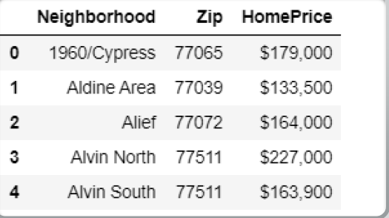
Home Price Data
•Data Source –
Website of HoustoniaMagazine
https://www.houstoniamag.com/articles/2017/3/24/neighborhoods-by-the-numbers-real-estate-data-2017
•Method
Scrape the page using BeautifulSuop4 Library

Slide 5
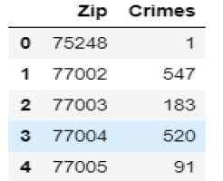
Crime Data
•Data Source –
Excel file from Website of Houston Police Department
http://www.houstontx.gov/police/cs/xls/06-2019.NIBRS_Public_Data_Group_A&B.xlsx
•Method
Read Excel

Slide 6
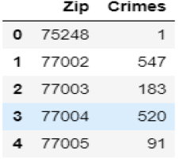
School Accountability Ratings
•Data Source
On ArcGIS website uploaded by Texas Education Agency
https://opendata.arcgis.com/datasets/6cf4436417ff43d0a6e741dc83339ae2_0.csv
•Method
Read CSV then filter for Houston City
Average the ratings foreachzip code

Slide 7
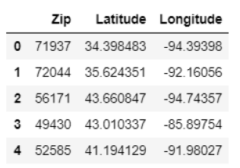
Latitude and Longitudes of Zip Codes
•Data Source
In CSV format on website of OpenDataSoft
https://public.opendatasoft.com/explore/dataset/us-zip-code-latitude-and-longitude/download/?format=csv&timezone=America/Chicago&use_labels_for_header=true&csv_separator=%3B
•Method
Read CSV then filter for Houston City

Slide 8
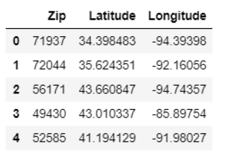
Venues
•Data Source
Foursquare API
https://api.foursquare.com/v2/venues/explore?&client_id={}&client_secret={}&v={}&ll={},{}&radius={}&limit={}
Method
API call for each Zip Code using its latitude and longitude
Count the venues in the zip code

Slide 9
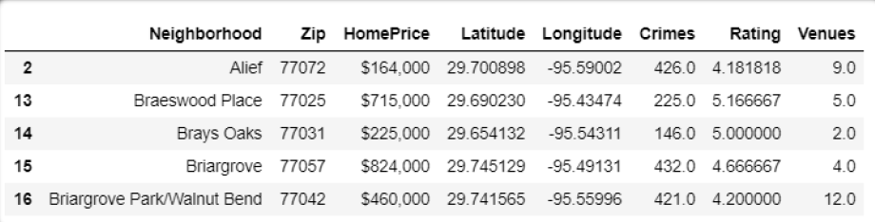
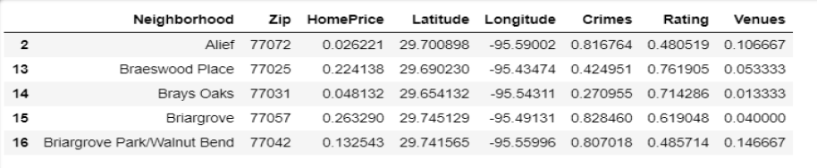
Final Dataset
Merge all data:
Normalize the data

Slide 10
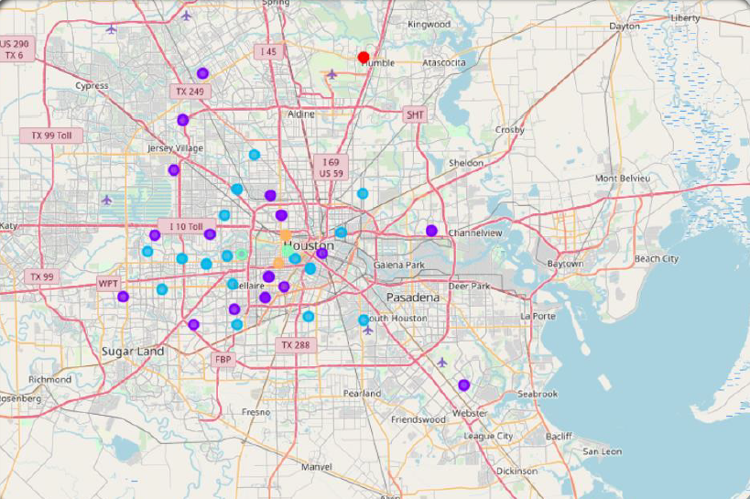
Methodology
Runk-means to cluster the neighborhood into 5 clusters
Analyze eachcluster
Recommendbest4-5neighborhoods/zip codes

Slide 11
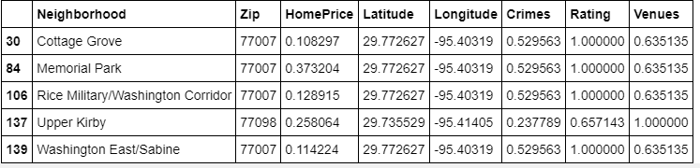
Analyze Cluster 1
When we look into the cluster 1, we find that in this cluster the Home Price is on lower side. Crime rate is average to high .
School Rating are average.
Number of Venues in neighborhoods are also lower.

Slide 12
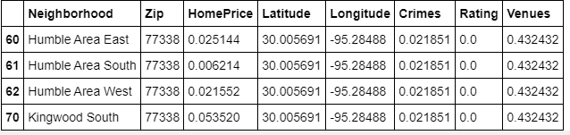
Analyze Cluster 2
•Neighborhoods in this cluster have low home prices and low crime rates.
•Public school ratings are not available.
•So we are unable to recommend them.

Slide 13
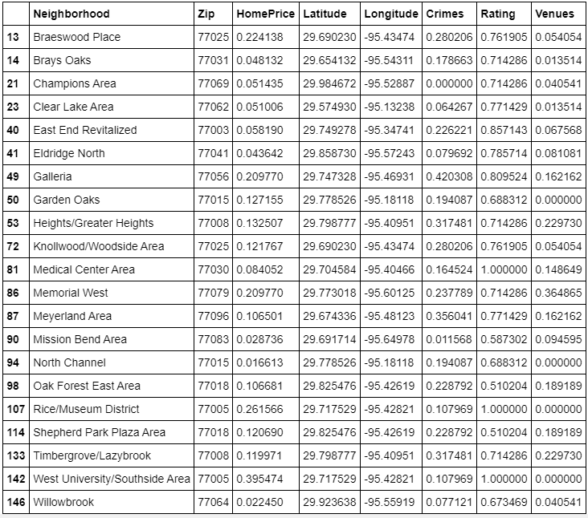
Analyze Cluster 3
•When we examine cluster 3, we find that in this cluster, the home price is on lower side except Memorial Villages, Crime rate is lower except Sharpstown area and Number of Venues are also lower. Some of the neighborhoods seems interesting -
Medical Center Area
Memorial Villages
West University
Rice/Museum District
•These neighborhoods have higher school ratings, lower crimes but have lower venues for other activities. Further Medical center area has lower home prices while others have higher home prices.
•We would recommend Zip Code -77030 and 77005 for the families who are okay with little less venues for activities in their own neighborhood.

Slide 14
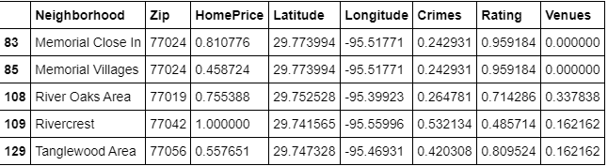
Analyze Cluster 4
•Neighborhoods in this cluster have highest home prices. Public school ratings are not the best except 77024. Also number of venues in the neighborhoods are not that many.
•We would recommend Zip Code -77024 for affluent families who are okay with little less venues for activities in their own neighborhood.

Slide 15
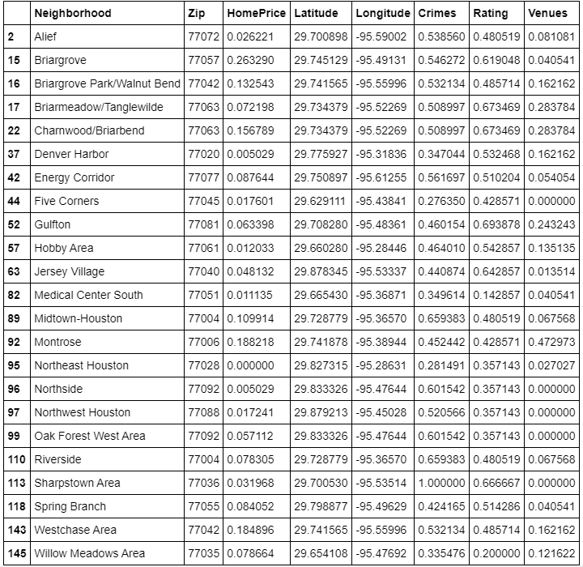
Analyze Cluster 5
•When we examine cluster 5, we find that in this cluster, the home prices are on relatively reasonable side, Crime rate is average. School ratings are high except Upper Kirby. These neighborhoods have many venues for different activities.
•We would like to recommend all neighborhoods in Zip Code -77007

Slide 16
Results and Discussion
•After analyzing the results it will difficult to recommend one single zip code where we get all 4 things together –Low Home Price, School Ratings, Lot of venues and Lower Crimes. It is generally observed that home prices would be higher in those area where schools are good, crimes are low and lot of venues to explore. But again, good schools and low crimes are very important so we will not compromise with these two attributes. Home prices as optional choices for family depending on the affluence.
•Considering all of this, we will finally recommend 4 zip codes. Families can choose based on their priorities –
•77007-We would like to recommend all neighborhoods in Zip Code. This zip code has all favorable attributes except Memorial Park are in this zip code may have costly homes.
•77024-We would recommend this zip code for affluent families who are okay with little less venues for activities in their own neighborhood.
•77030 and 77005-We would recommend zip code for the families who are okay with little less venues for activities in their own neighborhood.

Slide 17
Conclusion
•This analysis has been done with limited set of data and conserving the data which is available is correct.
•There are many other things which impact suitability of a neighborhood for a family like distance from office etc. Also, affluent facilities put their kids in private schools also.
•So before recommending a neighborhood for a family this individual, preferences should also be considered. But certainly, the above analysis would form a base for recommendation.

