Slide 1
Program Assignment 2: Timing Analyzer with False Path Detection
TA: Hung-Yu Chen email: bear417.ee10@nycu.edu.tw

Slide 2
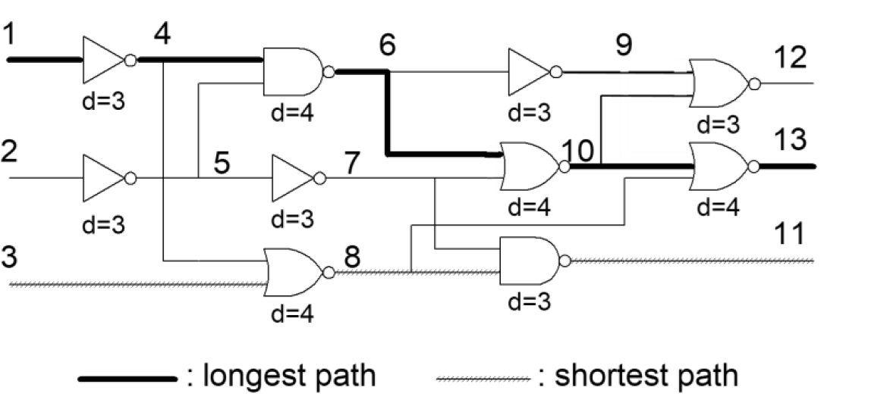
Delay Calculation
Given a gate-level netlist
Determine delay and output transition(slew) of each cell
Find the longest path

Slide 3
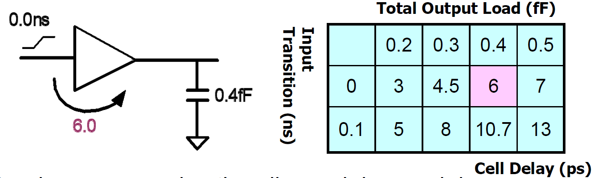
Delay Calculation on a Cell
Lookup table
Table Input
Input transition(slew)
Output capacitance
Table output
Delay
Output transition(slew)

Slide 4
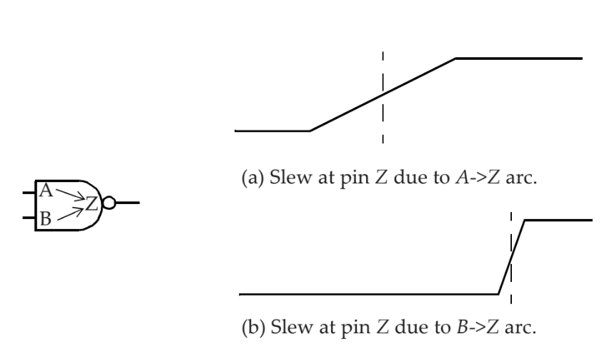
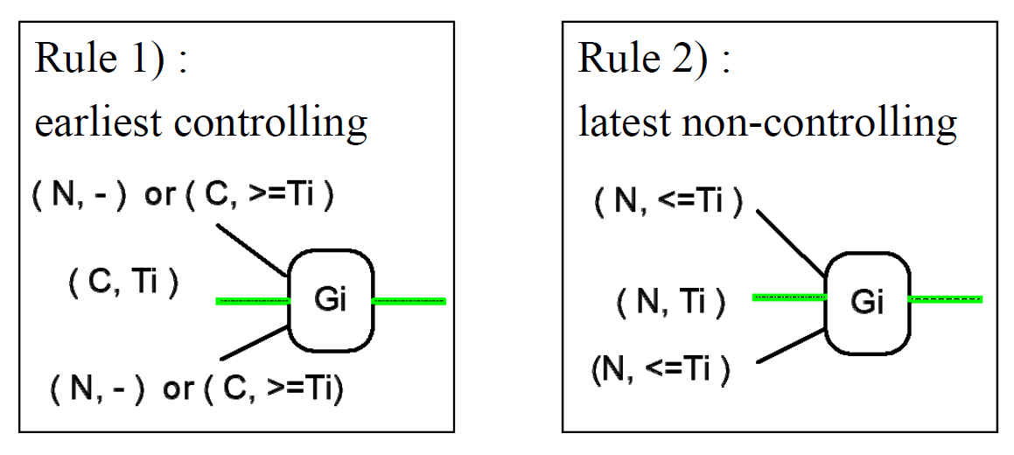
Delay Calculation on Multi Input Cell
Multiple timing arcs ( delay and slew ) may be found
Follow the sensitization rules to choose the timing arc

Slide 5

Boundary Condition
Module input
Input transition set to zero but with different logic input
Module output
Output loading set to 0.03pF
0.03pF
0.03pF
0.03pF

